Slide 1







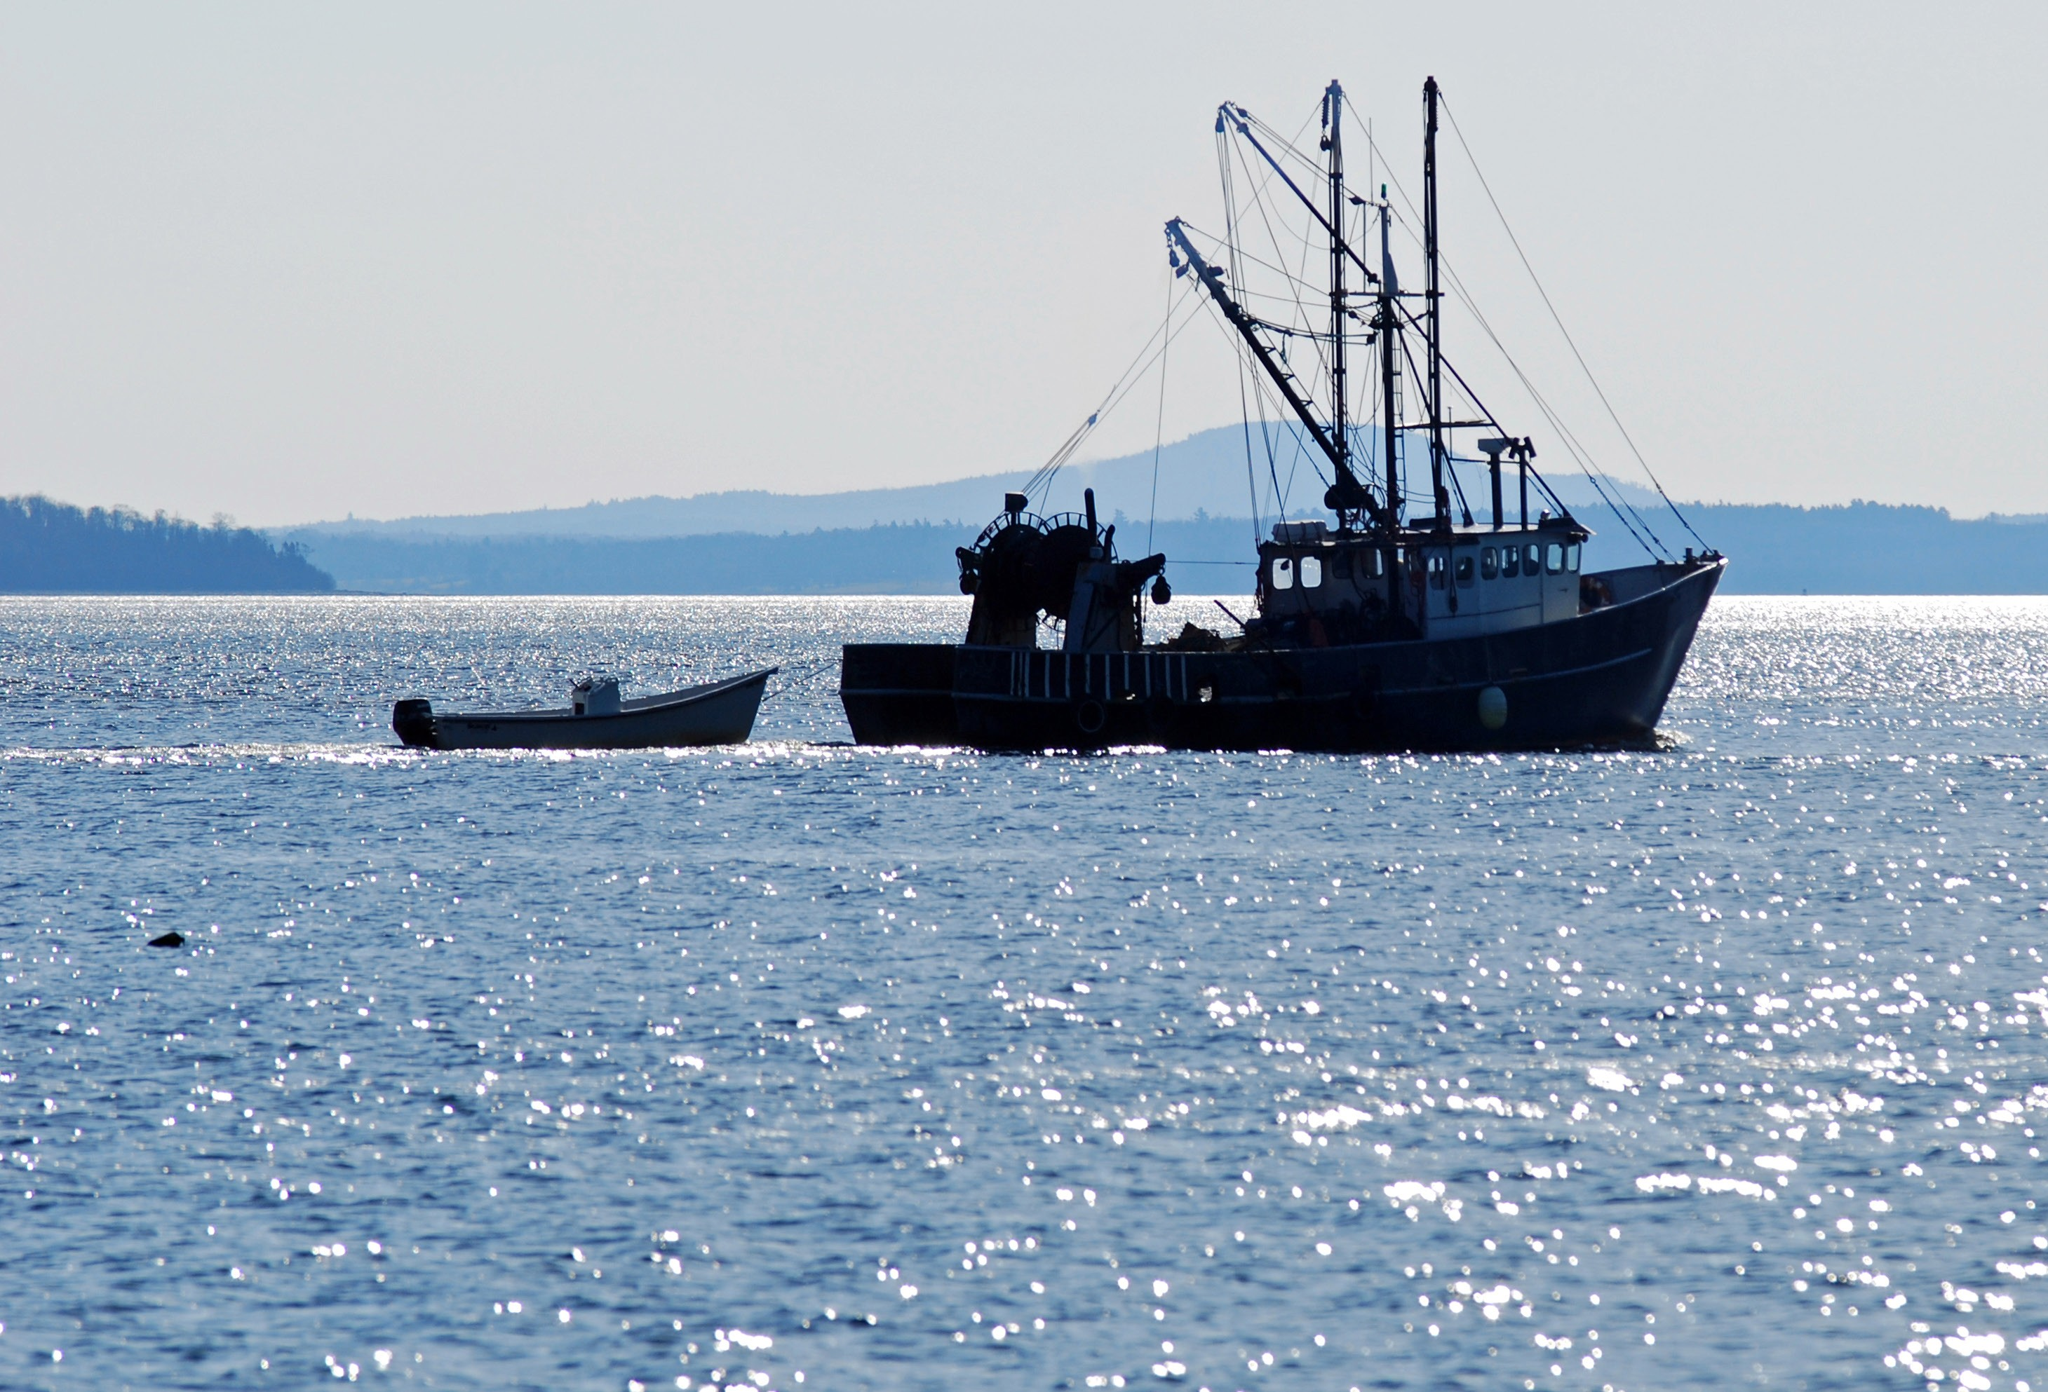



Slide 2
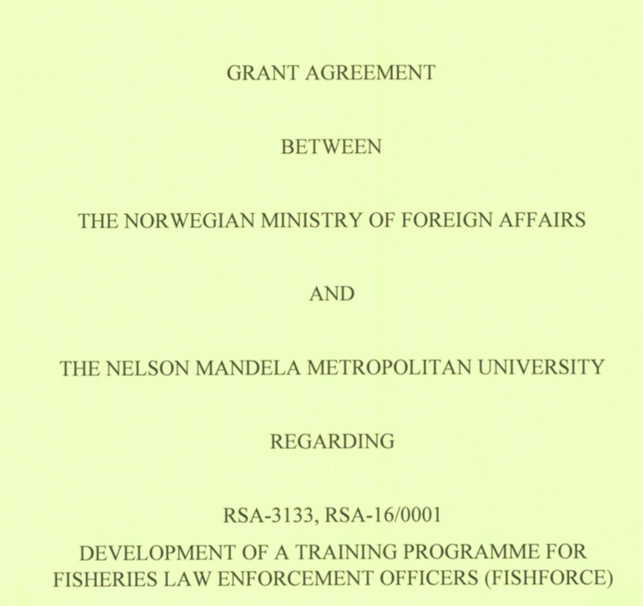
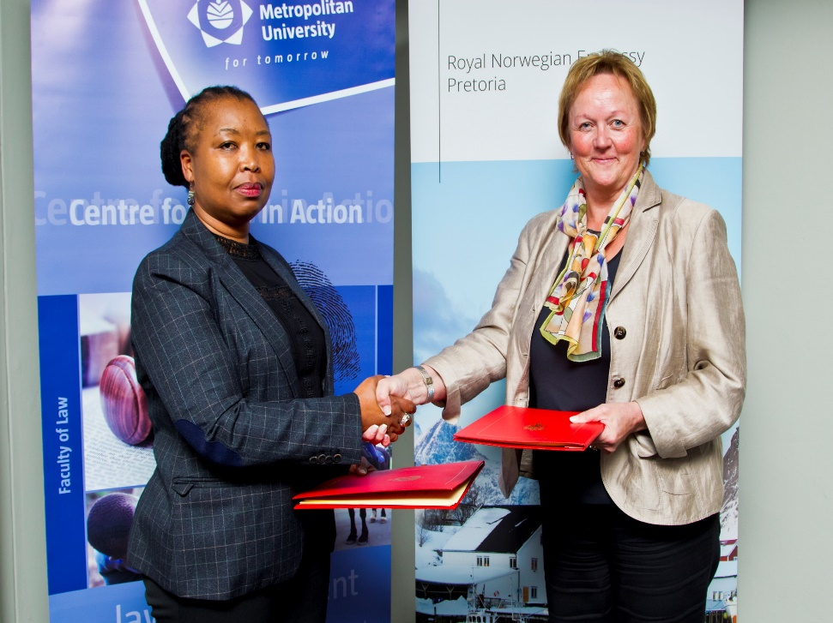

Slide 3
Project period: 2016 - 2021
Grant recipient: Nelson Mandela University
Development of a training programme for fisheries law enforcement officers and all role-players in the fisheries related criminal justice system

Slide 4


Norwegian institutional and technical partners:

Slide 5





South African institutional and technical partners and clients:

Slide 6









Slide 7
Project Impact:
Poverty reduction through the training of law enforcement officers
Advance economic development by increasing the capacity of selected countries to investigate and prosecute fisheries crime
Promote the sustainable utilisation of marine living resources
Project Purpose:
To build technical expertise amongst law enforcement officers that are active in the fight against fisheries crime in developing countries, so that these countries are able to conduct multi-agency & cross-border operations based on the harnessing of internal & external expertise, increased technical capabilities & research

Slide 8
Outcomes:
Technical expertise built in developing countries
  Training & academic qualifications developed and delivered
  Evaluation and analysis of training needs
  Post-training support provided
Multi-agency and cross-border coordination and cooperation improved
  Multi-agency and cross-border training delivered
  Legal and policy analysis
External expertise harnessed, research stimulated and law enforcement in the fisheries crime field promoted
  External specialised technical training provided
  Knowledge and lessons learned, harnessed and disseminated

Slide 9
GEOGRAPHICAL REACH:
Phase I: South Africa
Phase II: Southern, Eastern & Western Africa
Phase III: Indian Ocean Island States

Slide 10
The project …
1
Gap analysis between arrests & convictions to determine reasons for failure of LE attempts
2
Short Learning Programmes (SLP’s) building capacity and earning credits onto formal university qualifications
3
Development of accredited training programme
4
5
Individual countries to adapt courses developed by FishFORCE to suit their specific needs based upon their environment and legislative framework
Roll-out of programme & start process to establish academy

Slide 11
Boarding a vessel
System of weight reporting
Forensic investigation
Statements
Get LEO’s on a similar standard through ad hoc training & SLP’s that are minimum requirements for the job
Crime scene management
Legal framework
Interviewing
Investigation skills

Slide 12
SLP’s
Law for FCO’s
Crime scene management & Investigative Support in Fisheries Crime
Higher Certificate
Credits earned through SLP’s
1 Year qualification
Diploma
Law Enforcement
3 Year qualification
Criminal Justice
Detection & monitoring fisheries transgressions
Species ID & fisheries technology
Conducting Advanced investigations in fisheries crime
Advanced Forensic investigations in fisheries crime
Fisheries Trade Monitoring and compliance

Slide 13
GOVERNANCE: ADVISORY BOARD
South Africa Reference Group
Board
NMU Management Committee
Project Management Team
Core Reference Group
Functions of the Advisory Board:
The establishment and functioning of the Academy will be overseen by the Board in a strategic management capacity.
The Board will provide leadership and guidance to the Director to ensure that the objectives of the Academy are achieved.
The Annual Work Plan and Annual Budget of the Academy will be approved by the Board.
The Board shall direct the Academy regarding long-term strategies.
Review and make recommendations regarding the composition, structure, processes, and characteristics of the Advisory Board

Slide 14
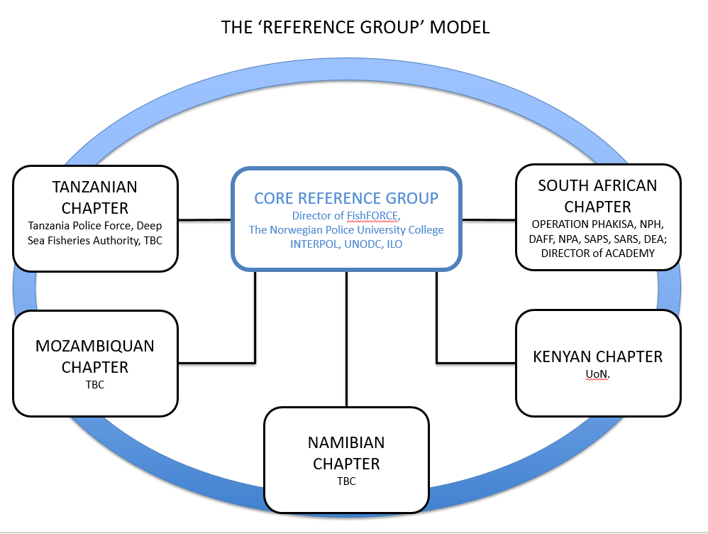

Slide 15
GOVERNANCE STRUCTURE
Functions of the Core Reference Group (CRG):
The CRG is the technical expertise hub of the project which will ensure that the education and course content is dynamic, practically relevant and of a high quality
Actively support the Project Manager to achieve the objectives set for the project
Serve as a reservoir of advice, based on their particular backgrounds and experience, to the project management
Functions of the Reference Group Country Chapter (RGCC):
Serve as the technical expertise hub for the country which will ensure that the education and course content is dynamic, practically relevant and of a high quality
Actively support the Project Manager to achieve the objectives set for the project
Serve as a reservoir of advice, based on their particular backgrounds and experience, to the Director
Assist with the identification of training needs and expert facilitators
Identify existing training Centre's of expertise and assist with establishing ties with such Centre's
Evaluate to content and structure of training materials
Assist with the development of formal training programmes and curriculum.

Slide 16


