Slide 1

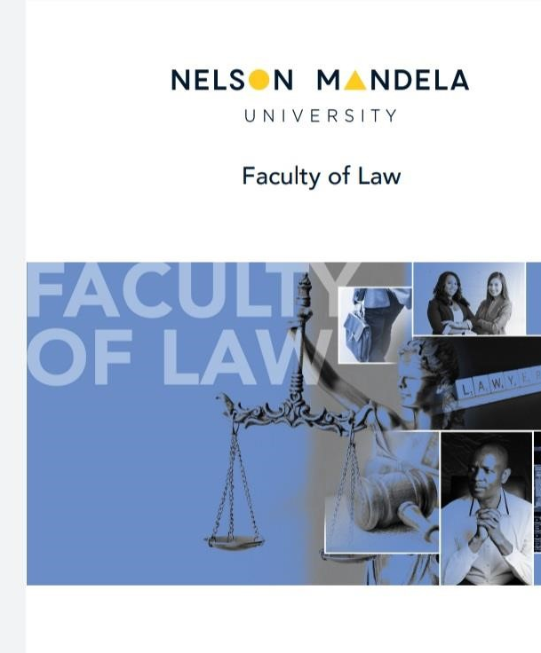
A CRITICAL ANALYSIS OF THE ROLE OF BOTSWANA’S DIRECTORATE ON CORRUPTION AND ECONOMIC CRIME
Dr Molefhi Phorego
Public Law
Nelson Mandela University

Slide 2
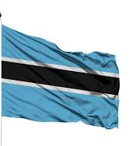
SOCIO-ECONOMIC AND POLITICAL OVERVIEW
1966-UP TO DATE

Slide 3




AT INDEPENDENCE
Third poorest country in the world
Only had 5 kilomettres of tarred road in a country of 582 000 kilometers square-three times the size of France
Had no university
Only 251 primary schools and 9 secondary schools
Heavily reliant on agriculture as a source of income.
A generally underdeveloped educational system.

Slide 4
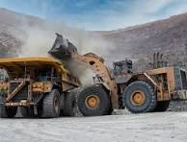
UP TO DATE:
EVOLVED TO BE AN UPPER MIDDLE INCOME WITH ONE OF THE GDP PER CAPITAS IN AFRICA
2025

Slide 5
The State of Governance in Botswana
Often hailed as a model of good governance in Africa-due to regular, free and fair elections
a legal framework with the necessary oversight institutions to keep government in check
Parliament and the judiciary play a key role in holding the executive accountable for the exercise of public power
Independent institutions such as the office of the auditor general and the ombudsman play a key role as one of the accountability mechanisms in the country’s constitutional framework.

Slide 6
MECHANISMS OF OVERSIGHT
PRESIDENTIAL COMMISSIONS OF INQUIRIES
OMBUSMAN
AUDITOR GENERAL
THE COURTS
PARLIAMENT
THE DIRECTORATE ON CORRUPTION AND ECONOMIC CRIME (DCEC)

Slide 7
The 2023 Corruption Perceptions Index (CPI) by Transparency International report on the perceptions of corruption in the 2022 reporting year put Botswana at second position 2 in Sub-Saharan Africa, behind Seychelles, with a score of 60. It dropped to third position in 2023, scoring a CPI score of 59, behind Seychelles and Cabo Verde, and further down to 57 in 2024. In a nutshell, the drop in Botswana’s CPI index is against the backdrop of an averaged 59.78 points between 1998 and 2024, “reaching an all time high Of 65 points in 2012 and a record low of 54 points in 2007”.
CORRUPTION IN BOTSWANA

Slide 8
THE DCEC
Established in 1994

Slide 9
DIVISIONS WITHIN THE DCEC
INVESTIGATIONS DIVISION
LEGAL SERVICE DIVISION
ANTI-MONEY LAUNDERING DIVISION
CORRUPTION PREVENTION DIVISION
CORPORATE SERVICES DIVISION

Slide 10
INVESTIGATIONS DEPARTMENT
“Investigates “allegations of corruption and economic crime, educate the public on the effects of corruption and prevent corruption”.

Slide 11
LEGAL SERVICES DIVISION
AVAILS LEGAL ADVICE TO THE OVERALL OPERATIONS OF THE DCEC. ALSO LIASES WITH THE INVESTIGATIONS DIVISION TO PROVIDE GUIDANCE AND QUALITY ASSURANCE IN THE PROSECUTION LED INVESTIGATION PROCESS

Slide 12
PUBLIC EDUCATION DIVISION
EDUCATES THE PUBLIC ON ISSUES OF CORRUPTION AND ENCOURAGES PUBLIC SUPPORT AND INVOLVEMENT IN THE FIGHT AGAINST CORRUPTION

Slide 13
CORRUPTION PREVENTION DIVISION
IDENTIFIES CORRUPTION OPPORTUNITIES IN GOVERNMENT AND PARASTAL INSTITUTIONS BY EXAMINING POLICIES AND PROCEDURES AND RECOMMEND REMEDIAL MEASURES.

Slide 14
ALLEGATIONS OF CORRUPTION IN BOTSWANA OVER THE YEARS
FIRST REPORTED CASE OF CORRUPTION WAS IN 1975-A MR KUNZ, an engineer working in the ministry of works and communication, accused of corruption, served 9 months in jail
Scandals in the 1980s in the cattle industry-the Botswana meat commission was accused of mismanagement and corruption. The vice president and some cabinet ministers were accused of contravention of applicable rules and regulations
Three Presidential commissions of inquiry had to be appointed to probe allegations of corruption relating to the acquisition of school books, alleged abuse of power pertaining to the acquisition of government land, and instances of dishonesty within the Botswana housing corporation.

Slide 15
MOST RECENT-FOLLOWING THE 2024 ELECTION
THE INCUMENT UMBRELLA FOR DEMOCRATIC CHANGE HAS APPOINTED A DUBAI BASED FORENSIC AUDITING FIRM, Alvarez and marsal, TO conduct a forensic audit of all state owned entities from the period 2014 to 2024.

Slide 16
SUCCESSES AND FAILURES
2004-world bank “report on anti-corruption institutions globally-ranked the dcec the top performing anti-corruption institution of all the participating African countries”.

Slide 17
STRONG ANTI-CORRUPTION LEGISLATION FUNDAMENTAL TO THE DCEC’S MANDATE
(A) The Penal Code of Botswana (Act 2 of 1964);
(B) The Corruption and Economic Crime Act, 1994 (13 of 1994);
(B) Proceeds of Serious Crimes (Amendment) Act, 2000 (13 of 2000);
(C) ANTI- Money LAUNDERING LEGISLATION and
(D) The Banking (Anti- money laundering) Regulations of 2003

Slide 18
MPHENDU AND HOLTZHAUSEN
"the WORK OF THE Directorate of Corruption and Economic Crime (DCEC) in Botswana has created new offences of corruption, including being in control of disproportionate assets or maintaining an unexplained high standard of living.“

Slide 19
KHEMANI
“enjoyed considerable success in implementing anti-corruption reforms due to strong political commitment, adequate resources and support from civil society”.

Slide 20
CHALLENGES
Lack of skills and adequate training for staff in the corruption prevention division
Budgetary constraints
Lack of independence as it falls under the office of the president
Challenges in obtaining convictions with regard to high-level investigations.

Slide 21
LEGAL FRAMEWORK GOVERNING THE DCEC
THE CONSTITUTION OF THE REPUBLIC OF BOTSWANA, 1966-DOES NOT EXPRESSLY ENSRHINE PROVISIONS PERTAINING TO THE DCEC
HOWEVER, REGARDING THE DIRECTOR’S APPOINTMENT-SECTION 47 IS RELEVANT
SECTION 47: “THE EXECUTIVE POWER OF BOTSWANA VESTS IN THE PRESIDENT, AND IS EXERCISED BY HIM DIRECTLY OR THROUGH OFFICERS SUBORDINATE TO HIM
WHEN EXERCISING THE POWERS VESTED UPON HIM, HE ACTS IN HIS OWN DELBERATE JUDGMENT AND IS NOT OBLIGED TO FOLLOW ANYONE’S ADVICE.

Slide 22
THE CORRUPTION AND ECONOMIC CRIME ACT 13 OF 1994
S 4: VESTS THE APPOINTMENT OF THE DIRECTOR IN THE PRESIDENT, USING HIS DISCRETIONARY POWERS
S 6: DEALS WITH THE FUNCTIONS OF THE DIRECTORATE
S 8: EMPOWERS THE DIRECTOR THE POWER TO OBTAIN INFORMATION NECESSARY TO CONDUCT AN INVESTIGATION
S 10: AN OFFICER ACTING ON BEHALF OF THE DIRECTOR MAY CARRY OUT AN ARREST UNDER SPECIFIED CIRCUMSTANCES
S 11: PROVISIONS FOR SEARCH AND SEIZURE
S 13: SEARCH WITH WARRANTS
S 14: SEARCH WITHOUT WARRANTS
S 24: CORRUPTION BY A PUBLIC OFFICER

Slide 23

CONCLUSION
THE NEWLY ELECTED PRESIDENT duma boko HAS INDICATED THAT THERE IS AN UPCOMING CONSTITUTIONAL REVIEW PROCESS. Perhaps that exercise will review the constitutional mandate of the dcec, particularly in relation to the need to separate it from the office of the president. Parliament should exercise more oversight over the work of the dcec, and its director should only be appointed by the president upon recommendation from the legislative body.

Slide 24

KE A LEBOGA!

