Slide 1
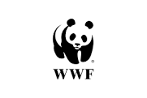
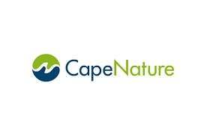
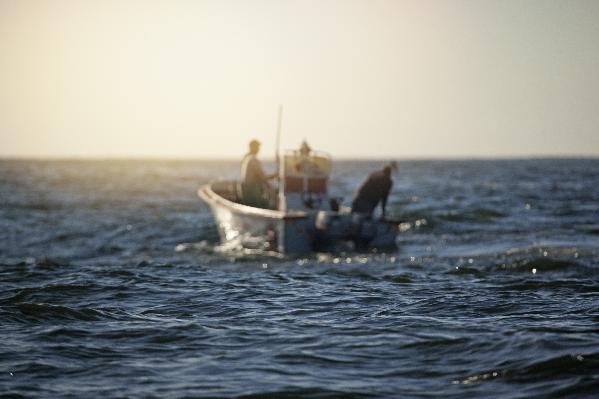
A MULTI-DISCIPLINARY APPROACH TO MCS
A STORY FROM THE KOGELBERG REGION

Slide 2
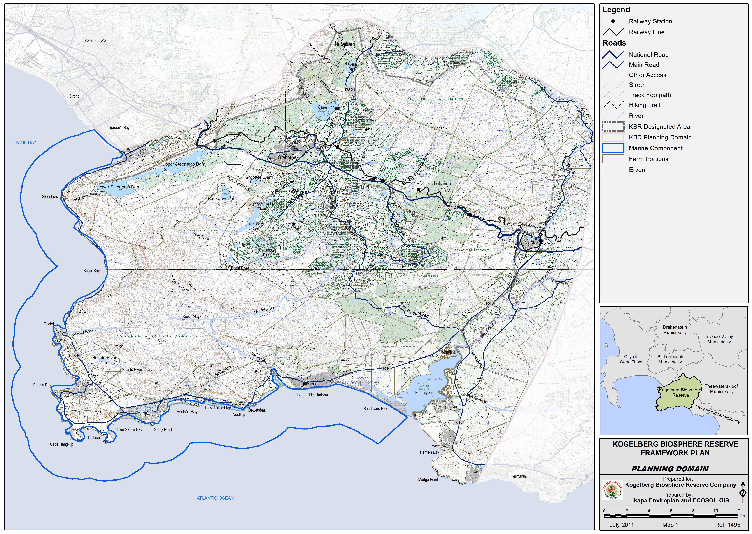
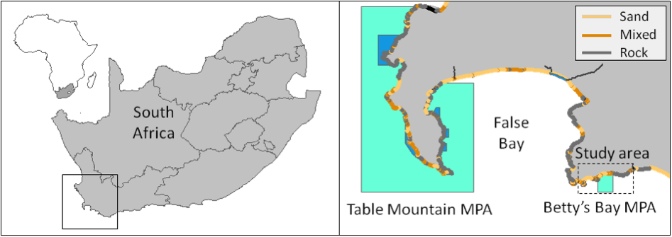
KOGELBERG BIOSPHERE (100,000 ha UNESCO)
23,000 ha marine buffer zone
Bettys Bay MPA (1,000 ha)
Huge tourism potential (terrestrial and marine)
Biodiverse, vegetation biome (1800 odd flowering spp. Amazon is second with 480 species).
Protection and sustainability of all living things!

Slide 3
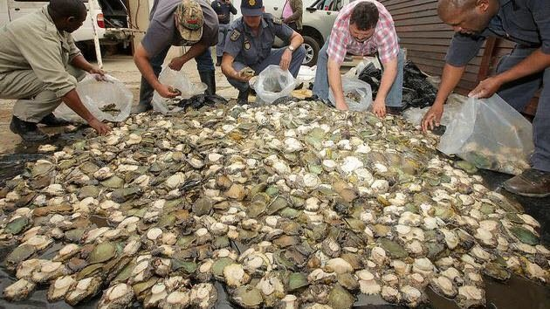
POACHING A brief look back
Kogelberg Region poaching began to escalate in the late 1990’s;
By early 2000, an epidemic;
Resulted Operation Neptune (Multi-Agency Task Force partnership with anti-abalone poaching units) by 2003 disbanded, increased poaching;
Operation Trident – ineffective (lost operational capacity);
Marines assisted, successful but short term;
Green court in Hermanus were at 85% prosecution success was disbanded, now total prosecution success less than 20%);
Local small preventative interventions (SHORT TERM SUCCESS STORIES);
Operation Phakisa (variable success).
Notes:
Multi-agency teams worked well
Interventions not sustained – long term ineffective.
Combination of prosecution and intelligence lead operations best results.
BUT WE NEED TO DO MORE – AS THESE INTERVENTIONS WERE ALL UNFORTUNATELY SHORT TERM, HOW DO WE FILL THE GAP.

Slide 4
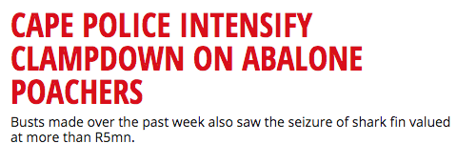
POACHING Current news headlines

Slide 5
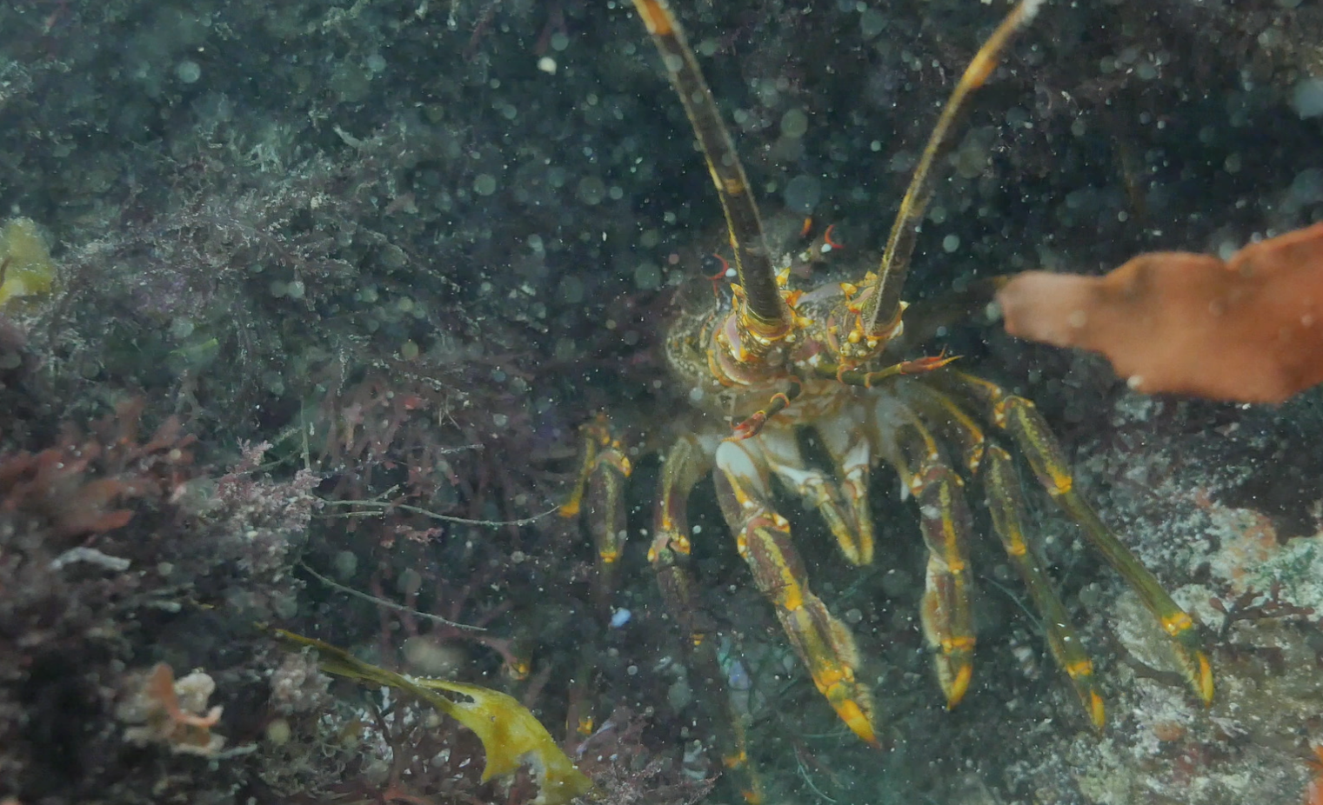
POACHING Positives learned & negatives faced
POSITIVES:
Combined operations reduced poaching (intelligence investigations);
Green courts imprisoned higher level players
Operation Phakisa (ongoing).
NEGATIVES:
Operations inconsistent to be overall effective
Major short-comings at National Level;
No trust;
Information leakage & corruption;
Poaching gang related, violent, (altering strategies);
No reaction teams, capacity, no community involvement;
Trust regarding the sale of confiscated abalone “major issue”.

Slide 6
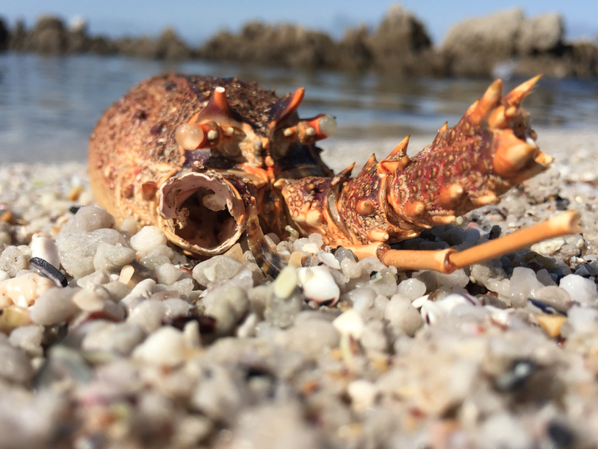
POACHING… Point of definition
POACHING vs. INFORMAL FISHING
POACHING – organized crime, greed (exploited those who need)
INFORMAL FISHING – those who need & immediate poverty alleviation
Ocean provides for our needs not our greed!

Slide 7
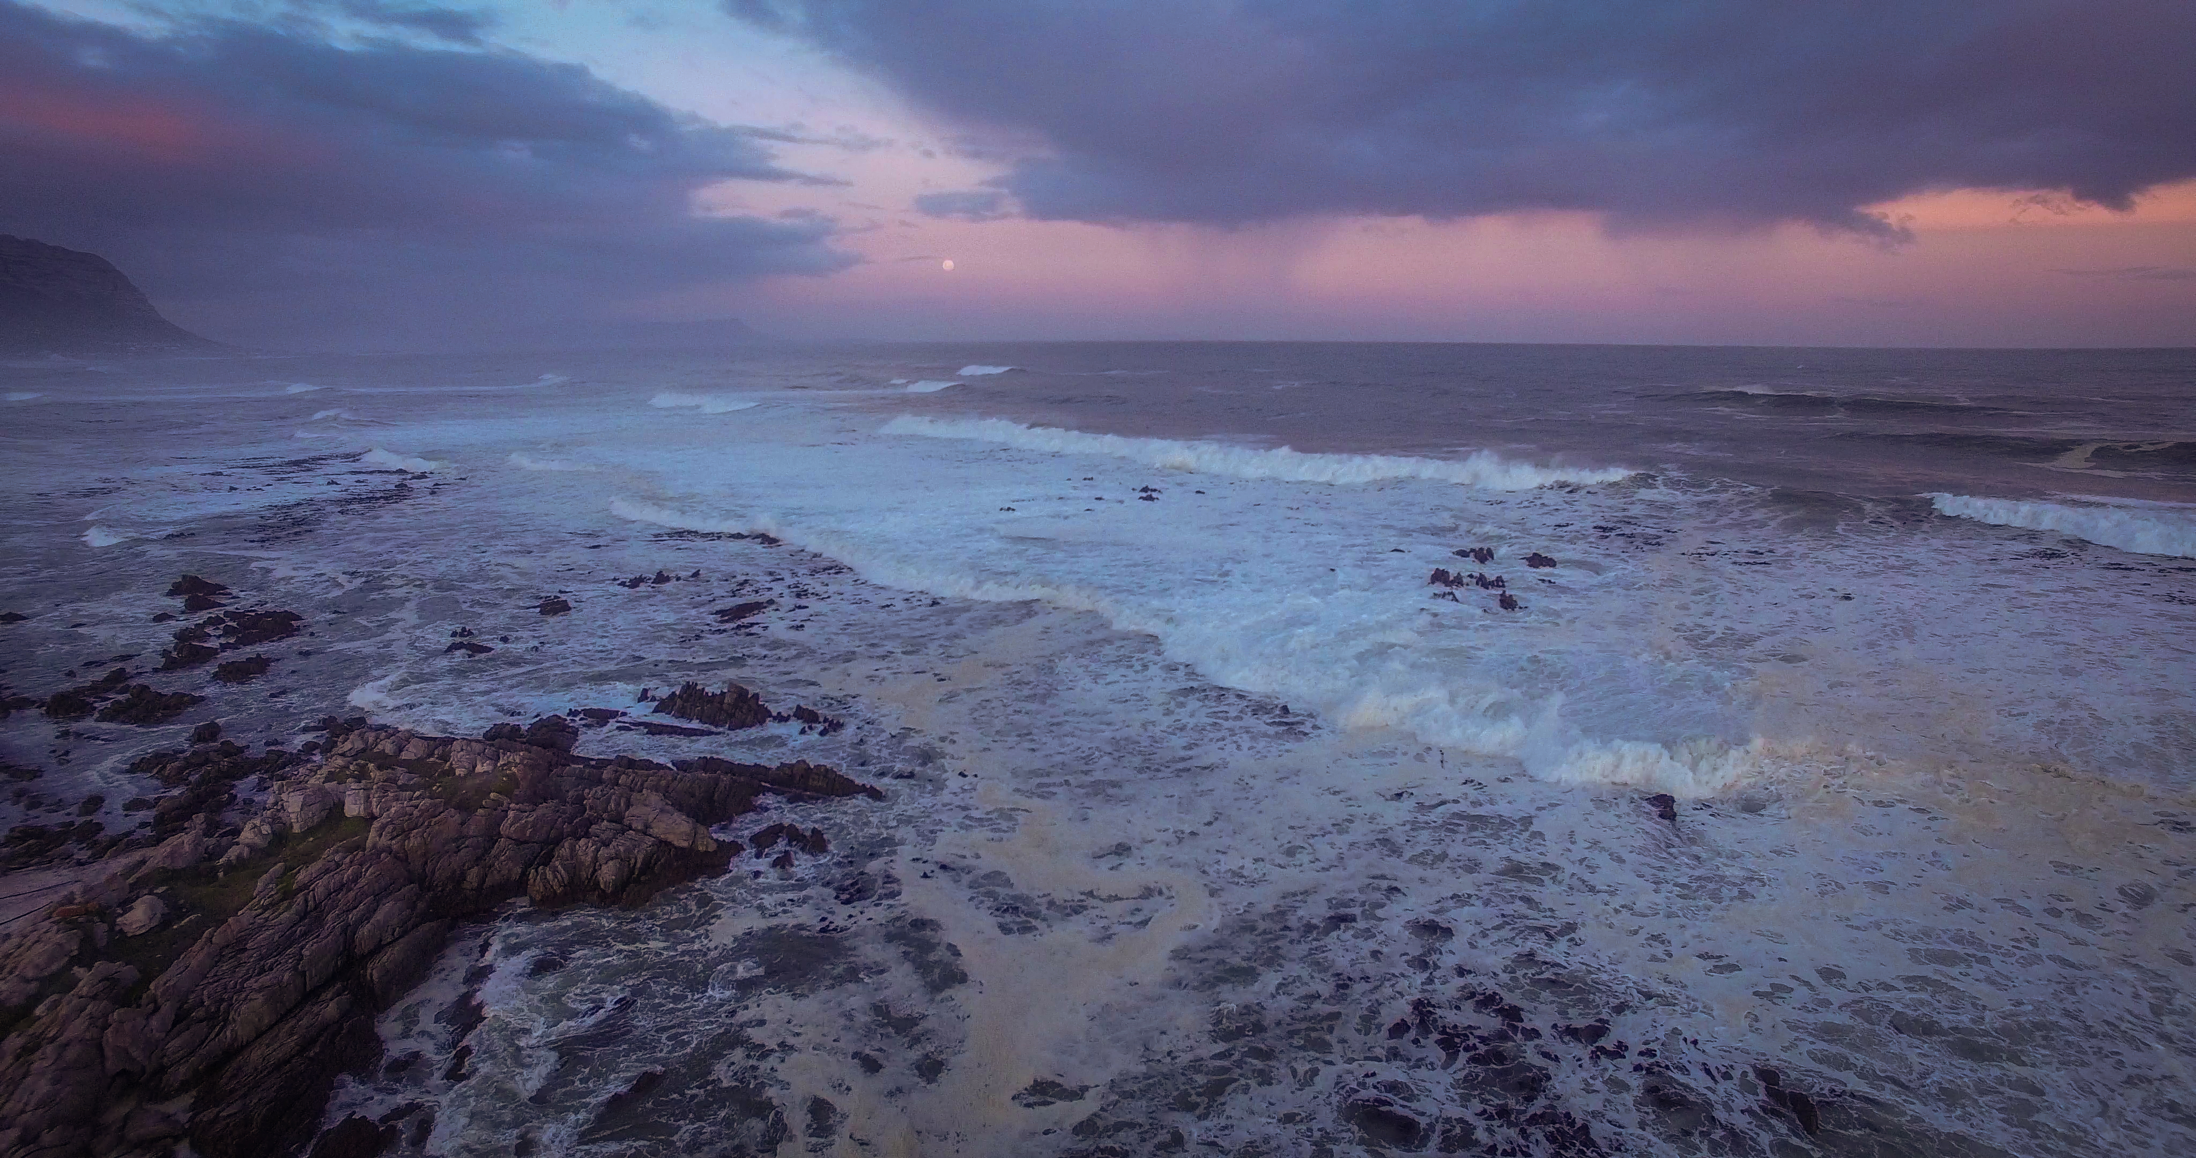
WHERE DO WE GO FROM HERE? Who are the stakeholders
COMBINATION OF EFFORTS FROM ALL STAKEHOLDERS PROVIDE THE PLATFORM FOR MULTI-DISCIPLINARY MCS MODEL
DAFF – Fisheries compliance and fisheries management;
DEA – Environmental management (broadly defined);
Kogelberg Biosphere Company – (UNESCO conservation/management);
SAPS – Law enforcement;
Muncipality;
Communities/Residents/Rate Payers Associations.
Seawatch – anti-poaching information and support;
WWF – Fisheries Improvement Project;
MAPU – new NGO, not readily in favour of some stakeholders (Pringle Bay);
Abalobi – communication platform and tool for fisheries data capture;
West Coast Rock Lobster Association.
Kogelberg Marine Working Group – support/communication Kleinmond
Integrated fisheries Forum (new IUU monitoring team).

Slide 8
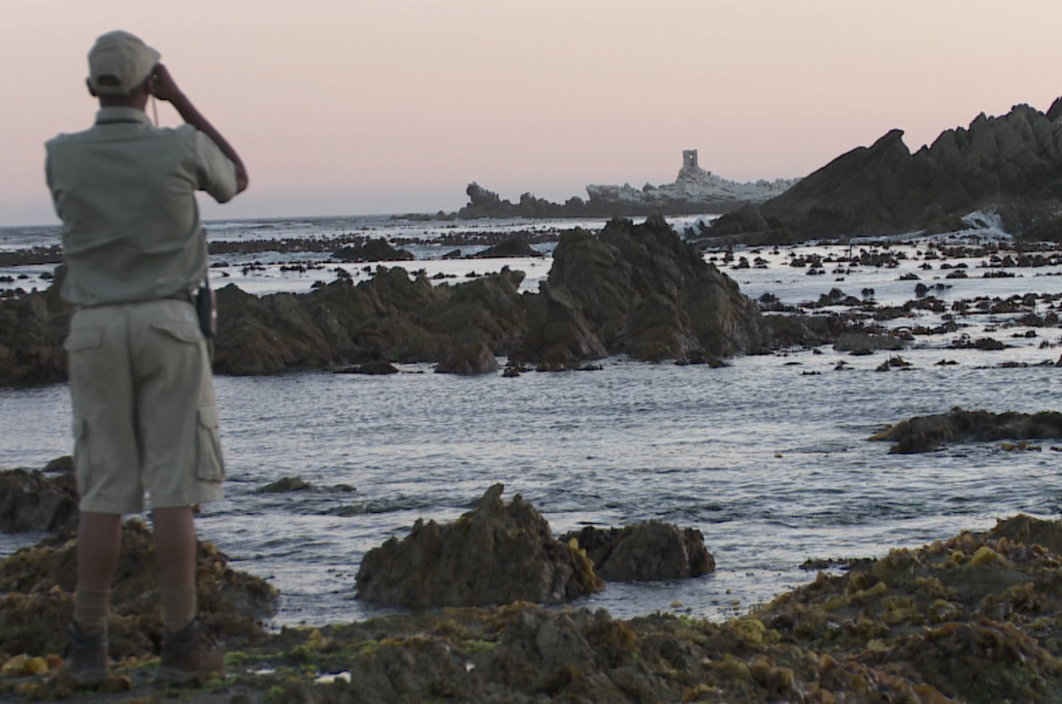
CAPE NATURE Coastal program initiative
Recognize that the small team of rangers is can’t stop poaching;
Invest in building relations with key agencies, SAPS, SANDF, NGO’s;
Recognize the ill effect of poaching on society with respect to:
Drug use;
Crime increase (burglaries – sea conditions poor);
Youth involvement in gang related activities;
Conduct specific operations to build momentum and capacity;
Create the Kogelberg Marine Working Group with WWF (and others);
Stimulate INFORMATION sharing;
Poaching & MPA management (rezoning)
Biosphere marine conservation
Aspects of data/scientific research and monitoring
Notes:
Recognize cant stop poaching
Build law enforcement relationships!
Social ills poaching
Information sharing and educational aspect.
Other stakeholders to build on these initiatives!

Slide 9
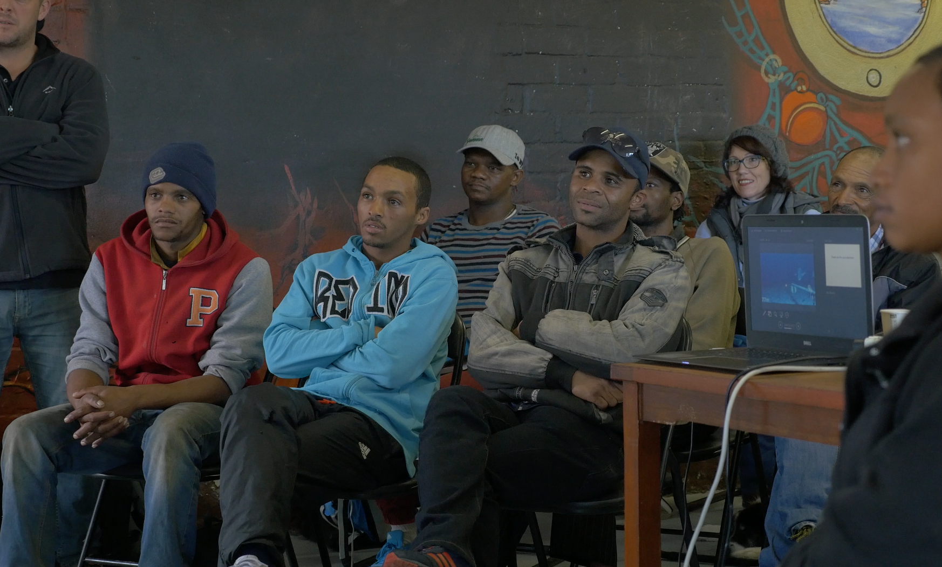
WWF FISHERIES IMPROVEMENT PROJECT
Kogelberg Region priority area – role model
Creating a restaurant value chain for small scale fishers;
Scaling the small-scale fishers information management system (ABALOBI);
Launching a community-driven research and monitoring project (BRUVs);
Developing an anti-IUU strategy.
REAL COMMUNITY ENGAGEMENT – LEGITIMACY IN BUILDING NEW RELATIONSHIPS
MAJOR CHALLENGE IS TRUST!

Slide 10
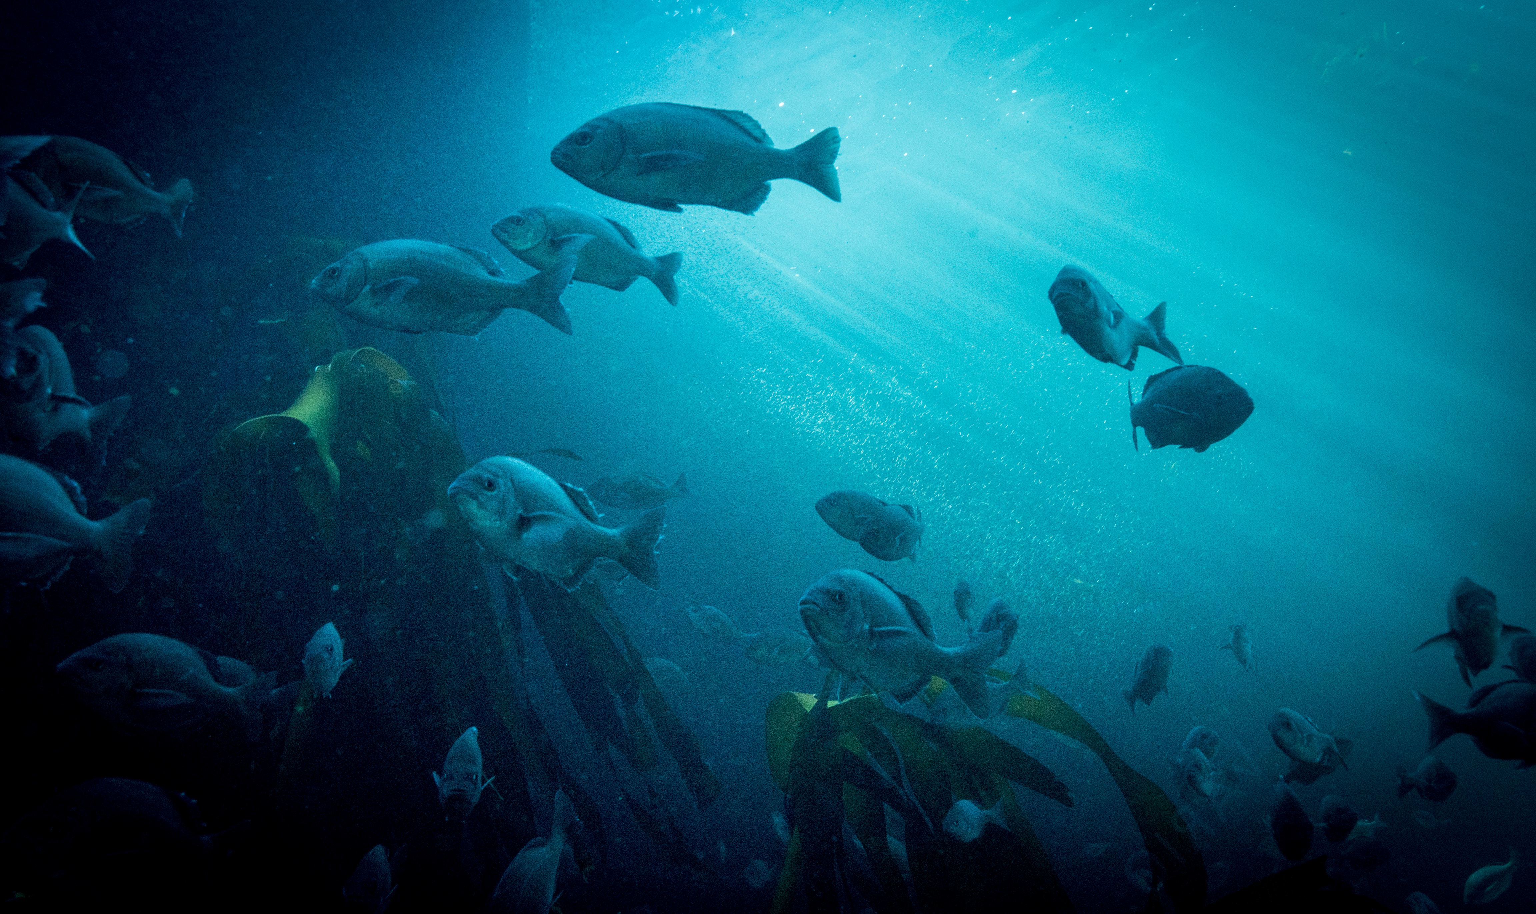
1. IMPACTS How are we investing in each other to combat poaching
MARKETS (traceability and sustainability):
No markets outside lobster, snoek, abalone – stimulate new market opportunities;
Kogelberg is a UNESCO Biosphere local caught fish has huge market potential for tourism;
Hottentot selling at R70kg and silvervis R90kg local shop;
Campaigning with food trucks, celebrity chefs & local restaurants;
Plan for harbour redevelopment with community proviosion for cold storage and fresh fish market opportunities (power struggles).
ITS NOT PERFECT YET BUT IT’S A DAM GOOD INVESTMENT

Slide 11
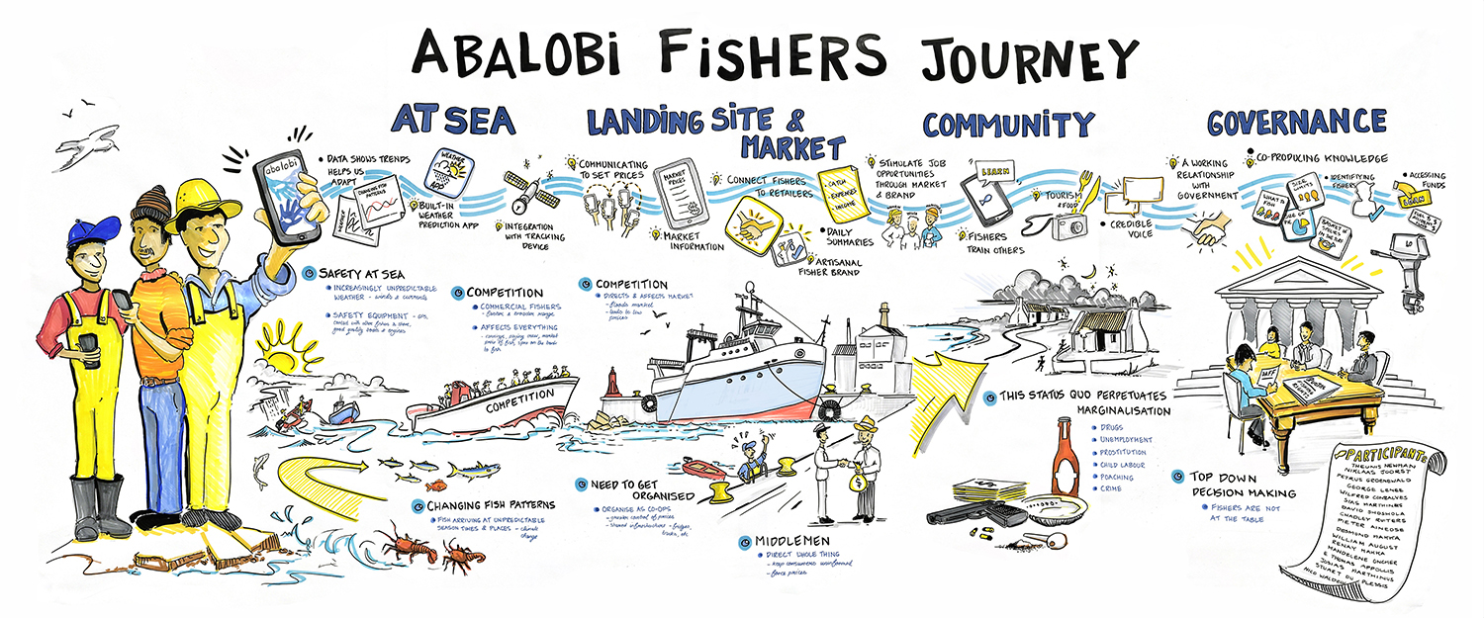
2. IMPACTS How are we investing in each other to combat poaching
COMMUNICATION
Receive information;
Share data;
Porthole for discussion and data creation (key missing link);
Technology solution (evolving technology not defined by rules);
Link to markets digitally.

Slide 12
2. IMPACTS How are we investing in each other to combat poaching
Communication targeted campaigns anti-poaching, market analysis;
New alternative income activity;
Targeting new generations with technology.

Slide 13
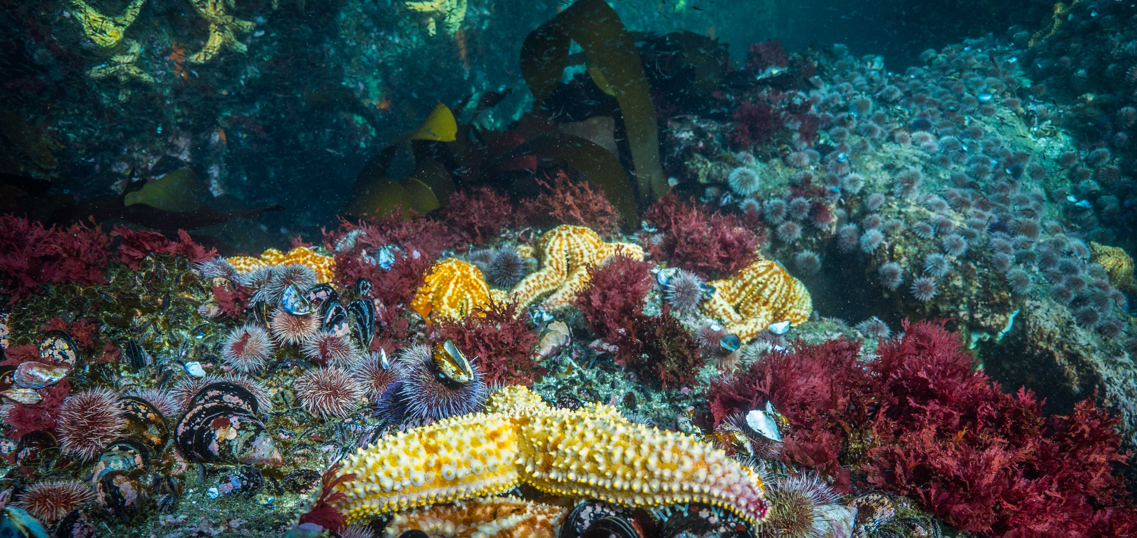
3. IMPACTS How are we investing in each other to combat poaching
Community Monitoring and Research Program (BRUVs)
Status of the collapsed stocks of West Coast Rock Lobster (WCRL) 2% and abalone stocks (poaching & fishing pressure);
Inadequate information on linefish stock abundance;
Inadequate monitoring of the Bettys Bay MPA in offering protection to critical species;
Inadequate information on the protection of habitat and ecosystems function as a result of overexploitation of species.
Notes:
Set of unknowns
During the engagemtn process with marine working group
Druing the FIP process
Through the IUU engagement process
These oare the concerns that kep being raised by the communitiy.

Slide 14
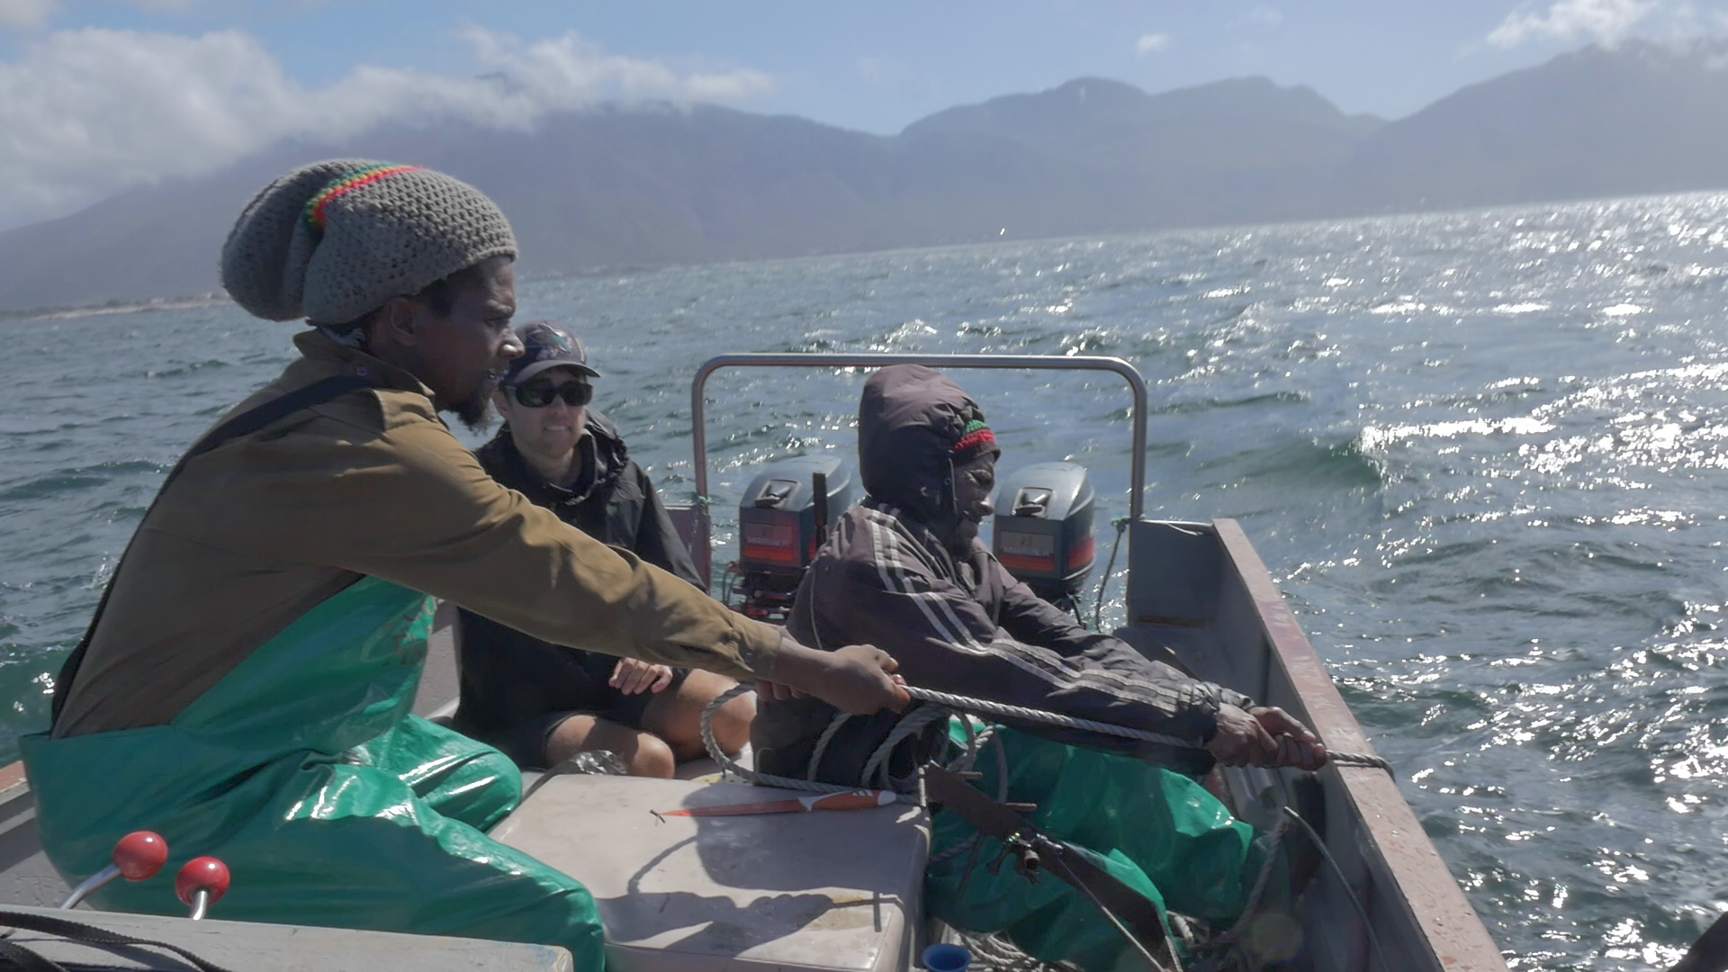
3. IMPACTS How are we investing in each other to combat poaching
March began BRUV deployments (100 already)
Use and pay for community assets and knowledge (service provider);
Involve interested fishers in the entire process of BRUV deployment;
Create a data monitoring platform, which the community can own;
Prove to DAFF that the community has the passion, skill and resources (outsource your data capture needs);
Legitimate scientific base for communities to engage in co-management

Slide 15
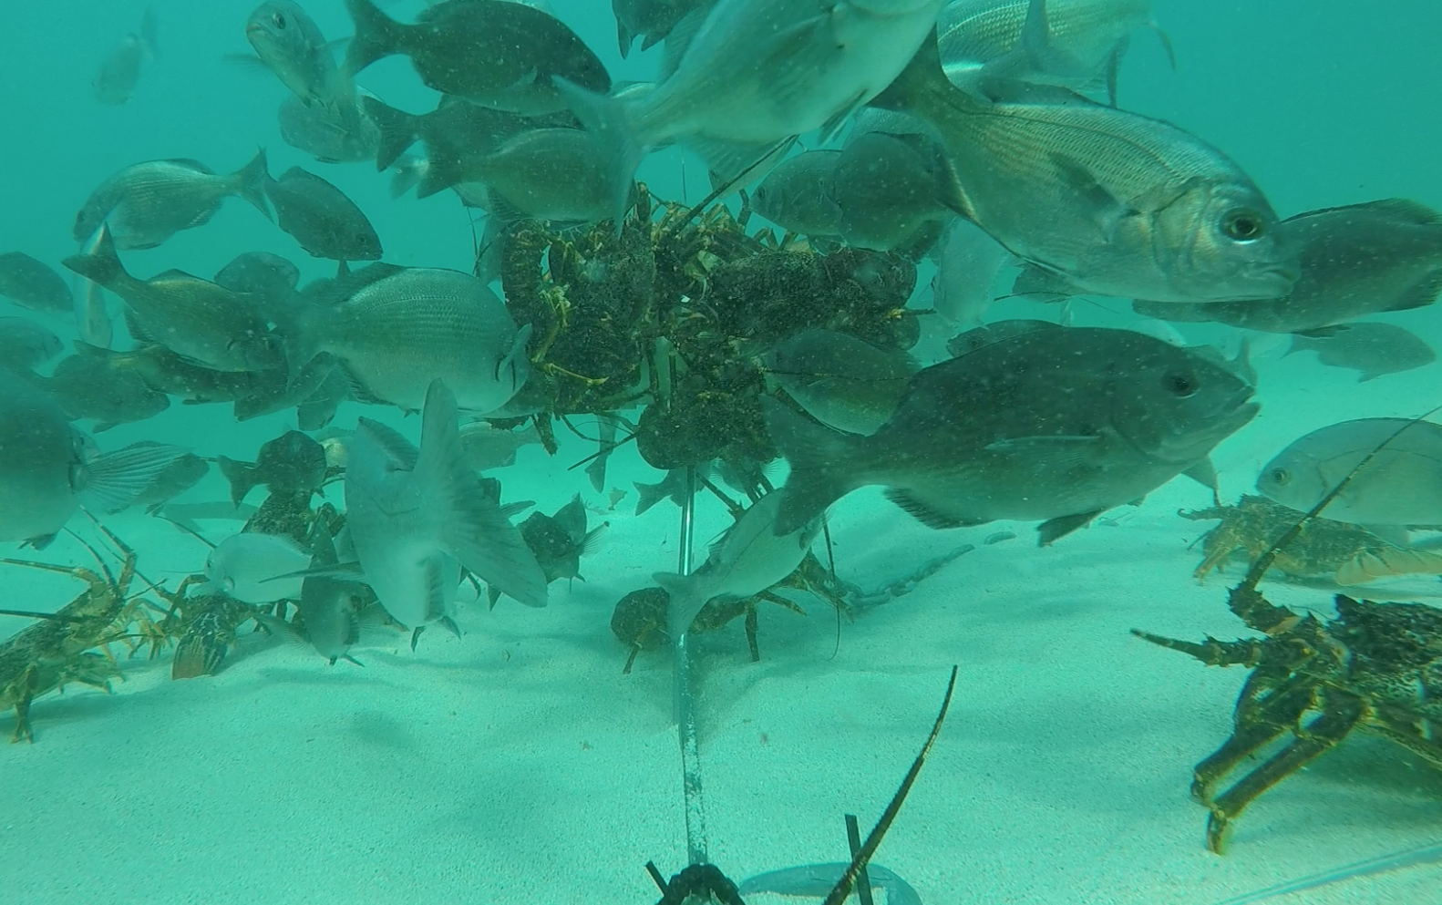
3. IMPACTS How are we investing in each other to combat poaching
Challenge we have been accused of, is using the data to rezone the MPA, which will further marginalize the fishers!
True belief?
Manipulation of facts for alternative gain/agendas?
Until the fishers present the data, no one has it!
BUILDING TRUST!

Slide 16
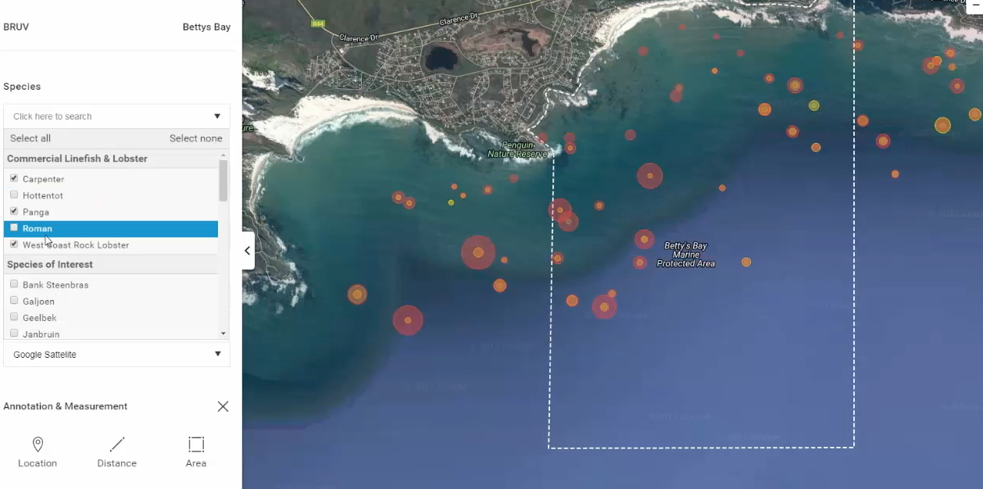
3. IMPACTS How are we investing in each other to combat poaching
Virtual Reality
Fishers want a different representation, not GPS points, “resource will be stolen”
Notes:
Virtual Reality
Education by fishers to kids
Investing in tech solutions/tech awareness for future generations.

Slide 17
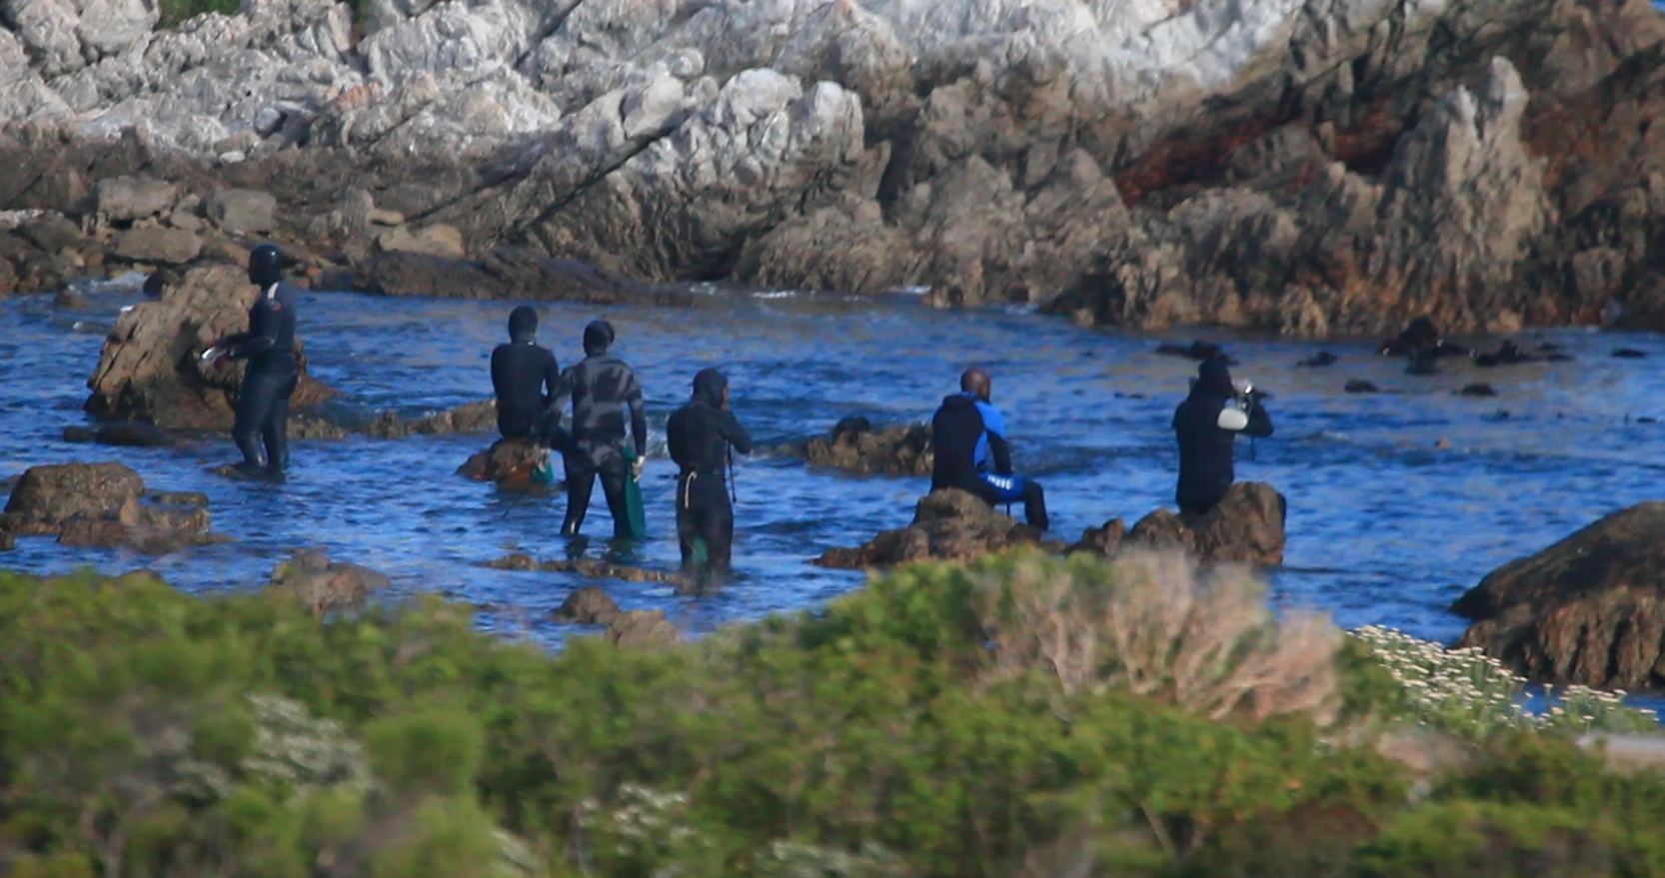
4. IMPACTS How are we investing in each other to combat poaching
Anti-IUU Strategy
Kogelberg Marine Working Group – finally IUU community engagement meeting;
Community has the capacity;
Kleinmond Integrated Fisheries Forum has formed an IUU monitoring team;
Communications have been established, only waiting for municipality and SAPS to be onboard;
Key is support, support, support!

Slide 18
IN CONCLUSION
Despite public opinion, we are working hard on challenging problems built on a history of mistrust;
Baby steps to rebuild trust and in many cases try earn it for the first time.
Multi-agency task team interventions are key, continuity and adaption;
“Thinking out the box” Innovation/technology key resources;
Its not perfect, if it was, we wouldn’t be learning;
Not scared of making mistakes, but we’re open about it;
I have made some new friends in the process.

Slide 19
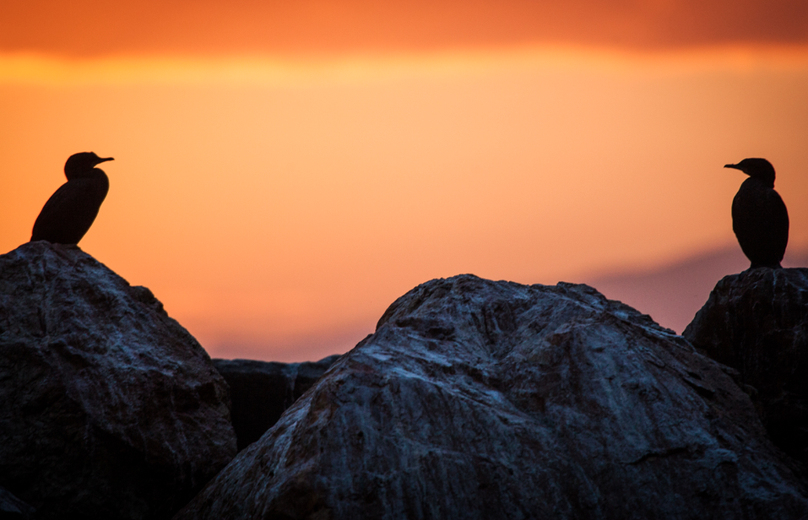
From the Kogelberg Region
Thank you for your time
We appreciate it!

