Slide 2
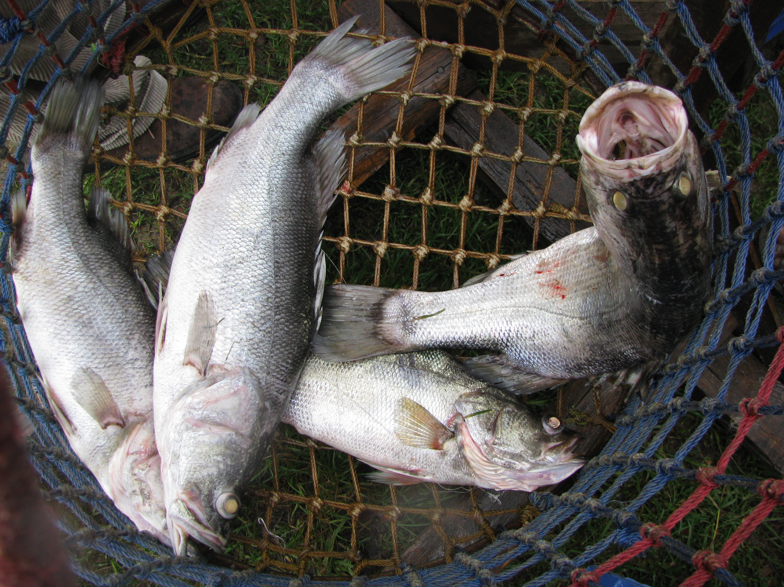
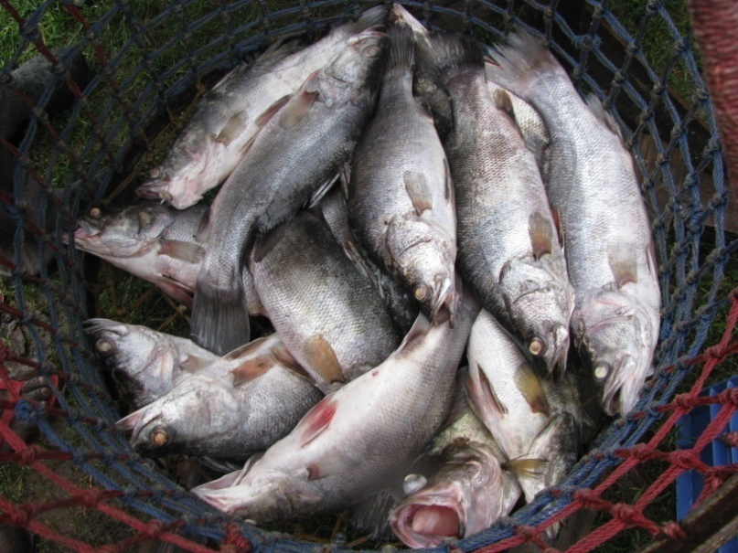
SO LONG AND THANKS FOR ALL THE FISH: Disposal of seized marine living resources
TIGHTENING THE NET
A FishFORCE Dialogue
9 & 10 March 2020
Port Elizabeth
Phil Snijman
pjsnijman@gmail.com
+27(0)83 290 7073

Slide 3
INTRODUCTION
A PRESENTATION IN/ON FIVE ACTS:
The Marine Living Resources Act 18 of 1998 (“MLRA”)
The Criminal Procedure Act 51 of 1977 (“CPA”)
The National Environmental Management Act 107 of 1998 (“NEMA”), and two of the SEMAs:
The National Environmental Management: Protected Areas Act [fishing in a MPA]
The National Environmental Management: Biodiversity Act [TOPS & CITES & alien and invasive species]
and keeping in mind the proposed amendments in the National Environmental Management Laws Amendment Bill (“NEMLAB”)

Slide 4
THE MLRA
Section 63: Disposal of perishables
May return fish or other thing of perishable nature to person from whom it was seized on receiving security equivalent to the value of the “fish or thing”
Cause the sale of the fish or other thing and pay the proceeds into a suspense account pending court order / where no proceedings are instituted, release the proceeds to the person from whom it was seized / if unable to sell, dispose in a manner deemed fit, including destruction
Live fish may be released or destroyed at the discretion of the seizing FCO

Slide 5
THE CPA
Section 30: Disposal by police official of article after seizure
A police official who seizes any article referred to in section 20 or to whom any such article is under the provisions of this Chapter delivered -
(a) may, if the article is perishable, with due regard to the interests of the persons concerned, dispose of the article in such manner as the circumstances may require; or
(b) may, if the article is stolen property or property suspected to be stolen, with the consent of the person from whom it was seized, deliver the article to the person from whom, in the opinion of such police official, such article was stolen, and shall warn such person to hold such article available for production at any resultant criminal proceedings, if required to do so; or
(c) shall, if the article is not disposed of or delivered under the provisions of paragraph (a) or (b), give it a distinctive identification mark and retain it in police custody or make such other arrangements with regard to the custody thereof as the circumstances may require.

Slide 6
THE CPA
Section 31: Disposal of article where no criminal proceedings are instituted or where it is not required for criminal proceedings
(1) (a) If no criminal proceedings are instituted in connection with any article referred to in section 30(c) or if it appears that such article is not required at the trial for purposes of evidence or for purposes of an order of court, the article shall be returned to the person from whom it was seized, if such person may lawfully possess such article, or, if such person may not lawfully possess such article, to the person who may lawfully possess it.
(b) If no person may lawfully possess such article or if the police official charged with the investigation reasonably does not know of any person who may lawfully possess such article, the article shall be forfeited to the State.

Slide 7
THE CPA
Section 32: Disposal of article where criminal proceedings are instituted and admission of guilt fine is paid
(1) If criminal proceedings are instituted in connection with any article referred to in section 30 (c) and the accused admits his guilt in accordance with the provisions of section 57, the article shall be returned to the person from whom it was seized, if such person may lawfully possess such article, or, if such person may not lawfully possess such article, to the person who may lawfully possess it, whereupon the provisions of section 31(2) shall apply with reference to any such person.
(2) If no person may lawfully possess such article or if the police official charged with the investigation reasonably does not know of any person who may lawfully possess such article, the article shall be forfeited to the State.

Slide 8
THE CPA
Section 34: Disposal of article after commencement of criminal proceedings
(1) The judge or judicial officer presiding at criminal proceedings shall at the conclusion of such proceedings, but subject to the provisions of this Act or any other law under which any matter shall or may be forfeited, make an order that any article referred to in section 33 -
(a) be returned to the person from whom it was seized, if such person may lawfully possess such article; or
(b) if such person is not entitled to the article or cannot lawfully possess the article, be returned to any other person entitled thereto, if such person may lawfully possess the article; or
(c) if no person is entitled to the article or if no person may lawfully possess the article or, if the person who is entitled thereto cannot be traced or is unknown, be forfeited to the State.
…….
(6) If the circumstances so require or if the criminal proceedings in question cannot for any reason be disposed of, the judge or judicial officer concerned may make any order referred to in paragraph (a), (b) or (c) of subsection (1) at any stage of the proceedings.

Slide 9
NEMA
Section 31I: Seizure of items
(1) The provisions of sections 30 to 34 of the Criminal Procedure Act, 1977, apply to the disposal of anything seized in terms of this Part, subject to such modifications as the context may require.

Slide 10
NEMA
Section 34E: Treatment of seized live specimens
(1) Pending the institution of any criminal proceedings in terms of this Act or a specific environmental management Act or the resolution of such proceedings, a live specimen that has been seized in terms of this Part must be deposited with a suitable institution, rescue centre or facility which is able and willing to house and properly care for it [emphasis added]

Slide 11
Anything else?
Protected Areas Act: No additional provisions
Regulations for Proper Administration of Special Nature Reserves, National Parks and World Heritage Sites, GNR 1061, GG 28181, 28 October 2005.
Biodiversity Act: No additional provisions
Threatened or Protected Marine Species Regulations, GNR 477, GG 40876, 30 May 2017
Convention on the International Trade in Endangered Species of Wild Fauna and Flora Regulations, GNR 173, GG 3302, 5 March 2010
Alien and Invasive Species Regulations, GNR 598, GG 37885, 1 August 2014 and listing in GNR 864, GG 40166, 29 July 2016.

Slide 12
The challenge
ACT | DEAD FISH | LIVE FISH | PROPOSED SOLUTION
MLRA | OBTAIN SECURITY SELL DISPOSE IN A MANNER DEEMED FIT (e.g. DONATE OR DESTROY | BACK TO SEA | NONE REQUIRED
CPA | IN SUCH MANNER AS CIRCUMSTANCES MAY REQUIRE MAKE ARRANGEMENTS WITH REGARD TO CUSTODY AS CIRCUMSTANCES MAY REQUIRE | MAKE ARRANGEMENTS WITH REGARD TO CUSTODY AS CIRCUMSTANCES MAY REQUIRE OR ACT IN TERMS OF MLRA (ALL SAPS MEMBERS ARE APPOINTED AS FCOs)…SO BACK TO SEA | NONE REQUIRED
NEMA Protected Areas Act Biodiversity Act | IN SUCH MANNER AS CIRCUMSTANCES MAY REQUIRE MAKE ARRANGEMENTS WITH REGARD TO CUSTODY AS CIRCUMSTANCES MAY REQUIRE | DEPOSIT WITH INSTITUTION PROPOSED AMENDMENT: NEMLAB REPLACES THIS SECTION WITH BY DELETING THE REQUIREMENT FOR A DEPOSIT WITH AN INSTITUTION, BUT THEN PRESCRIBES HANDLING IN TERMS OF SECTION 30(a) OF CPA (PERISHABLE ITEMS….WHICH LIVE FISH ARE NOT) | IDEALLY, SIMILAR PROVISIONS TO THAT IN MLRA - FOR BOTH DEAD AND LIVE FISH (AND OTHER ANIMALS). ALTERNATIVELY, SIMPLY DELETE S 34E OF NEMA AND THEREFORE ALLOW COURT ORDER IN TERMS OF S 34 OF CPA

Slide 13
NEMLAB
Section 34E: Treatment of seized live specimens
(1) Pending the institution of any criminal proceedings in terms of this Act or a specific environmental management Act or the resolution of such proceedings, a live specimen that has been seized in terms of this Part [must] may be deposited with a suitable institution, rescue centre or facility which is able and willing to house and properly care for it.
For the purposes of this Chapter , seized live specimens may be disposed of in terms of section 30(a) of the Criminal Procedure Act, 1977.
A reminder of section 30(a) of the CPA:
A police official who seizes any article referred to in section 20 or to whom any such article is under the provisions of this Chapter delivered -
(a) may, if the article is perishable, with due regard to the interests of the persons concerned, dispose of the article in such manner as the circumstances may require; or…. [emphasis added]

Slide 14
Proposed solution 1
Section 34E: Treatment of seized live specimens
(1) Pending the institution of any criminal proceedings in terms of this Act or a specific environmental management Act or the resolution of such proceedings, a live specimen that has been seized in terms of this Part [must] may be deposited with a suitable institution, rescue centre or facility which is able and willing to house and properly care for it, or dealt with in terms of the Criminal Procedure Act, 1977.
A reminder of section 34 of the CPA:
1) The judge or judicial officer presiding at criminal proceedings shall at the conclusion of such proceedings, but subject to the provisions of this Act or any other law under which any matter shall or may be forfeited, make an order that any article referred to in section 33 -
(a) be returned to the person from whom it was seized, if such person may lawfully possess such article; or
(b) if such person is not entitled to the article or cannot lawfully possess the article, be returned to any other person entitled thereto, if such person may lawfully possess the article; or
(c) if no person is entitled to the article or if no person may lawfully possess the article or, if the person who is entitled thereto cannot be traced or is unknown, be forfeited to the State. ….
(6) If the circumstances so require or if the criminal proceedings in question cannot for any reason be disposed of, the judge or judicial officer concerned may make any order referred to in paragraph (a), (b) or (c) of subsection (1) at any stage of the proceedings.

Slide 15
Proposed solution 2
Section 34E: Treatment of seized live specimens
(1) Pending the institution of any criminal proceedings in terms of this Act or a specific environmental management Act or the resolution of such proceedings, a live specimen that has been seized in terms of this Part [must] may be
released back into the wild; or
disposed of by euthanasia; or
deposited with a suitable institution, rescue centre or facility which is able and willing to house and properly care for it; or
kept or disposed of in any other manner deemed fit in the circumstances by the official seizing the specimen.

Slide 16
THANK YOU
Phil Snijman
pjsnijman@gmail.com
+27(0)83 290 7073
Notes:
Thank you!

