Slide 1








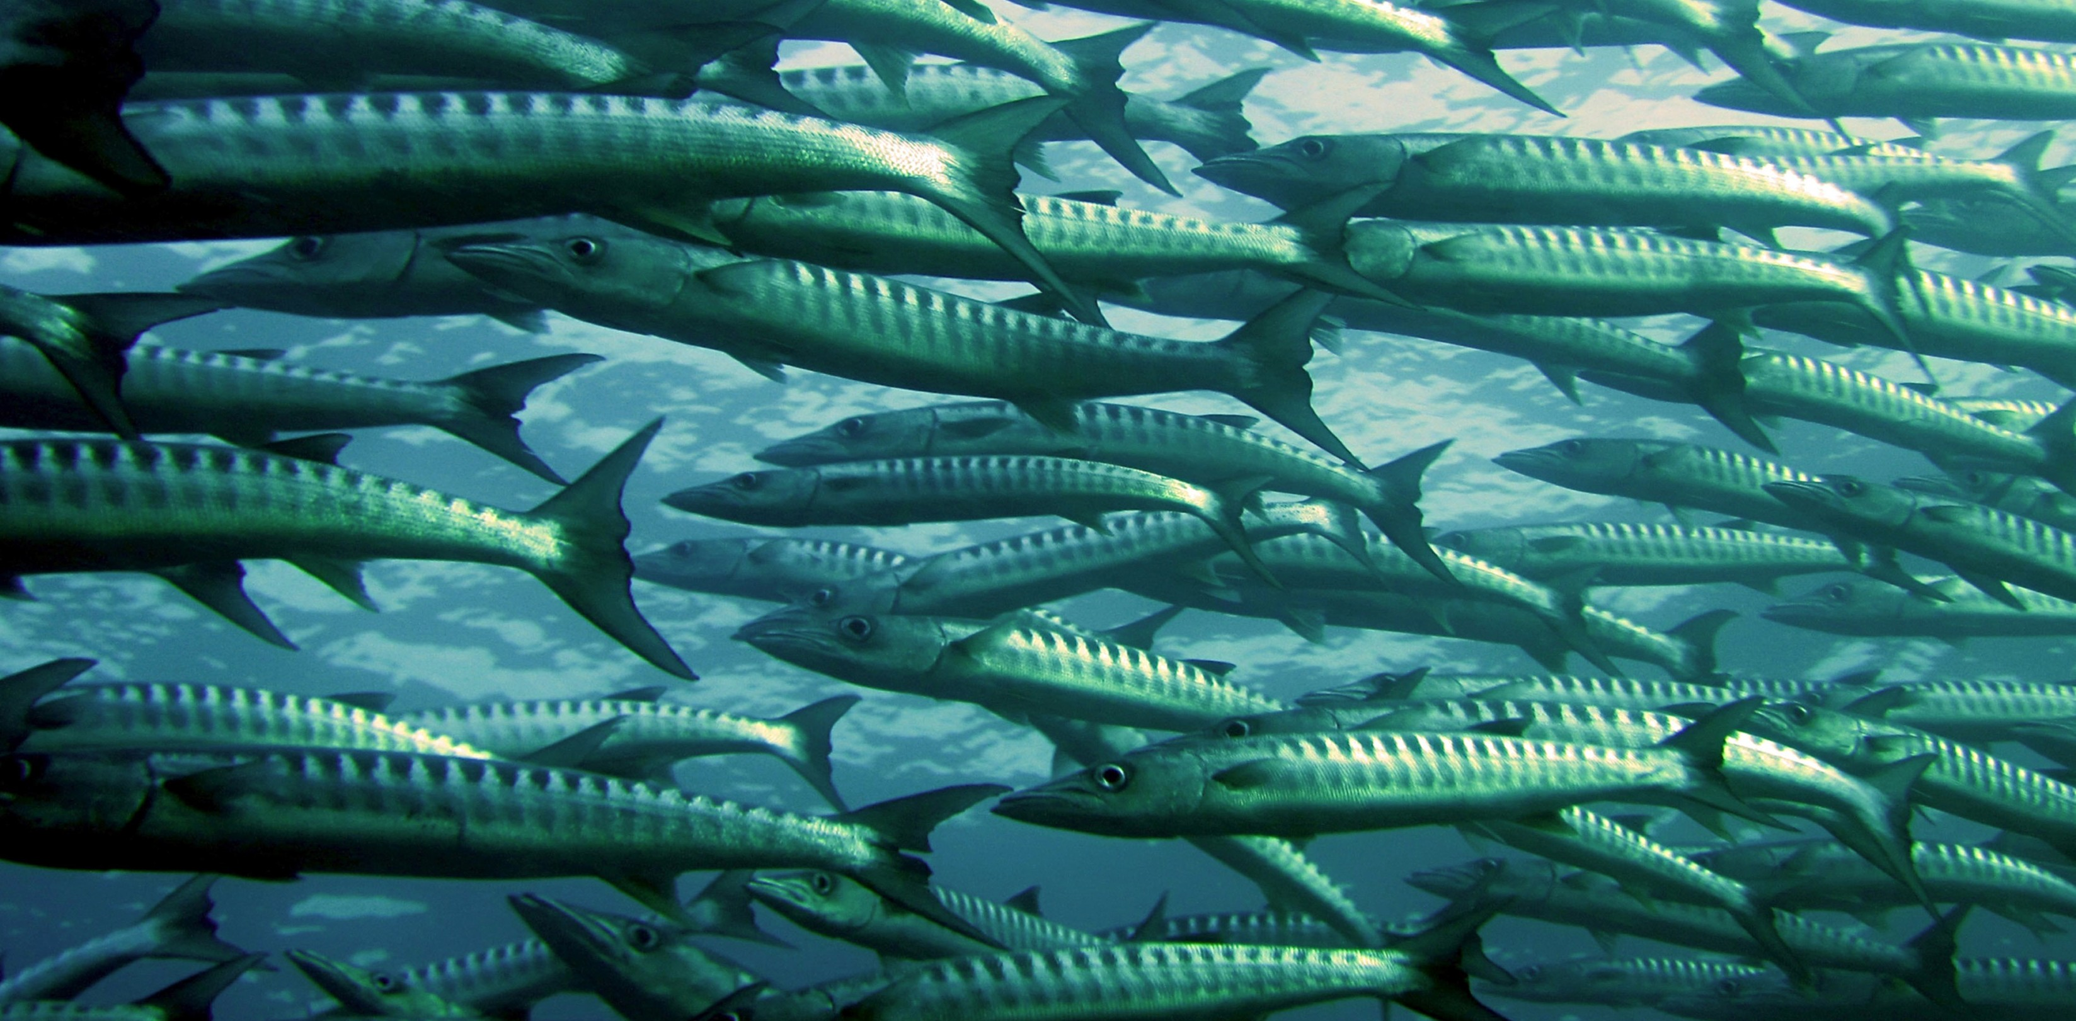
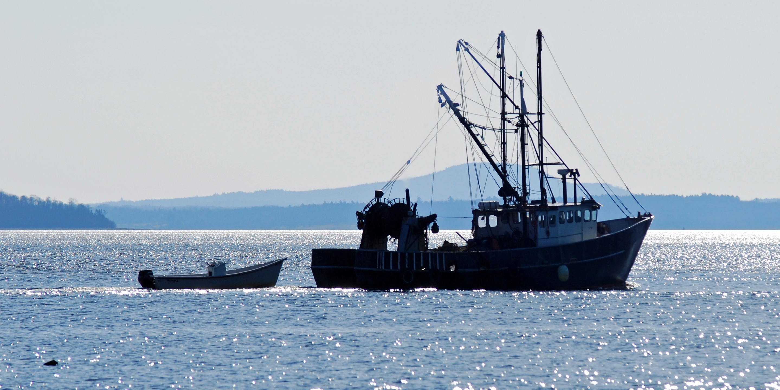



Slide 2
The permeating
impact of corruption

Slide 3
Corruption– the stark realities
SA has lost R1,5 trillion to corruption between 2014 and 2019
= R1 500 000 000 000
About 20% of all government procurements (R53,200,000,000) go missing p/a
Public procurement = biggest item on SA’s budget at around R1 trillion a year
SA uses a decentralised PFM & MFM System, of which procurement is part.
Means every public entity & sphere runs its own finances (Geo Quinot)
In 2022/23 financial year Corruption Watch identified a 250% increase in the number of deviations (tender process not followed) with lower values
Number of contract expansions skyrocketed
Notes:
An expansion is where you’ve got a contract, and rather than going out and getting a new contract, you just expand it – you make the pie bigger

Slide 4
ROLE OF PROCUREMENT
System not fit for purpose.
Small tenders or expressions of interest require at least 50 pages to be completed, myriad of supporting documents – exclude small upcoming entrepreneurs
Officials cannot prepare TOR – ask contractors, and technically exclude them
Many smaller towns don’t have 3 suppliers – invite “friends” to submit quotes just to satisfy requirements – it becomes easier to bypass the system and leads to more brazen activities
Procurement system = enabler of corrupt activities

Slide 5
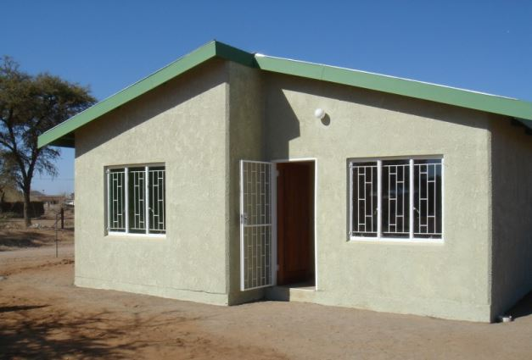
With theR1,120,000,000,000 ($80 billion) lost between 1994 & 2012 …
25 million

Slide 6

Notes:
Government throws amounts around, but do we know what it look like?

Slide 7
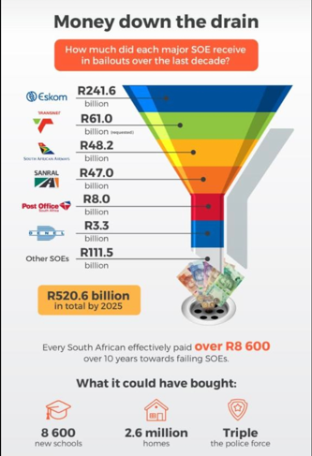

Slide 8
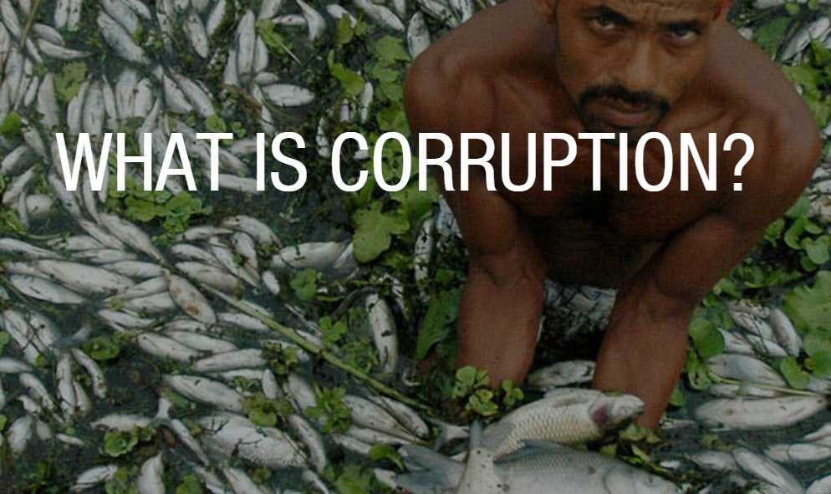

Slide 9

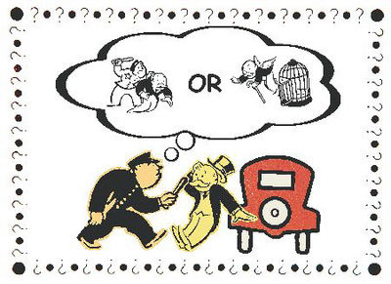
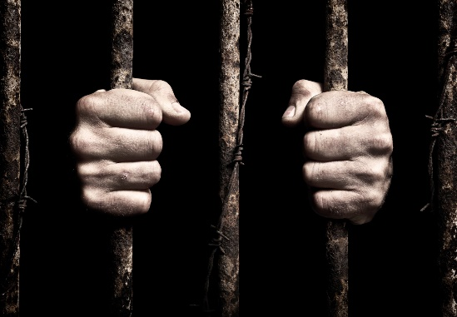
Klitgaard’s “recipe” for corruption from an economic standpoint:
M (monopoly power) + D(Discretion) – A (Accountability)
= Corruption

Slide 10
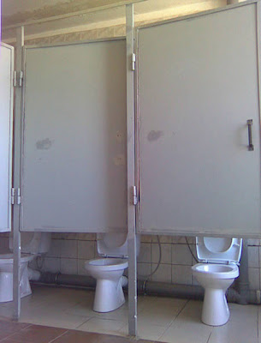
Effects of corruption …
Impacts severely on service delivery
Lowers economic growth
Reduces incentives to invest
Reduces the effective flow of aid packages
Loss of tax revenue
Adverse budgetary consequences
Inferior public infrastructure and services

Slide 11

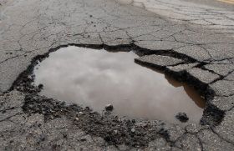
INCIDENT NOTICED PERSONALLY
Maserati in Kalahari (Kathu)
Sewage spill (2 years) in park adjoining 3 nursery schools
Anglo pays for lot of services

Slide 12
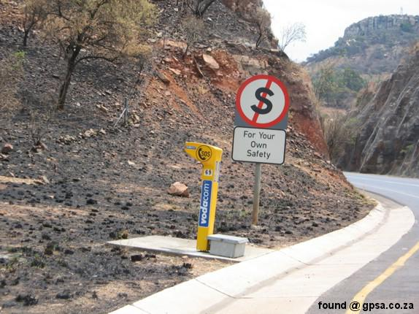
When the signs are there …

Slide 13
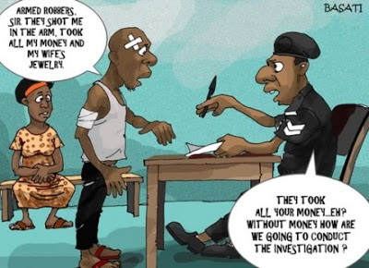

Slide 14
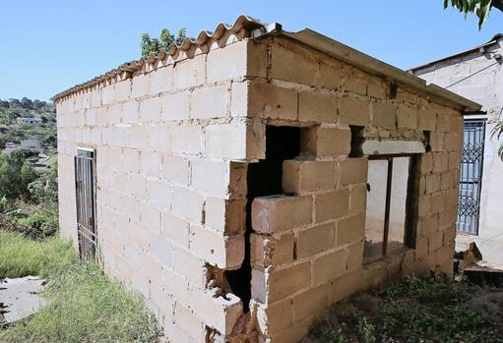
Notes:
We must hold public entities accountable – linking spending with service delivery.

Slide 15
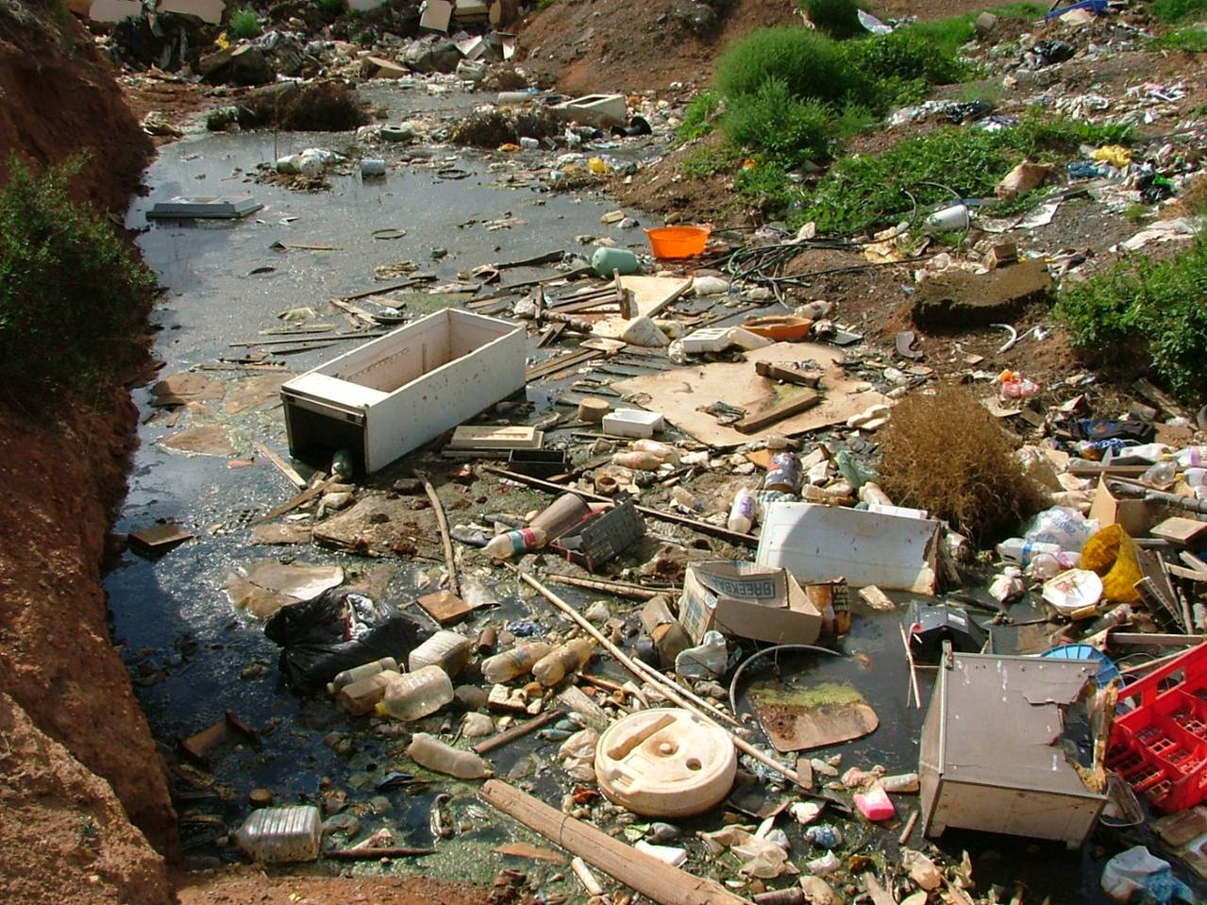

Slide 16
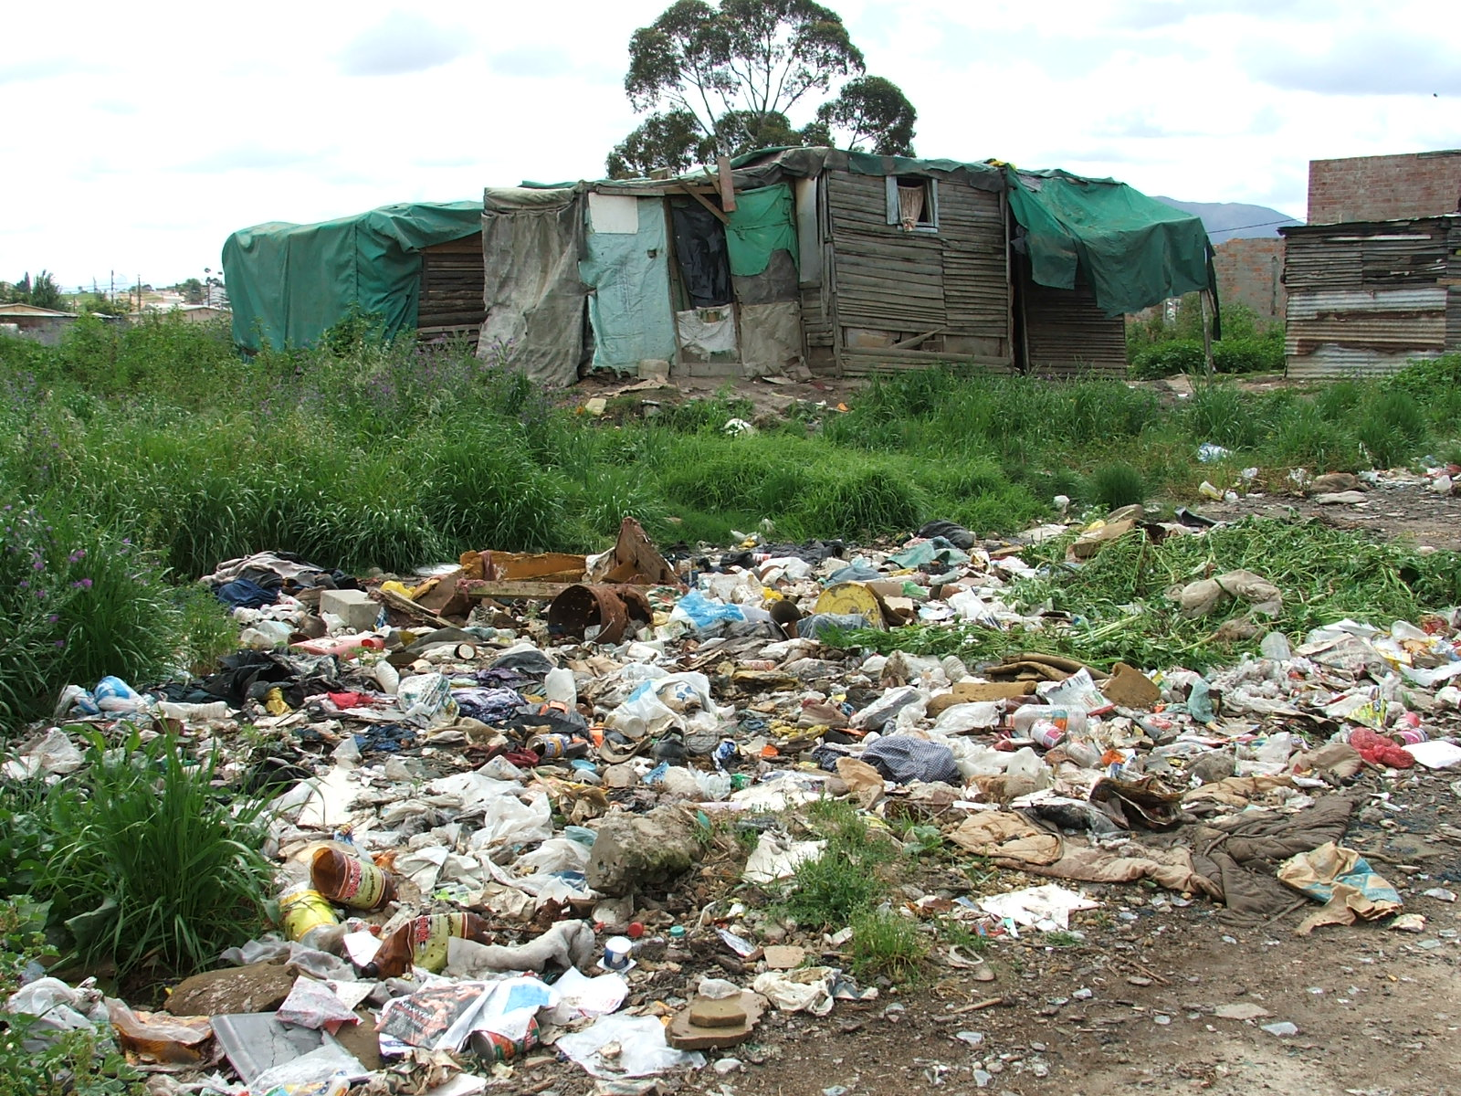

Slide 17
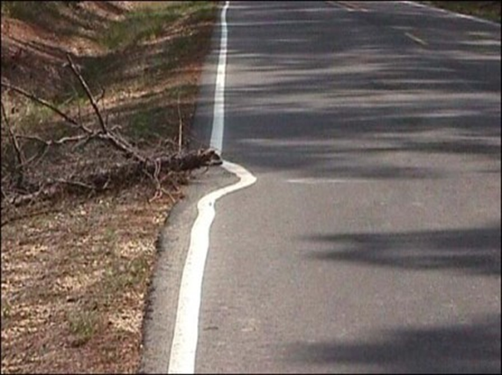

Slide 18
Corruption in South Africa's Fisheries Industry
Corruption Watch chairperson Themba Maseko: the high number of corruption issues in policing sector (includes other law enforcement agencies) is an indication of government’s inadequacy in confronting challenges in policing, safety and security; and a range of rights and services.
DFFE have faced allegations of mismanagement in the allocation of fishing rights and quotas.
Allocations were intended to promote transformation and sustainable harvesting, but instead benefited politically connected individuals with limited experience in fishing.
Quota system, designed to limit catches and protect marine resources undermined by corruption by:
Bribery of officials to obtain larger quotas or illegal fishing permits
"Paper quota holders" who sell their allocations to established companies
Political interference in quota allocations to benefit connected individuals
Corruption in monitoring and enforcement, allowing illegal fishing to continue unchecked

Slide 19
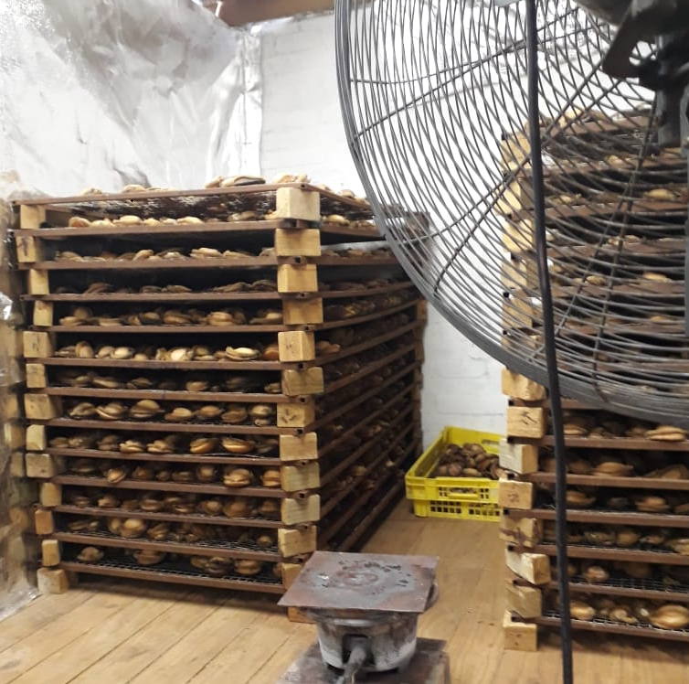
ORIGIN OF LINK BETWEEN ABALONE AND ORGANISED CRIME
Notes:
And increasing …

Slide 20
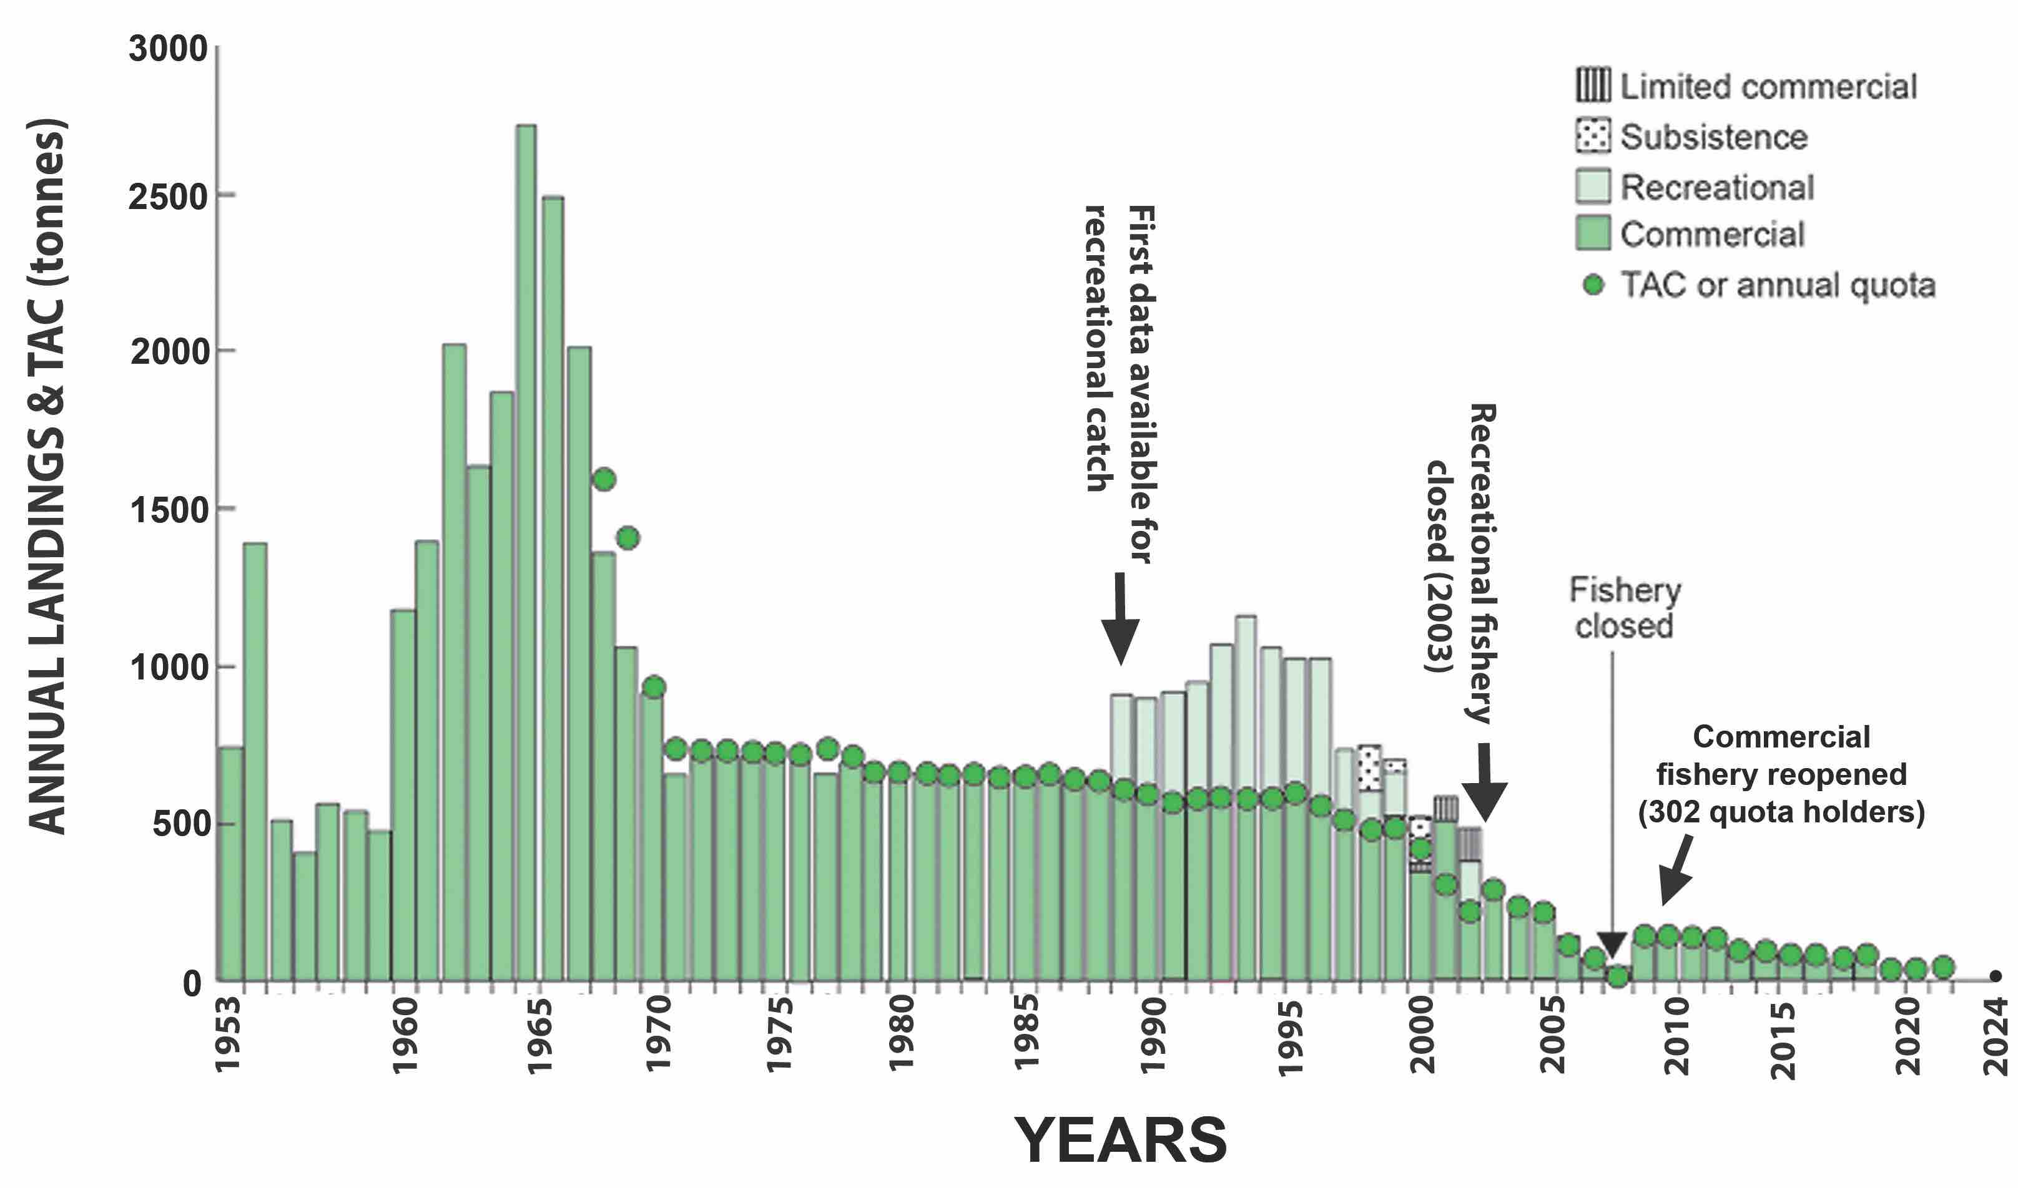
Notes:
In 2004, to undo the wrongs committed in the apartheid era, 301 abalone quotas were awarded, mostly to individuals from previously disadvantaged fishing communities. The Fishing Rights Allocation Process (FRAP2004) was fair and open to all, with the scoring weighted in such a way that you had a much better chance of success if you came from a previously disadvantaged community. Other matters that were considered was a history in fishing, relevant qualifications like diving and skippers tickets, if you owned a suitable vessel, investment in the fishing industry etc. The department organised free 15m abalone diving as well as skippers courses for those in need, to ensure previously disadvantaged individuals were not excluded.
In an attempt to accommodate as many fishers as possible, minimum viable quotas were given to the maximum number of fishers that the abalone resource could sustain.
In 2004, abalone quotas were given for a period of 10 years, and it was made clear to the fishers that their catch performance, involvement in the fishing, how well they looked after their crew, if they abided by the rules and what they achieved with the proceeds of their quotas would be monitored. At the end of the 10 years, all of this would be considered, after which the department would renew the quotas of those that ticked the appropriate boxes. This should have lifted these fishers out of poverty and set them up for life, provided they played by the rules.
The then DG, and other competent officials resigned shortly afterwards. The word on the ground was that increased corruption in the government made it impossible for them to be effective at their jobs. Shortly afterwards the Zuma era started, and from that point onwards it all went downhill. Effective policing of our marine resources became almost non-existent, our abalone resource was plundered to commercial extinction in most areas and quotas were cut to far below the minimum viable level. Quotas were also not renewed after the ten years as was planned, but previous quota holders were issued with “exemptions” on a yearly basis, providing zero security and leaving fishers uncertain of a future income.

Slide 21
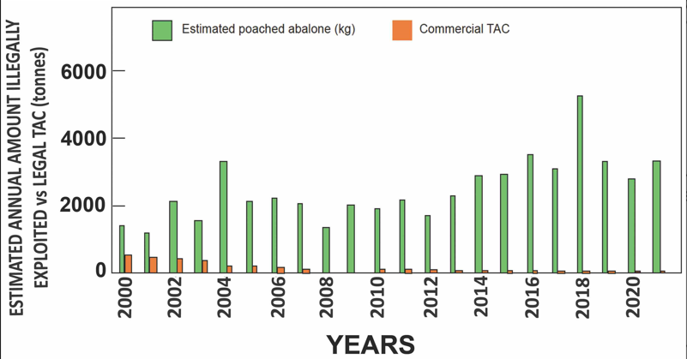

Slide 22
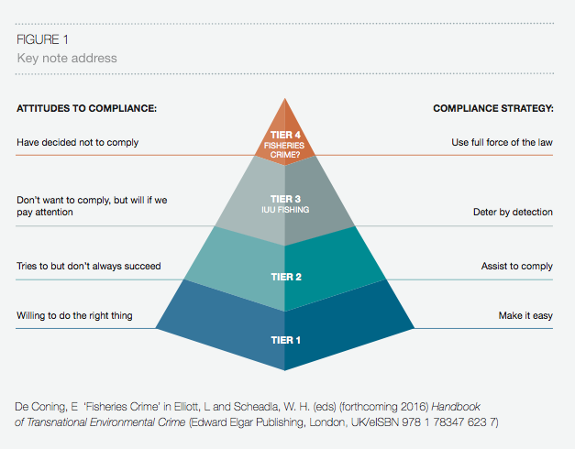
Attitudes to compliance

Slide 23
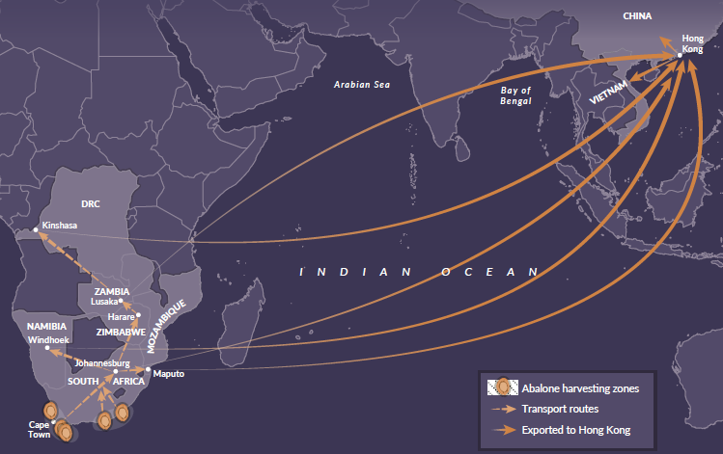

Slide 24
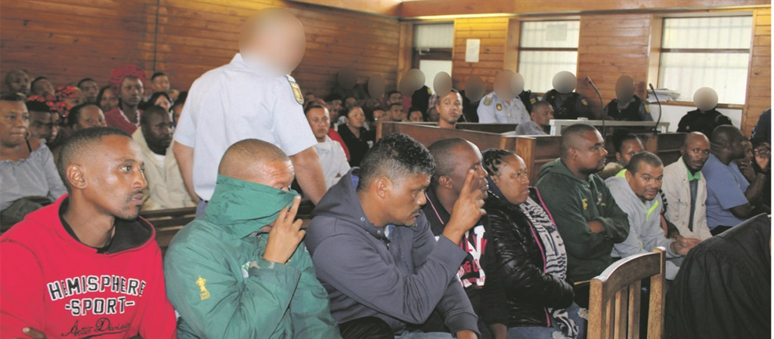
Another problem: 9 FCO’s (and eight others) arrested by Hawks for involvement in abalone poaching (corruption)
March 2018

Slide 25
Impact on Coastal Communities
Traditional fishing communities particularly affected by corruption.
Small-scale fishers unable to compete with larger operations that secured rights through questionable means.
This contributed to:
* Increased poverty in coastal communities
* Loss of traditional livelihoods and cultural practices
* Social unrest and illegal fishing as desperate communities seek to survive
* Distrust in government institutions and regulations

Slide 26
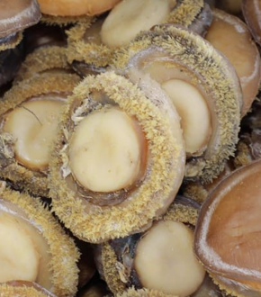
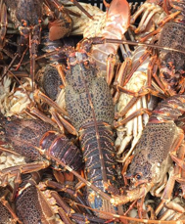
Involvement of organised crime syndicates in especially abalone and lobster trade and the impunity with which they act = loss of respect for the rule of law
Enforcement difficult along SA’s extensive coastline
Political will to tackle corruption varies
The complex network of interests involved in the fishing industry means that reforms often face resistance from those benefiting from the status quo

Slide 27
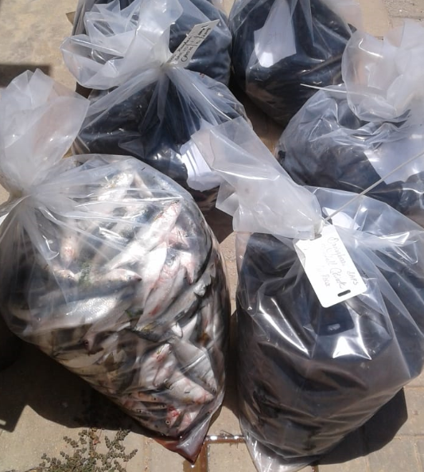
What is smuggled?

Slide 28
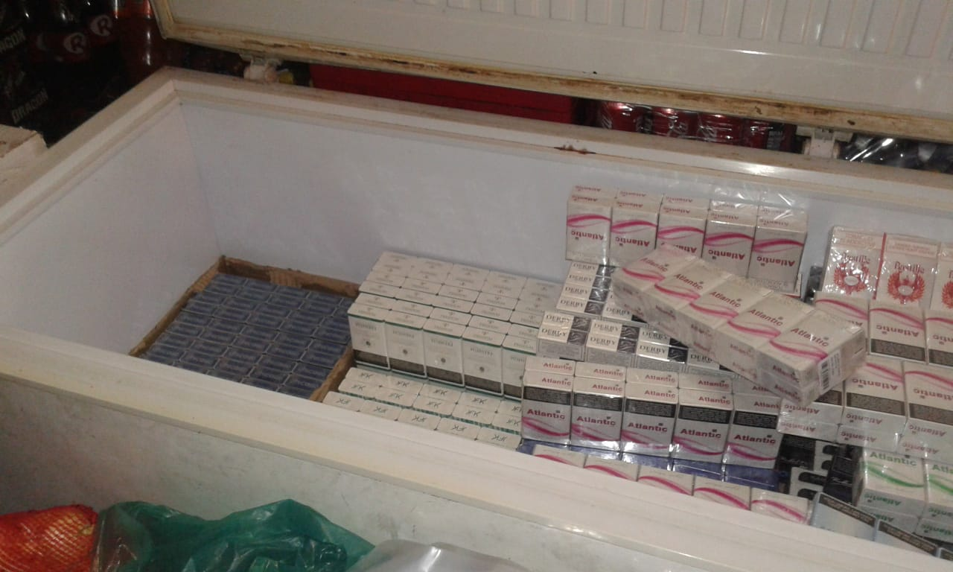

Slide 29
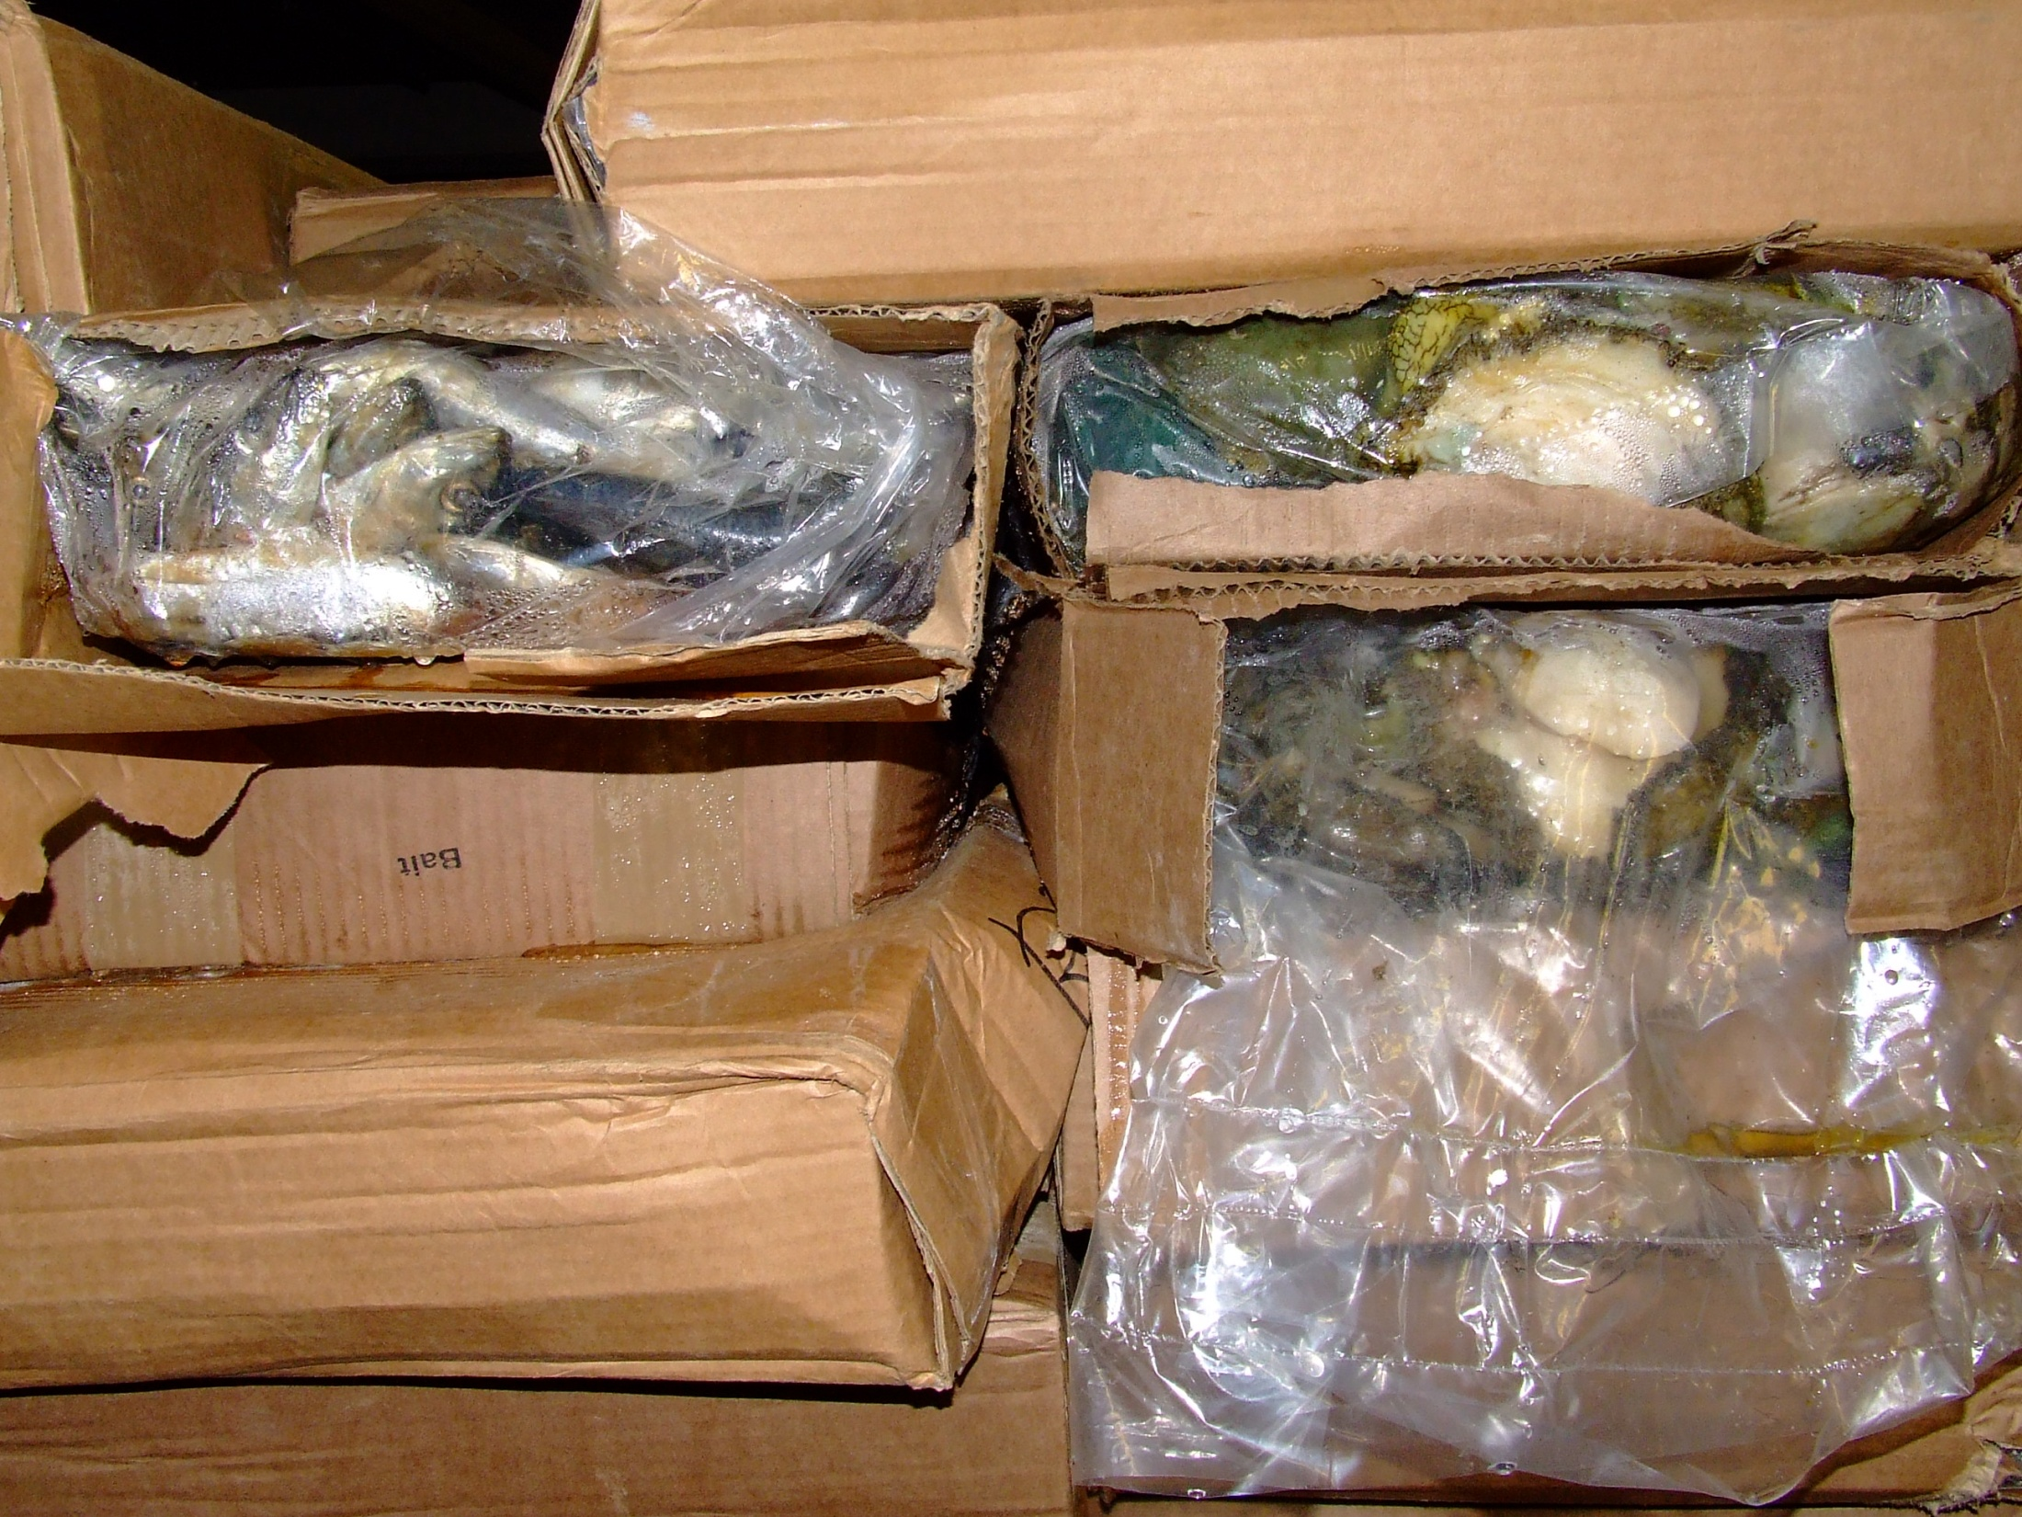

Slide 30
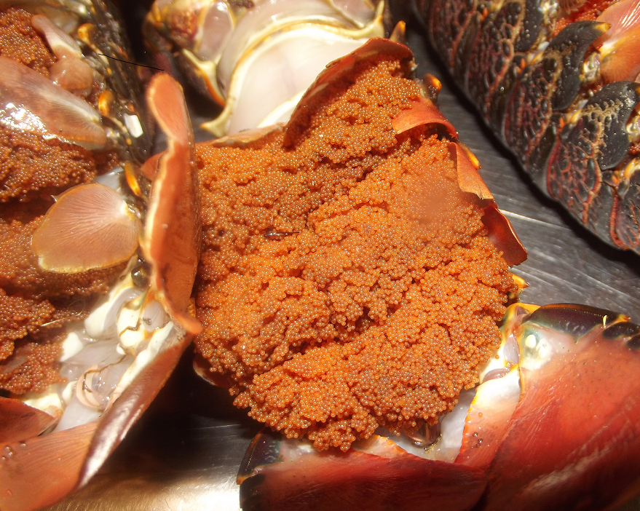
Notes:
They still are, but look at what are being taken …

Slide 31
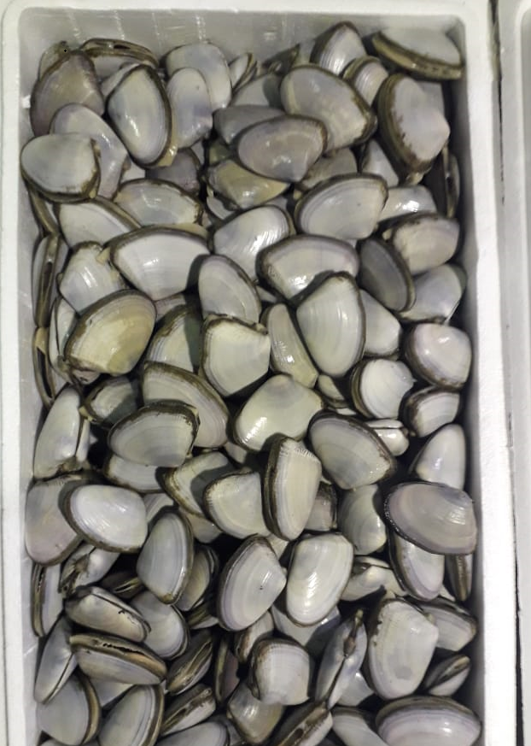
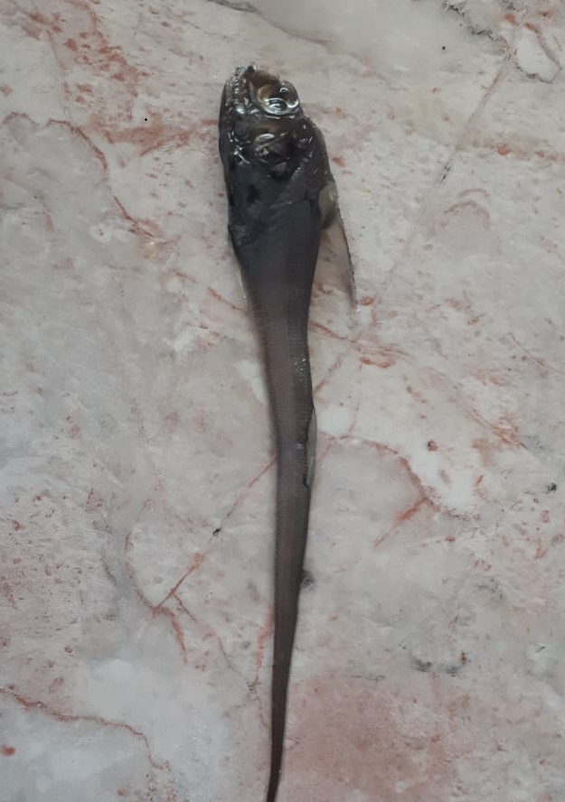
Notes:
As well as little mussels and little fish

Slide 32
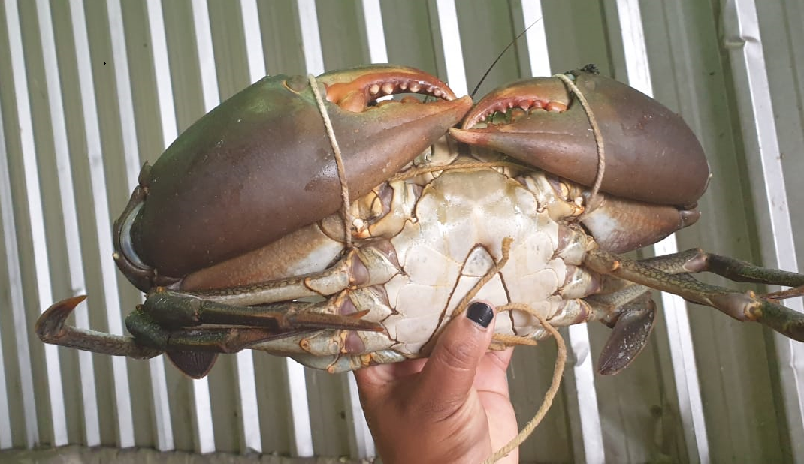
Notes:
The market is expanding

Slide 33
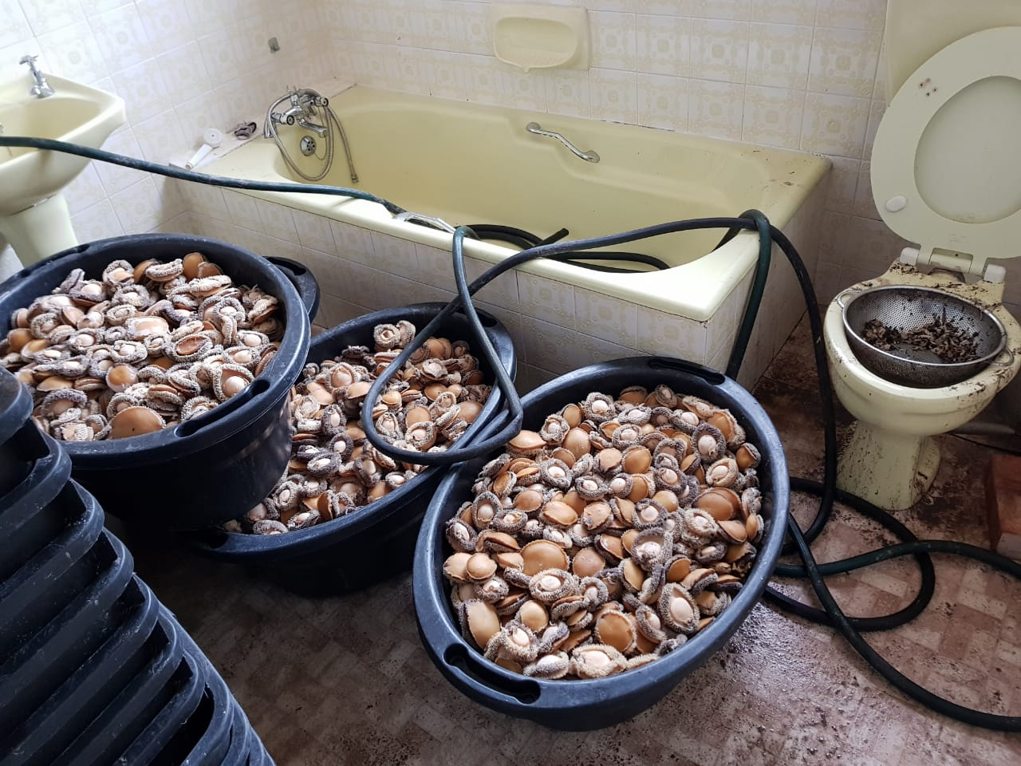
Processing methods may constitute health hazard

Slide 34
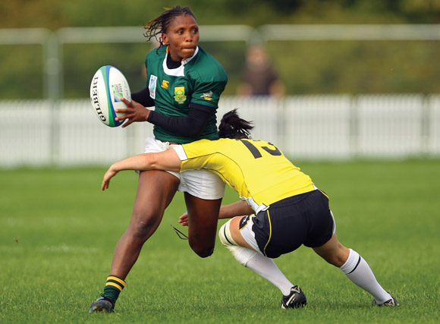
So, how do we address it?

Slide 35
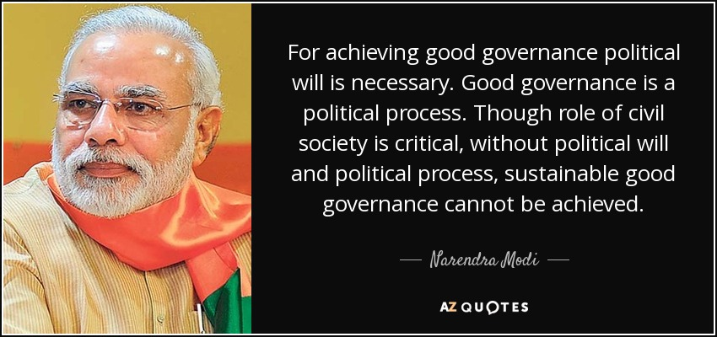

Slide 36
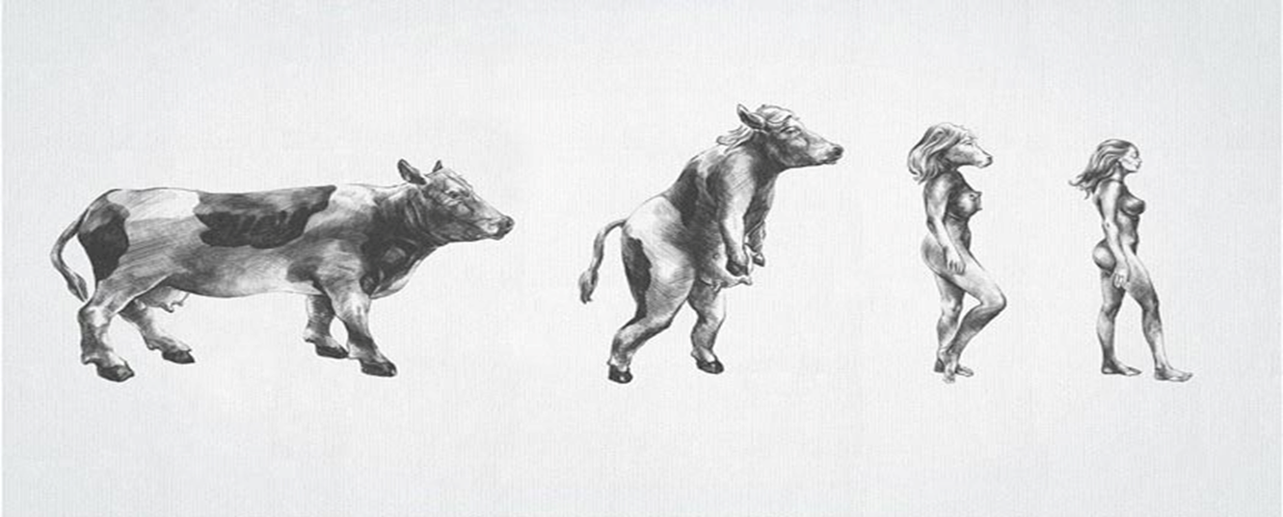

Slide 37
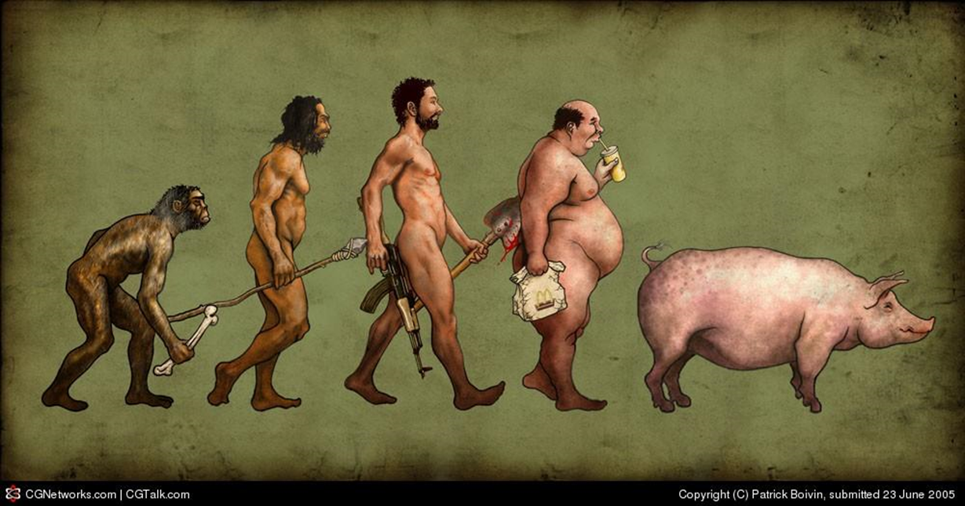

Slide 38


