Slide 1
Prof Hennie van As

Slide 2
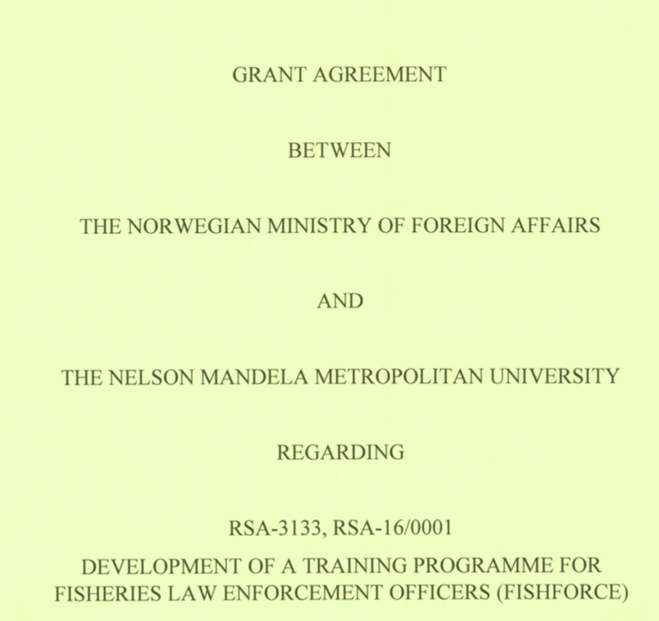
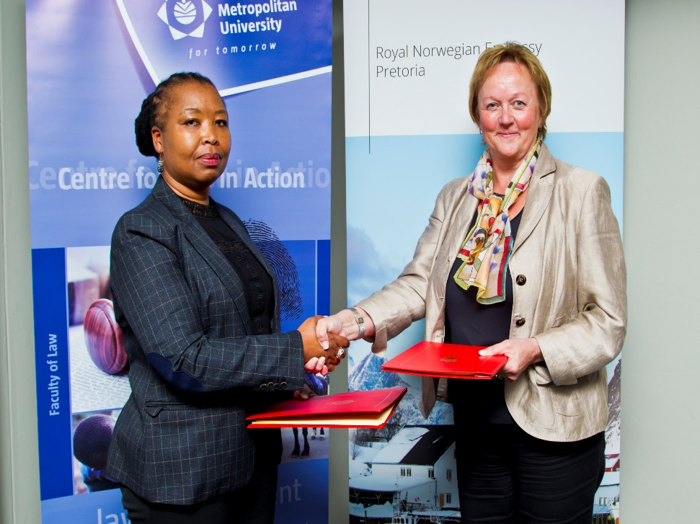

Slide 3
Norwegian institutional and technical partners

Slide 4
South African institutional and technical partners and clients

Slide 5
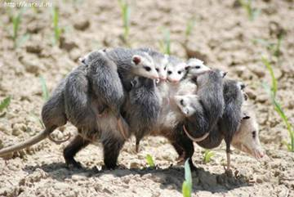
Proposed additional partners

Slide 7
The Project
DEVELOPMENT OF A TRAINING PROGRAMME FOR FISHERIES LAW ENFORCEMENT OFFICERS AND ALL ROLEPLAYERS IN THE FISHERIES RELATED CRIMINAL JUSTICE SYSTEM

Slide 8
Outputs
TRAINING
POST-TRAINING SUPPORT
RESEARCH & EVALUATION

Slide 9
Geographical research
Phase I: South Africa
Phase II: Southern and eastern Africa
Phase III: Indian Ocean Rim (Indonesia)

Slide 10
The project…
1
Gap analysis between arrests & convictions to determine reasons for failure of LE attempts
2
SLP’s building capacity and earning credits
3
Development of accredited training programme
4
5
Adapt course to needs of other countries. Starts parallel with Phase 1 through consultation with NEPAD, AU
Roll-out of programme & start process to establish academy

Slide 11
Accreditation - national
SLP’s
Law
Crime scene management
Higher Certificate
Credits earned through SLP’s
1 Year qualification
Diploma
Criminal Justice
3 Year qualification
Investigation of crime
Criminal Justice
Detection & monitoring fisheries transgressions
Species ID & technology
Advanced investigations
Forensic investigations

Slide 12
TANZANIAN CHAPTER
Tanzania Police Force, Deep Sea Fisheries Authority, TBC
SOUTH AFRICAN CHAPTER
OPERATION PHAKISA:
DAFF, NPA, SAPS, SARS, SSA
CORE GROUP
FishFORCE Project Management Team
The Norwegian Police University College
(INTERPOL, UNODC, ILO)
MOZAMBIQUAN CHAPTER
TBC
KENYAN CHAPTER
UoN, TBC

Slide 13
REFERENCE GROUPS
PROJECT MANAGEMENT TEAM
TERMS OF REFERENCE:
Facilitate initiation and implementation of Outcomes
Activities:
PROJECT MANAGER
SOUTH AFRICAN CHAPTER (CHAIR)
- CORE GROUP (PHS, FFA, TEAM HEADS)
SA EXPERTS & AGENCIES
TRAINING TEAM
INDIAN OCEAN CHAPTER (CHAIR)
- CORE GROUP
IO EXPERTS & AGENCIES
RESEARCH AND EVALUATION TEAM
INDONESIAN CHAPTER (CHAIR)
- CORE GROUP
IND EXPERTS & AGENCIES
INVESTIGATIVE SUPPORT TEAM

Slide 14
Boarding a vessel
System of weight reporting
Forensic investigation
Get LEO’s on a similar standard through ad hoc training & SLP’s that are minimum requirements for the job
Statements
Crime scene management
Legal framework
Interviewing
Investigation skills

Slide 15
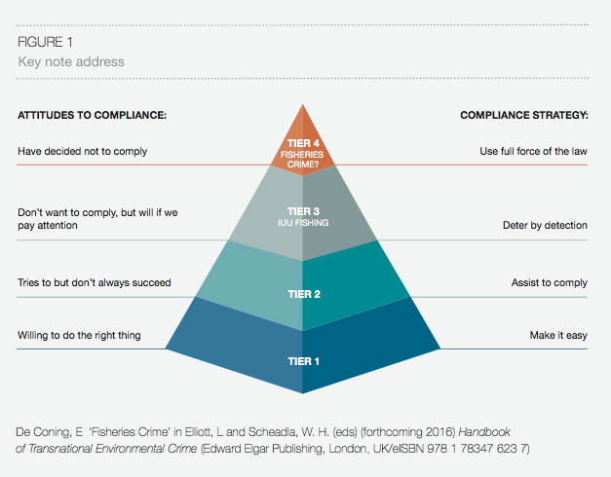

Slide 16
Activities so far
AD HOC TRAINING OF FISHERIES CONTROL OFFICERS ON REQUEST FROM DAFF
CO-HOSTING OF THE 2ND INTERNATIONAL SYMPOSIUM ON FISHERIES CRIME IN YOGYAKARTA, INDONESIA, WITH UNODC, THE NORWEGIAN MINISTRY OF INDUSTRY, TRADE AND FISHERIES AND THE GOVERNMENT OF INDONESIA
WRITING OF INCEPTION REPORT AND ENTERING INTO ICC WITH THE MINISTRY (NEAR COMPLETION)
NEGOTIATION OF AN MOU WITH THE UNIVERSITY OF NAIROBI
HIGH LEVEL REFERENCE GROUP MEETING IN MOMBASA 23-24 NOVEMBER 2016.

Slide 17
What else has been done?
Support LETrainNet
Have registered and is registering qualifications in criminal justice/law enforcement (can amend content)
Registered SLP’s (quick fix/interim relief)
Liaison with INTERPOL working group
Liaison with PescaDOLUS

Slide 18
THANK YOU!

