Slide 1
Every arrow in the quiver:
Municipal by-laws and the protection of marine living resources

Slide 2
What is the problem?
Wild abalone stock on brink of extinction
Wide-scale plundering – low risk – poor conviction rate
Strongly linked to organised crime syndicates
Huge impact on small-scale fishing communities
Communities involved – lucrative
Strong links to drugs in exchange
Tons confiscated – too late –dead

Slide 3
Purpose of presentation
To create awareness regarding other forms of legislation that can be applied in the fight against fisheries related crime

Slide 4
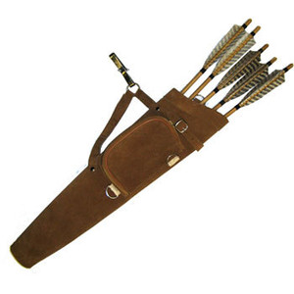
Are we harnessing our full potential?
Current primary protectors of marine living resources
FCO’s
SAPS
Municipalities? Some already FCO’s (GN 2418 of 2000) – Question? What are the extent of their activities? A question of uncertainty when it comes to MLR protection?

Slide 5
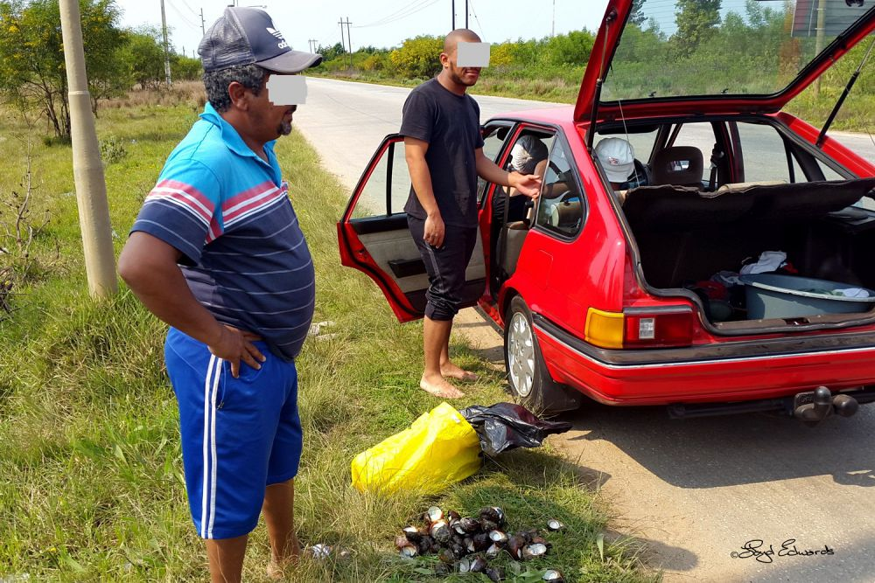
What other arrows do we have?

Slide 6
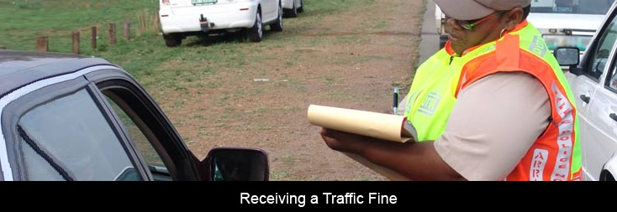
Examples
Municipal by-laws
Road traffic regulations

Slide 7
Legislative and executive powers of municipalities
Constitution
S152 – Object – to promote a safe and healthy environment
S156 – Municipality may make and administer by-laws for the effective administration of matters it may administer
Systems Act
S 11 – Municipality exercises legislative or executive authority by –
Passing by-laws
Implementing by-laws
S 15 – must compile and maintain municipal code
S 55 – MM responsible for administration and implementation of by-laws and other legislation

Slide 8
By-laws with direct relevance (Schedules 4 & 5B)
Pontoons, ferries, jetties, piers and harbours (draft Small Harbour by-law)
Beaches
Control of public nuisances
Public amenities
Public places
Places of recreation
EXAMPLE

Slide 9
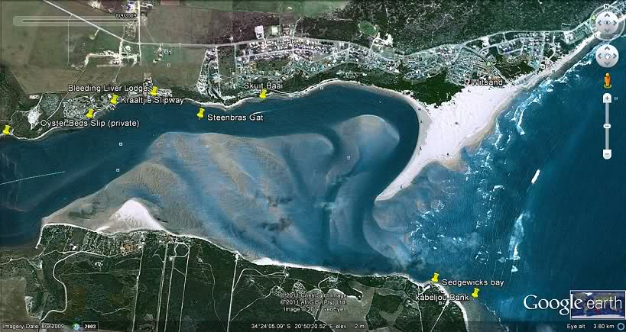
Nel v Hessequa Municipality

Slide 10
Nel et al approached the High Court to have the Hessequa and Swellendam Municipality’s By-law relating to the Management and use of Rivers declared unconstitutional and ultra vires national legislation; the grounds –
the by-laws conflicts with the National Water Act, Marine Living Resources Act and Criminal Procedure Act
the by-laws accorded draconian powers on authorised officers
the municipalities lacked authority to legislate on the matter

Slide 11
The municipalities by agreement authorised the Lower Breede River Conservancy Trust to implement the by-law.
The by-law regulate various boating activities, e.g. licensing of boats and prohibited behaviour relating to the use of boats, policing of by-laws.
Nel argued that the regulation of rivers fell outside the competency of municipalities. The municipality rejected this view
The court agreed that ‘rivers’ are public amenities’, ‘public places’ and places of ‘recreation’ within the meaning of Schedule 5B of the Constitution
The regulation of rivers is aimed at achieving the s152 objects of local government, i.e. ‘promoting a safe and healthy environment’
Court acknowledged the municipalities competence to legislate on the matter and rejected Nel’s contentions

Slide 12
Court also rejected the claim that the by-laws were draconian and an invasion of the right to privacy. Emphasised “The powers of such (authorised officers) are part of an effective regime of regulation of boats on the rivers, and as such the expectations of privacy of boat users, fall to be attenuated by their obligation to comply with reasonable regulations”
Court also made a very important observation, namely that a by-law has the same status as laws made by other legislatures
Court rejected Nel’s claim that the by-laws conflicted with national legislation
Application dismissed with costs

Slide 13
If such an interpretation is attached to rivers – what about beaches?
Possessions and use of diving equipment on public amenities?
S16 of NMB by-law: No person may -
dive, using scuba equipment, or be in possession of diving or scuba equipment.
The Municipality may permit a person to dive, using scuba equipment, in a designated area, and no person may dive, using scuba equipment, in any area not so designated

Slide 14
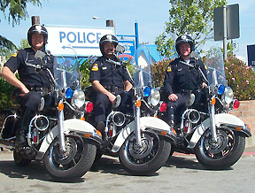
WHO CAN ENFORCE BY-LAWS?
Municipal employees appointed as peace officers
Municipal/metro police
Traffic officers
Members of SAPS

Slide 15
What happens if we don’t enforce?

Slide 16
Perhaps a bigger focus on …

Slide 17
Prevention triangle
Risk – increase chance of being caught & reduce risk
Opportunity – increase opportunity to fit into society
Desire – reduce desire to commit crimes

Slide 18
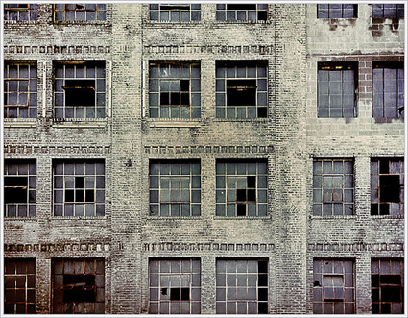
SAPS – Use by-law enforcement as crime prevention statistics

Slide 19
THANK YOU!

