Slide 1
Strengthening cooperation & capacity to stop illegal fishing & to build sustainable blue growth in the SADC region
Dr Motseki Hlatshwayo, Technical Advisor- Fisheries
SADC Secretariat in partnership with Benguela Current Convention (BCC), Indian Ocean Commission (IOC) E€OFISH Programme, South West Indian Ocean Fisheries Commission (SWIOFC), World Wide Fund for Nature (WWF), Stop Illegal Fishing (SIF), Government of Mozambique (MIMAIP) & SADC Regional Technical Team on MCSCC
2nd FishFORCE Academy Dialogue: Tightening the rope 2.0, 9-10 March 2020, NMU, Port Elizabeth, South Africa

Slide 2
Outline
Background on SADC
Policy framework for sustainable fisheries management & development
Status of fisheries resources in SADC region
Challenges facing fisheries sector in SADC region
Costs & impacts of IUU fishing in the SADC region
Combatting IUU fishing
Regional cooperation in strengthening MCS to combat IUU fishing
SADC Regional MCS Coordination Centre
Bilateral & Regional interventions in MCS
A need for better alignment & anchorage to improve regional cooperation
Conclusions

Slide 3
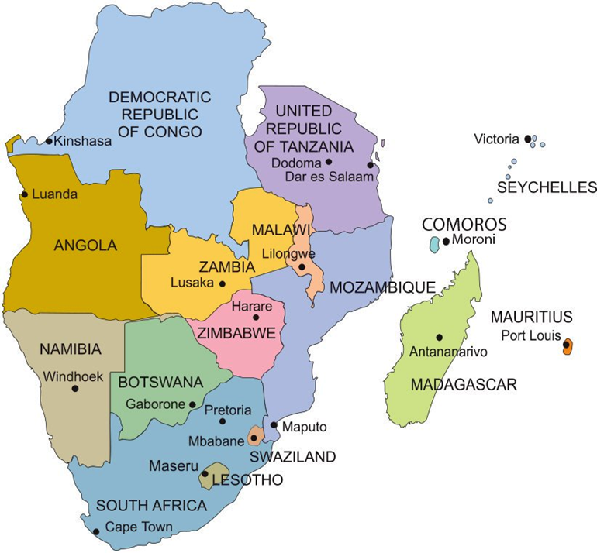
Background
1 April 1980:
Southern African Development Coordinating Conference (SADCC)
17 August 1992:
Southern African Development Community (SADC)
Vision: Common future
Notes:
Vision: Common future, a future in a Regional Community that will ensure economic wellbeing, improvement of the standards of living & quality of life, freedom & social justice & peace & security for the peoples of Southern Africa guided by the SADC Treaty (1992, amended 2001)

Slide 4
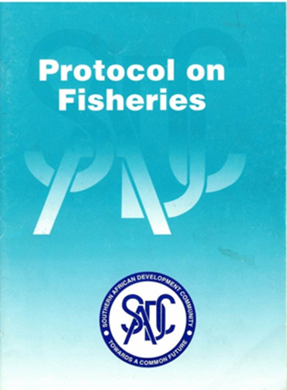
Policy framework for sustainable fisheries management & development
Regional Indicative Strategic Development Plan (RISDP) (2020-2030), SADC Industrialization Strategy & Roadmap to 2063, Regional Agriculture Policy (RAP)
Protocol on Fisheries (2001), aims to promote responsible & sustainable use of the living aquatic resources & aquatic ecosystems of interest to State Parties, in order to:
  promote & enhance food security & human health
  safeguard the livelihood of fishing communities
  generate economic opportunities from nationals in the region
  ensure that future generations benefit from these renewable resources
  alleviate poverty with the ultimate objective of its eradication
Notes:
The SADC Common Agenda is stipulated in Article 5 of the Treaty & is implemented through the Regional Indicative Strategic Development Plan (RISDP) & Strategic Indicative Plan for the Organ (SIPO)

Slide 5
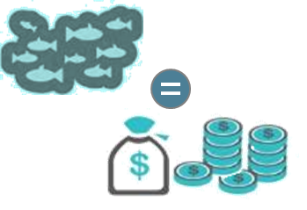


Status of fisheries resources in SADC region
121,130 tons
Total fish production from aquaculture
3,5%
Contribution of fisheries to regional GDP
2.4 million tons
Total fish caught
77,967
Total number of people employed in the regional aquaculture value-chain
2.3 million
Total people employed in the fisheries sector
~12 kg/annum
Per capita fish consumption in the SADC region

Slide 6
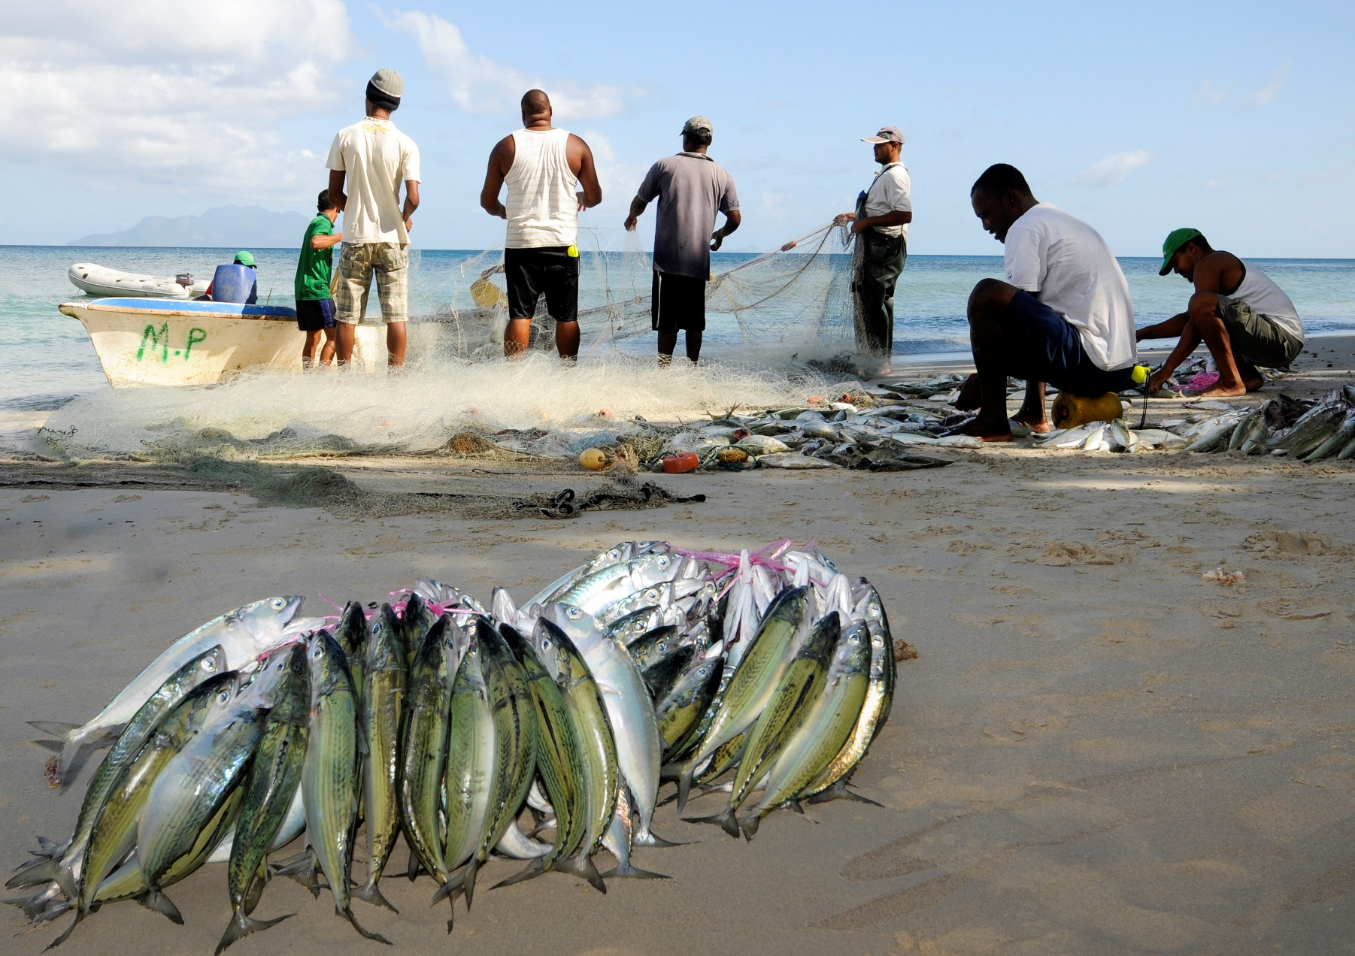
Challenges facing fisheries sector in SADC region
(© Stop Illegal Fishing)

Slide 7
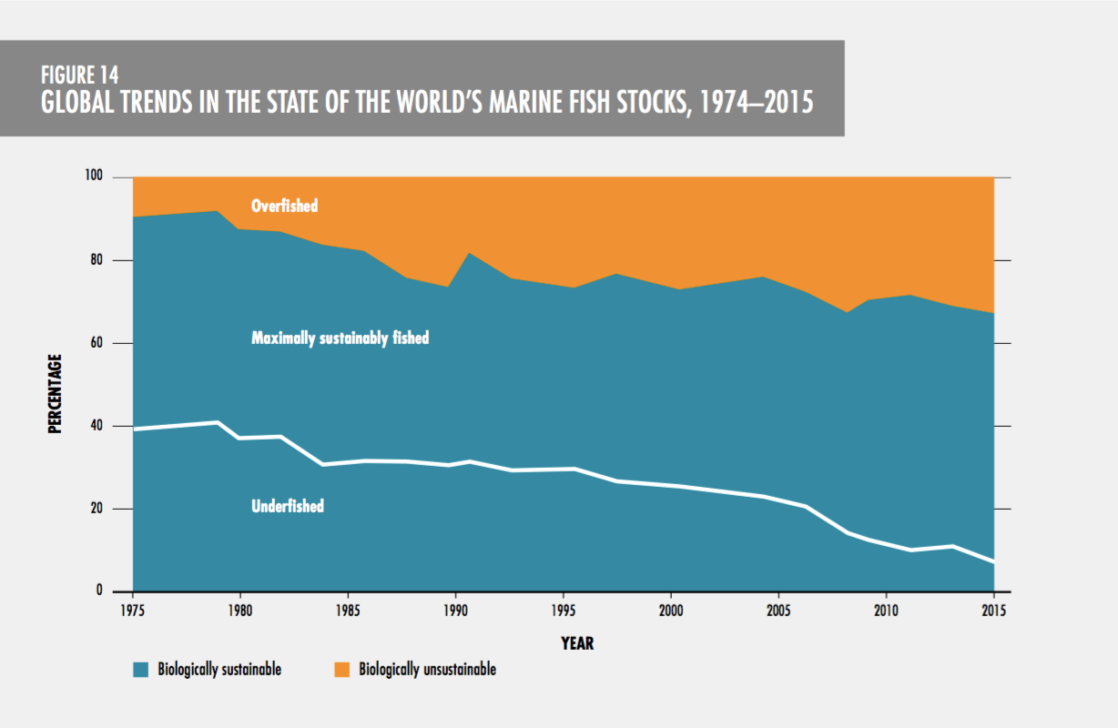
Overfishing - Globally 33.1% (over-exploited), 59.9% (fully fished) & only 7% (under-fished) (FAO, 2018)

Slide 8
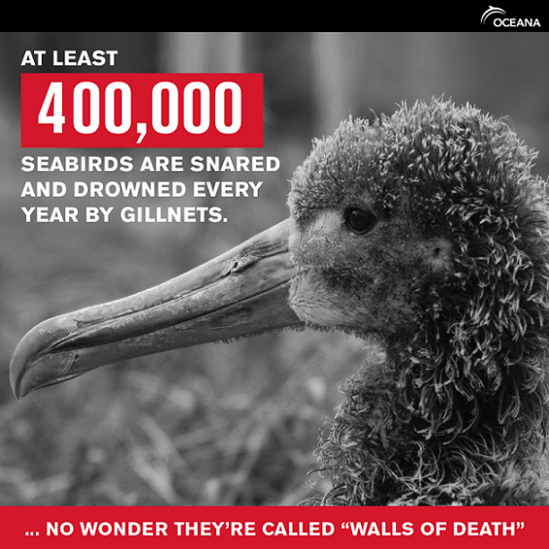
Negative ecosystem impacts - can result from fishing with destructive fishing gear (explosives, poisons, heavy bottom trawls & small meshed nets), by-catch & discards

Slide 9
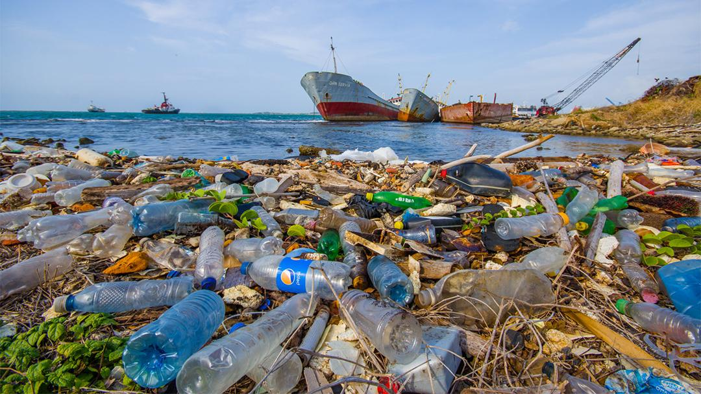
Climate Change & degradation of critical coastal habitats (mangrove, sea-grass beds & estuaries) - from natural & anthropogenic factors, affecting reproduction & nursery grounds, & consequently the recruitment of relevant fish stocks
(© Shutterstock)

Slide 10
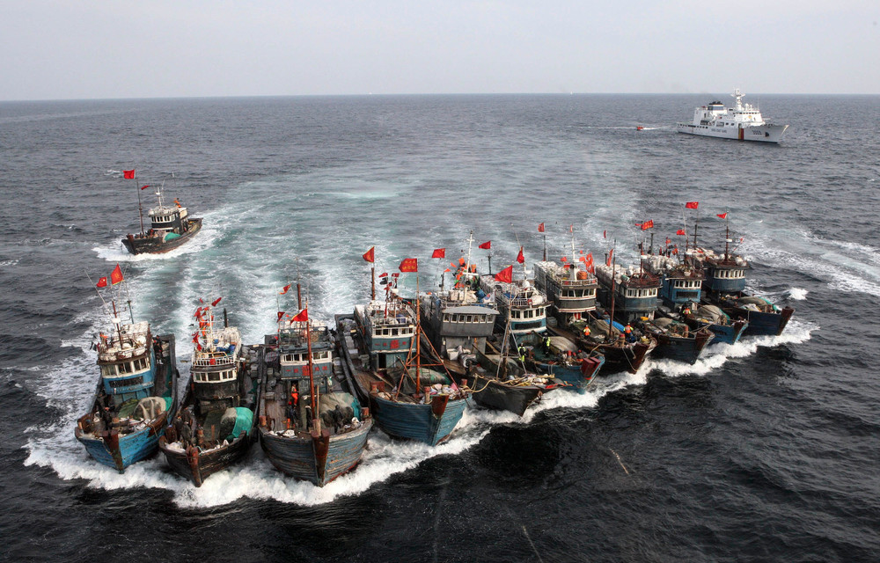
IUU fishing - a main contributor to overfishing & aquatic & marine ecosystem damage
(© Mail & Guardian)

Slide 11
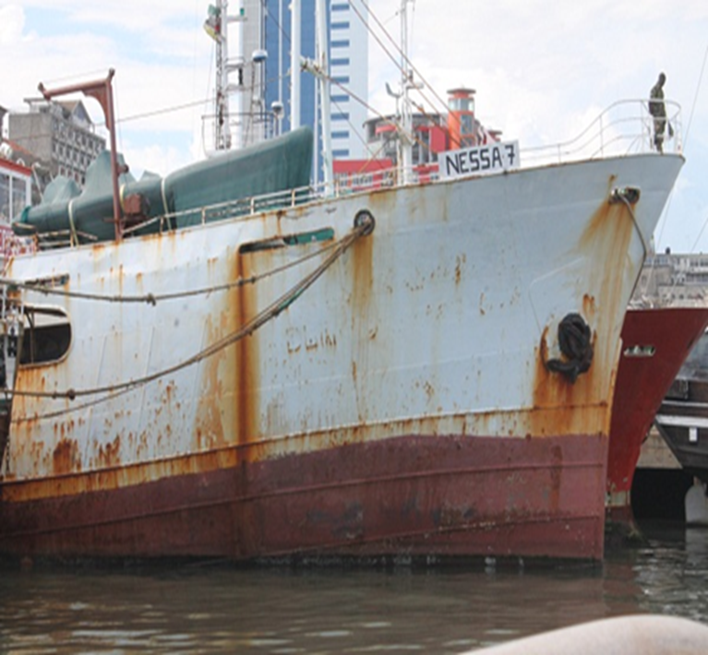
Costs & impacts of IUU fishing in the SADC region
IUU fishing cost up to US$1.5 to 2 billion/year (Sub-Saharan Africa), & US$500 to 800 million/year (SADC region)
Threatens the health of fish stocks, distorts markets, undermines governance, & undermines the wellbeing & livelihoods of coastal communities
In SADC region, it is seen as a low risk, high reward activity by perpetrators, partially due to the low levels of MCS & enforcement
(© Stop Illegal Fishing)

Slide 12
Combatting IUU fishing
Challenges with IUU fishing have to be addressed not only nationally, but equally through strengthened regional collaboration & partnerships with relevant stakeholders
There have been important global achievements in the fight against IUU fishing since adoption of the IPOA-IUU in 2001:
  Development & adoption of international guidelines to promote the use of catch documentation schemes (CDSS) for better traceability of fish and fish products in the value chain
  Global Record of fishing vessels, refrigerated transport vessels (Global Record)
  Adoption of the FAO agreement on port state measures to prevent, deter & eliminate IUU fishing (PSMA)
PSMA, CDS guidelines & Global Record represent a synergistic framework for combating IUU fishing

Slide 13
Regional cooperation in strengthening MCS to combat IUU fishing
To secure long-term productivity & sustainability of fish stocks in the SADC & adjacent regions, such as tuna, swordfish, hake or Nile perch, as well as improve conservation of biodiversity & ecosystems, a regionally coordinated MCS effort is essential to develop compliant fishing operations
Efforts to stop illegal fishing in the SADC region have been historically driven by national MCS activities that are often hindered by a lack of human, institutional, monetary & infrastructure capacity, & a lack of systematic cooperation between agencies
However, since the turn of the century, efforts have been ongoing to change this situation & to create a more coherent & cooperative approach to tackling IUU fishing in the region
In order to strengthen their MCS systems & to support regional coordination, through the development of a regional MCS strategy & the set-up of a MCS Coordination Centre, SADC Ministers responsible for Fisheries signed the Statement of commitment to combat IUU fishing in 2008

Slide 14
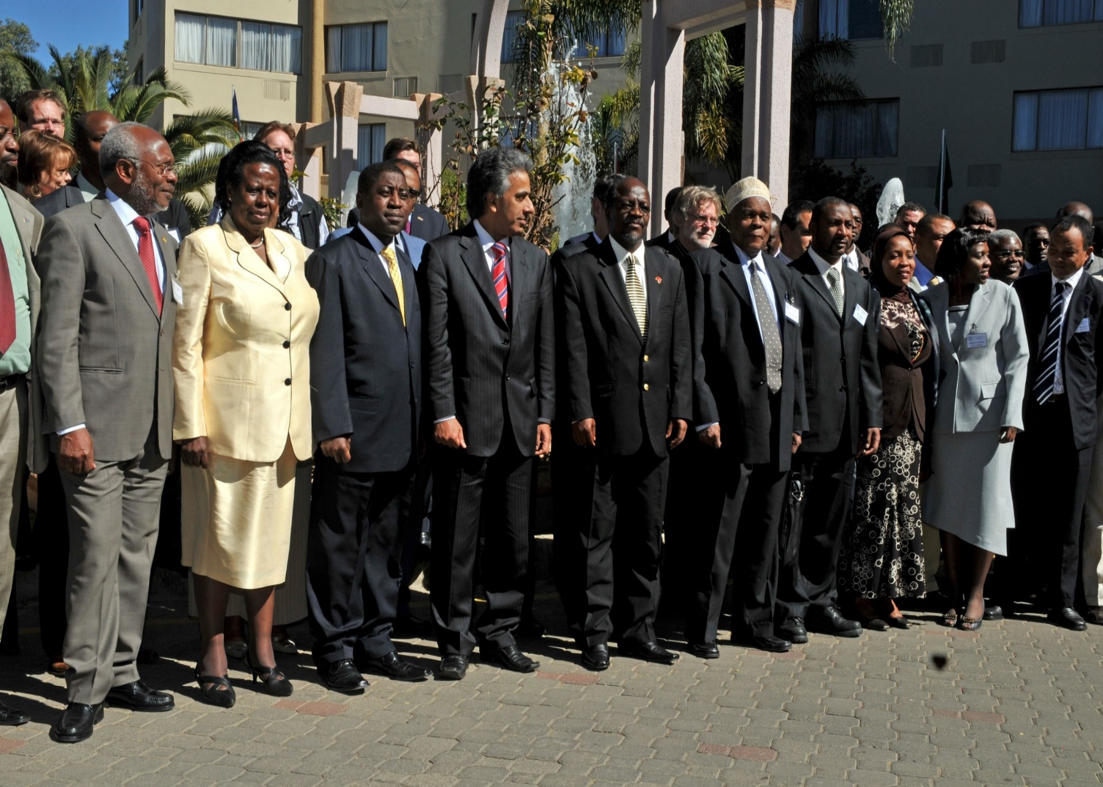
SADC Statement of Commitment to combat IUU fishing, July 2008, Windhoek, Namibia

Slide 15
SADC Regional MCS Coordination Centre
Regional MCSCC will provide services to the SADC States & cooperating partners, & these are likely to include:
  A regional fishing vessel register & a monitoring system
  A regional fisheries MCS information portal, including fisheries MCS data & information sharing services
  Regional fisheries surveillance & observer coordination services
  Fisheries law enforcement & legal support services
  Port State measures implementation support services
  National MCS capacity support services

Slide 16
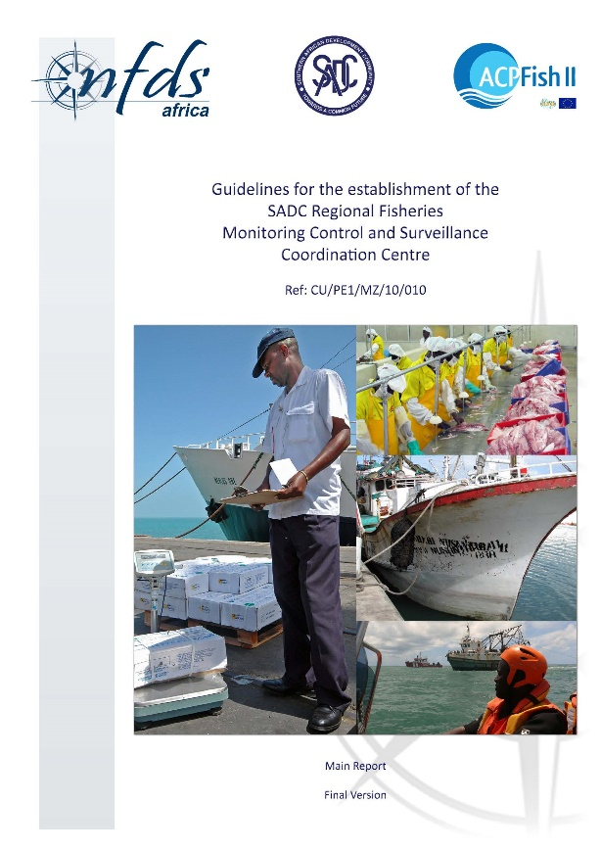
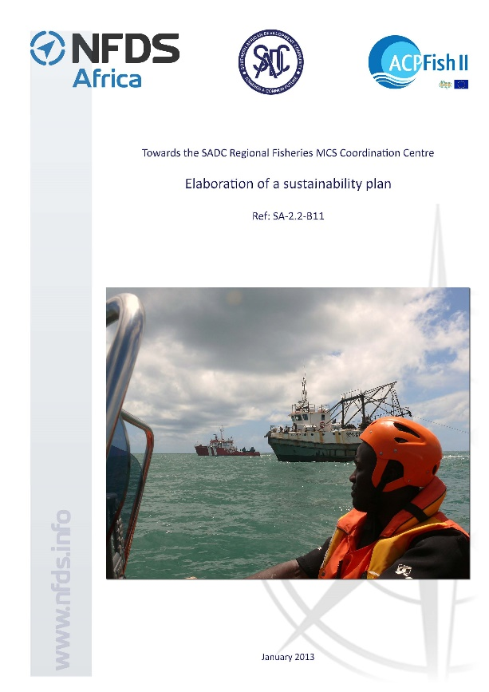
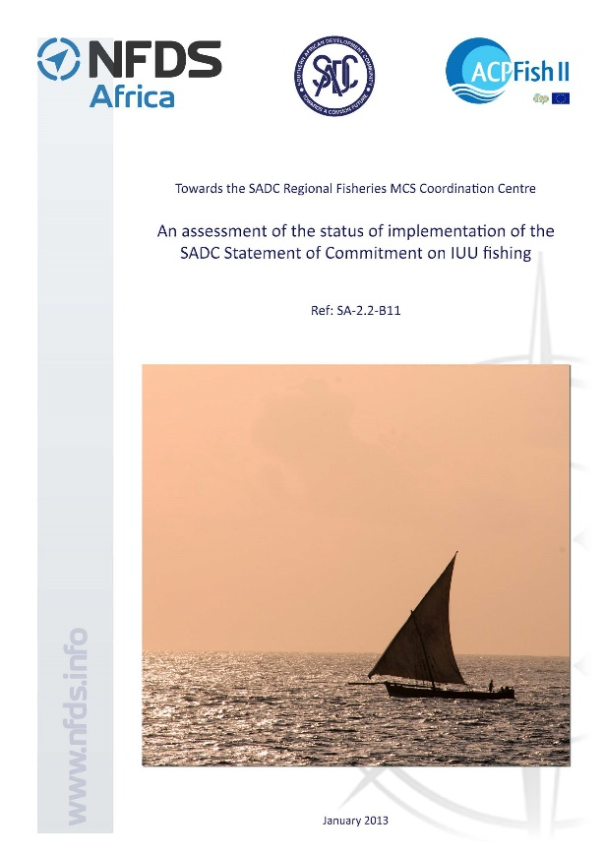
SADC Regional MCS Coordination Centre (cont’d)
Between 2009 & 2013, with support from EU funded ACPFish11 Programme, SADC in partnership with NFDS Africa & SIF, developed frameworks to set up the regional cooperation mechanisms.

Slide 17
SADC Regional MCS Coordination Centre (cont’d)
Between 2015 & 2017, WWF supported SADC processes to negotiate & validate a Charter for setting up the regional MCS Coordination Centre, as well as revision & alignment of Project frameworks.

Slide 18
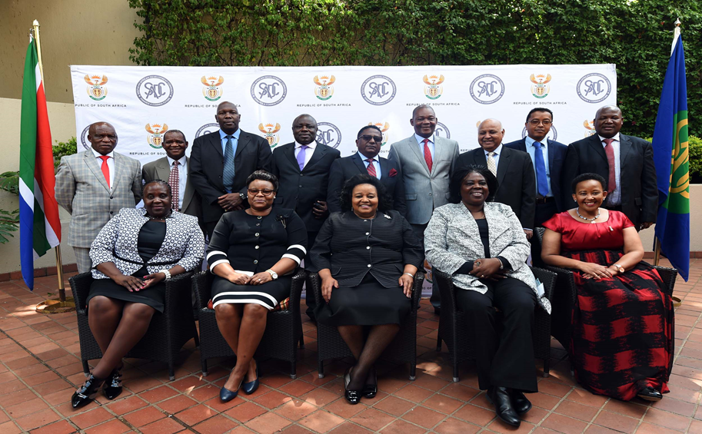
SADC Regional MCS Coordination Centre (cont’d)
In August 2017, the SADC Council of Ministers approved a SADC Charter establishing Regional MCS Centre, & so far 8 countries signed the Charter (Angola, Eswatini, Lesotho, Mozambique, Namibia, South Africa, United Republic of Tanzania & Zambia)

Slide 19
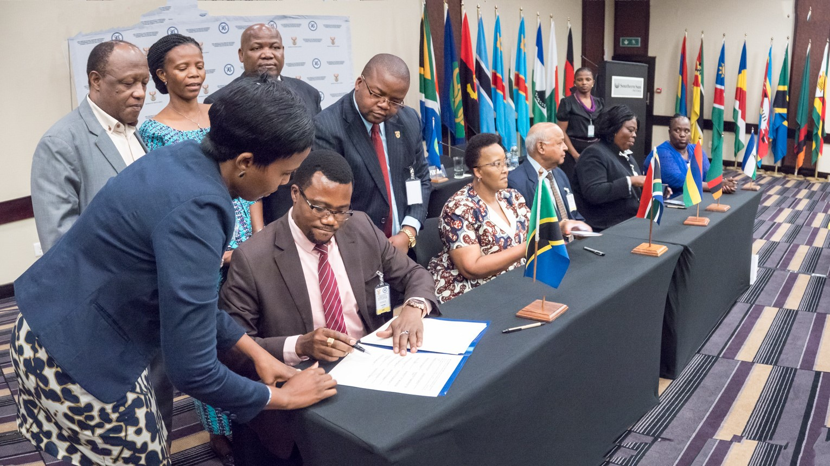
SADC Regional MCS Coordination Centre (cont’d)
Aims are to:
  improve MCS capacity of Member States to combat IUU fishing in the region
Objectives:
  Promote regional cooperation in fisheries governance, especially MCS
  Strengthening of regional VMS, fisheries observer & other programmes for effective MCS systems including information sharing
  Coordinate MCS capacity building at national levels
  Coordinate capacity building towards ratification & implementation of international instruments (e.g. PSMA etc.)

Slide 20
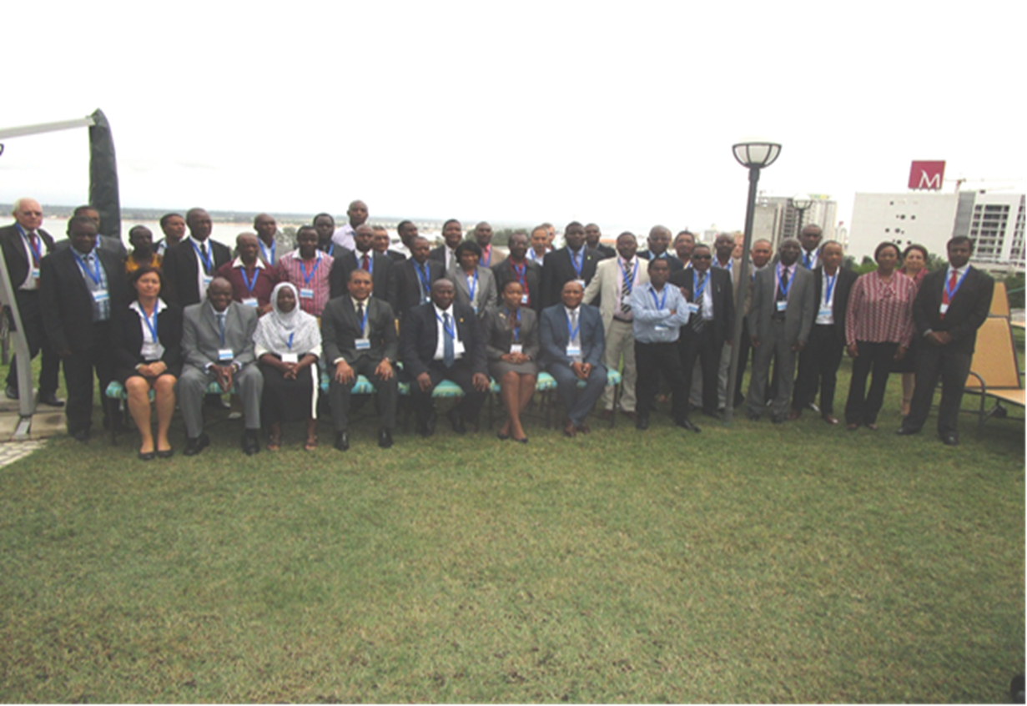
Bilateral & Regional interventions in MCS

Slide 21
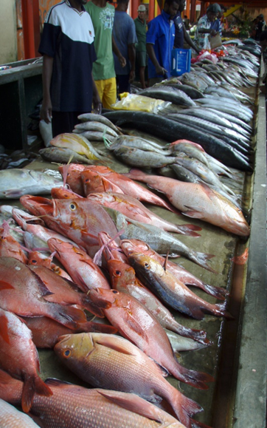
Bilateral Agreements
Existing agreements to strengthen collaboration & cooperation in fisheries governance, trade & economic development:
  South Africa/Namibia
  South Africa/Mozambique
  Mozambique/Namibia
  Mozambique/Malawi
  Namibia/Angola
  Zambia/Zimbabwe
There is a need to strengthen implementation of these agreements as most are not fully implemented

Slide 22
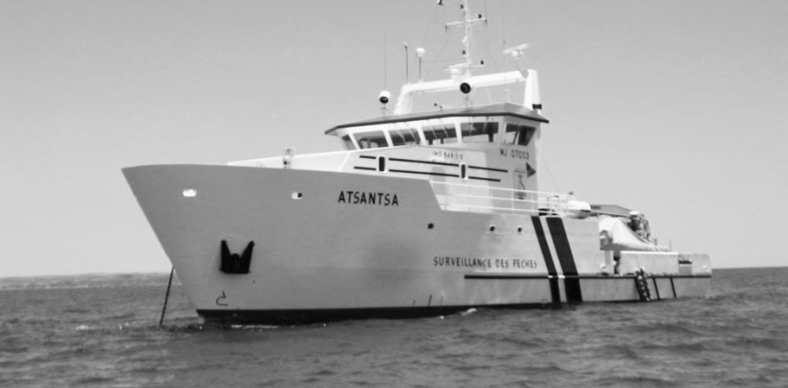

IOC PRSP (SWIO Islands, Kenya, Mozambique & URT)
PRSP pools the surveillance officers, patrol vessels and airplanes of the IOC Member countries for regional joint deployment plans
PRSP has also set up a regional VMS data exchange platform, servicing the national Fisheries Monitoring Centres

Slide 23
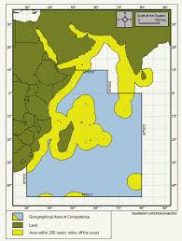


IOC-SWIOFish1 Project (SWIO Islands, Maldives, Mozambique, Kenya, Somalia, South Africa & URT)
SWIOFish project has an objective to improve the management effectiveness of selected priority fisheries at regional, national & community levels.

Slide 24
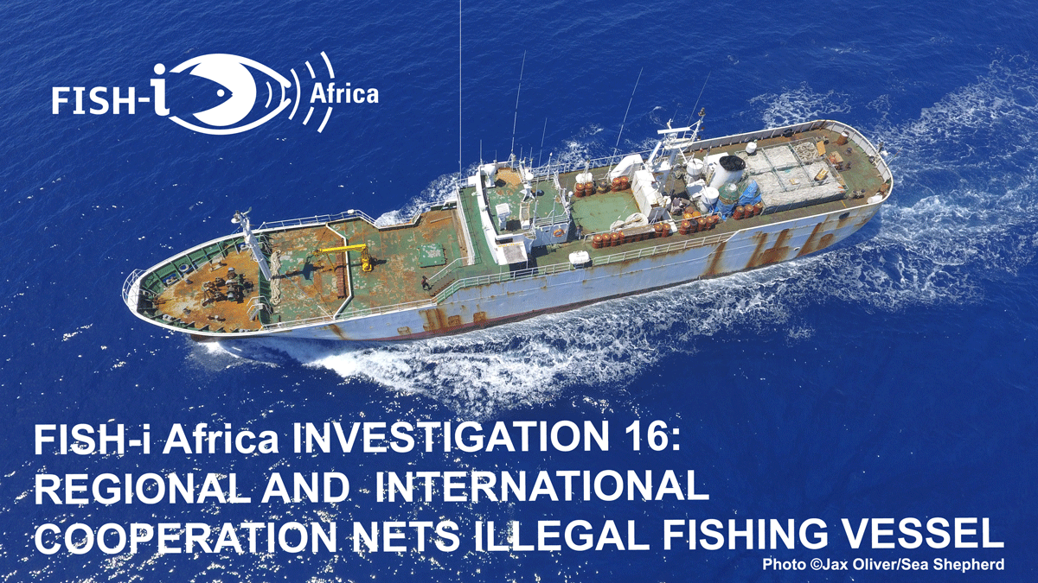
FISH-i Africa Project (Comoros, Kenya, Madagascar, Mauritius, Mozambique, Seychelles, Somalia & URT)
Partnership between the 8 coastal States, SIF coordinates FISH-i Africa & NFDS provides technical advice & input. The purpose of the project is to enable targeted enforcement actions against illegal fishing operators through the use of shared intelligence & information & coordinated analysis. Recently incorporated under SADC MCS Centre initiative

Slide 25
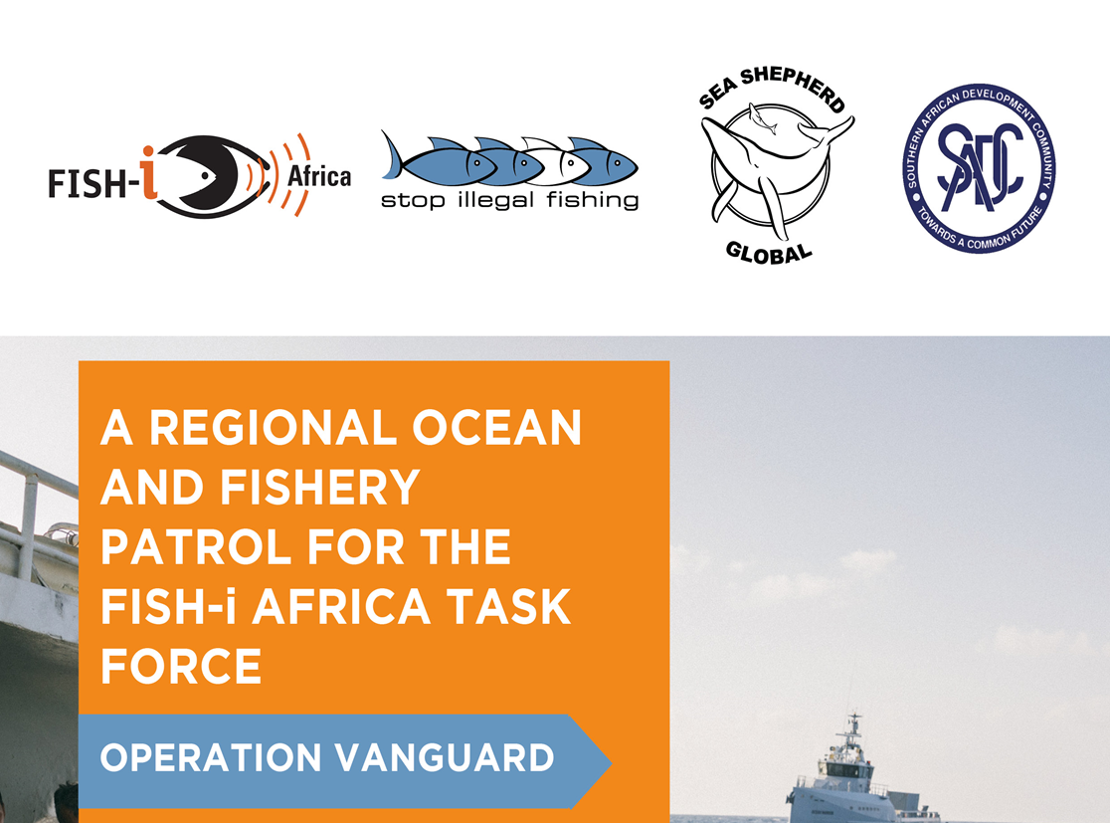
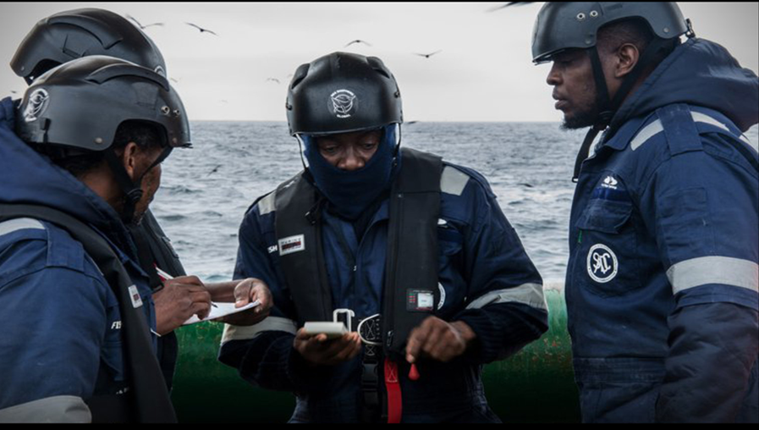
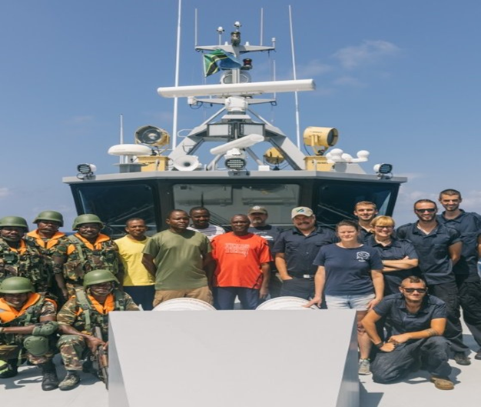
SIF-SADC-Sea Shepherd Operation Vanguard (URT, Namibia)
OV (Tanzania, Namibia)- based on successful Tanzanian Operation Jodari & Regional operation of 2009 (Sarah Baartman)

Slide 26

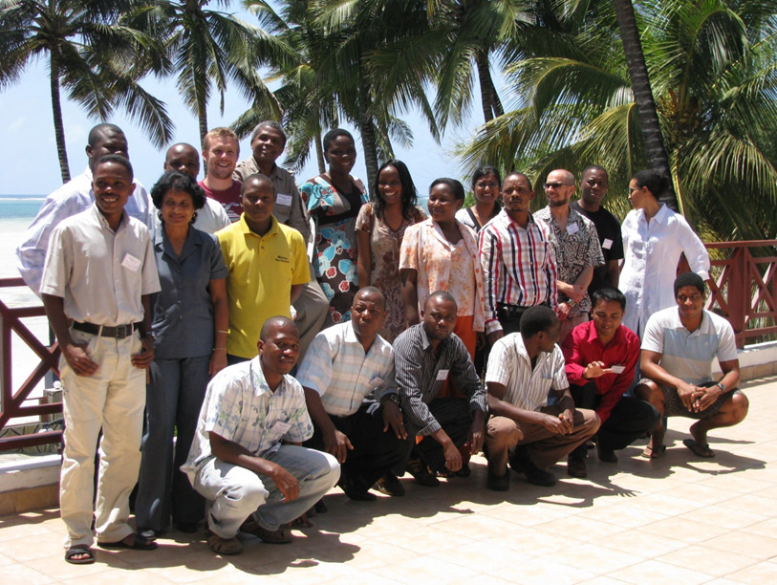
WWF SWIO Initiatives
Working with individual countries (SWIO Islands, Kenya, Mozambique & URT)
Partnering with regional organizations (SADC, IOC, IOTC, SWIOFC, SIF)
Supporting regional actions (MCS, fisheries governance & management, CSO engagement, livelihoods, SSF in coastal communities)
Supporting setting up of the MCSCC & combating IUU fishing in SADC & SWIO
Supporting ratification & implementation of regional & international fisheries instruments (PSMA, Charter for MCSCC, MTCs, IOTC Resolutions)
Supporting capacity building efforts (transparency, CDS, MCS tools)
Promoting sustainable blue growth & policy advocacy

Slide 27
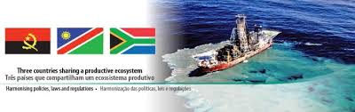
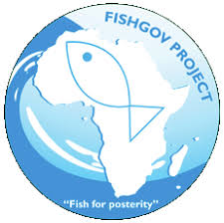
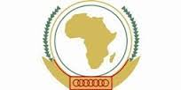




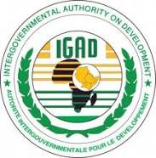
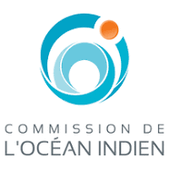
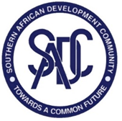
BCC- ECOFISH Project (Angola, Namibia & RSA)
FISHGOV (Continental)
FishFORCE (RSA, URT, Kenya, Mozambique, Namibia, Madagascar, IOTC, SADC) - training of officials who are involved in the fight against fisheries crime
IOC- ECOFISH Programme (COMESA, EAC, IGAD, IOC & SADC)

Slide 28


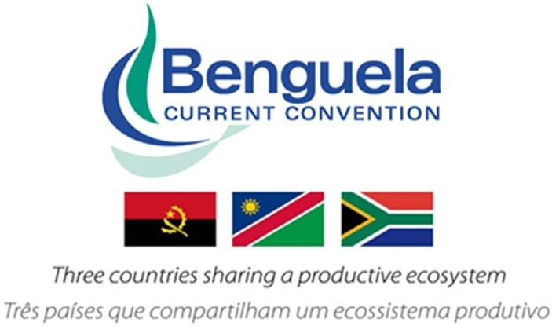

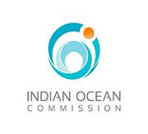
A need for better alignment & anchorage to improve regional cooperation

Slide 29
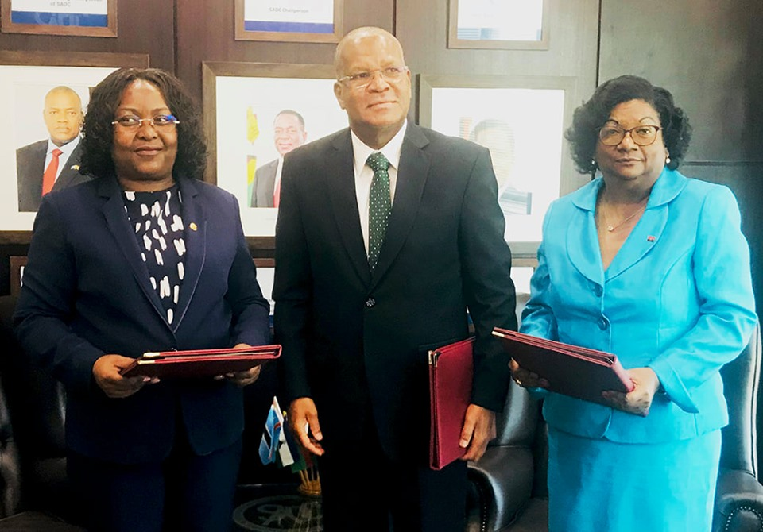
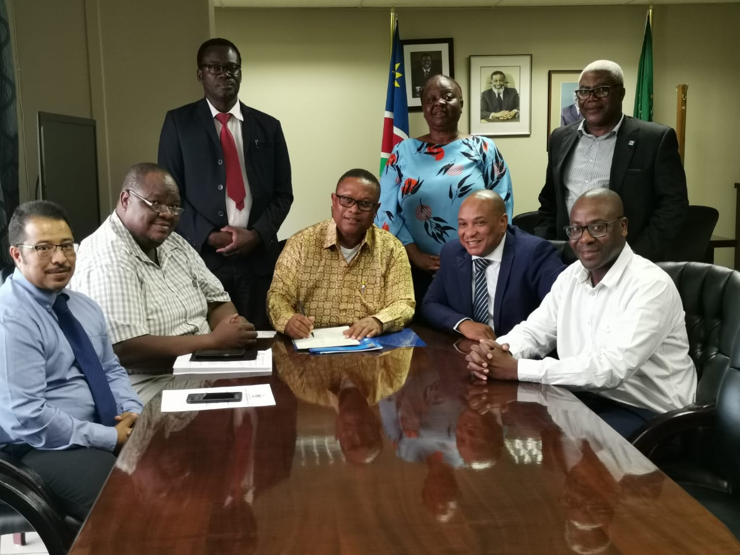
SADC Member States continue to show commitment towards this project
SADC MCSCC & IOC-E€OFISH Programme provides both long-term & short to medium-term opportunity to strengthen cooperation amongst all actors (national & regional, & cross-regional), respectively.

Slide 30
A need for better alignment & anchorage to improve regional cooperation (cont’d)
The MCSCC is more relevant now & necessary than ever before to coordinate:
Cooperation between national agencies & between neighboring countries to ensure:
  Monitoring of vessel movements
  Assessing risk associated with vessels, owners and operators
  Gathering & analysis of information & intelligence
  Providing background reports
  Recording fishing vessel information in a regional vessel registry or record
  Coordinating the sharing of assets, including patrol vessels, planes & observers
  Facilitating the sharing & cross checking of fisheries information, between members & partners
  Coordinating & collaborating with other regional entities & partners

Slide 31
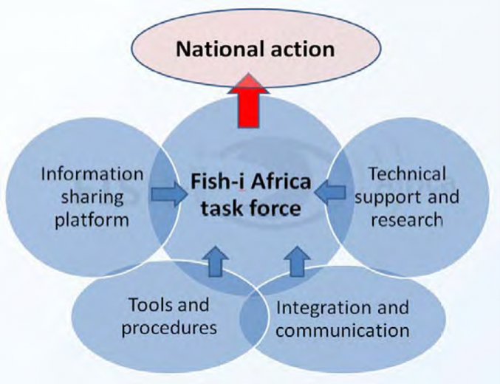
A need for better alignment & anchorage to improve regional cooperation (cont’d)
Capacity is essential to both national & regional activities to enhance MCS & is key to stopping illegal fishing
The Regional MCSCC is geared to provide support nationally & opportunities regionally to strengthen capacity SADC & partners for MCS, this include:
  Sharing lessons & tools in MCS, between countries & also between fisheries, especially between coastal fisheries & inland fisheries
  Training to develop expertise, both through training workshops & field work & on-the-job training
  Providing technical capacity & support

Slide 32
Conclusions
Lessons learned from the implementation of regional initiatives to combat IUU fishing:
  Relying on donor funding limits regional capacities in the medium to long-term
  Donor funding is important in setting up frameworks & institutional arrangements, but implementation should be supported through commitments & resources deployed from countries
  Regional initiatives should focus on strengthening national capacities & providing platforms for cooperation & collaboration amongst countries
  Regional initiatives should exist to share best practices & disseminate information amongst countries (e.g. Operation Phakisa in South Africa- inter-agency cooperation, Operation Vanguard in Tanzania & Namibia- inter-country cooperation, etc.)
  Need for countries to prioritize fisheries governance, improve legislation (e.g. making fines deterrent, aligning & harmonizing legislation)
Based on cases studied under FISH-i Africa project (vessel identity fraud, document forgery, corruption, modern day slavery & human trafficking, drug smuggling, illegal by-catch etc.)- demonstrates that focus should go beyond IUU fishing to include fisheries crimes
Working together to stop illegal fishing – promoting regional Centres of Excellence aligned to MCSCC – compliance monitoring & scientific data collection & capacity building (e.g. FishFORCE etc.)
Strengthening collaboration with RFBs & RFMOs & other ROs for better alignment & coordination

Slide 33
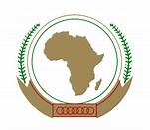
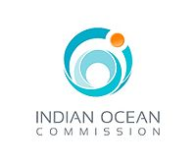



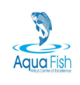

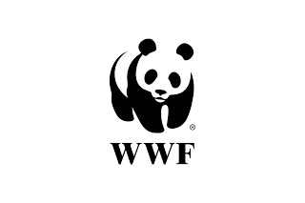

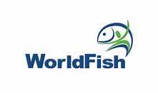




Partners involved in the Implementation of the SADC Fisheries Programme

Slide 34
Resources – Case studies
PRSP - https://youtu.be/Fh5tIg9ylbc
FISH-i Africa - https://youtu.be/HtQ4sfkgwm4
Operation Jodari - https://youtu.be/r0XhpVnocyM
SWIOFish Project1 - https://youtu.be/C6VDg8x318Q

Slide 35
Asante
Merci
Obrigado
Thank You

