Slide 1
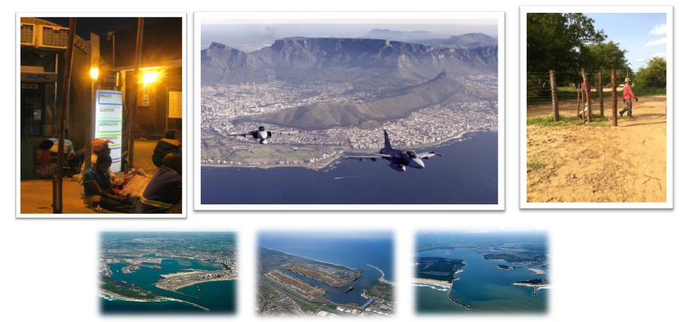
UPDATE: ESTABLISHMENT OF A BORDER MANAGEMENT AUTHORITY IN SOUTH AFRICA
NOVEMBER 2017

Slide 2
PURPOSE
Provide an overview of border management in South Africa
Indicate progress made in establishing a Border Management Authority (BMA)

Slide 3
GLOBAL AND AFRICAN CONTEXT OF BORDER MANAGEMENT

Slide 4
HUMANITARIAN & SECURE BORDER MANAGEMENT IS A GLOBAL CHALLENGE
“Across the globe, insecure borders enable the trafficking of drugs, weapons, contraband, terrorist funding, materials related to weapons of mass destruction, conflict minerals, wildlife and people.” Ban Ki Moon, 2012

Slide 5
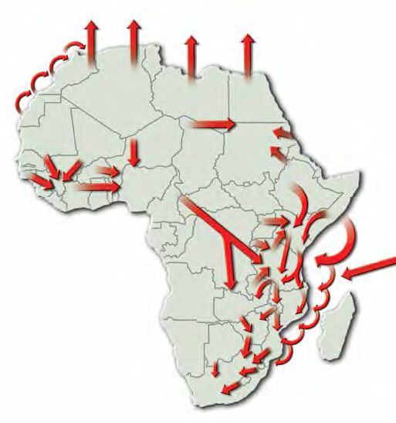
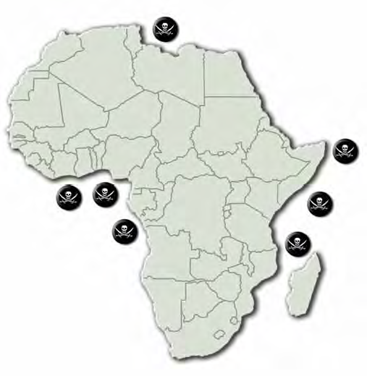
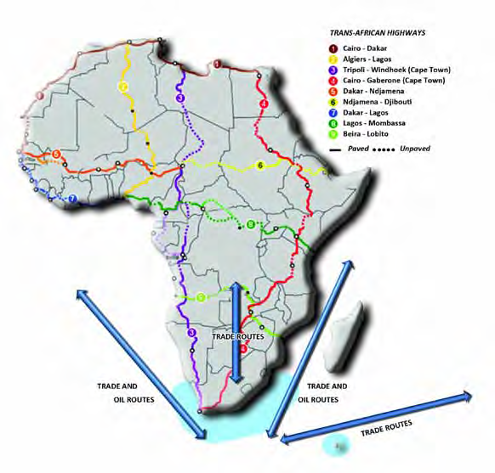
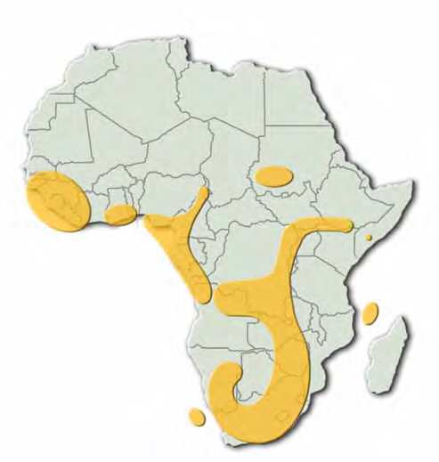
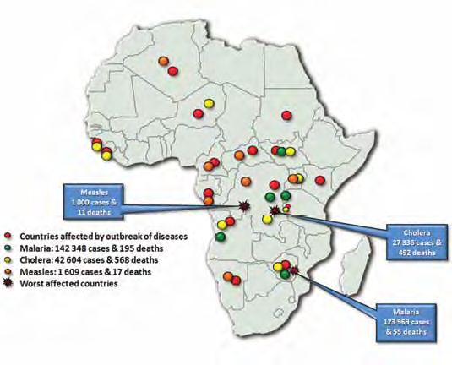
ISSUES THAT AFFECT BORDER MANAGEMENT WITHIN AFRICA
In Africa, about half of the increase in the migrant stock during 2010-2013 was the result of the movement of migrants from Northern Africa to Eastern Africa
Some Border Management Drivers

Slide 6
BORDER MANAGEMENT IN SOUTH AFRICA: OVERVIEW AND CHALLENGES

Slide 7
HISTORY AND FAILURE OF FRAGMENTED BORDER MANAGEMENT
Since 1994 SA made gallant strides in demilitarising and deracialising the management of the country’s borders by introducing various capabilities to give effect to border management.
The consequence of establishing these various organs of state, e.g. immigration control, customs control, border policing etc., resulted in the emergence of a silo approach to border control, border law enforcement and border protection.
Various structures were subsequently put in place to attempt to coordinate the mandates and actions of these distinct organs of state in the border environment:
Border Affairs Committee Coordinating Committee (1996)
National Inter-Departmental Structure (NIDS) (1997)
Border Control Operational Coordinating Committee (BCOCC) (2001)
Inter-Agency Clearing Forum (IACF) (2010)
From at least the mid-2000 various studies and reports have pointed to the failure of these structures to address the systemic and structural problems of coordination model associated with fragmented border management.
It is against this background that Cabinet decided on the 26th of June 2013 to establish a Border Management Authority (BMA) in South Africa under an integrated approach.

Slide 8
TRAJECTORY OF BORDER MANAGEMENT IN SOUTH AFRICA
Pre-1994:
Exclusionary & race-based border control
Militaristic
Sanctions busting
Restrictive land Port of Entry designs
1994-2016:
Conventional border control
Silo-based border management
Progressive immigration system
Trade facilitation
2017 and Beyond:
Balancing security, development & human rights
Single Integrated Border Entity
Demilitarisation
Equitable global trade
Greater African & regional integration
Apartheid Border Management
Coordinated Border Management
Integrated Border Management

Slide 9
WHAT IS BORDER MANAGEMENT?
Immigration Control
Immigration service
Specialised law enforcement / intelligence agencies
Customs Control
Custom control and VAT services
Customs law enforcement
Human Health Inspection
Public health & sanitary inspection service
Quarantine service
Inspection of Plants and Plant Products
Border Safeguarding & Surveillance
Inspection of Animals, Fish, Animal Products & Foodstuff
Armed forces (army, navy, air force)
Specialised law enforcement / intelligence agencies
Plant health & phytosanitary inspection service
Plant quarantine service
Veterinary , animal, fish & food inspection service
Quarantine service
Border Policing
Cross-border policing & law enforcement
INFRASTRUCTURE DEVELOPMENT AND MAINTENANCE

Slide 10
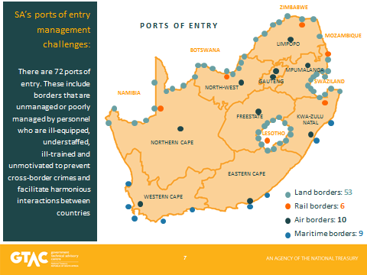
PORTS OF ENTRY IN SOUTH AFRICA

Slide 11
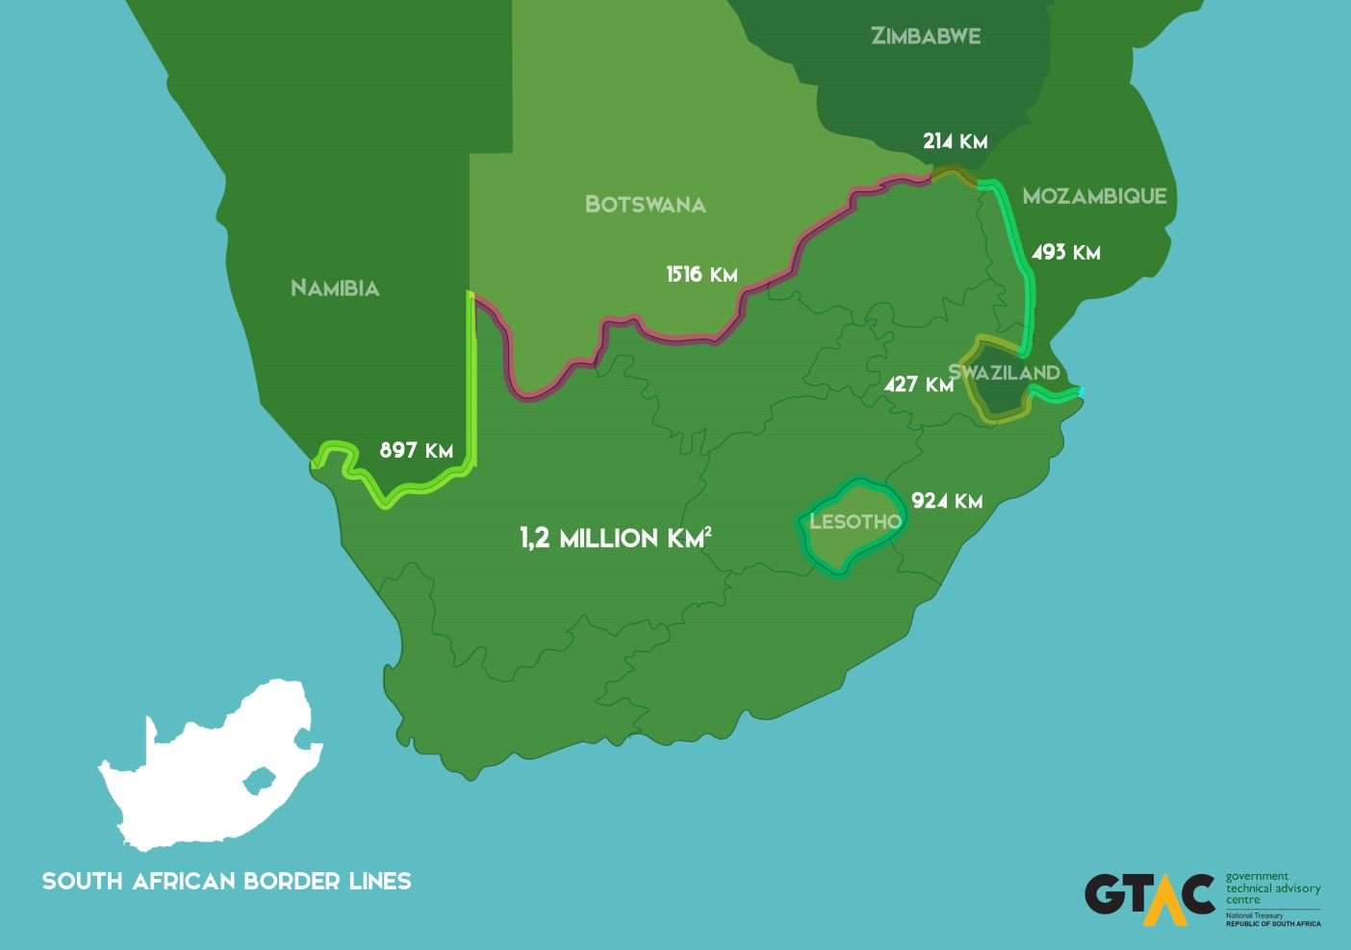
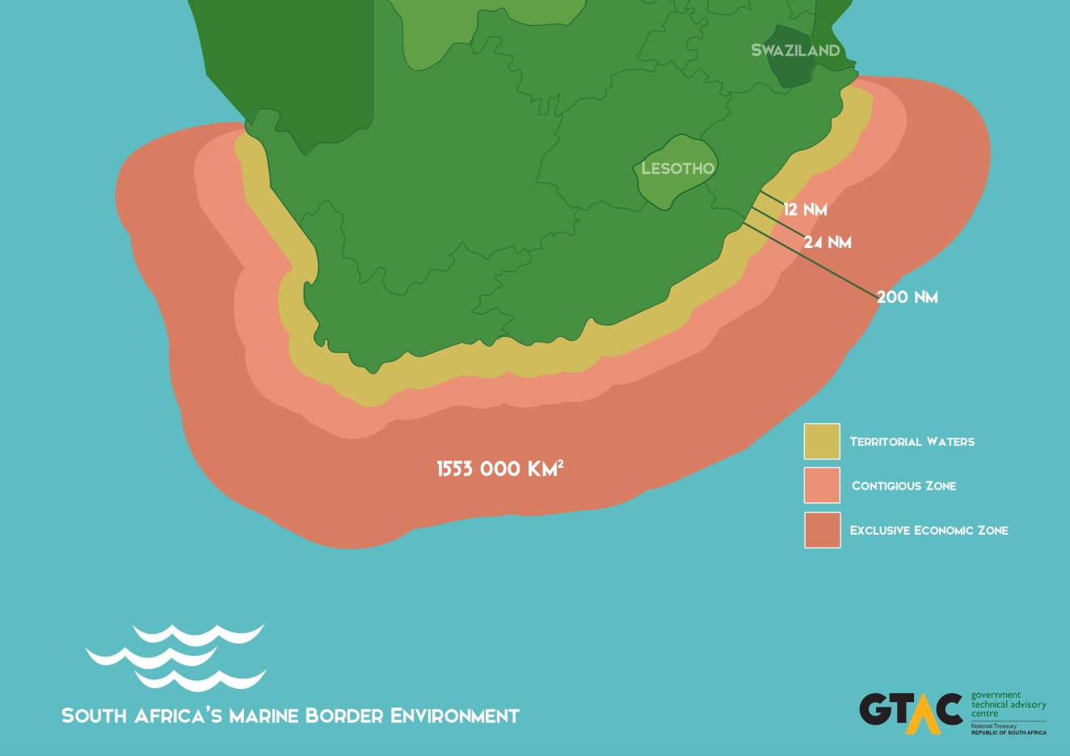
OVERVIEW OF SA BORDER ENVIRONMENT
About 22 government departments and State agencies active in the border environment
Above responsible for cross-border trends:
Processing of 36,6m people leaving or entering SA (2012)
Of above, 26m were foreign nationals
Processing of 4,3m containers crossing Ports of Entry (2012)
Managing over 5m export and import transactions annually

Slide 12
SOUTH AFRICAN PORT OF ENTRY CHALLENGES

Slide 13
SOME KEY CHALLENGES & RISKS FACING SOUTH AFRICA’S BORDER ENVIRONMENT
Limited surveillance capability & coverage over the country’s airspace; many small airstrips close to the borderline
Extensive maritime jurisdiction; Vessel Monitoring System (VMS) is transponder based; Large volumes of cargo pass through maritime Ports of Entry; illegal fishing; illicit movement of contraband and narcotics
Over 39m people move through 72 Ports of Entry annually; Extensive land (4471km) & coastal (3924km) borders; high number of Ports of Entry; 7 Transfrontier Conservation Parks; many informal border crossings; cross-border communities; inadequate border fences & patrol roads; strategic gaps in the borderline; wild-life poaching; illegal migration
Air
Sea
Land

Slide 14
KEY FEATURES OF FRAGMENTED BORDER MANAGEMENT APPROACH
About 8891 state officials from at least 5 organs of state (DHA, SARS, DAFF, SAPS, DoH) are working at the country’s 72 Ports of Entry,
With different conditions of service and remuneration;
Implementing distinct Departmental mandates in at least 58 pieces of legislation;
With competing priorities and deliverables;
Having dissimilar tools of trade and equipment;
With some systems that are not automated, e.g. DOH and DAFF;
Engaging in limited sharing of information; and
Lacking a single management, command and control structure.

Slide 15
KEY FEATURES OF FRAGMENTED BORDER MANAGEMENT APPROACH
The consequences of the above fragmentation are:
Non-aligned and often poor border control-related service delivery ;
Ineffective facilitation of the movement of persons and goods (unnecessary delays and cost to clients)
Compromised joint efforts and outcomes resulting from different risk management tools and approaches;
The ineffective utilisaton of public resources due to limited information sharing;
Inability to enforce a standard approach in dealing with border law enforcement transgressions;
A higher volume of Illegal goods entering the country;
Corruption and organised crime thriving in a fragmented management environment
An increase of undocumented foreign nationals within the country; and
Siloism with agencies focusing on their own mandates.

Slide 16
SOUTH AFRICAN GOVERNMENT’S RESPONSE TO BORDER MANAGEMENT CHALLENGES

Slide 17
KEY GOVERNMENT DECISIONS
3 June 2009
In the State of the Nation Address: President JG Zuma stated that government “will start the process of setting up a Border Management Agency” in South Africa
26 June 2013
Cabinet resolved:
To establish a BMA that would include the ceding of functions from relevant organs of state
Implementation steps
Department of Home Affairs (DHA) designated as the lead department for the BMA
10 December 2014
Cabinet endorsed:
BMA Vision
Key priorities for the Transitional Period (2015-2016)
BMA should be established by December 2016
23 September 2015
Cabinet endorsed:
That the BMA Bill, 2015 should be introduced into Parliament

Slide 18
BMA VISION
BMA will be outcomes focused: Balance facilitation of legitimate trade and travel functions, while simultaneously addressing security risks
BMA will be established as a single body
BMA will assume control of Ports of Entry and borderline functions
Establishment of a National Border Risk Management and Targeting Centre
BMA will continue current service delivery improvement initiatives
BMA will assume operational responsibility for Port of Entry infrastructure and maintenance:
BMA will establish its own organisational culture, identity and conditions of service

Slide 19
INTENDED BORDER MANAGEMENT OUTCOMES
More cost effective services
Enhance security and management of the border environment
Improvement in shared information between organs of state
Optimisation of Port of Entry operations and processes to enhance efficiencies through maximum compliance and minimum administrative costs and delays
Effective utilisation of financial, human, infrastructure and accommodation resources at a Port of Entry
Improved sterility and integrity of Port of Entry and borderline areas
Improvement in management, discipline and transparency with single command and control organizational environment
Creation of customer service efficiencies through streamlined, integrated operations at the Ports of Entry

Slide 20
KEY PRINCIPLES OF BMA LEGISLATION
BMA Vision
Integrated Border Management approach
Basket of key functions will be ceded to the BMA
BMA is an Implementation Agency
Policy mandates will remain with principal organs of state
BMA will assume full command and control over Ports of Entry and border law enforcement areas
Complementarity between Defence’s Constitutional function of ensuring the sovereignty and territorial integrity of the Republic and the BMA’s law enforcement functions

Slide 21
PROCESS OF CONSULTATION: BMA BILL
Public comments on BMA Bill, 2015: The BMA Bill, 2015 was published for public comments in August/September 2015. Approximately 289 issues and comments received from 34 organisations and persons were considered.
Cabinet and Departmental Consultations: Cabinet approved the introduction of the draft BMA Bill into Parliament on the 23rd of September 2015 (based on intergovernmental consultations, gazetting of the draft BMA Bill for public comment and socio-economic impact assessment).
PSCBC: Three (3) engagements took place at the Public Service Co-ordinating Bargaining Council (PSCBC).
NEDLAC: Seven (7) engagements took place at the National Economic Development and Labour Council (NEDLAC). Bilateral meetings were convened separately with Labour (4 meetings) and Business (4 meetings).
OCSLA Certification: Consultations and inputs from the Office of the State Law Advisor (OCSLA) on the draft BMA Bill, 2016 led to its certification on the 18th of May 2016.
The BMA Bill is currently being processed in Parliament. The National Assembly adopted the Bill on the 8th of June 2017.

Slide 22
PREPARATIONS FOR THE ESTABLISHMENT OF THE BMA

Slide 23
PREPARING FOR THE BMA (2017 – 2032)
The BMA PMO is currently working on the following documents in preparation of the establishment of the BMA:
BMA Blue Print
Outlines the ideal end state of the BMA
BMA Road Map:
Articulates the milestones and timeframes for the various phases of the BMA’s establishment until the realisation of the BMA’s ideal end state
BMA Change Management Strategy
Focuses on change management tasks and activities to ensure the smooth transition in the transfer of resources to the BMA.
Supports the BMA Road Map with regard to the operationalization of the BMA

Slide 24
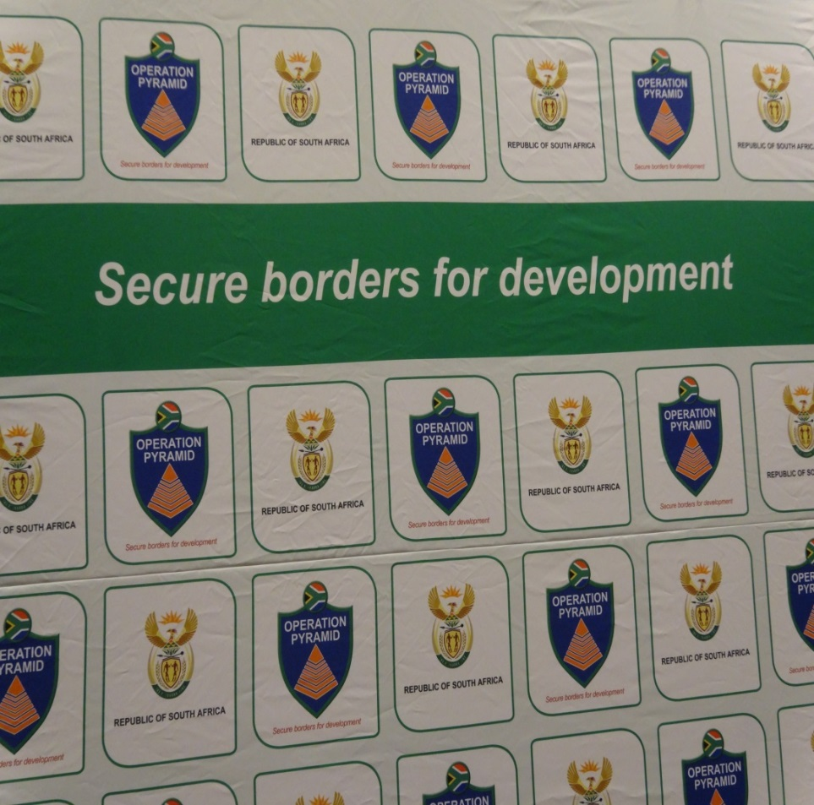
THANK YOU
Mr Elroy Africa (BMA: Project Manager)
Office: +27 12 432 6631
Email:
elroy.africa@dha.gov.za
bma.pmo@dha.gov.za

