Slide 1
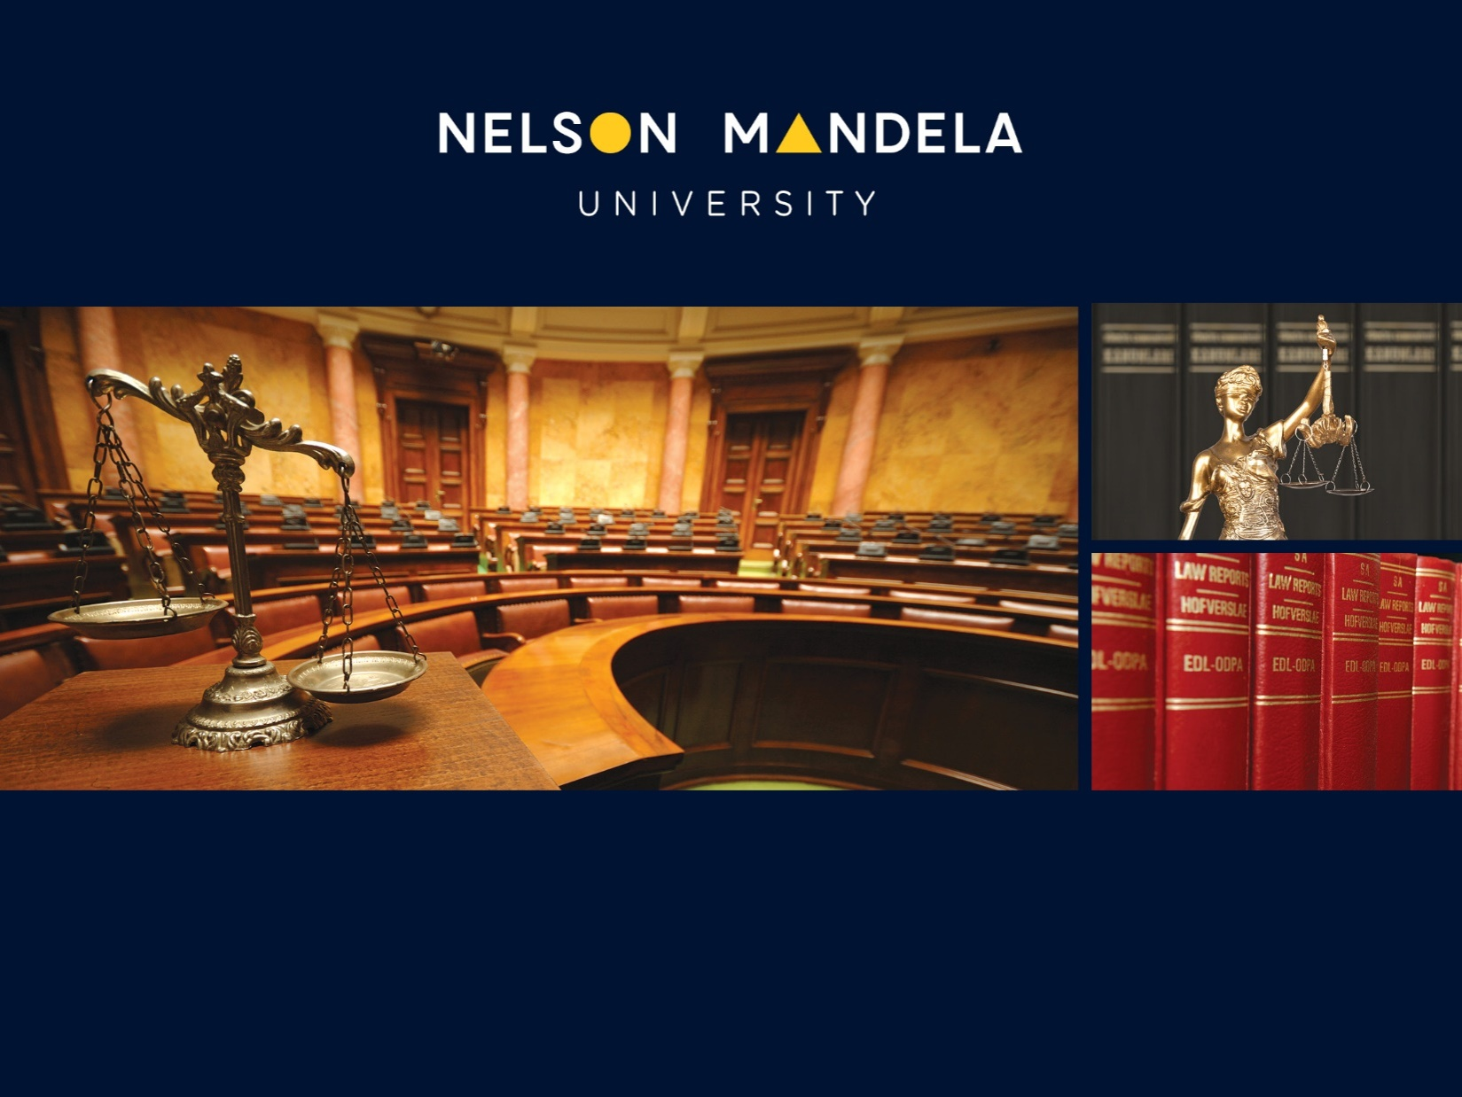
Faculty of Law
THE ROLE OF CIVIL SOCIETY IN THE FIGHT AGAINST CORRUPTION
PROF D ERASMUS

Slide 2
INTRODUCTION
Corruption hampers and ultimately destroys meaningful human development by diverting public resources earmarked for the provision of essential public services. It perpetuates inequality and inhibits economic development at national and local level. This leads to distorted markets for essential goods and services. Ultimately corruption undermines the rule of law and causes the loss of public trust in governments.
Sustainable Development Goal (SDG) 16 strives to promote peaceful and inclusive societies for sustainable development, provide access to justice for all and build effective, accountable, and inclusive institutions at all levels. This goal creates a direct link between corruption and the Sustainable Development Goals (SDGs) in that one of its targets aims to substantially reduce corruption and bribery in all forms.
This goal acknowledges corruption as a barrier to sustainable development. It can be said that there can be no sustainable development in an environment where corruption is widespread as a majority of individuals agree that corruption, in all its manifestations, restricts the growth of the economy.
SDG17 aims to strengthen the means of implementation and revitalize the Global Partnerships for Sustainable development. SDG17.17 strives to encourage and promote effective public, public-private and civil society partnerships, building on the experience and resourcing strategies of the various partnerships.

Slide 3
THE ROLE OF CIVIL SOCIETY IN THE FIGHT AGAINST CORRUPTION
The basic idea is that civil society consists of “voluntary, uncoerced collective action around shared interests, purposes, and values”. It is seen as being different form the traditional concept of the state (consisting of executive governmental institutions, the administration and judiciary) as well as the political sphere (consisting of the legislature and political parties). Civil society makes political demands towards the state, but does not run for political office in government itself. This is indicative of the formal and legal independence from the state or political sphere, although it interacts closely with the state, as well as the political and economic sectors.
Consequently, civil society remains distinct from the state and political sphere, while maintaining a strong connection and interaction with them.

Slide 4
THE ROLE OF THE PRESS AND INVESTIGATIVE JOURNALISM
It is a contentious issue whether the media is a part of civil society. The media, in all its forms is seen by some as a key factor in enabling citizen participation in public debate. This leads to effective public engagement and as such enhances democracy.
Investigative journalism involves exposing to the public matters that are concealed –either deliberately by someone in a position of power, or accidentally, behind a chaotic mass of facts and circumstances that obscure understanding. It requires using both secret and open sources and documents.

Slide 5

In South Africa specifically investigative journalism has led to the exposition and subsequent prosecution of corruption in the public and private sector.
The advantage the media has over public officials in uncovering state corruption lies in the fact that they are detached from government and its processes.

Slide 6
CSO involvement
According to Hilliard and Kemp, the involvement of civil society in democratic governance is crucial for the development and effective functioning of a strong civil society. This is because it prevents the abuse of power and authority, ensures that government does not dominate its citizens, allows for the expression of diverse viewpoints, enables citizens to challenge unsubstantiated claims, serves as a check on administrative activities, helps citizens understand governance, and generates a sense of civic pride.
Holloway emphasises the oversight functions of CSO’s, which include overseeing governmental activities and decisions across multiple domains including privatization, procurement, budget oversight, housing allocation, public spending monitoring, election supervision, legal reforms, and the protection of human rights; and offering guidance or lobbying to remove corrupt officials at national and local levels.
Carr and Lead add that CSOs need to engage in research activities in order for them to adopt and improve their anti-corruption strategies.

Slide 7
PUBLIC INTEREST LITIGATION AND IMPACT LITIGATION
In general PIL is litigation which aim to provide legal representation to unrepresented or under-represented litigant in the legal process.
Impact Litigation (IL) is the latest development. CSOs nowadays, due to a lack of funding, rely on IL instead of routine litigation in the public interest. IL aims to obtain court decisions and orders which creates new legal precedents or which will be to the benefit of large numbers of disadvantaged people.

Slide 8
SOUTH AFRICA CSOs
The Legal Resources Centre (LRC ) in 1979, the Centre for Applied Legal Studies (CALS) and Lawyers for Human Rights (LHR). Later, the Black Lawyers Association (BLA) followed. During this period CSOs worked together with these activist lawyers and embarked on an array of PIL cases. These CSOs included trade unions, churches and the United Democratic Front (UDF), which developed into the Mass Democratic Movement (MDM).
With the advent of the constitutional era, new specialist CSOs were established to embark on PIL in specifically identified areas focussing on designated vulnerable groups. These include the Centre of Child Law (CCL) and the Woman’s Legal Centre (WLC). Other CSOs include the Southern African Litigation Centre (SALC), the Centre for Environmental Rights (CER), the Socio-Economic Rights Institute of South Africa (SER) and SECTION27, focussing on access to healthcare services and basic education.
In addition to these focussed CSOs an array of CSOs employ litigation (after detecting and reporting corruption) as a strategy to bring about systemic change. These CSO’s include the following: Afriforum (AF), the Black Sash (BS), Corruption Watch (CW), Council for the Advancement of the South African Constitution (CASAC), Dullah Omar Institute (DOI), Equal Education (EE), Judges Matter (JM), MyVoteCounts (MVC), Open Secrets (OS), Organization Undoing Tax abuse (OUTA), Public Affairs Research Institute (PARI), Right2Know (R2K) and Southern African Faith Communities’ Environment Institute (SAFCEI).

Slide 9
Biowatch Trust v Registrar Genetic Resources and Others
“Interventions by public interests groups have led to important decisions concerning the rights of the homeless, refugees, prisoners on death row, prisoners generally, prisoners imprisoned for civil debt¹⁶ and the landless. There has also been pioneering litigation brought by groups concerned with gender equality, the rights of the child, cases concerned with upholding the constitutional rights of gay men and lesbian women, and in relation to freedom of expression. Similarly, the protection of environmental rights will not only depend on the diligence of public officials, but on the existence of a lively civil society willing to litigate in the public interest.”

Slide 10

EXAMPLES OF PIL / IL
  Black Sash Trust and the non-payment of social grant payments
The Black Sash, through its "Hands Off Our Grants" (HOOG) campaign, played a crucial role in the legal battle against the South African Social Security Agency (SASSA) and its contract with CPS, which led to the invalidation of the contract and a transition to a new social grant payment system with the South African Post Office (Sapo).

Slide 11

Organization Undoing Tax Abuse - detecting and reporting corruption at the National Student Financial Scheme
The South African Organisation Undoing Tax Abuse (OUTA) has uncovered “multimillion-rand tender corruption” at the National Student Financial Aid Scheme and has handed over all information to the Special Investigating Unit. OUTA said its revelations follow an investigation into corruption and irregular contracts at the Services Sector Education and Training Authority after a successful Promotion of Access to Information application relating to a ZAR170 million (US$9.6 million) tender for a biometric attendance monitoring system.

Slide 12
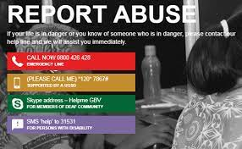
The collapse of the gender-based violence command centre
According to reports, the GBVCC in Pretoria is currently not in operation due to a contractual dispute between the Department of Social Development and service provider Brilliant Telecommunication (Brilliantel). But even before this dispute, it seems that the Centre failed in its mandate.
It seems that since the Department of Social Development decided to end its relationship with Vodacom at the end of 2022, and signed the R45 million contract with Brilliantel, GBV victims have been left in the lurch with social workers being fired and no one to take their calls.
Which begs the question, why did Social Development Minister, Lindiwe Zulu, decide to end the beneficial partnership with Vodacom when most of its services were free of charge and allowed GBV victims to contact the GBVCC for free.

Slide 13
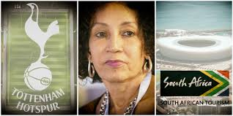
South Africa Tourism intended sponsoring of UK soccer club Tottenham Hotspur
South African Tourism's proposed R1bn sponsorship deal with UK football club Tottenham Hotspur has been cancelled. This follows Minister of Tourism, Patricia de Lille's update to the media on 24 March 2023 on the SA Tourism and Tottenham Hotspur FC sponsorship proposal. As requested, on Wednesday 29 March 2023, De Lille received a response from the SA Tourism board chairperson, Thozamile Botha, regarding the proposed sponsorship deal.

Slide 14
CONCLUSION
According to the 2024 Sustainable Development Report South Africa ranks 115 out of 166 countries and has an overall score of 63.44 out of 100. This means that South Africa shows a limited progress of 35% towards achieving its SDG targets. This displays that not much progress has been made by South Africa at the midway point to the 2030 deadline.
Constant activism and concerted efforts by CSOs to expose and prevent corruption will substantially contribute towards the achievement of the SDGs by 2030. The UN Secretary Antònio Guterres remarked: “Civil society organizations link governments and people. They are a vital voice for human rights. When civil society is muzzled, we lose an essential forum for dialogue – and we lose the lifeblood of democracy. That is why I advocate at every possible opportunity for the protection and expansion of civic space”.

