Slide 1
Nelson Mandela University Ocean Sciences Strategy

Slide 2
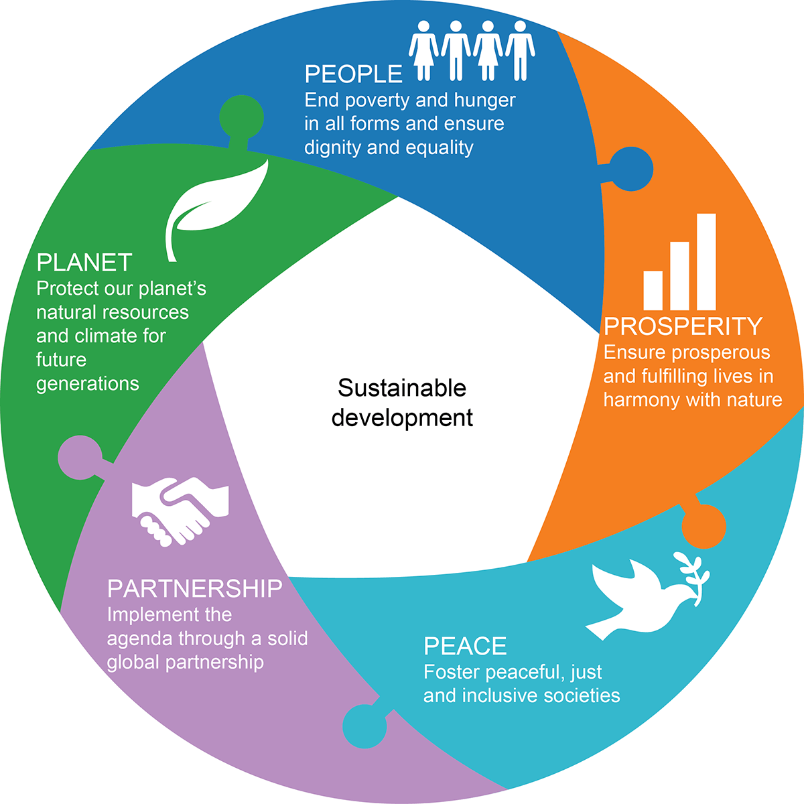
Our vision: knowledge for a sustainable future

Slide 3
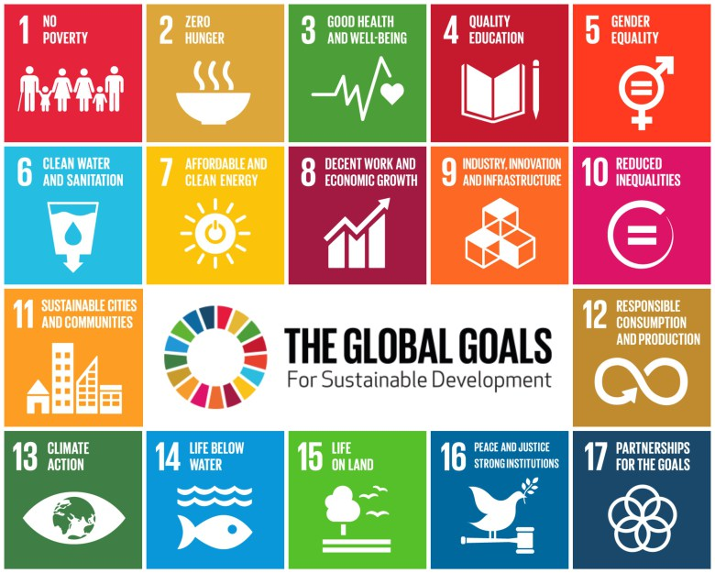
Global sustainable development goals

Slide 4
African Union Agenda 2063

Slide 5
Some facts about South Africa’s oceans
3924 kilometres of coastline & ocean space is bigger than land territory at 1.5-million square kilometres
Positioned on a major shipping route and has 8 commercial ports
Generates 3.5% of the world’s seaborne trade volume
One of the highest coastal population densities in Africa with approximately 80 people per square kilometre
Government has unlocked oceans economy investments worth R24.6-billion since 2014
Aquaculture contributes to almost half of the global fish supply, but less than 1% of South Africa’s fish supply

Slide 6
Operation Phakisa: Oceans economy sectors
Marine transport and manufacturing
Offshore oil and gas exploration
Aquaculture
Small harbour development
Marine protection services and ocean governance
Marine and coastal tourism

Slide 7
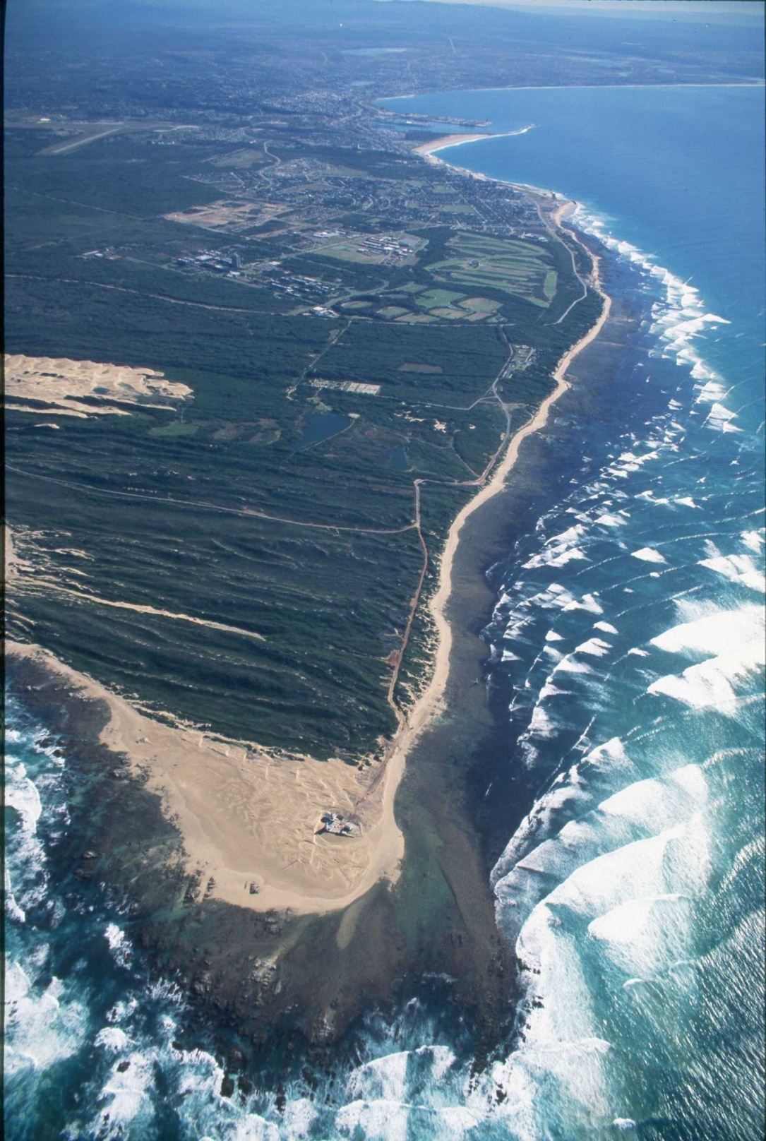
Nelson Mandela University – host to Coastal and Marine Research Institute and South African International Maritime Institute (SAIMI)

Slide 8
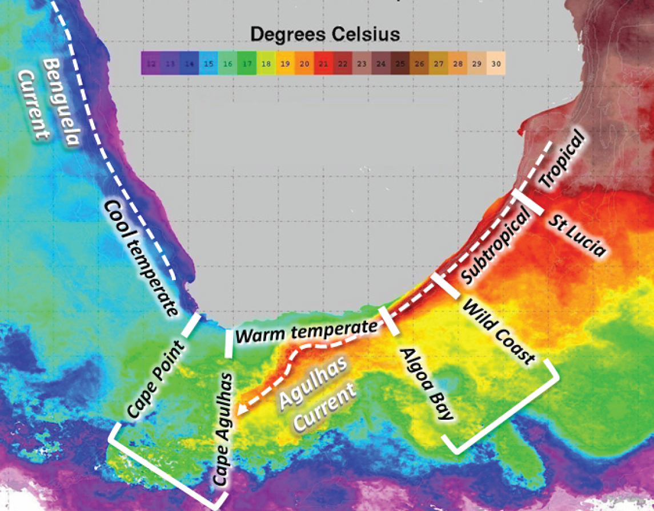
Sea Surface Temperature Map
Port Elizabeth
Notes:
Sea Surface Temperature map indicating oceanographic features along the coast (warm, south flowing Agulhas Current and north-flowing cold Benguela Current)
Four major biogeographic regions ranging from the cold-temperate in the west to the tropical and sub-tropical in the east. Port Elizabeth is in the warm-temperate biogeographic province.

Slide 9
Our Ocean Sciences Strategy
2016 - 2020
Dedicated campus, research equipment and facilities
Qualifications: under- and postgraduate, inter- and trans-disciplinary
Partnerships from local to global domains
Scholarship, research and innovation

Slide 10
Ocean sciences: Key deliverables
Campus spatial plan & infrastructure development
Scale up ocean sciences qualifications & research
Ocean sciences campus governance & management model
Partnerships & revenue mobilisation

Slide 11
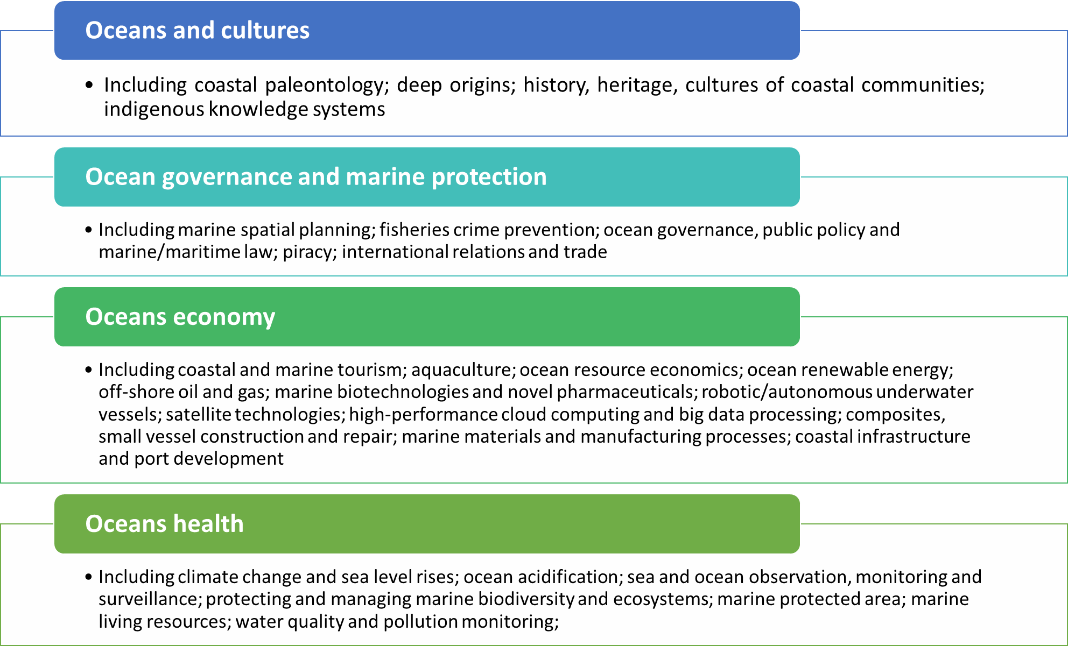
Cross-cutting ocean sciences themes

Slide 12
Imperatives of ocean sciences strategy
Increasing size and scale of contribution to ocean sciences
Broader range of UG and PG qualifications
Research and industry-funded chairs
Diversifying scope and spectrum of distinctive academic offerings and research niche areas
Identify and consolidate strengths
Enhancing scientific, policy, economic and social impact
High quality scientific impact
NGAP scholars
Differentiate and position campus to become centre of excellence
Research outputs and publications
M&D graduates and post-doc scholars
SLPs and executive development opportunities
Bursaries and scholarships
Widen geographical reach and expand partnership footprint, especially in Africa
Develop academic plan and campus governance/ management model to determine funding, ICT, HR and infrastructural needs
Branding and marketing strategy
Social impact – empower marginalised coastal communities and contribute to transformation of oceans economy
Economic impact – partner with government and industry to contribute to inclusive economic development, entrepreneurship and job creation
Policy impact - structured, systematic approach to informing government policy at local, regional and national levels
Technological and innovation impact – pioneering technology solutions (e.g. marine robotics)
Identify gaps and invest to address these
Conduct viability modelling to promote long-term sustainability

Slide 13
Existing capabilities in ocean sciences
Coastal and marine sciences & oceanography
Law of the seas, ocean governance & marine protection
Ocean origins & coastal paleontology
Maritime studies
Marine engineering

Slide 14
Emerging capabilities in ocean sciences
Marine & coastal tourism & hospitality
Marine manufacturing & naval architecture
Port management & logistics
Small harbour development
Marine robotics
Ocean cultures & coastal livelihoods

Slide 15
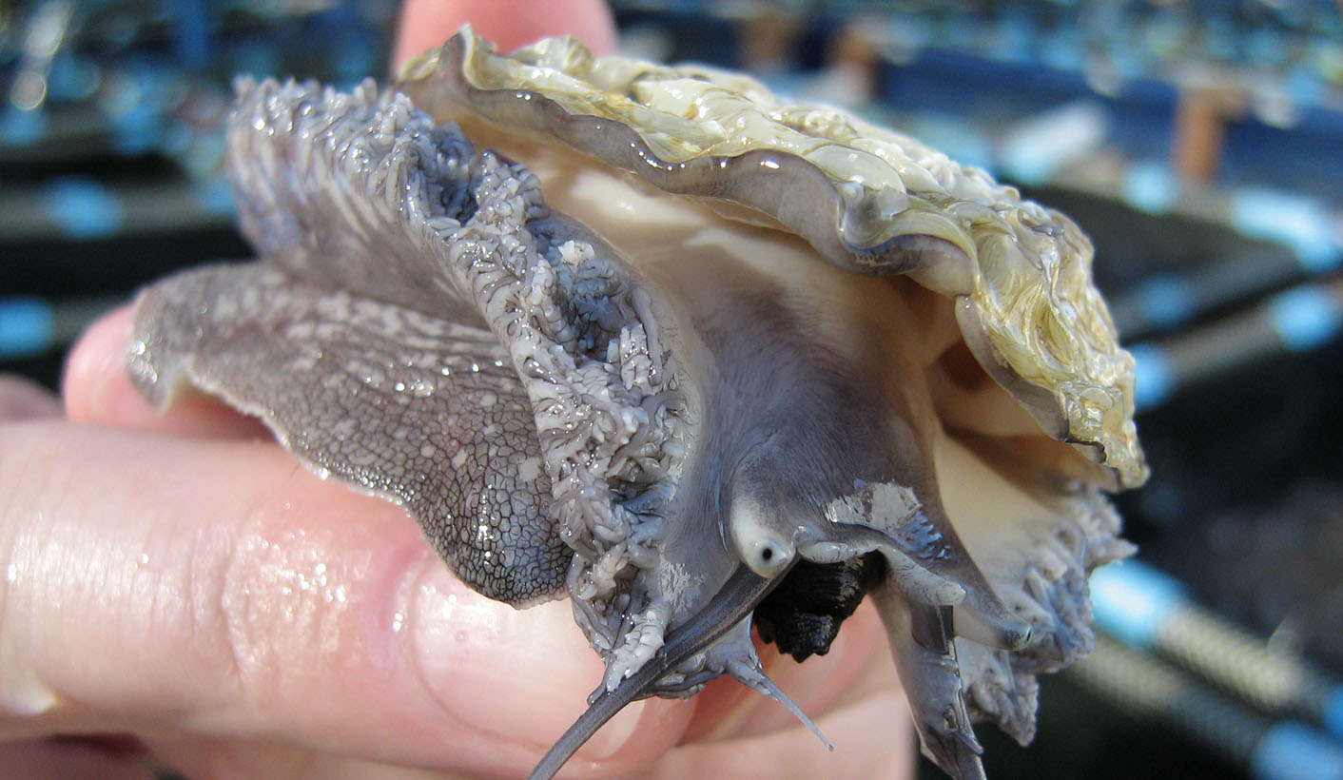
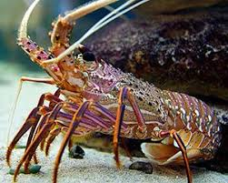
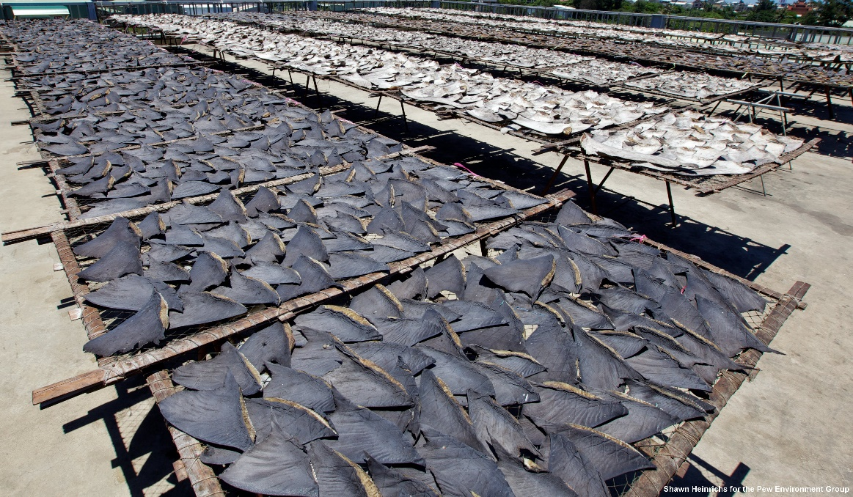
The Problem: Our vulnerable species
Abalone (Haliotis Midae)
West Coast Rock Lobster (Jasus lalandii)

Slide 16
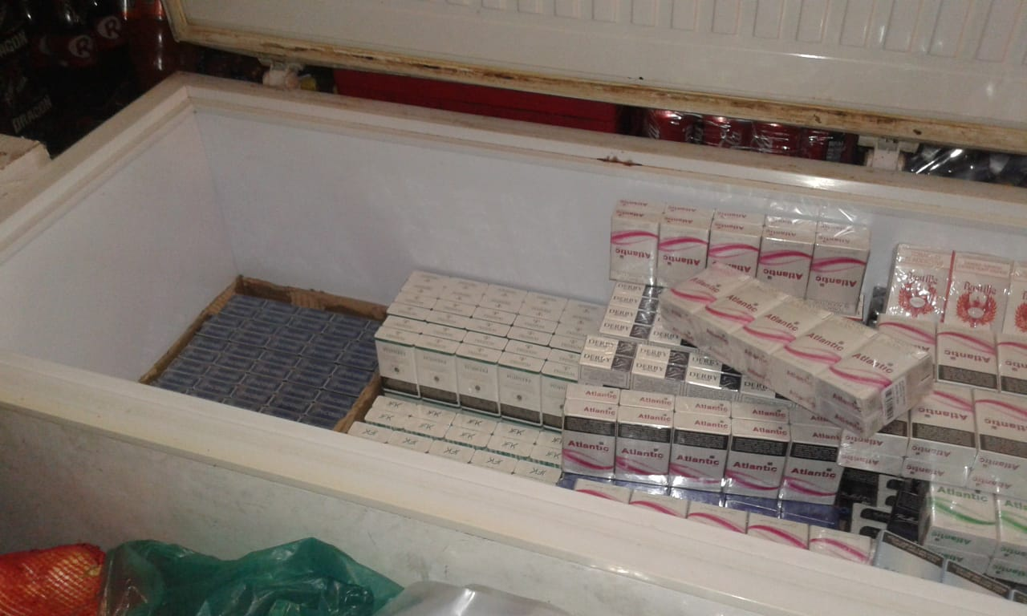

Slide 17
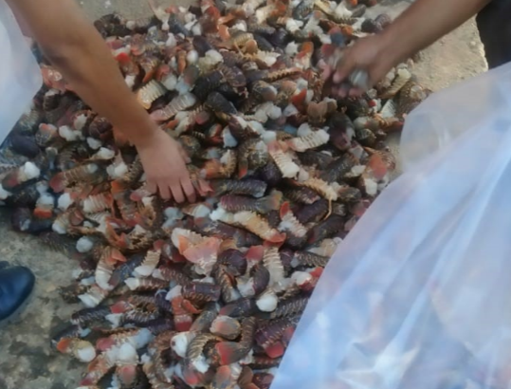

Slide 18
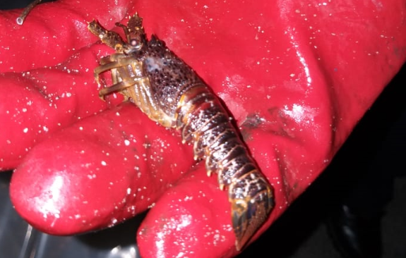

Slide 19
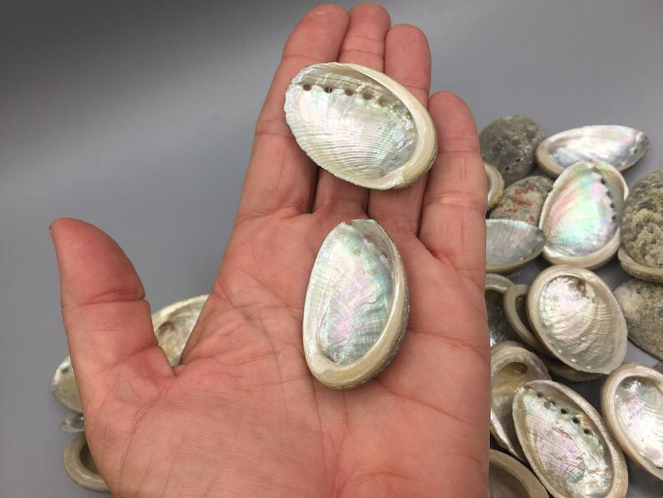
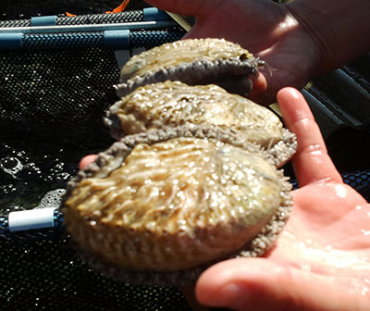

Slide 20
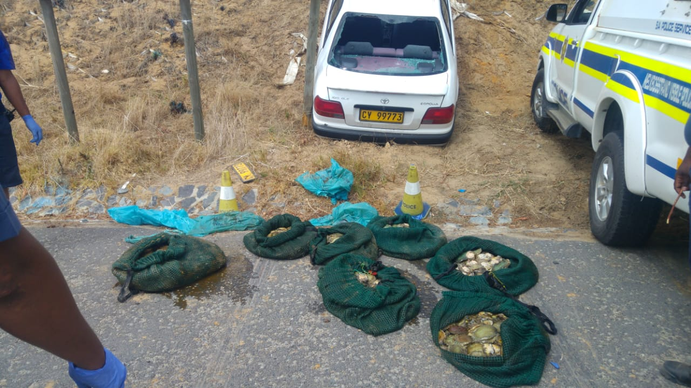

Slide 21
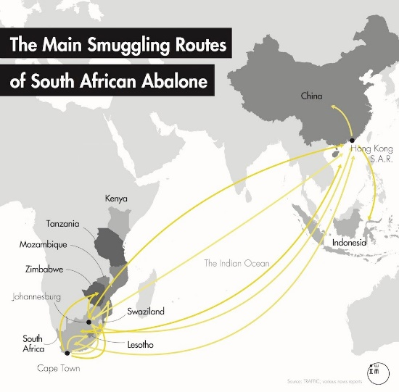
Cross-border

Slide 22
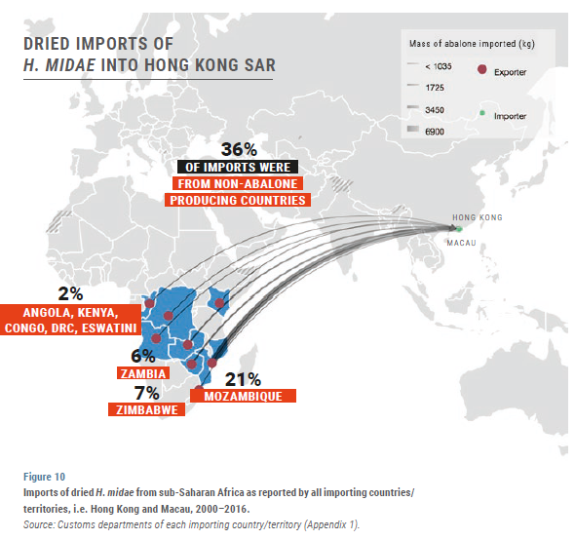
Organisation

Slide 23
What is the FCO and officers from other agencies dealing with (in many instances without knowing it)?
What is the FCO and officers from other agencies dealing with (in many instances without knowing it)?

Slide 24
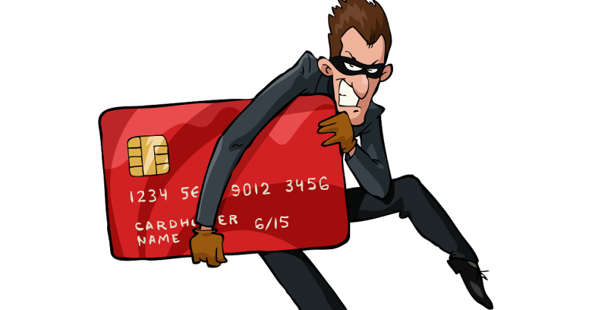
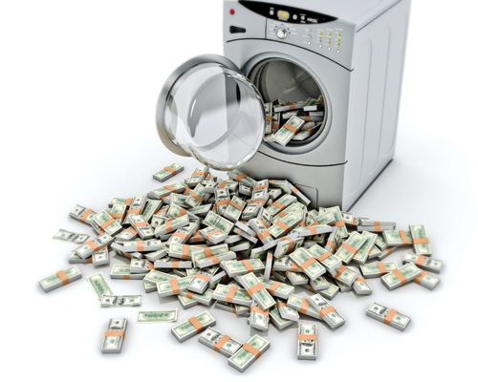
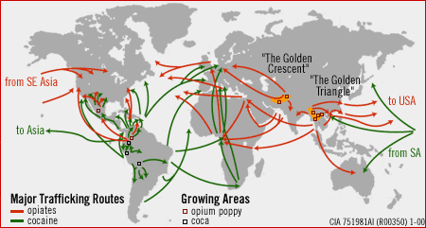
So … how do they weigh up?

Slide 25
Organised crime
FCO & police

