Slide 1
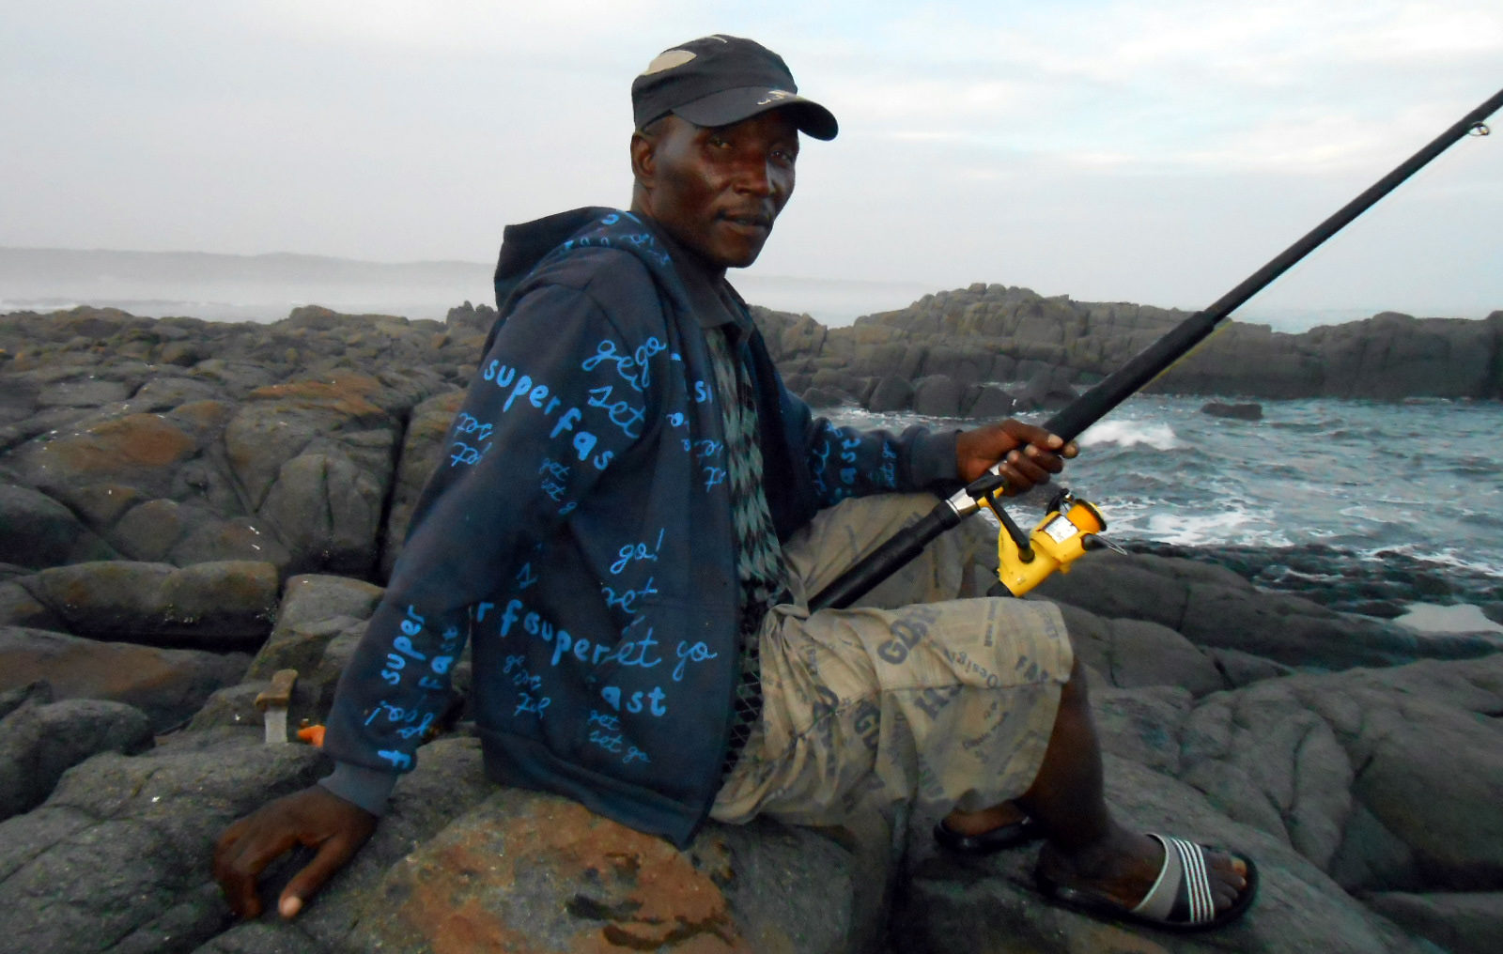
A customary right to fish as a legitimate defence to criminal liability – Gongqose v Minister of DAFF 2018
ANTHEA CHRISTOFFELS DU PLESSIS PHD CANDIDATE / FACULTY OF LAW, NMU

Slide 2
TALKING POINTS
1. Summary of the facts, history and legal issues
3. Where are Customary fishing rights? Analysis of the Problem in the law
2. Meaning/impact and Key findings of the judgement
4. Outline of concerns with governments approach
5. Take-away

Slide 3
1. HISTORY/ facts/ISSUES/litigation
The appellants are members of the Hobeni community.
Arrested and charged with attempting to fish in the Dwesa-Cwebe MPA in 2010
Allegedly contravened the following laws:
MLRA & Environmental Conservation Decree
Fishing in a MPA without permission
[Section 43 – MLRA]
Entering a Nature Reserve(MPA) without a permit
[Section 29(1)(a) – Conservation Decree]
Being in possession of any weapon, explosive, trap or poison (e.g. fishing gear) [Section 29(1)(b) – Conservation Decree]
Killing/disturbance of other species other than the fish caught [Section 29(1)(c) –Conservation Decree]
Notes:
Community history and existence:
The communities have been living within the reserves for some 300 years. The appellants are members of the Hobeni community, situated directly adjacent to the Reserve. The Cwebe community is located north of Hobeni adjacent to the border of the MPA and the coastline. The Mendwane community is also located adjacent to the Reserve, but it has no access to the coastline. These communities, hereafter referred to as ‘the Dwesa-Cwebe communities’, have shared rules of access to land and marine resources and as such, constitute communities in terms of customary law.

Slide 4
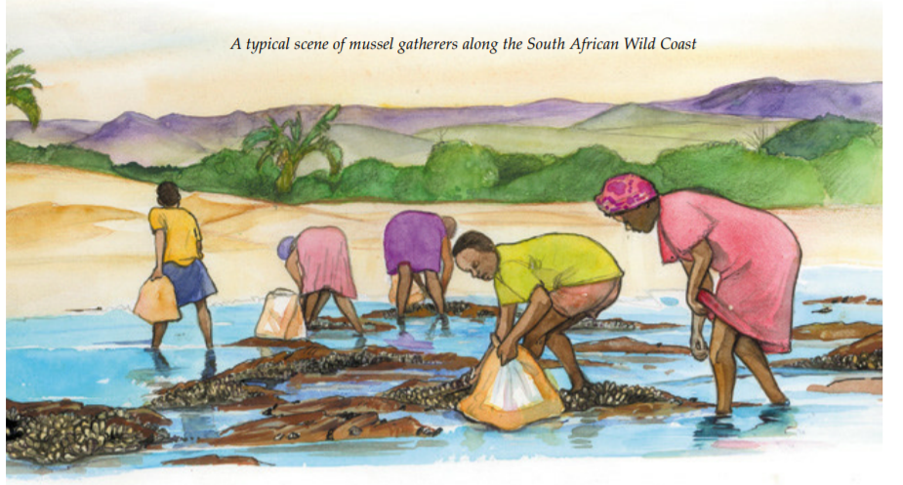
1. HISTORY/ facts/ISSUES/litigation
Enforcement of the prohibition on fishing in the MPA (2000) only started in 2005.
2000-2005: Dwesa-Cwebe communities continued to fish according to their customary rights and practices.
2006-2008: Attempts were made (but failed) to engage the DEAT concerning the communities’ access to and sustainable use of marine resources.
Litigation history:
Elliotdale Magistrates Court (2012) → Mthatha High Court (2015) ⇢ Supreme Court of Appeal (2018)
Main legal issues:
Can the exercise of a customary right to fish be raised as a defence in criminal proceedings?
Can a customary right of access to marine resources render fishing without a permit, in the MPA, lawful?
Notes:
Exclusion of the communities by the legal system:
In 1885 the Cape government annexed the area within which the Dwesa Reserve is situated in terms of Proclamation 140 of 26 August 1885 and annexed the area within which the Cwebe Reserve is situated under the Tembuland Annexation Act 3 of 1885. In 1890 Dwesa was declared a state forest but local people continued to use the land and its resources for residential and agricultural activities until well after 1913. Between 1900 and 1950 local villages, including Cwebe, were destroyed and residents moved out of the reserves. The MPA was declared in the democratic era in December 2000 under the now repealed s 43 of the Marine Living Resources Act 18 of 1998 (the MLRA), on a strictly ‘no take’ basis, ie no fishing nor harvesting of resources in the MPA was permitted. Prior to the declaration of the MPA in 2000, their access to marine resources was restricted by various laws, referred to hereafter. The Transkei Nature Conservation Act 6 of 1971 (the Transkei Nature Conservation Act) prohibited persons from fishing, save in accordance with its provisions, and regulated the areas in which certain fish could be caught. During that time, terms the Sea Fisheries Act 58 of 1973 (the Sea Fisheries Act) the Minister was entitled to take measures to protect fish, which prohibited fishing in a specified area. The Minister was also entitled to place restrictions on the quantity of fish that could be caught or processed.
In 1991 the shoreline abutting the Reserve, the tidal waters and the inland waters up to 6 nautical miles were incorporated as a marine reserve in terms of special regulations made under the Sea Fisheries Act. This further exacerbated exclusion of communities from marine resources. No collection of any marine organism was permitted under the rules of the marine reserve and anyone found contravening that rule was liable for a fine of up to R50 000 or six years’ imprisonment. The Sea Fisheries Act authorised the Minister to take measures to protect fish, including the prohibition of fishing in a specified area; and to place restrictions on the quantity of fish that could be caught. The Transkei Nature Conservation Act was repealed by the Transkei Environmental Conservation Decree No 9 of 1992 (the Conservation Decree),3 which authorised the Minister, inter alia, to designate a closed season during which fish of any defined species could not be caught; to prohibit the catching or wilful disturbing of fish; and to authorise the catching of fish.
In the 1930s the Dwesa community was removed from the area and relocated to land adjacent to the fenced reserves of Dwesa and Cwebe. The removal was effected to give white traders and farmers priority access to prime land. Black families were not allowed to live in the reserves but the communities continued to use the land and its resources. In the 1970s further forced removal took place as part of ‘betterment’ planning in respect of black communities as a means of concentrating them within easily controllable areas, in line with government policy at the time. The Transkei Conservation Act established the Dwesa-Cwebe Nature Reserves in 1975, and fencing of the reserves commenced with the resultant denial of access to the local villagers. During that period white families were allowed to maintain residential areas within the reserves and use the forest and sea resources whilst the local black communities were denied access to the reserve and its resources.

Slide 5
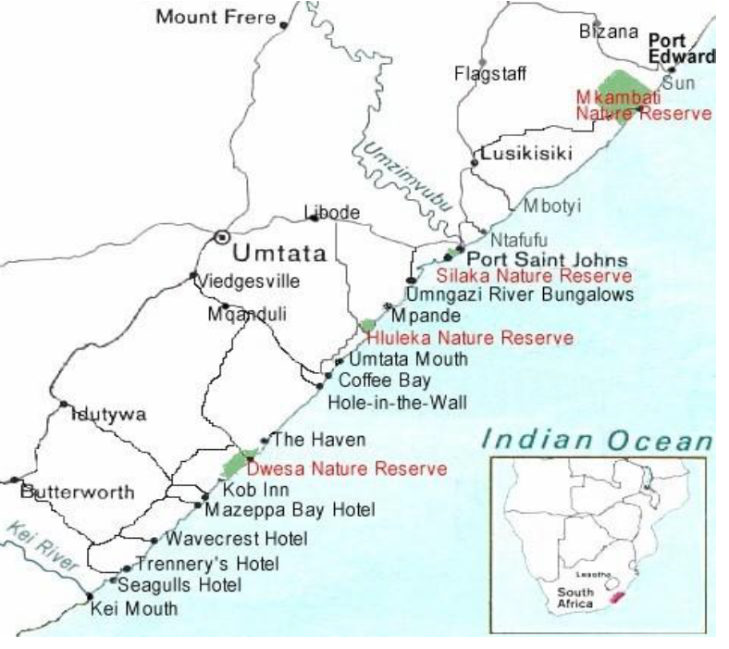
DWESA – CWEBE MPA

Slide 6
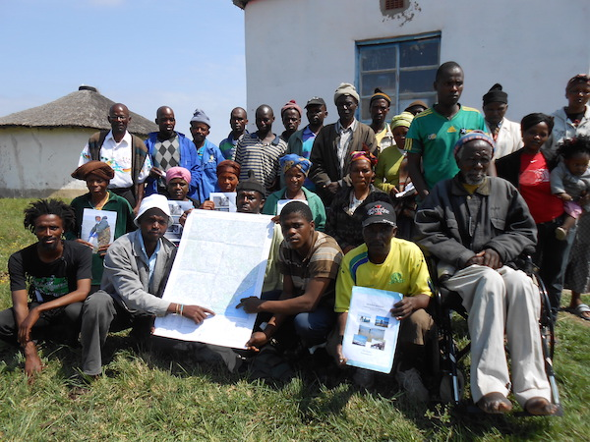
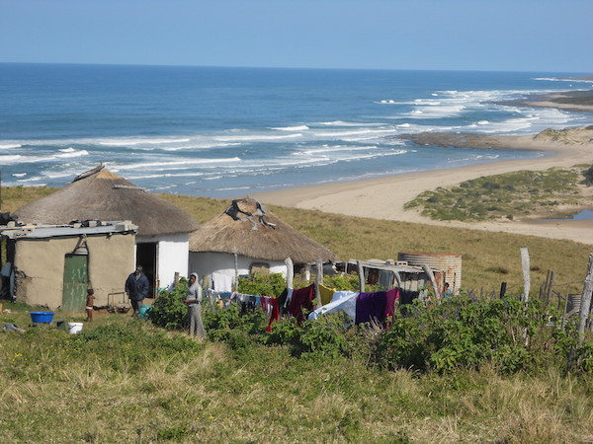
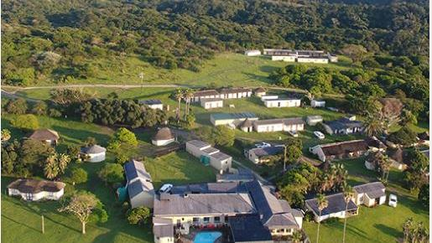
COMMUNITY REALITY VS RECREATIONAL LUXURY
The MPA is located in the former Transkei, on the east coast of South Africa, north-east of East London. It incorporates approximately 19 km of mainly rocky shore coastline and extends 6 nautical miles (10.8 km) out to sea. The MPA is adjacent to the Dwesa-Cwebe Nature Reserve (the Reserve) which was the subject of a successful land claim by communities of the area. The Haven Hotel Complex is a popular tourist destination an angling attraction.

Slide 7
2. The judgement: Meaning and impact
The three courts differed on the application and interpretation of the law particularly the provisions MLRA and customary rights and hence the matter was appealed to the SCA but all three courts accepted that the:
status of customary law is an equal and original source of law;
recognition and application of customary law rests on a right to culture in terms of sections 30; 31 & 39 of the Constitution;
appellants had demonstrated and exercised their
customary right to fish.

Slide 8
2. key findings in the SCA judgement
  MLRA 1998 only made provision for subsistence fishers.
  The MLRA did not neither extinguished nor preserved the customary rights.
  Subsistence fisher and customary right fisher are similar but not the same/identical.
  Customary fishing rights not limited to consumption but also exercised for purposes of customary rituals / ceremonies and practices.
  MLRA Amendment Act, 2014 broadly defined small-scale fishing communities to include communities who fish according to custom.
  Customary fishing rights and conservation can co-exist as envisaged in the MLRA.
  Customary fishing communities are acutely aware of the sustainable usage of marine resources because of its cultural significance.
  The fishers had the necessary authority by means of a customary right of access to and use of the marine resources in terms of section 250 of the CPA.
  This customary right renders fishing without a permit lawful.
Notes:
The Appellant and the Hobeni community members with legal representatives.

Slide 9
Where Are customary fishing rights ?
MLRA 1998
Original Fishing Rights Categories:
Commercial Fishers = fishing for money
Recreational Fishers = fishing for luxury
Subsistence Fishers = Fishing for the “poor and marginalized” community”?
Subsistence Fishers =
A natural person
who regularly catches fish for personal consumption or for the consumption of his or her dependents,
including one who engages from time to time in the local sale or barter of excess catch.
Excludes persons who engages on a substantial scale in the sale of fish on a commercial basis.
MLRA Amendment Act 5 of 2014 =
Small-scale fishers are included as the new category of fishing rights.
The section mentions that the Minister in trying to achieve the objectives of sections 39(3) makes provision for a SSF-community. SSF community is also defined to mean continue to exercise their rights in a communal manner in terms of an agreement, custom or law.
SSF-Regulations 2016 – Created to give legal force to the implementation of the SSF-Policy. Notably, Silent on customary fishing rights. This is a fundamental flaw that must be remedied.
2018 Gongqose =
The Court confirmed that a customary fishing right is protected in terms of the Constitution and the MLRAA and could not be extinguished by giving a different interpretation to the legislative scheme. Customary fishing right is a legitimate defence to criminal liability
2005 case: George vs Minister DEAT.
Government’s failure to provide access to marine resources violated a number of constitutional rights, including the right to equality and the right not to be unfairly discriminated against, the right to engage in a trade or occupation and the right to access sufficient food.
Outcome: Court found in favour of fishermen and the court ordered the Minister to issue interim fishing rights being to the fishermen while developing a proper legal framework which specifically catered to the needs of small scale fishing communities.
SSF-Policy 2012 = Recognize that: indigenous/ local coastal communities have been harvesting Marine living resources for inter alia cultural and spiritual practices for centuries along our coastline and evidence of marine resource use along the south, east and west coast.
?

Slide 10
3. Analysis of the law : problems & Uncertainty
The current provisions of the MLRA only mentions section 39(3) – since then no further clarity on content, reach and meaning of customary fishing rights
Currently the law deals with customary fishing communities parallel to regulation for recreational fishers – requiring permits to be held (see how they treat MPA Regulations for Dwesa-Cwebe MPA issued in 2015/2016)
SSF-Policy recognises customary fishing rights and its distinguishing features however, this is not reflected in the SSF-Regulations
Customary fishing vs Subsistence fishing vs Small-scale fishing. These terminology are often used as synonymous – They are not which is adds to the disparity prevailing in our fisheries legal framework.
Disparity in the legal framework creates uncertainty about the place of customary fishing rights for communities.

Slide 11
CONCERNS WITH government’s Approach
Government’s approach:
  Government fails to properly engage and consult with the communities who are directly impacted (shown in all cases brought to date)
  Regulating the rights of customary fishing communities similarly to recreational fishing rights (lack of permit means illegal and then arrested and dealt with like poachers) is deeply problematic since the one class of fishers is not dependent on livelihoods and expression of culture.
  Customary fishers have an inherent right to fish which needs to recognised by the State and not allocated a fishing right as with other class of fishers provided for in the current legal schemes.
  Piece-meal remedies when problem arise within a specific community (MPA regulations to allow limited access with permits and bag and species limits but also includes similar relief for recreational fishers) is no solution at all but can be viewed by the fishing communities as a silencing mechanism at best.

Slide 12
5. Take – away
This case established a customary right to fish as a legitimate defence to criminal sanction imposed on persons otherwise fishing in restricted MPA’s;
However, without the necessary clarity in the law it is practically difficult to enforce the law as the Gongqose case clearly illustrates;
Customary fishing communities will continue to be vulnerable to criminal liability and legal sanction;
Customary fishing rights cannot be “allocated rights” similar to other fishing rights;
Proper consultation and engagement with the local communities is indispensable/imperative;
Piece-meal solutions are not sustainable and cannot be par for the course as customary fishing communities in various areas of the coast have become accustomed to;
Proper and holistic reform of the legal framework is necessary to ensure that customary fishing communities are no longer treated as the step-child of the ‘fishing rights family’ but rather granted their place as legitimate fishing rights holders alongside other fishing rights holders.

