Slide 1
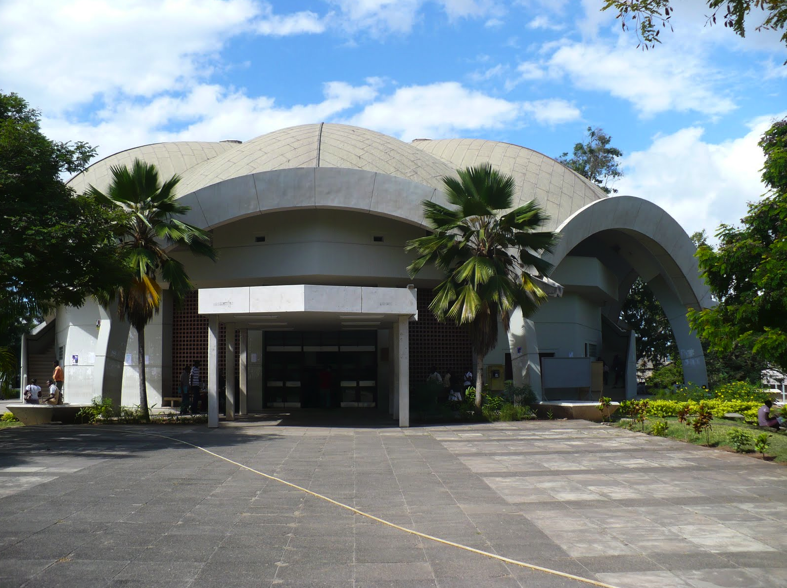
About UDSM
University of Dar es Salaam’s role in the quest for sustainable management of Africa’s marine resources

Slide 2
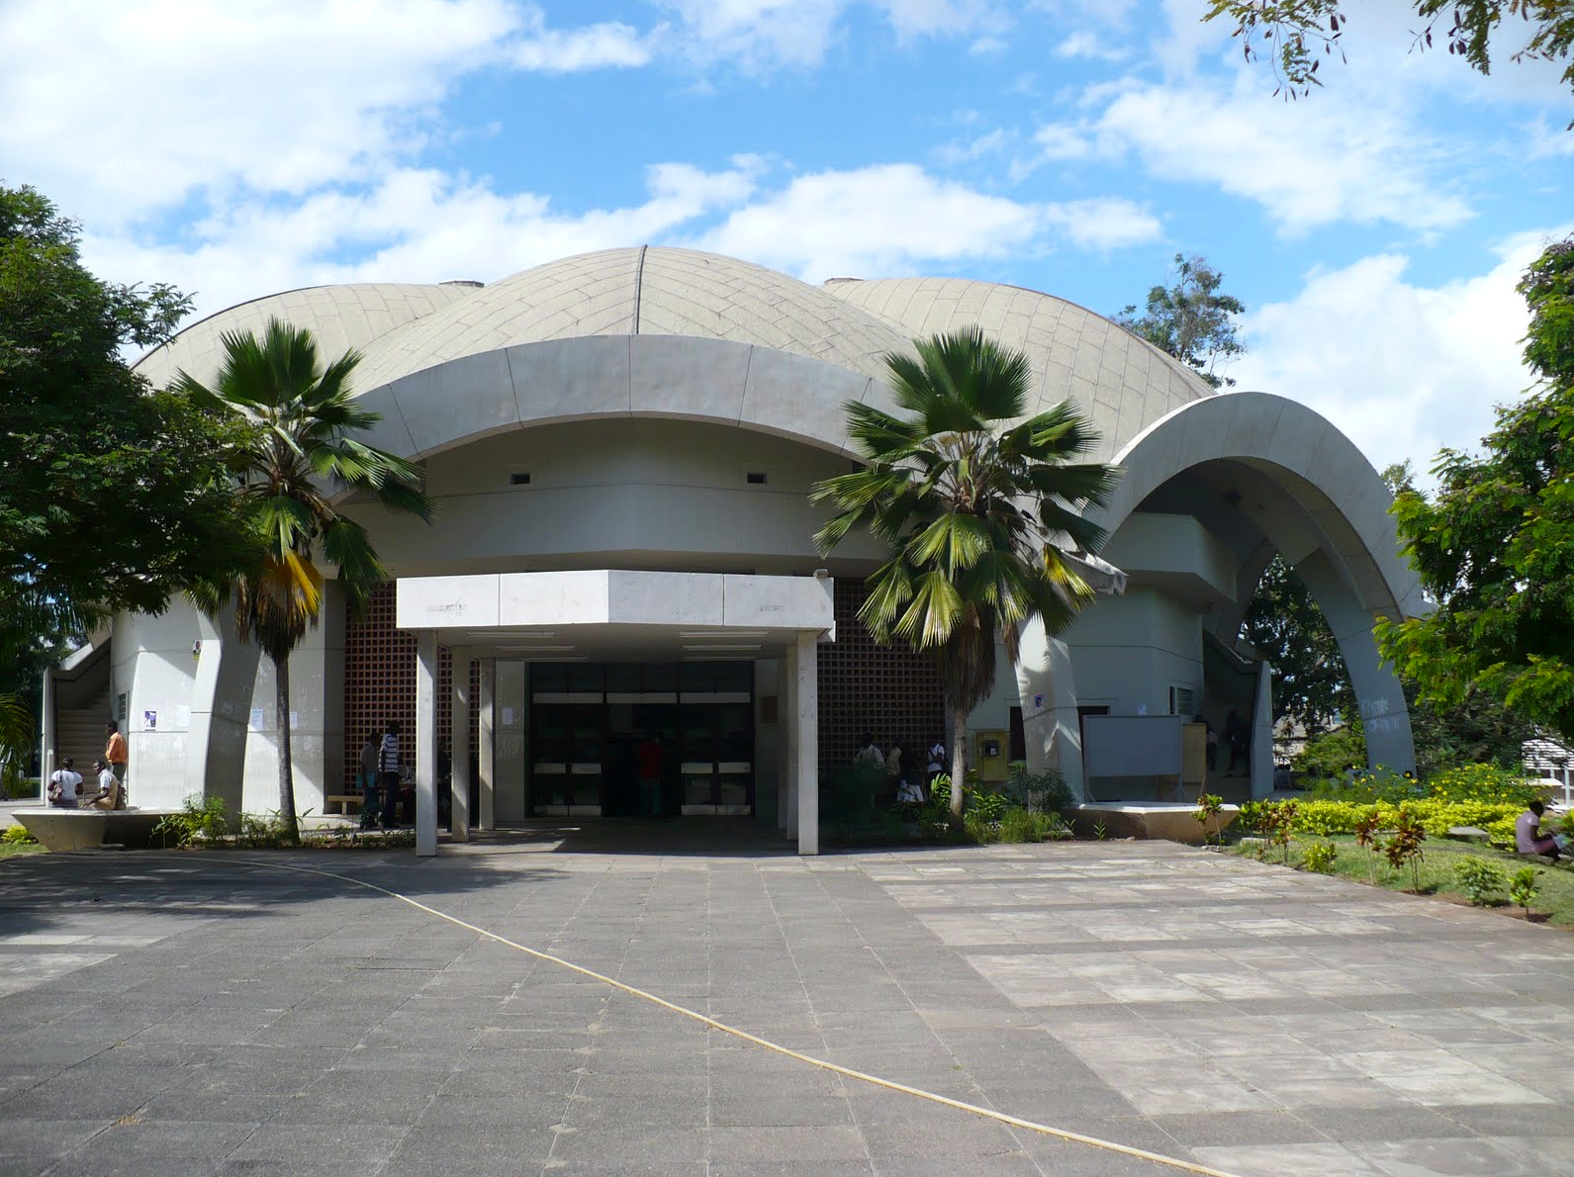
Background
The coastline of Tanzania 1424 km long
Some of the key marine resources in Tanzania include:
Fisheries resources (fish, prawn and other crustaceans, mollusc and sea cucumber)
Coastal habitats (Coral reefs, Mangroves & Seagrasses)
Marine Mammals (dugongs, whales) and Turtles
Sandy and rocky shores
Oil, gas and minerals

Slide 3
Status of Marine Resources in Tanzania
Most coastal and marine living resources in Tanzania are declining, due to:
Overexploitation
Illegal and destructive fishing
Land-based sources of pollution
Habitat loss and destruction
Climate change

Slide 4
Sustainable management of Marine Resources
Sustainable management of Marine Resources means meeting people’s needs today without compromising the needs of the future generation
Sustainable Management of Marine Resources, also referred to as “BLUE ECONOMY” entails sustainable use of marine resources for economic growth, improved livelihoods and jobs, and marine ecosystem health

Slide 5
Marine Sciences at UDSM
The importance of conducting research and training in marine sciences dates back to 1965 when the Faculty of Science of the then Dar es Salaam College of East Africa introduced a course in Marine Biology.
The course was offered by the Department of Zoology and Marine Biology
In 1979 the institute of Marine Sciences (IMS) was established.
IMS operates from Zanzibar

Slide 6
Marine Sciences at UDSM
In 2002 the Faculty of Aquatic Sciences and Fisheries Technology (FAST) was established from the Marine Biology section of the Zoology and Marine Biology Dept.
In 2008 FAST & Faculty of Science merged to form the College of Natural and Applied Sciences (CoNAS)
Department of Aquatic Sciences and Fisheries (DASF)
In 2015 DASF was used to establish the College of Agricultural Sciences and Fisheries Technology (CoAF)
DASF name was changed to Department of Aquatic Sciences and Fisheries Technology (DASFT)

Slide 7
Marine Sciences at UDSM
Therefore UDSM conducts teaching/training, research and consultancy in marine sciences mainly through these two units (DASFT and IMS)
Other courses especially in oil, gas and marine minerals are taught in Geology, Chemistry Departments and through College of Engineering and Technology

Slide 8
The Role of UDSM in Sustainable Management of Africa’s Marine Resources
Capacity building through teaching and training
Both undergraduate and Postgraduate programmes, & Occasional students
UDSM receives students from both within and outside Tanzania
From Africa: Rwanda, Burundi, Kenya, Nigeria, Zambia, Mozambique, South Africa
Outside Africa: Sweden, Canada, Australia, USA, Finland, Norway, UK, Belgium, Netherlands, Germany, Israel, etc.

Slide 9
The Role of UDSM
Among the courses taught at undergraduate level include:
Oceanography,
Ocean productivity,
Coastal and marine resources management (fisheries, estuaries and mangroves, seagrass beds and coral reefs)
Fish stock assessment,
Fisheries socio-economics,
Fisheries biology and ecology,
Fish taxonomy and population genetics,
Law of the Sea,
Marine Pollution

Slide 10
The Role of UDSM
Capacity building
Master and PhD studies projects covers all aspects of marine sciences from Physical Oceanography, marine Chemistry, marine Biology to Coastal/marine Management
Most personnel working in the fields of fisheries, aquaculture and other marine related fields in the country are graduates from UDSM.
UDSM also offers short/tailor made course in various fields of marine sciences

Slide 11
The Role of UDSM
Knowledge generation through Research
Through Postgraduate Research Programmes (MSc. & PhD)
Through collaborations with other Universities/ Institutions within and outside Africa
Examples:
Kenya (KEMFRI, Pwani University)
South Africa (University of Western Cape, NMU)
Mozambique (Eduardo Mondlane University)
Nigeria (Ibadan University)

Slide 12
The Role of UDSM
Knowledge generation through Research
Participation in cruises e.g. Fridtjof Nansen cruise ship & SA Agulhas II (Miriam Makeba)

Slide 13
The Role of UDSM
Provision of professional/expert advise – through consultancy and outreach activities
E.g. EIA for development projects so as to minimize their social and environmental impacts on coastal and marine resources
Sharing of information – through participation in conferences/ scientific meetings/workshops
UDSM is also a member of various networks and associations e.g. Western Indian Ocean Marine Science Association (WIOMSA), Western Indian Ocean Seagrass Network (WIOSN), Western Indian Ocean Mangrove Network, etc

Slide 14
-Thank you-

