Slide 1

The European Union and IUU Fishing:
The Case of Vietnam
Prof. Dr. Erik Franckx
“Tightening the Net 2,0”
The second instalment of the FishFORCE Dialogue
Nelson Mandela University, North Campus, Conference Centre
Port Elizabeth, South Africa, 9-10 March 2020

Slide 2
Outline
The European Union
  A regional actor
  Competence with respect to fisheries
  Impact of the Lisbon Treaty
The EU and IUU Fishing
The EU, Vietnam and IUU Fishing
Conclusions

Slide 3
1) Introduction
1.1) The EU a Regional Actor
  EU is a strange, solitary and chameleon-like animal in the international zoo
    Strange
      ≠ state
      ≠ RFMO
    Solitary
      Has not found alter ego on international scene
    Chameleon-like
      Original member states of EC could hardly have envisaged in 1957 what the EU turned out to be today

Slide 4
1.1) The EU as a Regional Actor
  Strange:
    FAO publication
      Analysis of national legal systems
        Aus/Can/Nam/NZ/Nor/Sp/US
      Analysis of (Sub)Regional Arrangements
        CCAMLR/EC/FFA/ICCAT/IOTC/NEAFC/NAFO/MHLC/SEAFO
      Study dates back to 2001
        EU – EC
        RFMO?
        State?

Slide 5

1.1) The EU as a Regional Actor
  Solitary:
    Is so far only “international organization” under Art. 305 (1)(f), which is defined in Annex IX, Art. 1 as
    “For the purposes of article 305 and of this Annex, ‘international organization’ means an intergovernmental organization constituted by States to which its member States have transferred competence over matters governed by this Convention, including the competence to enter into treaties in respect of those matters”
    1982 Convention was forerunner in this respect
      Many states not ready initially (ex. Baltic Sea)
      Many other conventions not that far-reaching (ex. CITES, only about half of Member States are party to the amendment allowing the EU to become member)

Slide 6
1.1) The EU as a Regional Actor
  Chameleon like:
    ≠ Regional actor, based on WYSIWYG
    = evolving international organization sui generis
    WYSIWYG should rather read WYSIWYW

Slide 7

  Articles 32-38 of the 1958 Rome Treaty
    Common market rules apply to fishery products
  On the EU agenda since 1964
  Article 37 EC Treaty is now formal legal basis of the CFP
    Main focus is on agricultural policy
    Gives the European Council broad discretionary power
    Limited means to oppose decisions, e.g. Court of Justice

Slide 8
1.2) Competence with Respect to Fisheries
1957 Treaty of Rome
Common Agricultural Policy
1957 Treaty of Rome
1957 Treaty of Rome
Transport provisions
Secondary rules
Air navigation
Secondary rules
Common Fisheries Policy (CFP)
Secondary rules
Procedure

Slide 9
1.2) Competence with respect to fisheries
2) The Role of the EC as a RFMO
  Basic division of competence in area of CFP
    EC has exclusive competence with respect to conservation and management of living marine resources
    Enforcement remains primarily Member State competence, with Commission responsible for the monitoring and enforcing of the correct application of these rules by Member States
  This all seems to be the internal kitchen
  BUT in foro interno, in foro externo

Slide 10
1.3) 2007 Lisbon Treaty
(EIF 1/12/2009)
  Novelties
    Art 1 TEU: EU replaces & succeeds EC
    Art 47 TEU: EU has legal personality
    Fisheries explicitly mentioned in TFEU
      Art. 3 “conservation of marine biological resources under CFP” are exclusive competence
      Art. 4 other issues in the field of fisheries are shared competence
      Art. 43 EP & Council develop CFP through co-decision procedure (in foro interno, in foro externo)

Slide 11
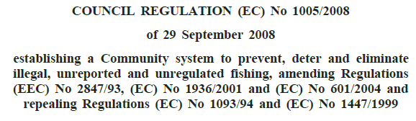
2) The EU and IUU fishing
Council Regulation 1005/2008
  Internal effect
    Cooperation with Member States
      With their flag States, port States and market State responsibilities

Slide 12
2) The EU and IUU fishing
  External effect
    Cooperation with third states
      Improving traceability (requires cooperation with States exporting fish into the EU)
    Through dialogue
    Or, if dialogue fails
      Yellow cards (pre-identification)
      Red cards (identification)
      Green cards (lifting pre-identification or delisting)

Slide 13
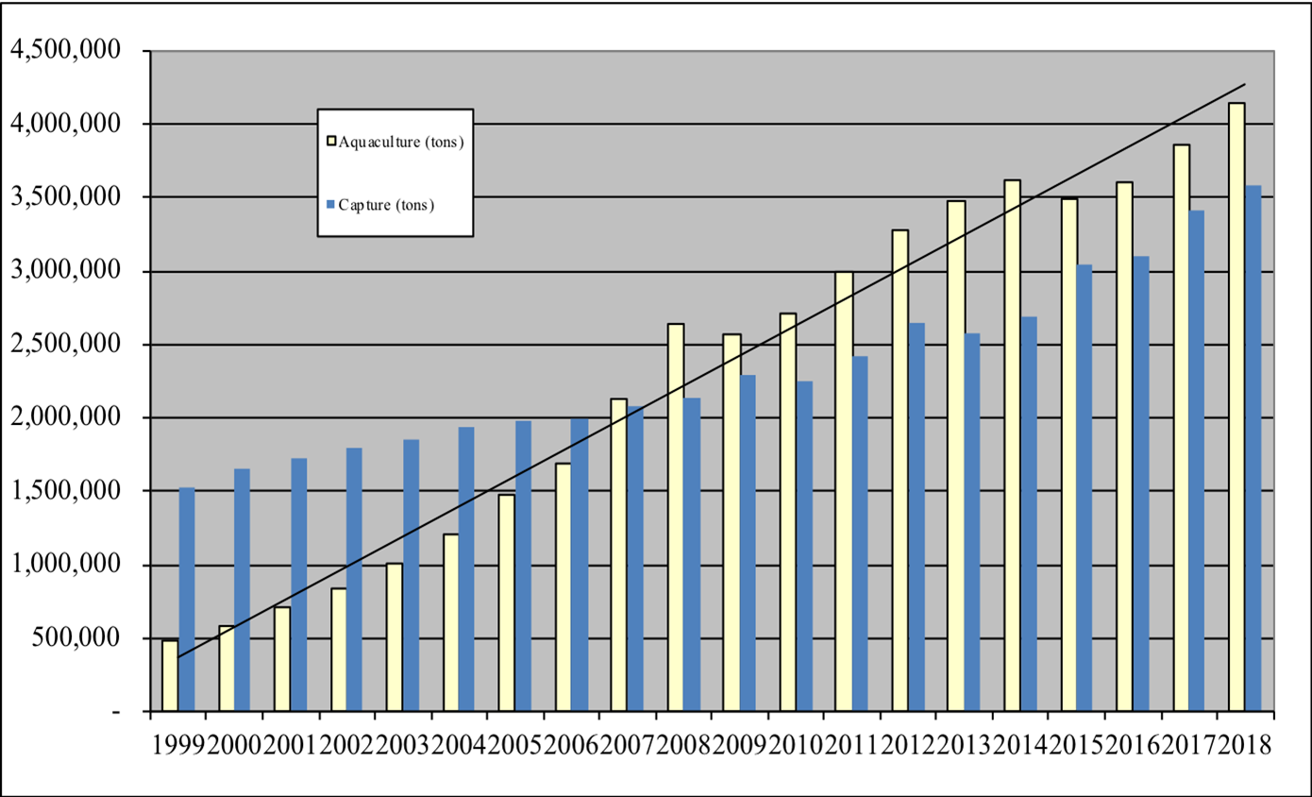
3) The EU, Vietnam and IUU fishing
Vietnam and fisheries
  Very long coastline
  Growing fishing industry (capture and aquaculture)
              Source: Directorate of Fisheries, Vietnam (2018)

Slide 14
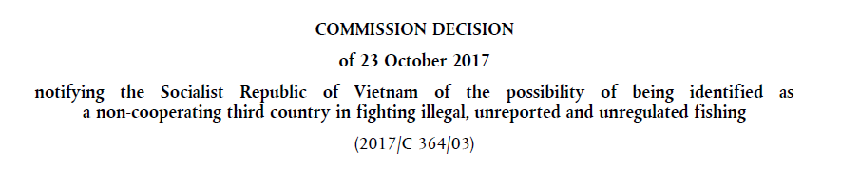
3) The EU, Vietnam and IUU fishing
The EU, Vietnam and IUU fishing
  2017: Yellow card (after dialogue that started in 2012)
    Elaborate document, in which the Commission systematically checks all the requirements enumerated in Art. 32 of Council Regulation 1005/2008

Slide 15
3) The EU, Vietnam and IUU fishing
    Vietnam
      Failed to uphold its responsibilities as flag state
        Did not prevent its fleet from engaging in IUU
        Did not prevent IUU products from entering its market
      Failed to cooperate and enforce
        Its Fisheries law of 2003 totally inadequate (no catch reporting requirement; no landing declaration requirement; no provisions on HS/third State EEZ fishing; level of sanctions and inspections have no deterrent effect; …)
        Did not bring legislation in line with relevant international instruments
      Failed to become party to relevant international instruments (only 1982 Convention; under CCAMLR does not cooperate with Catch Documentation Scheme)
      Overall performance of Vietnam is not impaired by its level of development

Slide 16
3) The EU, Vietnam and IUU fishing
  Vietnam response
    New 2017 fisheries law, decrees and circulars (EIF 01/01/2019; highest fines x10)
    Creation of national steering board on IUU fishing
    Adoption of national plan of action on IUU fishing
    MoD cooperates to suppress IUU fishing in foreign waters
    Adheres to a number of international instruments
      1995 Fish Stocks Agreement (18/12/2018)
      FAO Port State Agreement (03/01/2019)
    Hotline with third countries established
    Quota and reporting system are established
    VMS required on all vessels of more than 24 m in length

Slide 17
3) The EU, Vietnam and IUU fishing
  2019: Bilateral dialogue on IUU fishing
    New legislative framework is in place
      but too recent to be evaluated …
    New monitoring, control and surveillance is in place
      But control remains weak; VMS not yet fully implemented, …
    Fleet management needs to be further adjusted
      Too many fishing vessels
    Traceability needs further improvement
    Enforcement is still a soar point (only applied once to Vietnamese vessel in foreign waters, even though many such vessels are arrested there)
    New mission in six months

Slide 18
4) Conclusions
EU restricted trade measures
  Theory
    Those in favour
    Those against
  Practice
    With respect to Vietnam is seems to have a clear impact (new legislative framework, new ratifications, new attitude towards fishing in third countries’ waters, …)
      But not yet a green card
    Overall, the picture is more mitigated

Slide 19
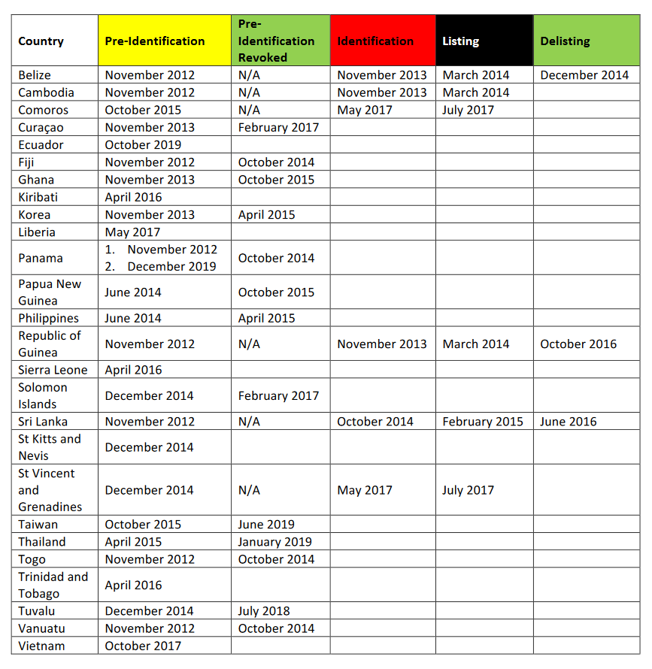
4) Conclusions

Slide 20
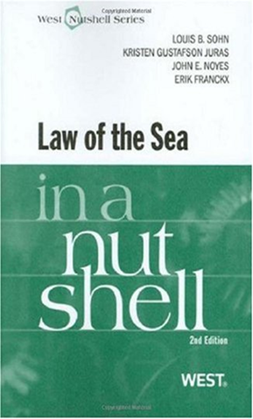
The End

