Slide 1


Protecting whistleblowers against retaliation - the European approach
as. Jan Stajnko, mag. prav.

Slide 2

Who is a whistleblower?
A person who points at irregularities or harm being done in his/her working environment
Reports about such irregularities inside our outside of the organization
Seeks to protect the public interest
Daniel Ellsberg, 1973
Pentagon Papers

Slide 3
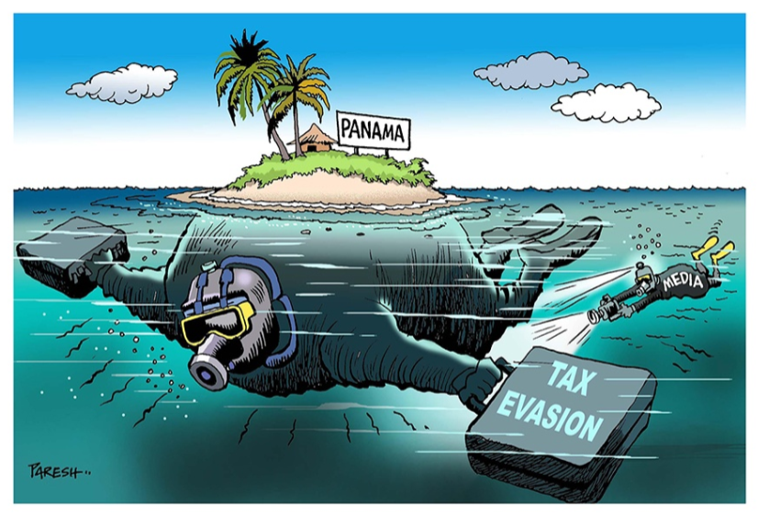


Whistleblower scandals in the EU
Panama Papers
2016
LuxLeaks
2014
Dieselgate 2015

Slide 4

The story of Antoine Deltour
Former PwC employee (auditor) in Luxembourg
Criminal charge: violating professional secrecy and trade secrets
2016 - 1st instance court: a 12-month suspended sentence and a €1,500 fine
2017 – Appellate court 6-month suspended prison sentence a €1,500 fine
2018 – Higher Court overturns the previous verdict.

Slide 5
Impact Assessment Report 2017
Calls of the European Parliament for EU Whistleblowing Directive.
2017 – Impact Assessment on Whistleblower Protection:
  Detection and reduction of fraud and corruption (estimated cost 1% of EU GDP – 120 billion per year).
  Economic growth, by:
    Attracting cross-border investment.
    Increased competitiveness of the EU
    Trust in companies by consumers (averting reputational risks).
  Protection of the environment.
Problem: Fragmented and uneven protection across MS and policy areas

Slide 6
EU Whistleblower Directive at a Glance
Adopted on October 2019 (implementation by December 2021)
Providing common minimun standards for whistleblower protection
MSs allowed to provide a wider protection
Obligation to establish internal and external reporting channels
Ensuring confidentiality of the reporting person
Prohibition of retaliation measures
Effective, proportional and dissuasive penalties

Slide 7
Personal Scope - Who is protected?
Wide scope:
  Private and public sectors
  Workers, self-employed persons, trainees, volunteers etc
  Even after termination of employment or during pre-contractual negotiations
  Protection extending to the whistleblower‘s family, assistants, and his legal persons.

Slide 8
Material Scope – What counts as Whistleblowing Content?
Breaches of EU law, including:
  Public procurement, environmental protection, food safety, public health, consumer protection, protection of privacy and personal data.
Information gathered in work-related context (de facto economic dependence)
Reasonable suspicions, about actual or potential breaches, which occurred or are very likely to occur in the organisation, and about attempts to conceal such breaches.
Does not cover: hearsay, unsubstantiated rumours!

Slide 9
Internal and External Reporting Channels
Internal reporting channels:
  Every public entity (narrow exceptions)
  Private entities:
    50+ employees
    Specific areas (financial sector, vulnerable to money laundering etc).
  Designation of an impartial person for receipt and review
  Duty to provide confidentiality
  Diligence of the follow-up
  Reasonable timeframe (3 months)

Slide 10
Internal and External Reporting Channels
External reporting channels:
  Provided by every MS
  Independent and autonomous
  Duty to provide confidentiality
  Rules on diligence of the follow-up
  Reasonable timeframe (3 months or 6 in duly justified cases)
For example: Commission for the Prevention of Corruption (Slovenia)

Slide 11
Whistleblower as a Journalist Source – When to „whistle“ to the Public?
the person first reported internally and externally, but no appropriate action was taken in due time, or
person has reasonable grounds to believe that:
  the breach may constitute an imminent or manifest danger to the public interest, or
  there is a risk of retaliation or there is a low prospect of the breach being effectively addressed, due to the particular circumstances of the case.
      (for example - collusion of the authority and the perpetrator)

Slide 12
Retaliation Measures
Threats or attempts to retaliate are prohibited, including:
  Suspension, lay-off,
  Demotion or withholding a promotion,
  Discrimination, unfair treatment, coercion, harassment,
  Blacklisting, cancellation of a licence or a permit, and similar.
Effective, proportional and dissuasive penalties for retaliation or failure to establish a reporting channel (Slovenia: up to 60.000 EUR for legal person + 2.500 EUR CEO)

Slide 13
Measures of Support and Protection
Assistance from competent authorities
Legal aid
Psychological support (optional)
No liability in case of report or public disclosure in line with the Directive (under reasonable grounds and necessity conditions)
Remedies and full compensation for damage suffered
Shifting the burden of proof regarding the causal link if a) a disclosure was made in line with the applicable legislation and b) a retaliation measure was suffered.

Slide 14
Shortcomings of the EU Whistleblowing Directive
Sectoral approach
No regulation on financial rewards for whistleblowers
Anonymous reporting excluded
Trade secrets and professional secrecy (attorney-client privilege!)
State secrets excluded (classified information)
Cost for the private sector
Cultural aspects

Slide 15
Criminal Procedure Act (ZKP)
Journalist as a privileged witness
Duty to disclose documents and hand over objects
Data stored on electronic devices
When being questioned as a witness, a journalist does not have to disclose his source of information,
except where this is necessary to prevent an immediate danger for life or health of people or to prevent a criminal offence for which a 3+ years prison sentence may be imposed or for the offence of abuse of office.

Slide 16
Criminal Procedure Act (ZKP)
Journalist as a privileged witness
Duty to disclose documents and hand over objects
Data stored on electronic devices
Objects and documents which may be used as evidence are confiscated.
Whoever is in possession of such items needs to hand them over if so instructed by the court.
If he does not want to hand over such objects, he may be imposed a fine and, if he persists, sent into prison.
However, a person who may deny being questioned as a witness in criminal procedure (including a journalist) cannot be punished.

Slide 17
Criminal Procedure Act (ZKP)
Journalist as a privileged witness
Duty to disclose documents and hand over objects
Data stored on electronic devices
The owner or user of the electronic device needs to enable access to his device, hand over encryption keys or passwords and explain to the authorities how to use the device in order for the purpose of the investigation to be achieved.
If he does not want to comply, he may be punished (see above).
Again, a person who may deny being questioned as a witness in criminal procedure (including a journalist) cannot be punished.

