Slide 1
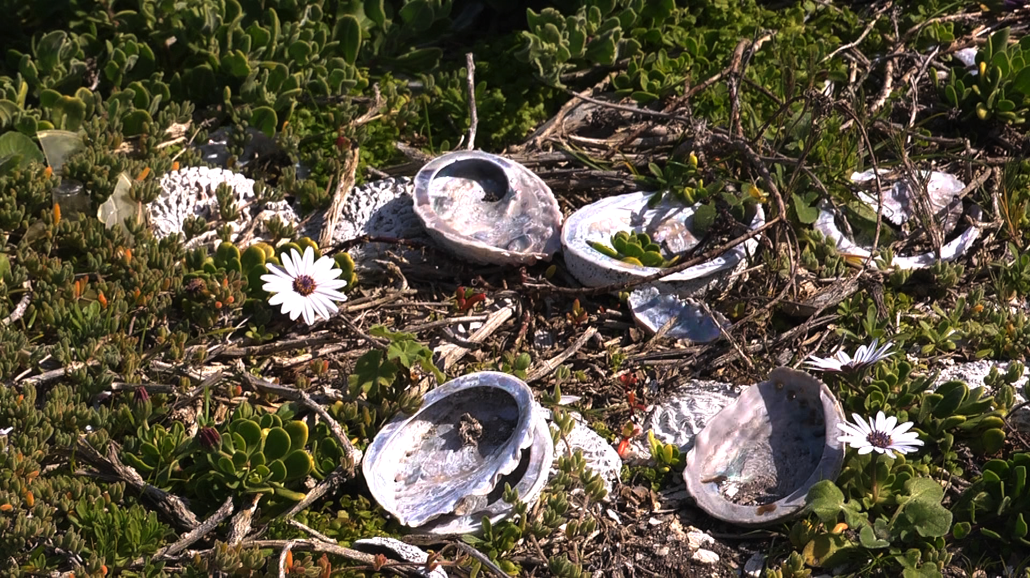

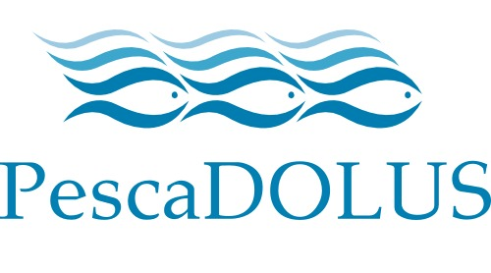

Small-scale Fisheries and Abalone – the case of Buffelsjagsbaai.
Moenieba Isaacs

Slide 2
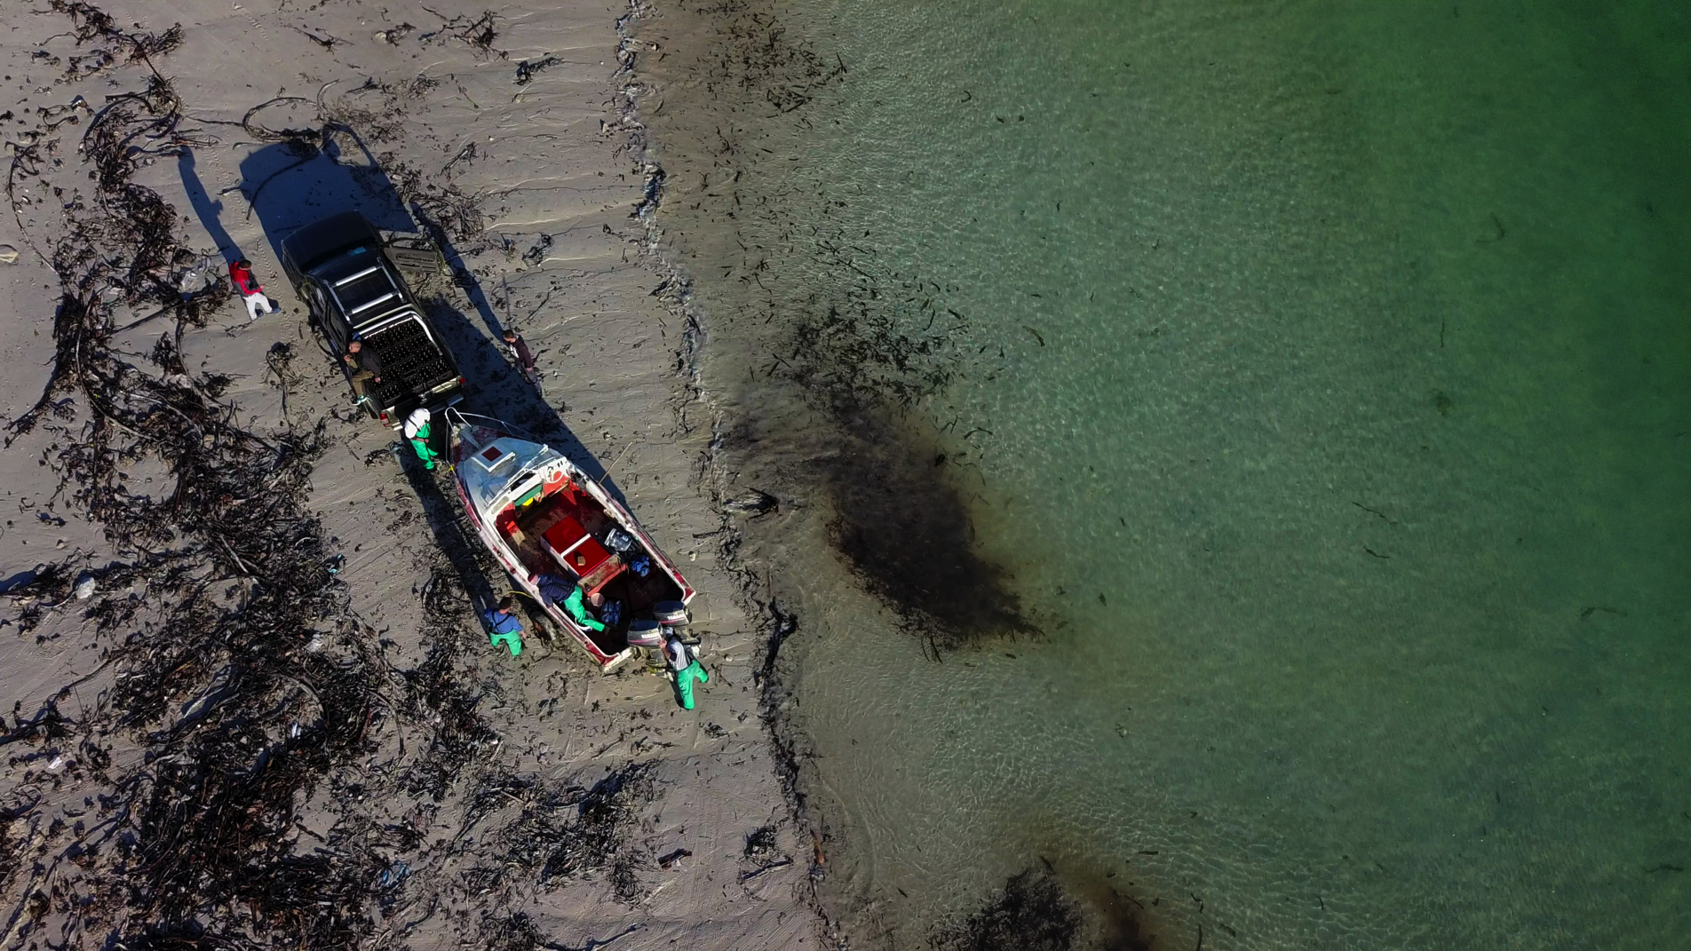
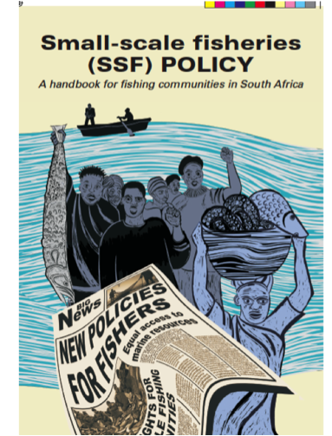
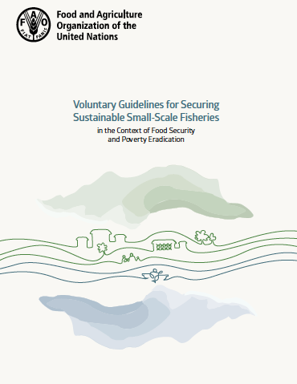
Notes:
Human rights based approach, Food security, Livelihoods, Poverty, Access, and Tenure
Key international and local instruments for small-scale fisheries. UNFAO the Voluntary Guidelines for Securing Sustainable Small-scale Fisheries in the Context of Food Security and Poverty Alleviation (SSF).
The Civil Society Organisations (CSOs) with the support of The Food and Agriculture Organisation (FAO) took 6 years to draft the Voluntary Guidelines for Securing Sustainable Small-scale Fisheries in the Context of Food Security and Poverty Alleviation (SSF).
The main objectives of SSF are to reverse the marginalization, contribute to food security and nutrition, to alleviate poverty and equitable development and sustainable utilization of fisheries resources.
The SSF Guidelines are developed as a complement to the 1995 FAO Code of Conduct for Responsible Fisheries (CCRF).
The guidelines raised the profile, increase the value, reconfirmed their importance, scale and size of this sector.
The new instrument is global in scope, and applies to small-scale fisheries in all contexts, but with a specific focus on the needs of small-scale fishing communities in developing countries.
SA Small-scale Fisheries:
The social and economic justice of these instruments are rooted in the new small-scale fisheries policy in South Africa created an action space for fishers to participate in a formalized value chain with a development agenda that is concerned with poverty alleviation, food security, access to financial capital, and subsidies. In the new small-scale policy, the state will make budgets available through national, provincial and local governments to strengthen the capacity, training and skills of local community entities or cooperatives.

Slide 3
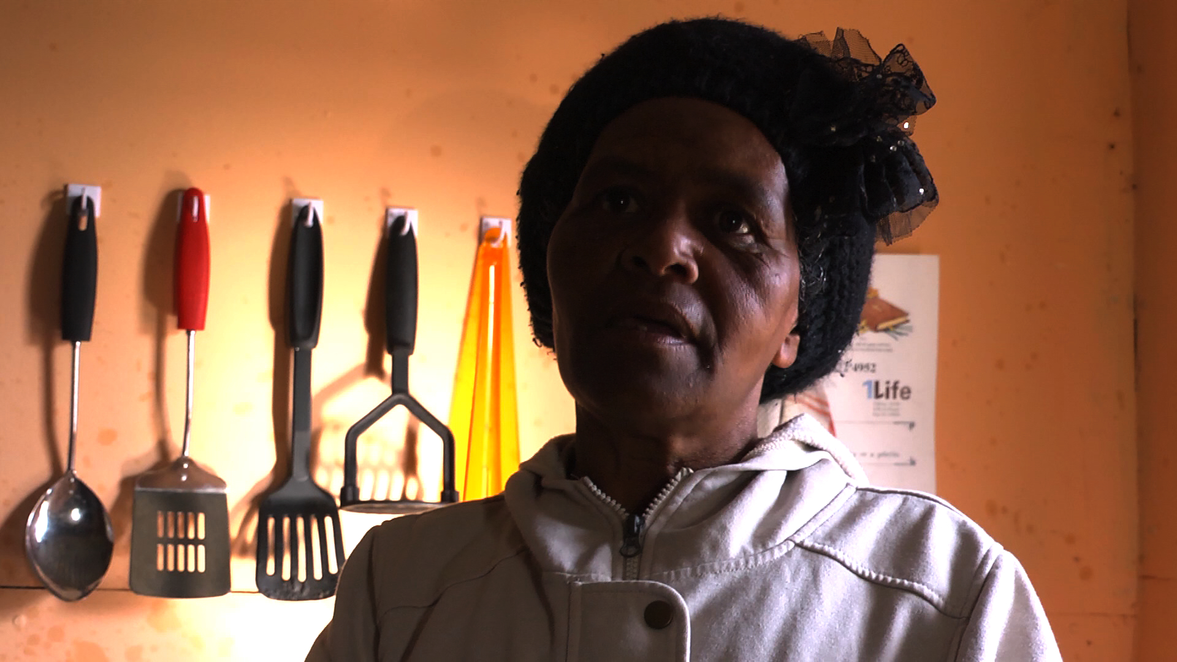
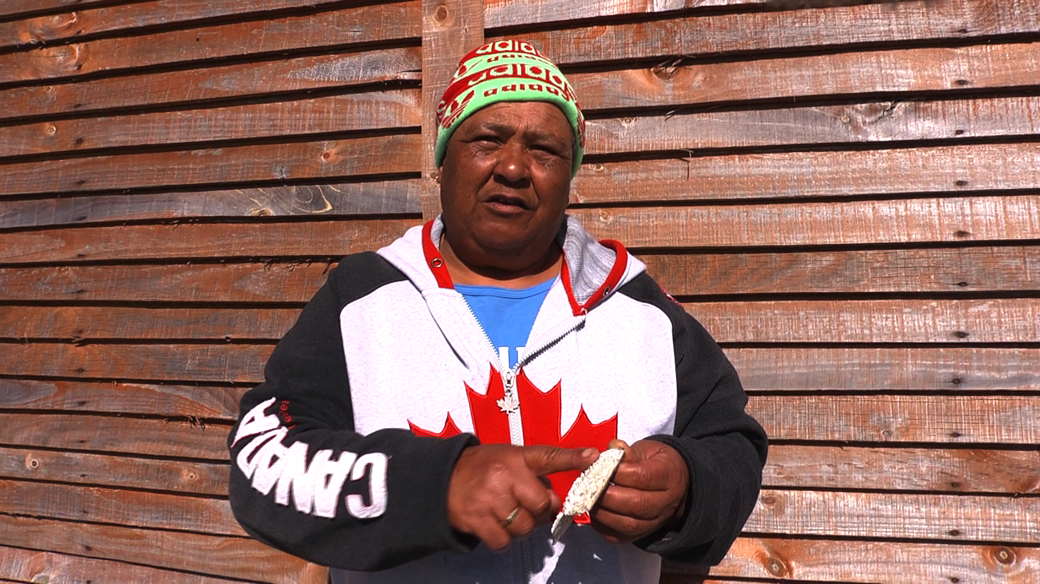
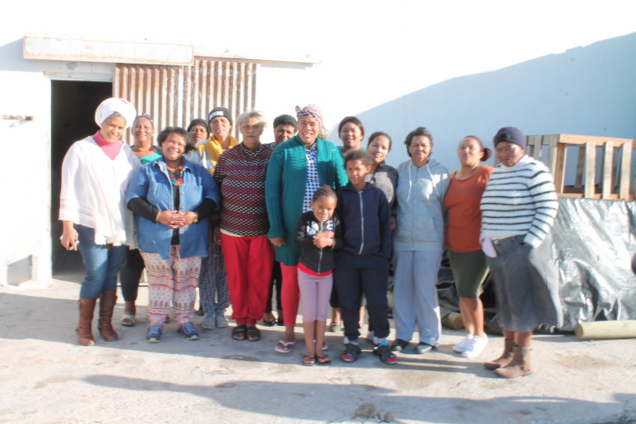
The women of
Buffelsjagsbaai
Notes:
“If I walk on the rocks in front of my house, the police wants to know why and what I am doing on the rocks?”
“If we do not stop the poachers there will be nothing left for our children to see or to sell”
“What can I do? If I need food and my children are hungry and the poachers asked me to wash their wetsuits then I will do it for food for my family. I know it is wrong and I know it is illegal

Slide 4
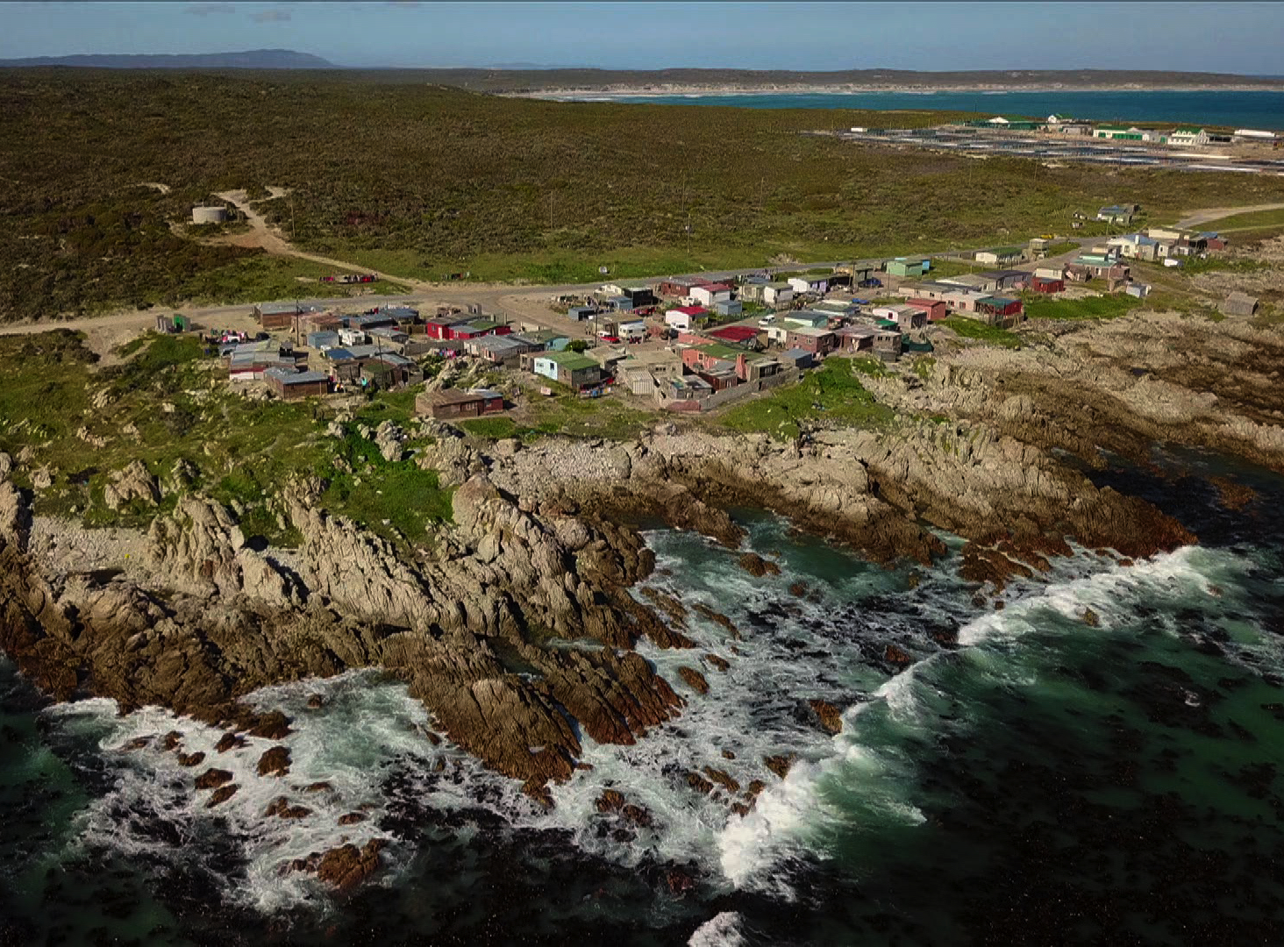
Buffelsjagsbaai
Notes:
Buffelsjagsbaai an informal rural fishing community of 40 households about 150 km from Cape Town situated in the wealthy Overstrand local Municipality yet the community struggles with access to schooling, basic housing, running water, sanitation and to fishing rights to harvest the marine resources on their shores to sustain their livelihoods.

Slide 5
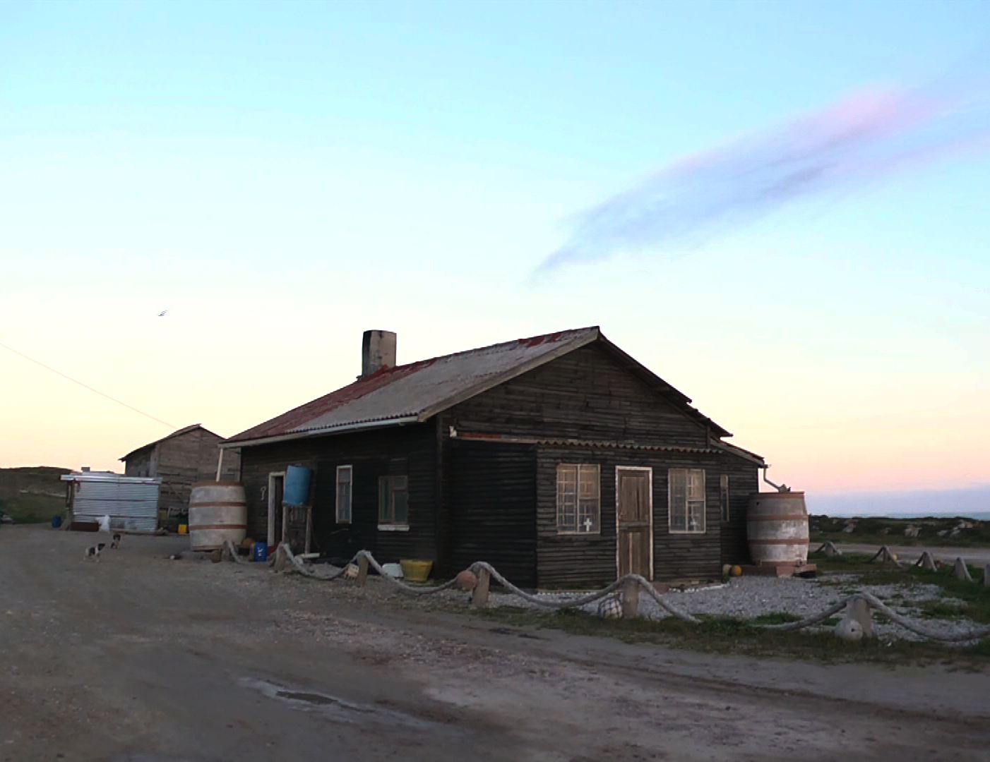

Insecure Tenure - Water, Sanitation, and Housing
Notes:
The Committee of Food Security of the United Nations’ Voluntary Guidelines on the responsible Governance of tenure of land, fisheries and forests in the context of national food Security protect the right to tenure (where communities live) and access to marine resources to secure their food security. This home is on the border of the 300ton abalone Aquaculture farm (Viking Fishing) in the next months will be be erecting massive wind turbines for sustainable energy.

Slide 6
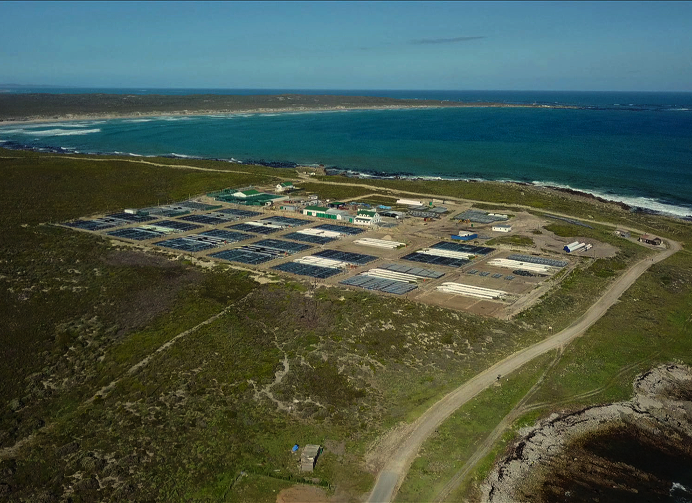
Blue growth, Oceans Economy, Operation Phakisa,
Notes:
Currently a more immediate threat under the auspices of blue growth in the oceans economy the land they living on and making a livelihood from the resources on land and sea is earmarked for Aquaculture development and this with the support of the National Development Plan’s Operation Phakisa. In the past 5 years concessions and lease agreements were given to Viking Fishing to set up a 300ton abalone aquaculture farm and currently HIK and Abagold are all establishing their farms. Blue Growth, Oceans Economy, and Jobs for the poor in the community.
The community of buffelsjagsbaai dreams of owning and managing an Abalone Aquaculture Farm as a form of community development. However, in reality if you want to farm abalone 1 ton you will need R 1 million and to be profitable you need a farm of over 120tonnes. This is out of the reach of community aquaculture…

Slide 7
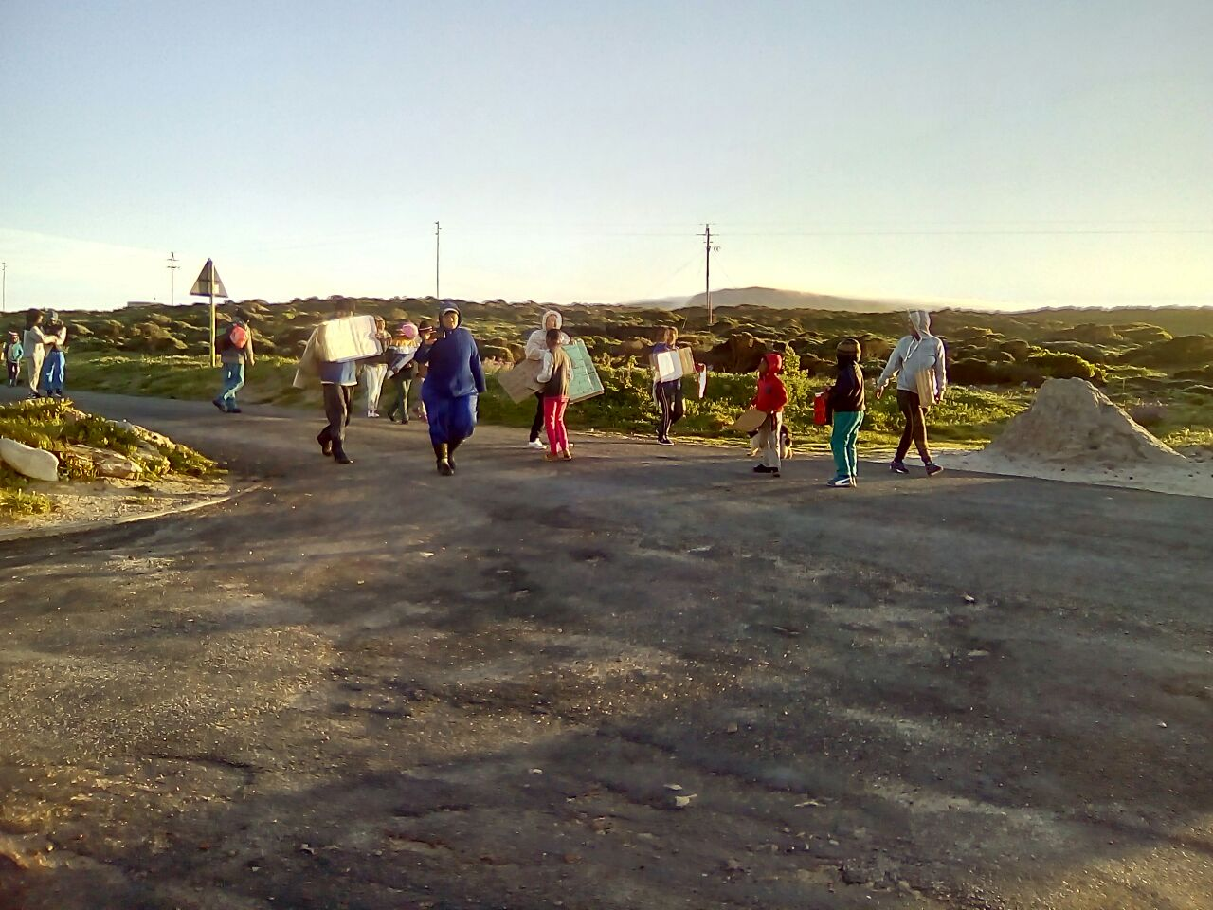
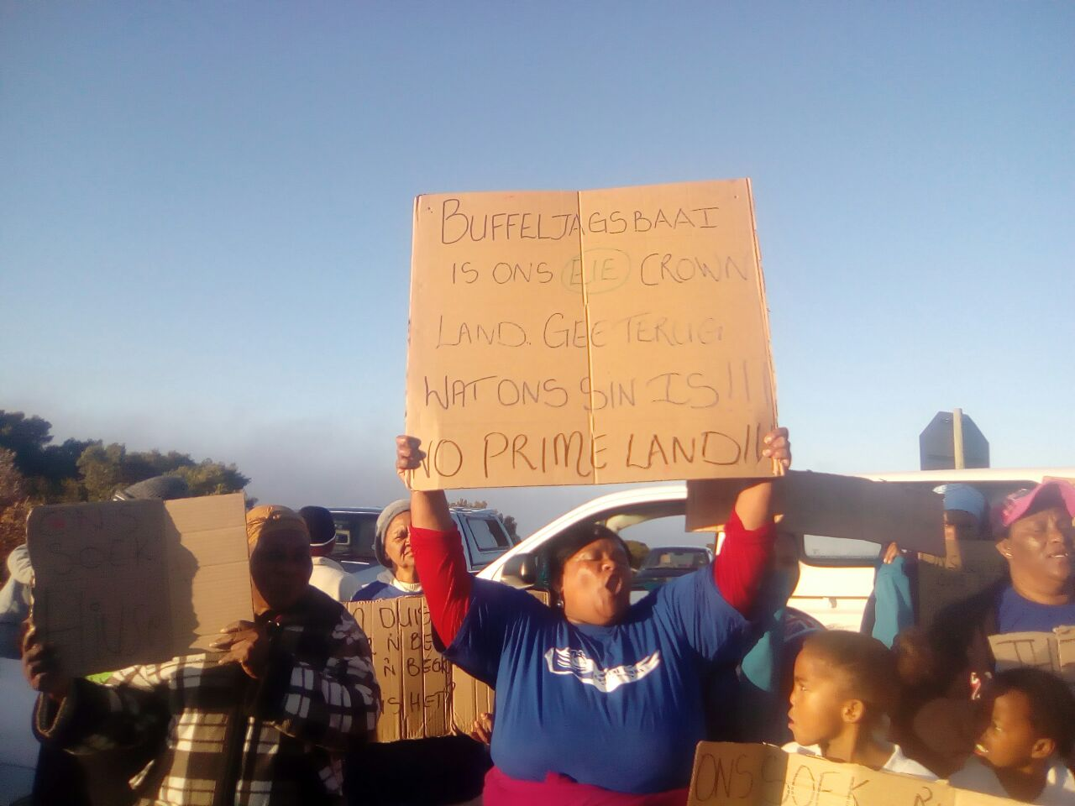
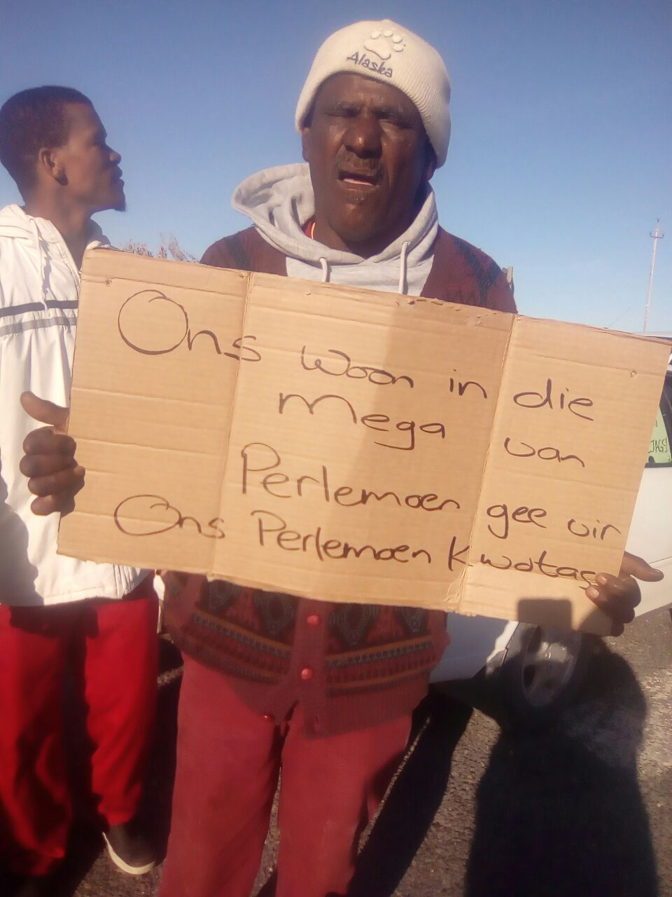
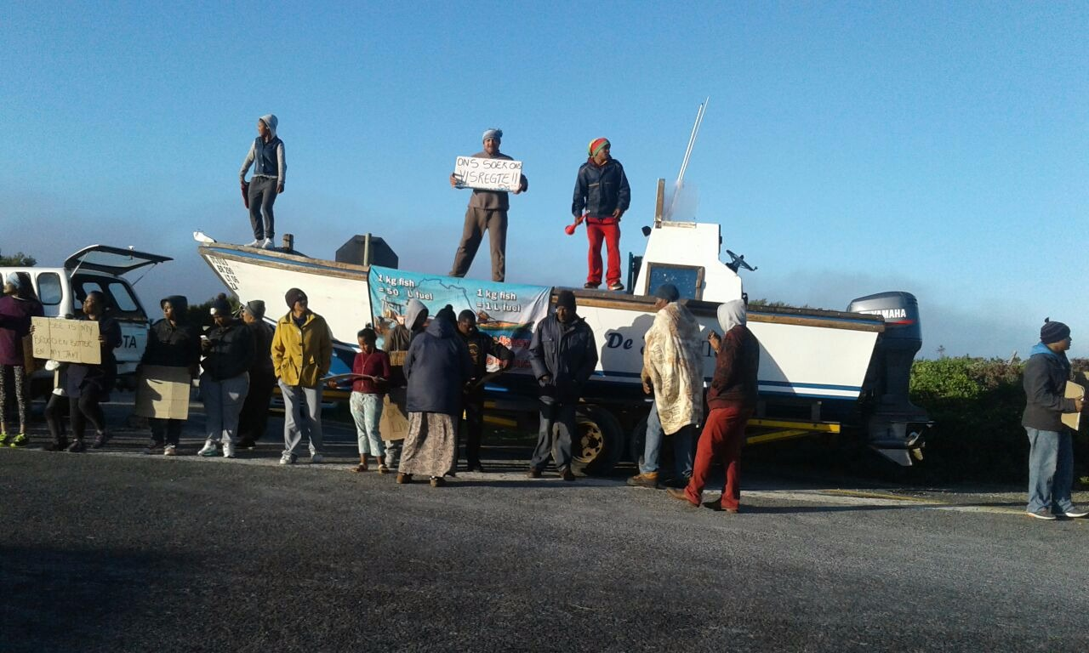
18 September 2017 – a day of Protest – against the lack of water, sanitation, housing, fishing rights, abalone farms, and the poachers from taking abalone for the day…
Notes:
18 September 2017 – The women organised a day of protest for housing (sanitation and water), fishing rights, fear of eviction, keeping the poachers out ( the ones who steal our resources and will leave nothing for our children). The women of the community wants to take action and take control of their community, their livelihoods, their housing, and support local economic development (tourism, selling food and some crafts) and wish for their own abalone community aquaculture farm.
Community leaders feel the poaching with the gangs are out of control and any co-management arrangements with abalone will fail
“If there is no money what must we do “
Youth getting involved in poaching as it is a form of quick money, buy expensive name brand shoes, clothes, and a traps into the gang world of money, cash, some even drugs.

Slide 8
