Slide 1
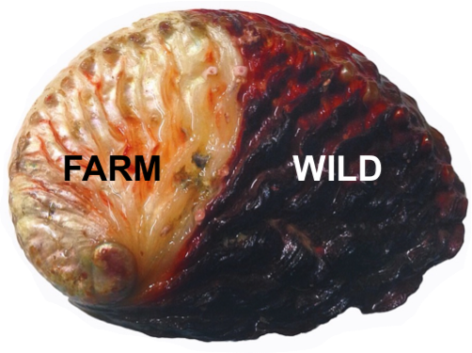

TURF BASED ABALONE STOCK ENHANCEMENT USING HATCHERY SPAT AND PRIVATE SECURITY PROTECTION IN THE EASTERN CAPE, SOUTH AFRICA
Peter Britz, Andrew Witte
Department of Ichthyology and Fisheries Science, Rhodes University

Slide 2
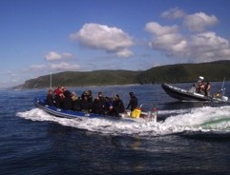
Fishery Management Failure
South African Abalone Production (Tons whole mass)
Why?
What to do?
Illegal Fishery
Aquaculture
Legal Fishery

Slide 3
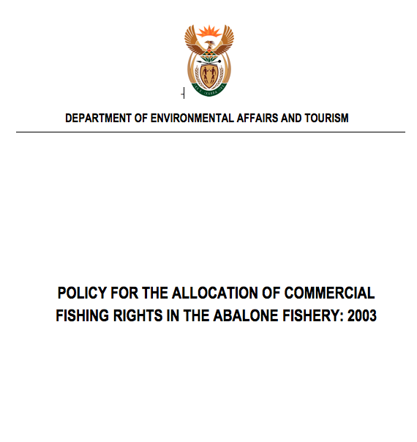
Flawed Fishing Rights
No Incentive or Institutional Arrangements for rights holders to invest in resource rebuilding, protection and value maximization.
Short term rights – one year
Constant threat of fishery closure
Fishing zones not exclusive
Rights not transferable
Catch Quota’s not economically
viable (500kg/y)

Slide 4
Traditional Fishery Management Tools Ineffective
Traditional top-down fishing authority ‘command and control’ approach
Main management focus areas:
  Setting of Total Allowable Catch (TAC) and catch quota allocation.
  Fishing effort limitation
Lacks tools for managing the ‘Human Dimension’ of the fishery
  Use of economic drivers to encourage investment in resource rebuilding
  Co-management institutions to empower resource custodianship and community buy-in to legal resource use
  Incentives to maximize harvest value (value chain approach)

Slide 5
Outcomes
Institutional failure
  Rights lack legitimacy
  Poaching an acceptable livelihood in communities
  Organised crime and drugs eroding community social fabric
  Rent seeking with quotas and confiscated abalone
  $200 million illegal value chain – untaxed
  Huge value lost – low quality product
  Livelihood, jobs, education and community upliftment opportunities lost

Slide 6
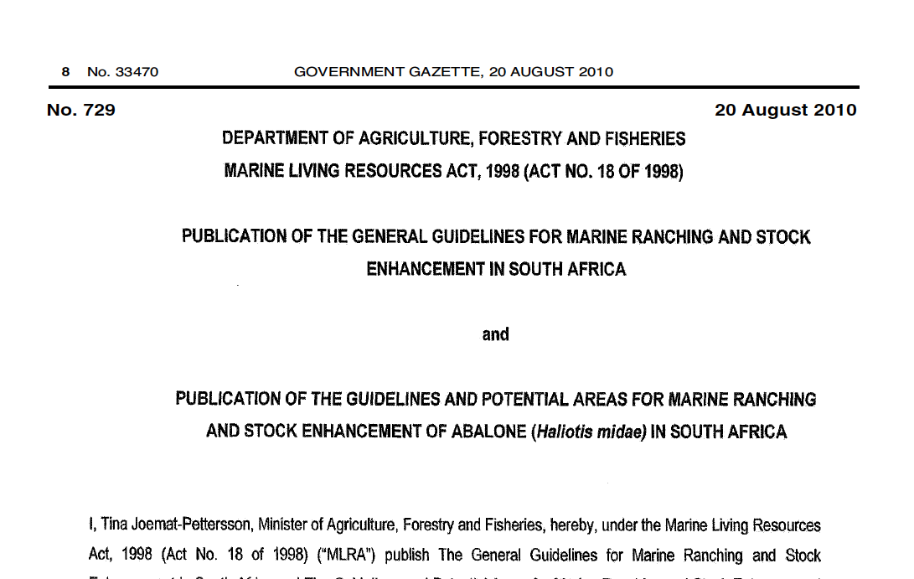
A Potential Solution to the Abalone Fishery Crisis…

Slide 7
What’s Different about the Ranching and Stock Enhancement Policy?
Long term rights (15y)
Rights holder exclusive TURFs
Legal right by rights holder to protect stock
Right to reseed hatchery reared spat of local genetic origin
Private investment in resource rebuilding and sustainable fishing
State-Private-Community partnership

Slide 8
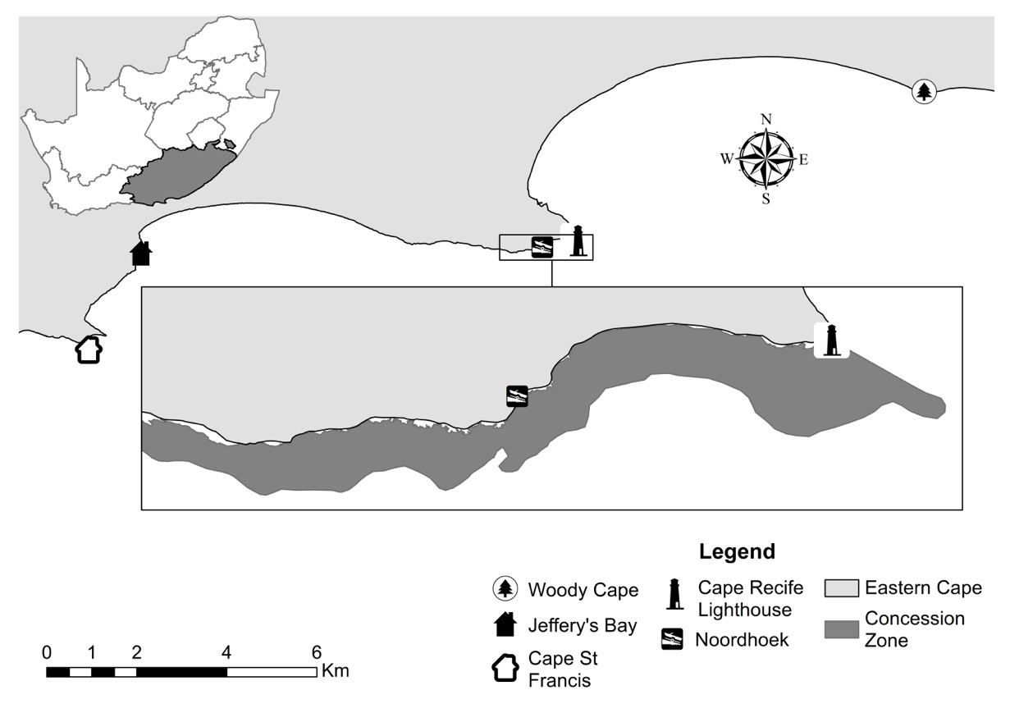
Experimental Ranching Rights Granted
Permits for three (3) Eastern Cape sites granted in 2013
Cape Recife, Port Elizabeth the main focus
South Africa
Eastern Cape Province
Cape
Town
Port Elizabeth
Cape Recife

Slide 9
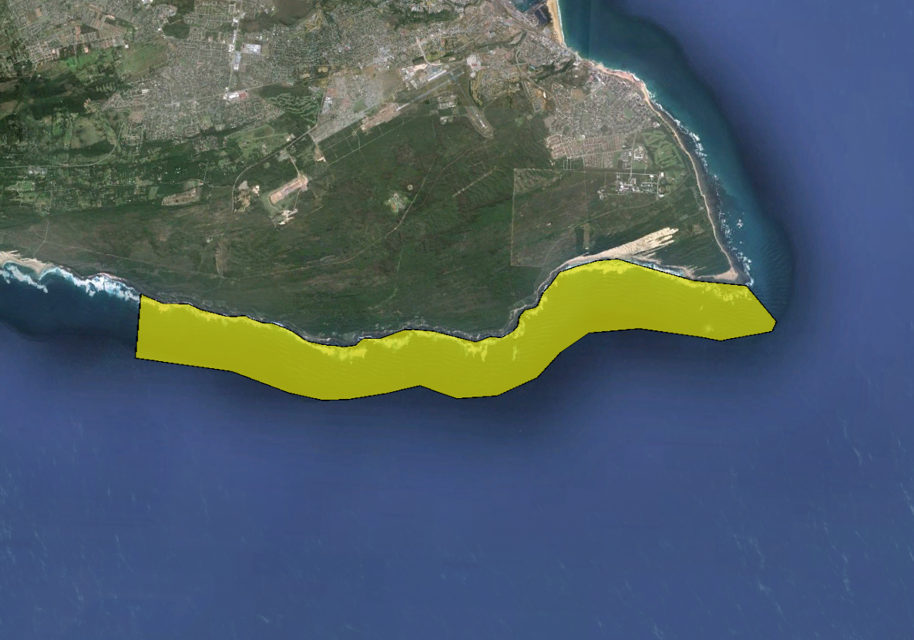


Overview
Port Elizabeth
Anti-poaching unit base
Core seeding area
Ranching Area
18km
Highly productive habitat
Focus of poaching since 1997

Slide 10
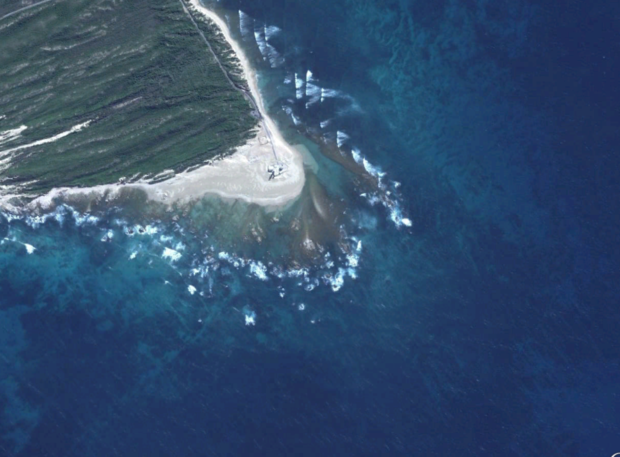
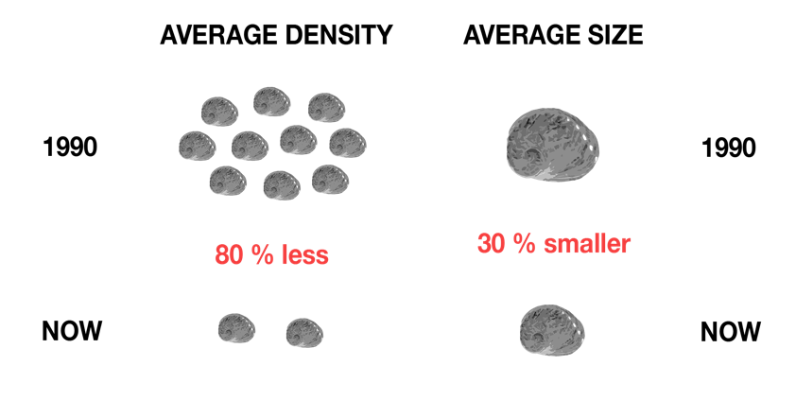
Situation in 2013
Illegal Fishing Effort
160 active poachers
12 ‘Crews’
6 Boats
1.5 ton abalone /week harvest
Resource Depletion
Density
Size
1993
1993
1.6 m²
2013
2013
0.3 m²

Slide 11
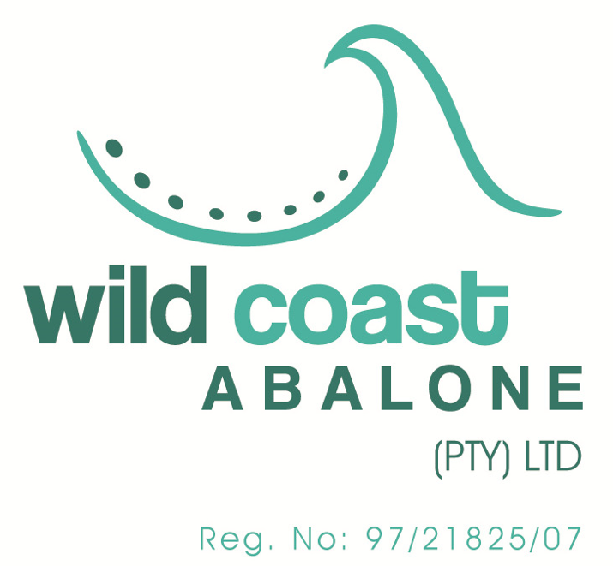
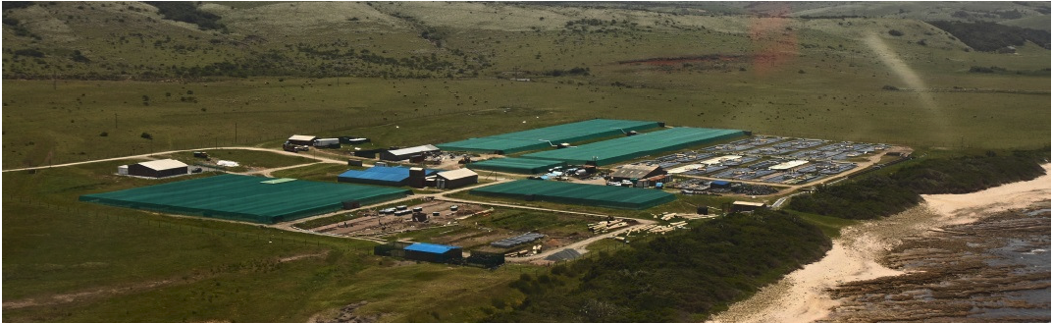
Produce 180 tons of abalone a year
Large capacity for producing juvenile abalone
Notes:
Wild Coast Abalone have taken the bold initiative and invested into abalone ranching. They are the only abalone farm in the Eastern Cape…

Slide 12
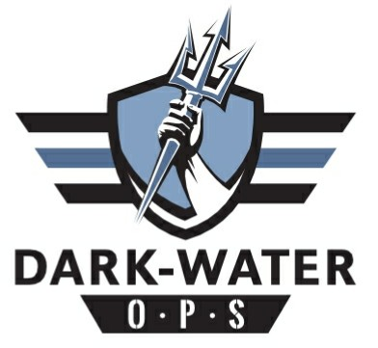
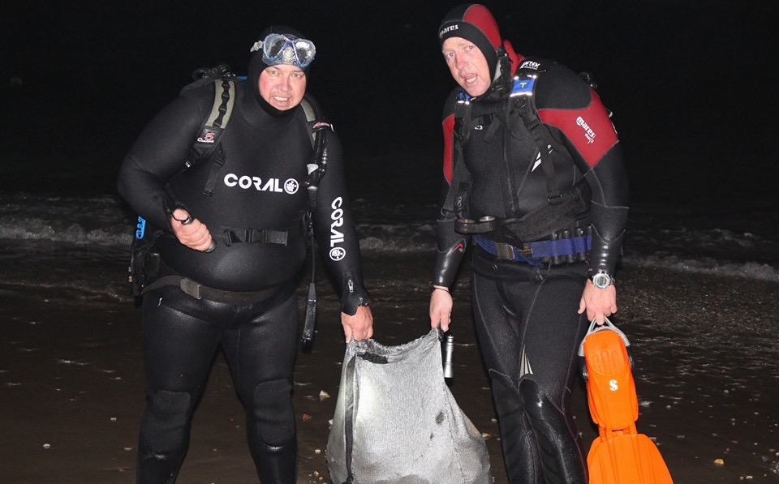
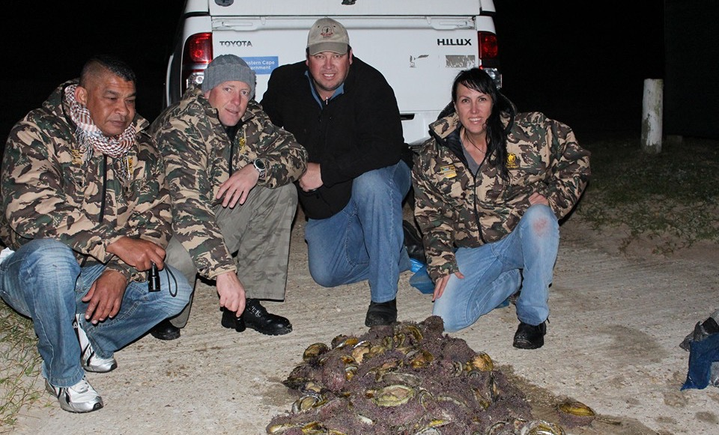
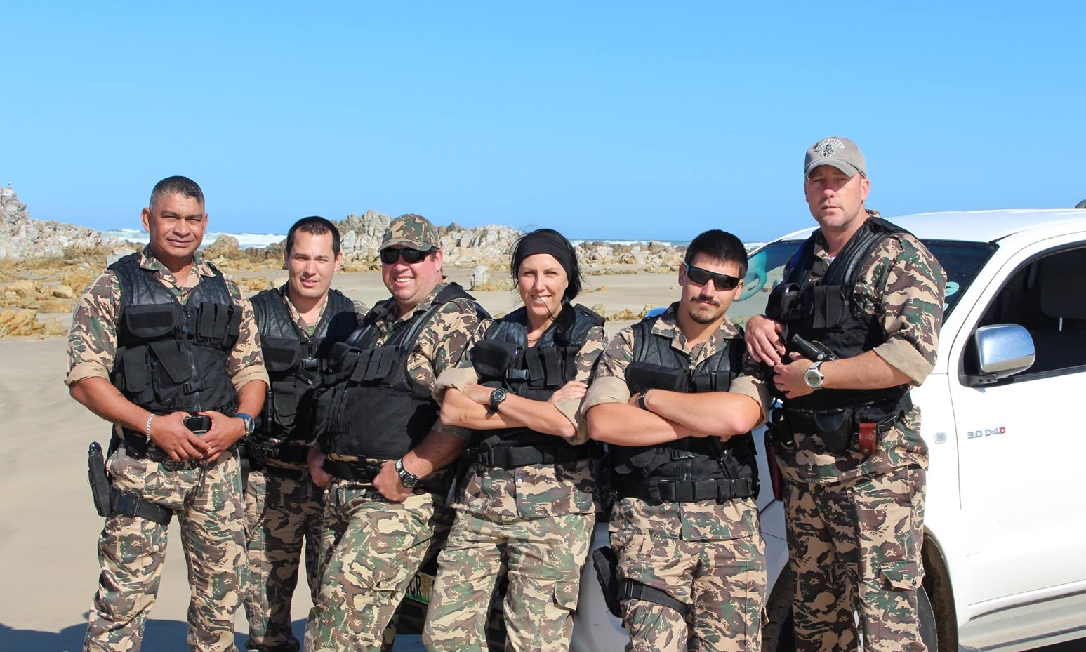
Private abalone Anti-poaching unit
Notes:
We knew that in order for ranching to be successful in any way we needed to have a fully functioning security team employed 24 hours a day to provide protection to the newly transplanted abalone from the farm. Wild Coast abalone farm formed a security group called Dark Water Ops

Slide 13
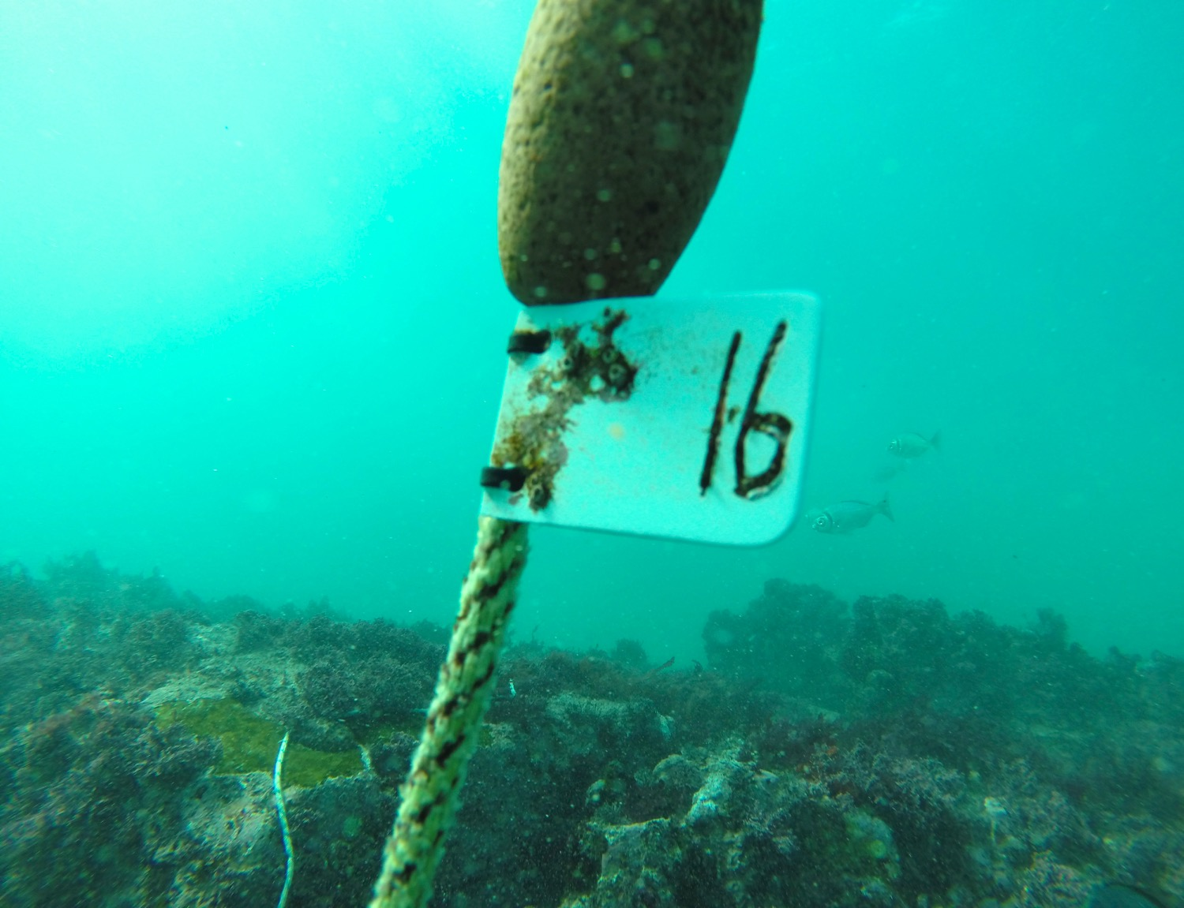
Experimental seeding
100
Density
200
400
Survival & Growth
Inside Bay
Habitat
Outside Bay
25mm
Seed Size
50mm
Notes:
Past work on ranching suggest that site selection, seed size and seeding density are critical variables in determining the success of abalone reseeding
The two important parameters are of course survival and growth of the abalone. We want to find out what is the favorable seeding density, habitat and seed size. Three densities have been chosen along with a Small and Big seed size. Two habitats have been selected.

Slide 14
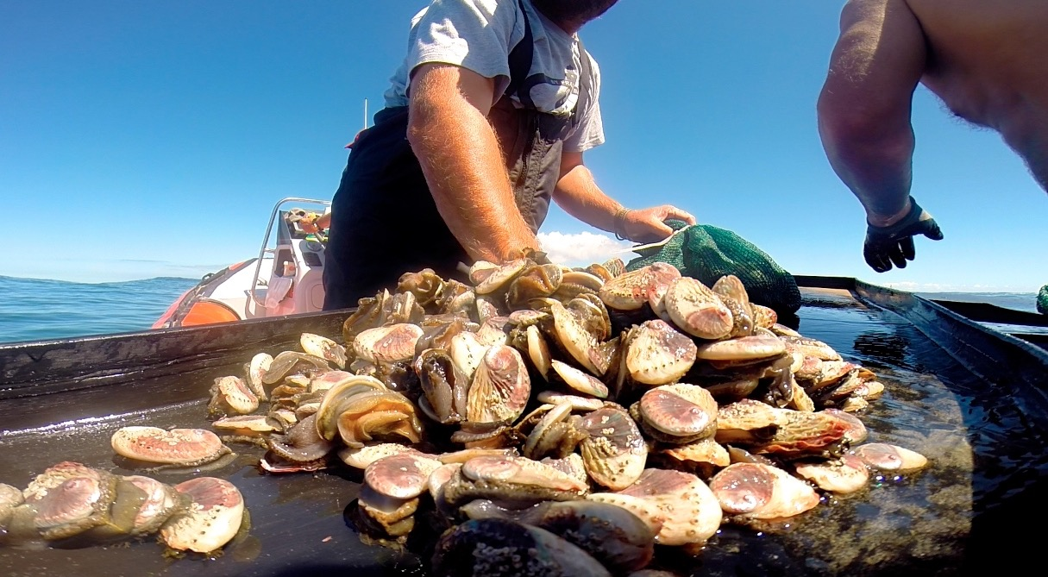
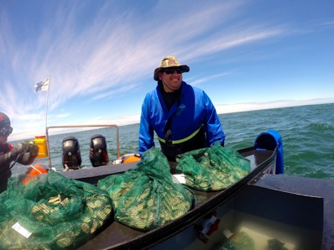
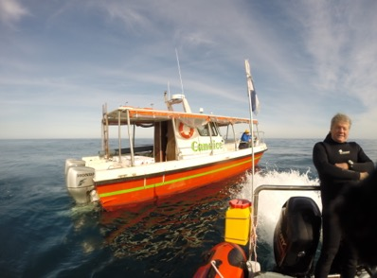
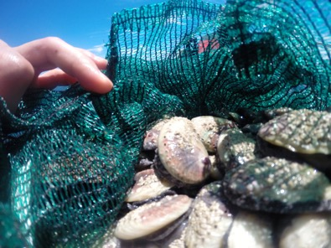
Large-scale releases
Mass surface releases
Seeded 1.4 million abalone or 29 tons over 21 months from 2013 -2015.
160 sites seeded
Sites seeded at densities according to size
Large – ±75mm SL (31719)
Medium – 45mm SL (820424)
Small – 37mm SL (550057)

Slide 15
Genetic Comparison
Farm population vs Wild populations
Notes:
Farm pop contains higher diversity than both wild pops, with Cape Recife displaying lower diversity estimates than both pops. This could have been caused by poaching

Slide 16
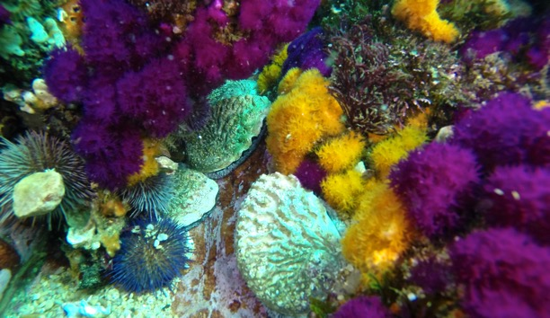
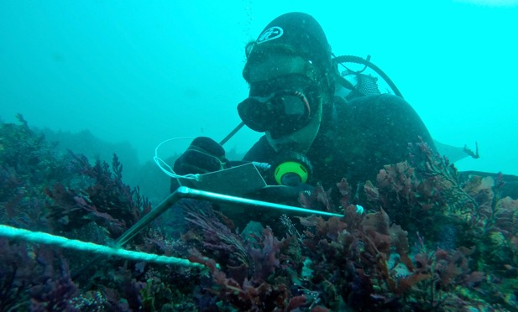
Large-scale sampling methods
Used quadrats to survey seeded sites (n=120-200)
Surveyed 17 sites across the 3 size classes from 30d to 3y post release
7500 quadrat counts performed accumulating in 200 hours of dive time

Slide 17
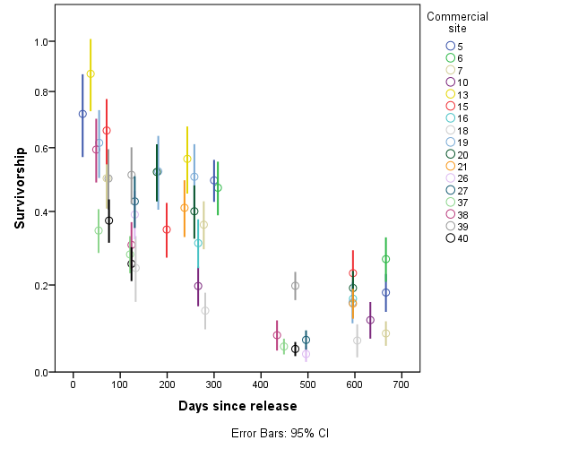
Large-scale seeding results
Notes:
Graph shows a decline in survival over time.

Slide 18
Large-scale seeding results
abalone released/ track area
100
Actual initial
Initial Loss – 30%
Predicated initial
% Survival
Emigration & Predation %?
50
M = -0.002767
Harvest size
(114mmSL)
0
150
300
450
600
Days since release
Notes:
From the track area we were able to calculate the initial seeding density for a site – actual initial
Then calculated the mortality rate from the days at large or since seeding.
We could then back calculate what the initial

Slide 19
Private Security anti-poaching
Surveilance and monitoring
Interception of poachers
Prosecutions
Intelligence
Combined operations with state agencies
Organised crime boss prosecutions

Slide 20
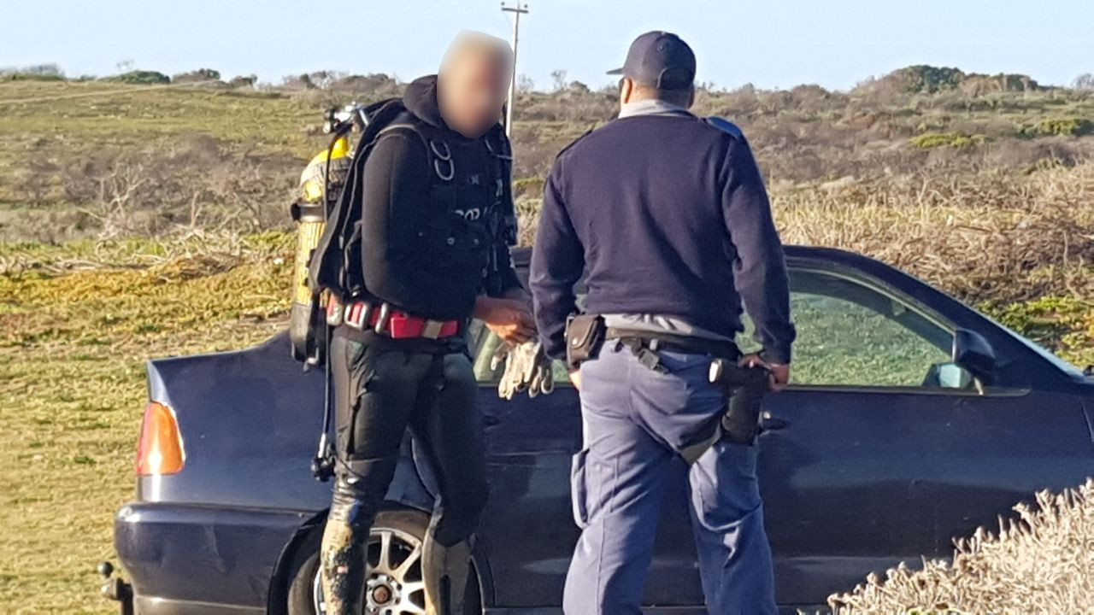
Reactive Policing – Marine Drive

Slide 21
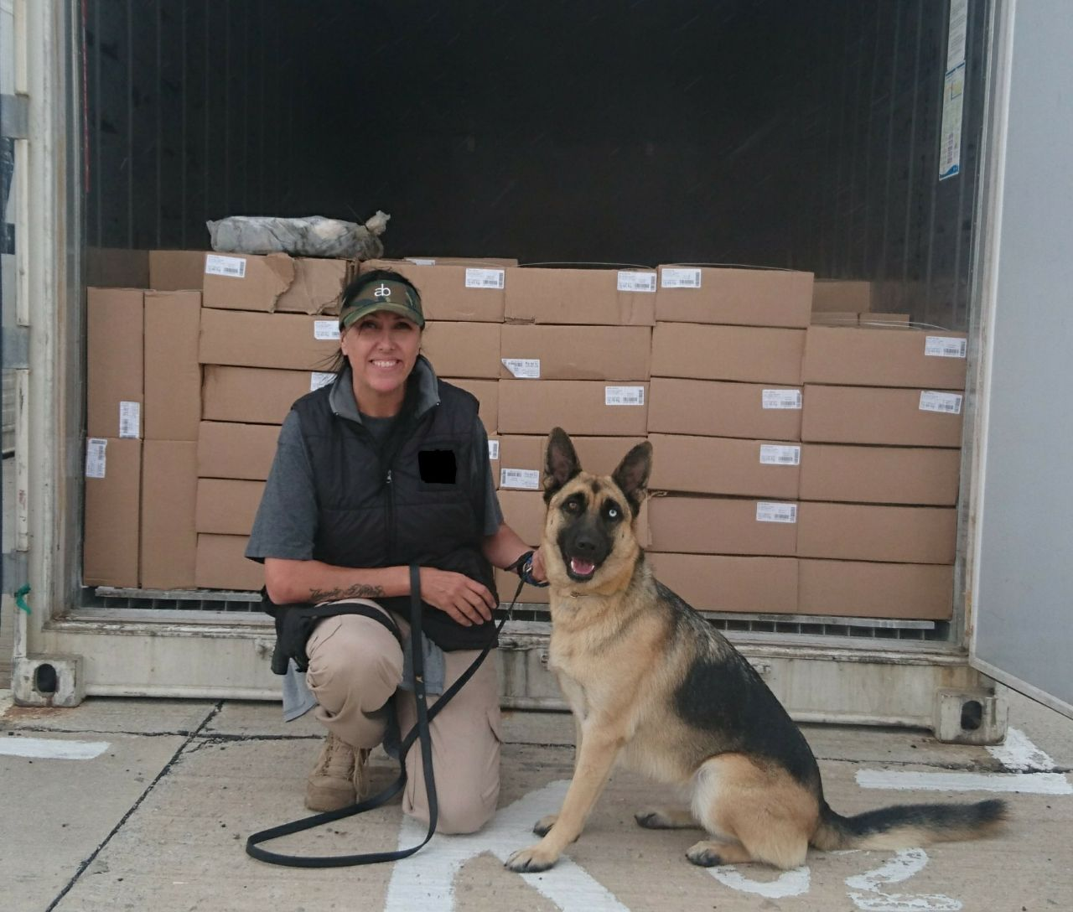
K9 detection

Slide 22
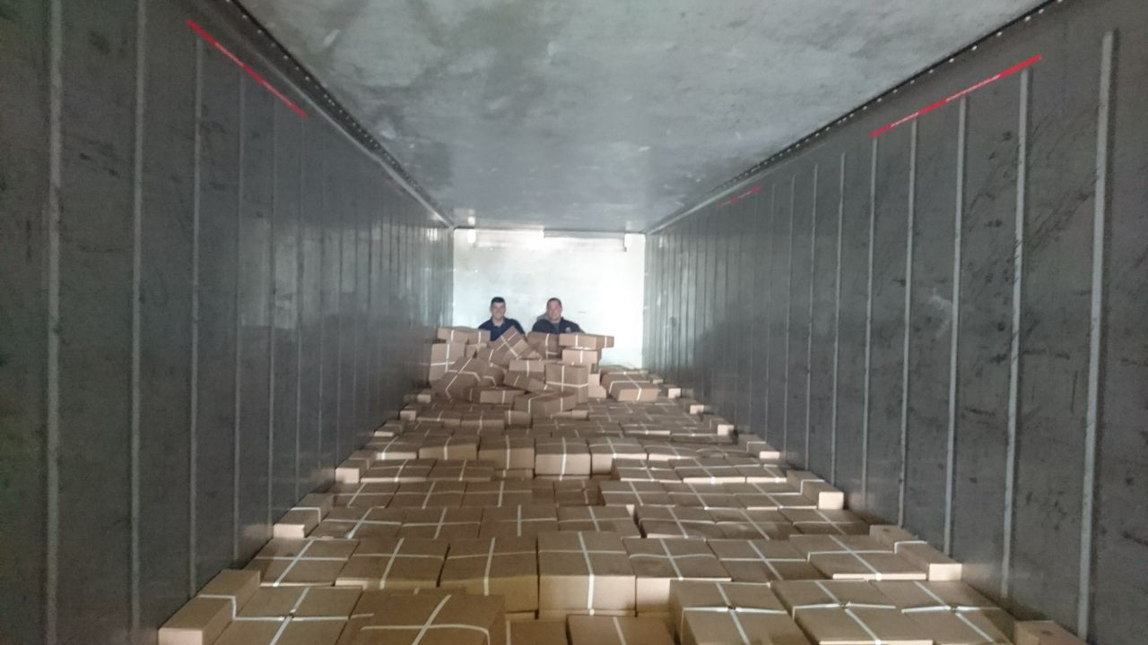
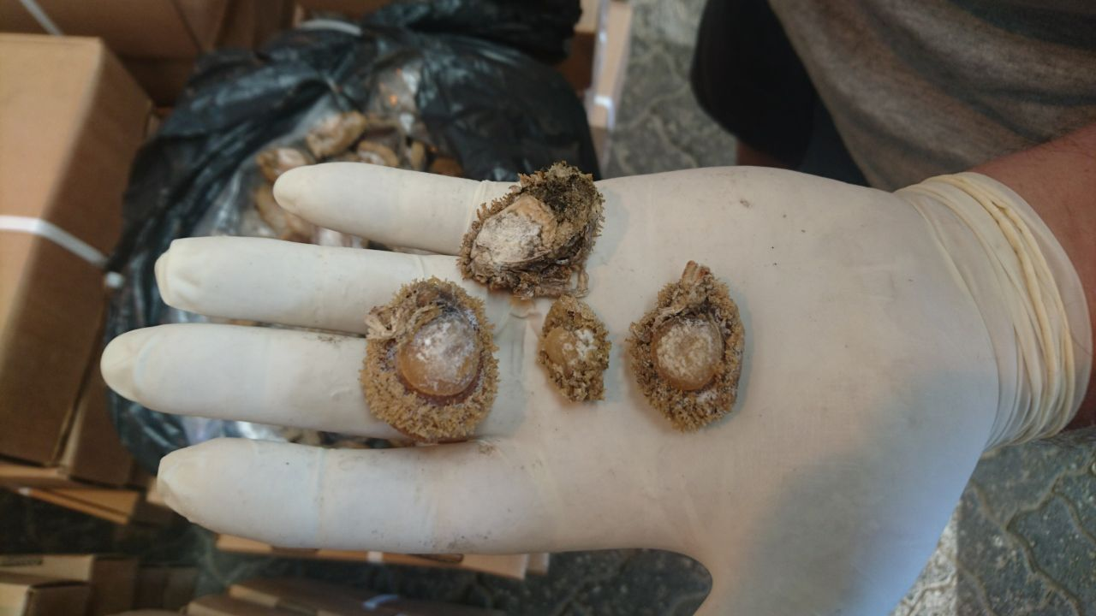
Organised Crime Intelligence
Shipping container
20,000 units abalone
Port Elizabeth Harbour

Slide 23
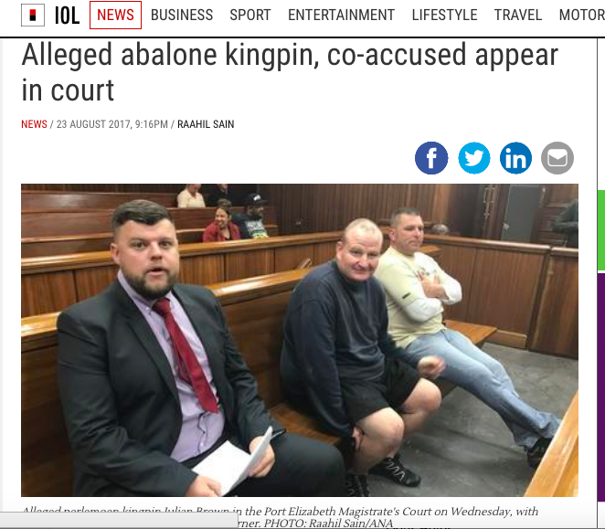


Prosecutions

Slide 24
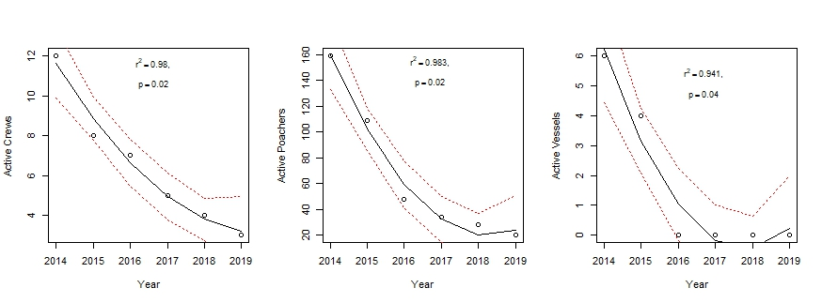
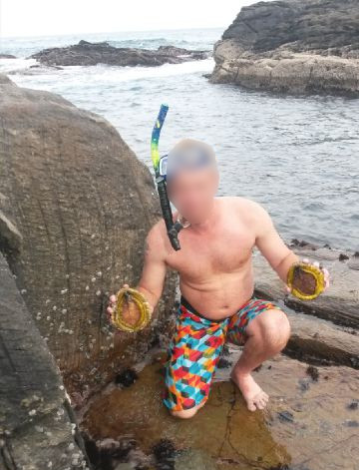
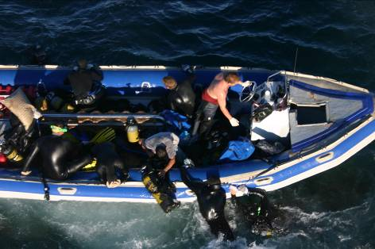
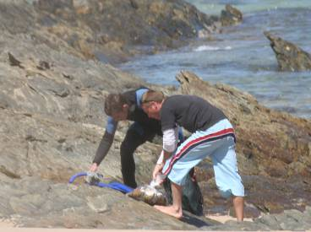
Poaching Effort

Slide 25
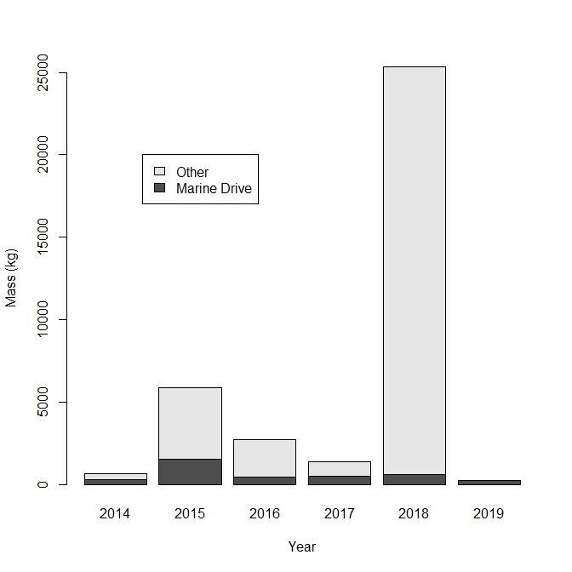
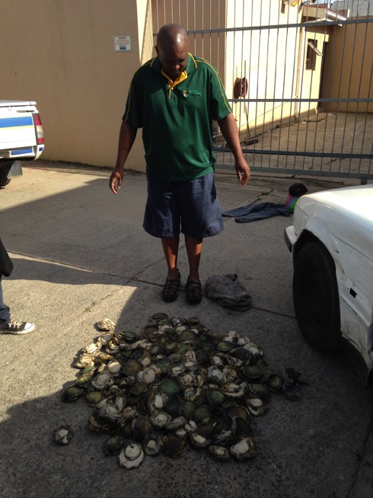
Confiscated Abalone

Slide 26
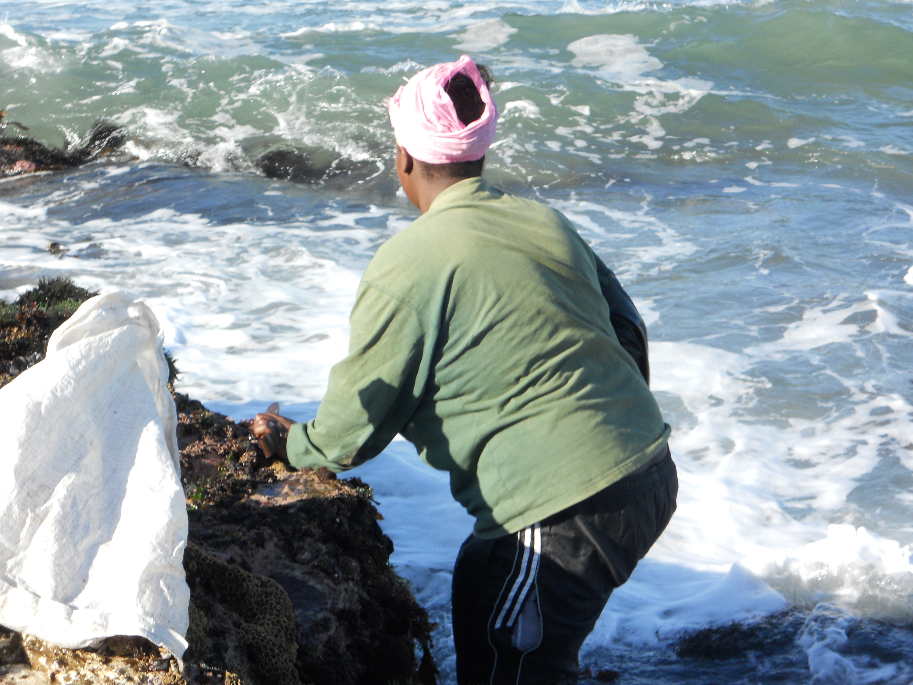
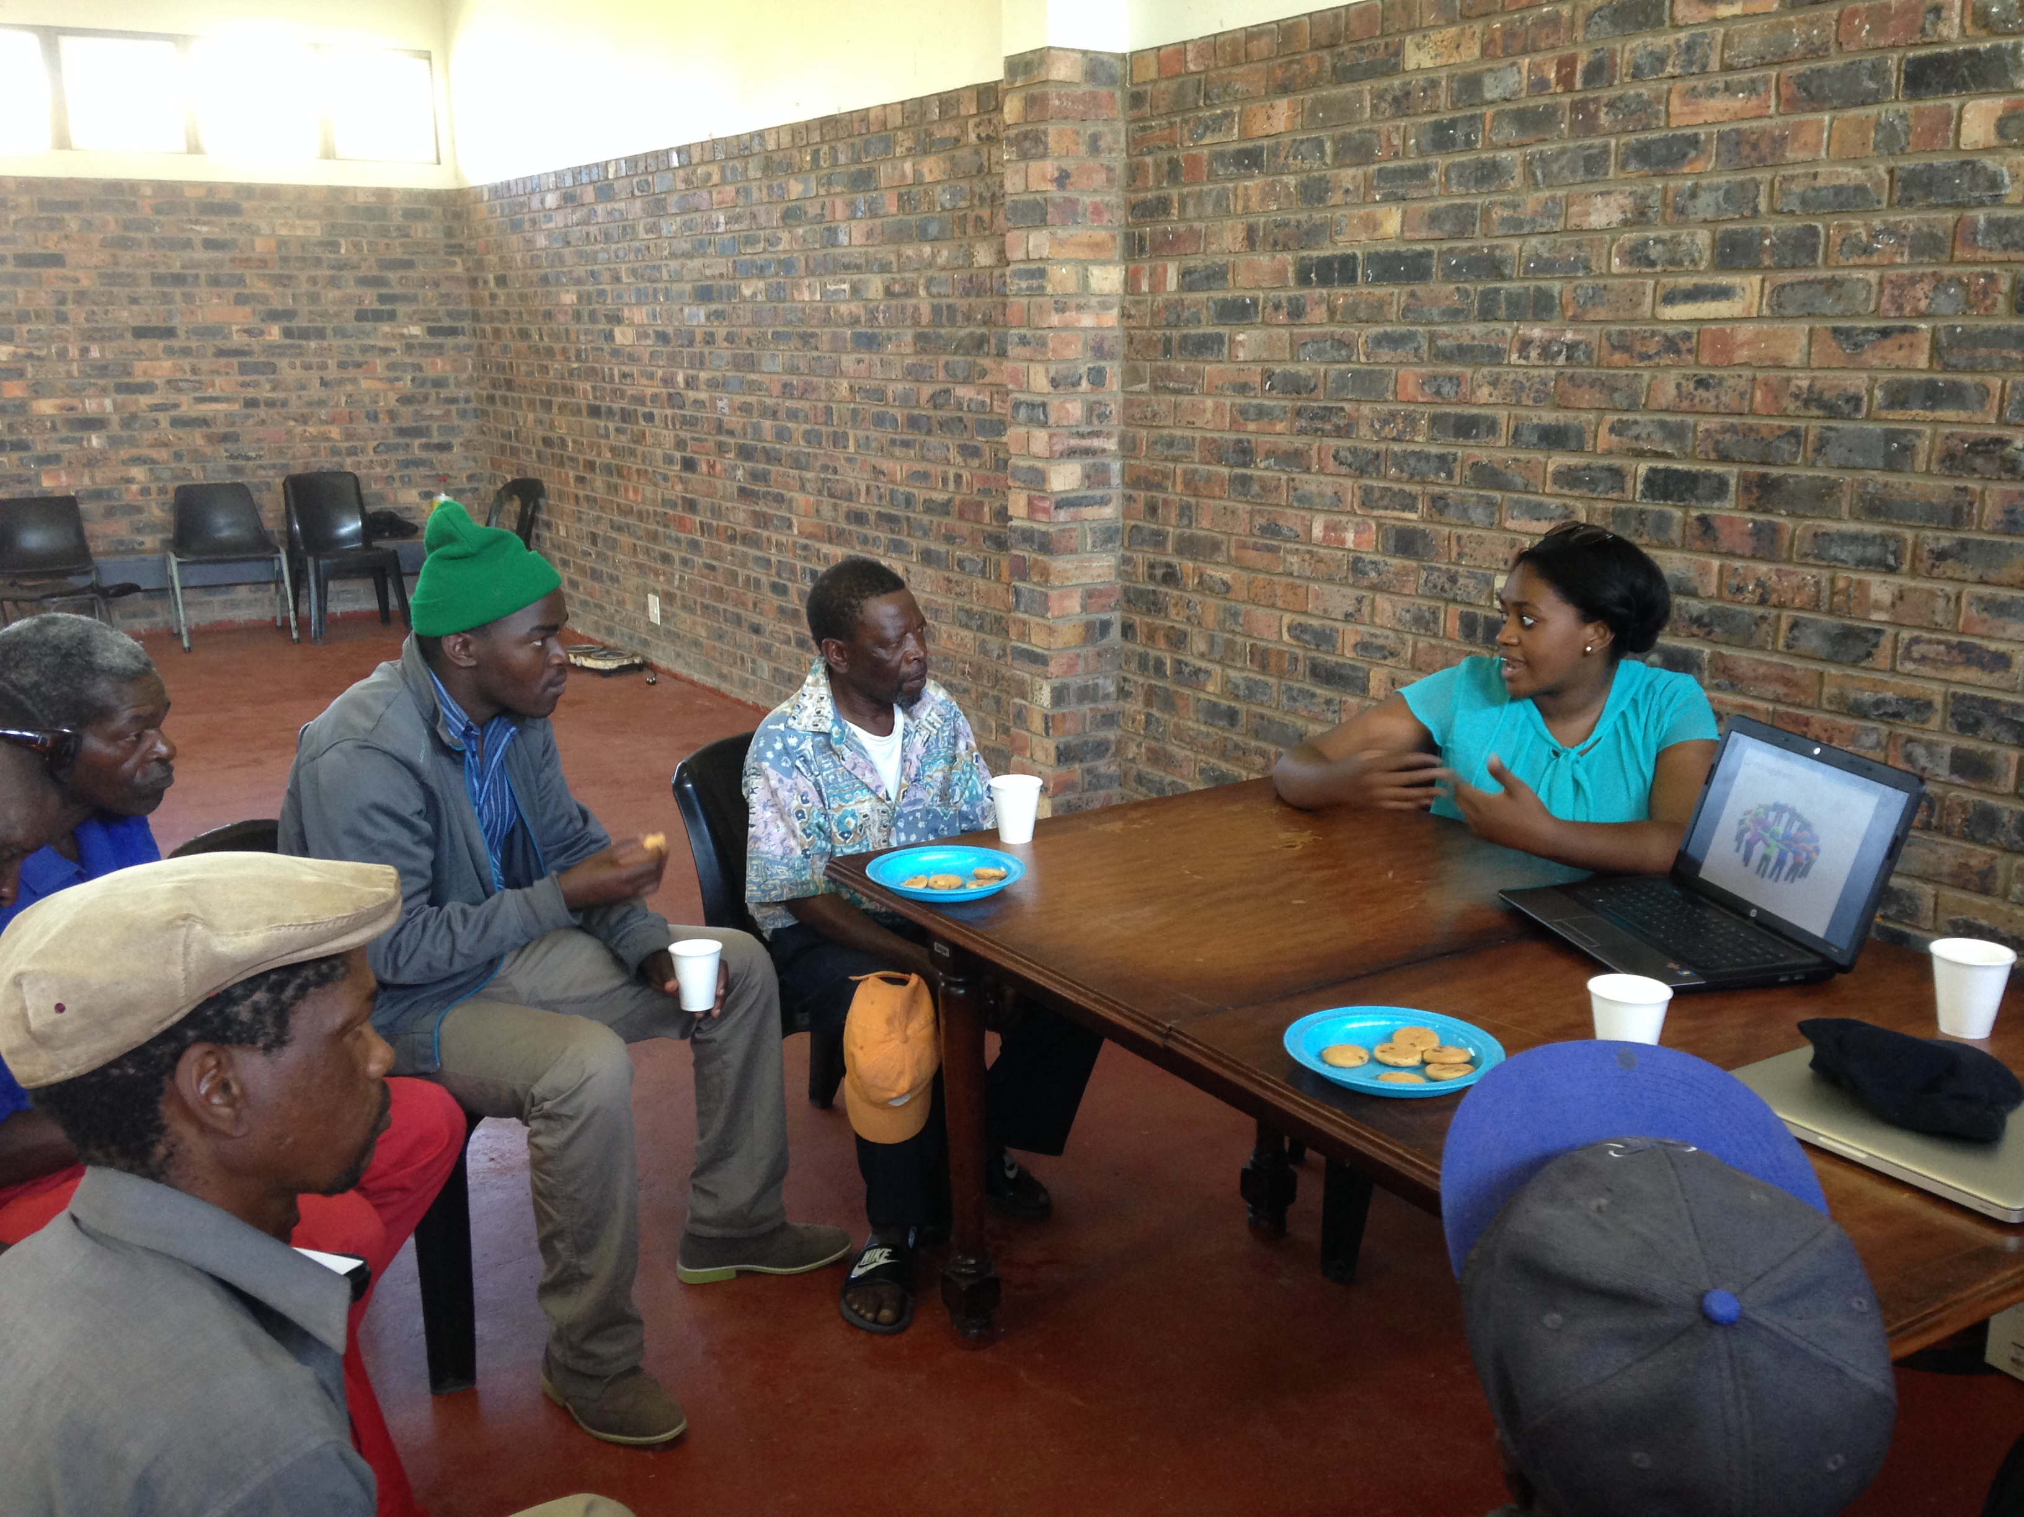
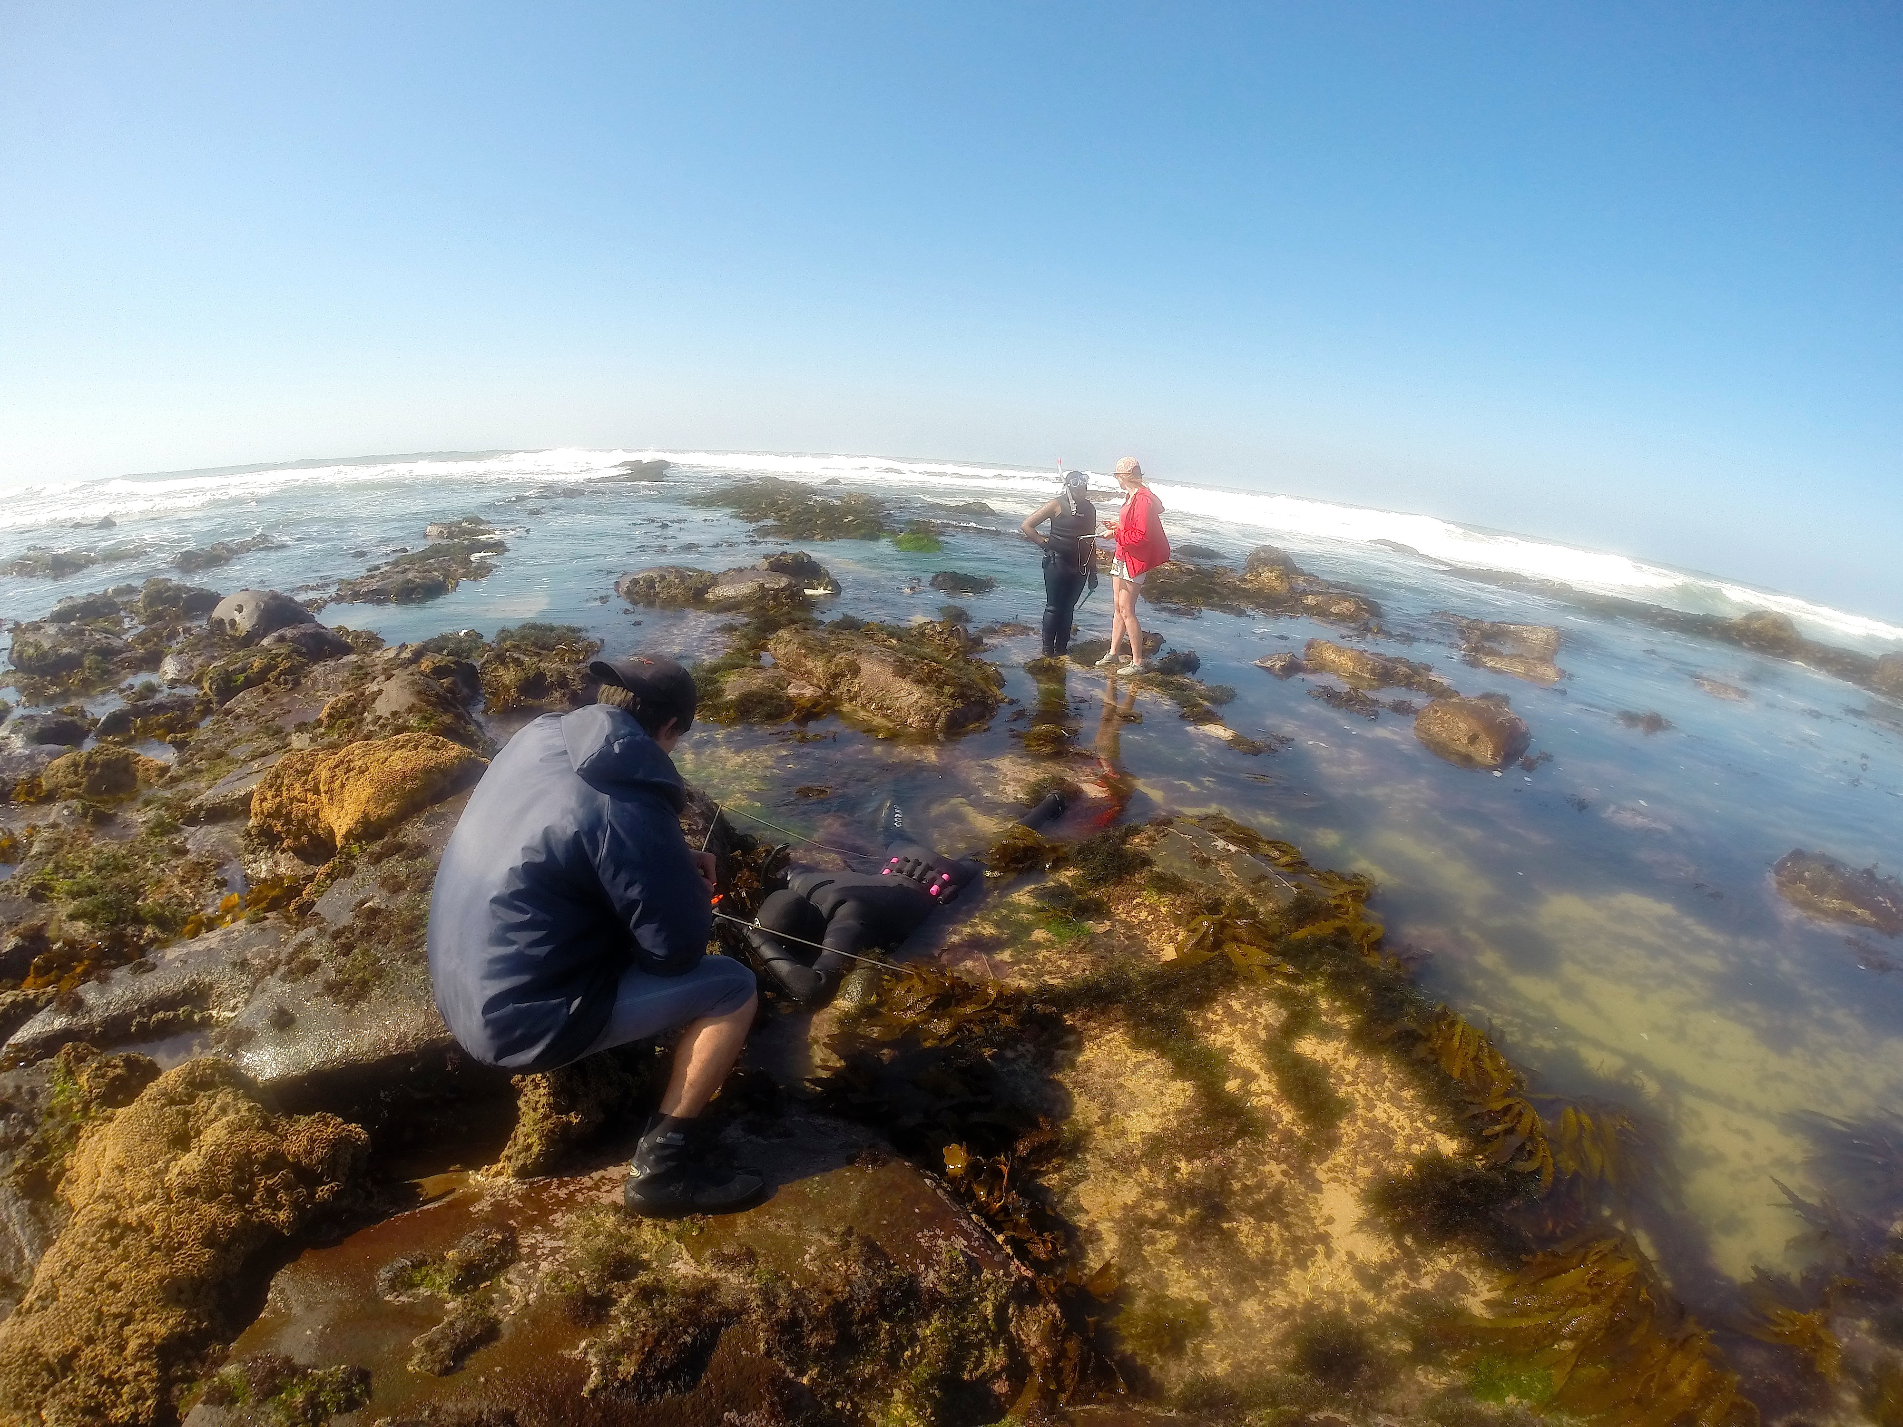
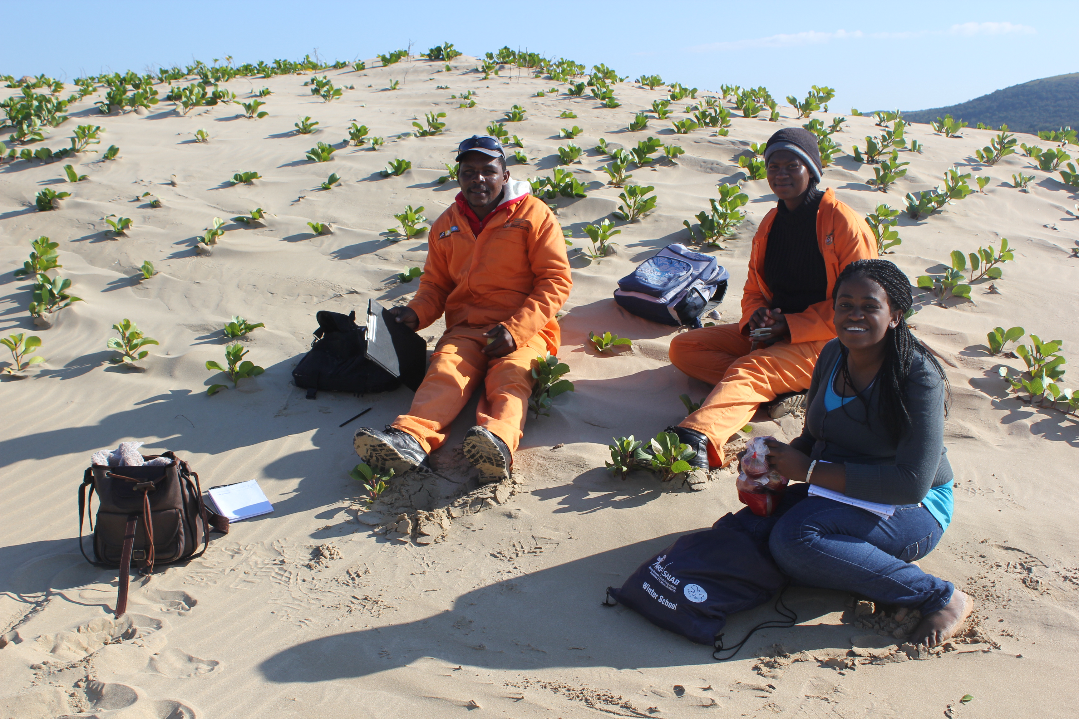
Community Partnership

Slide 27
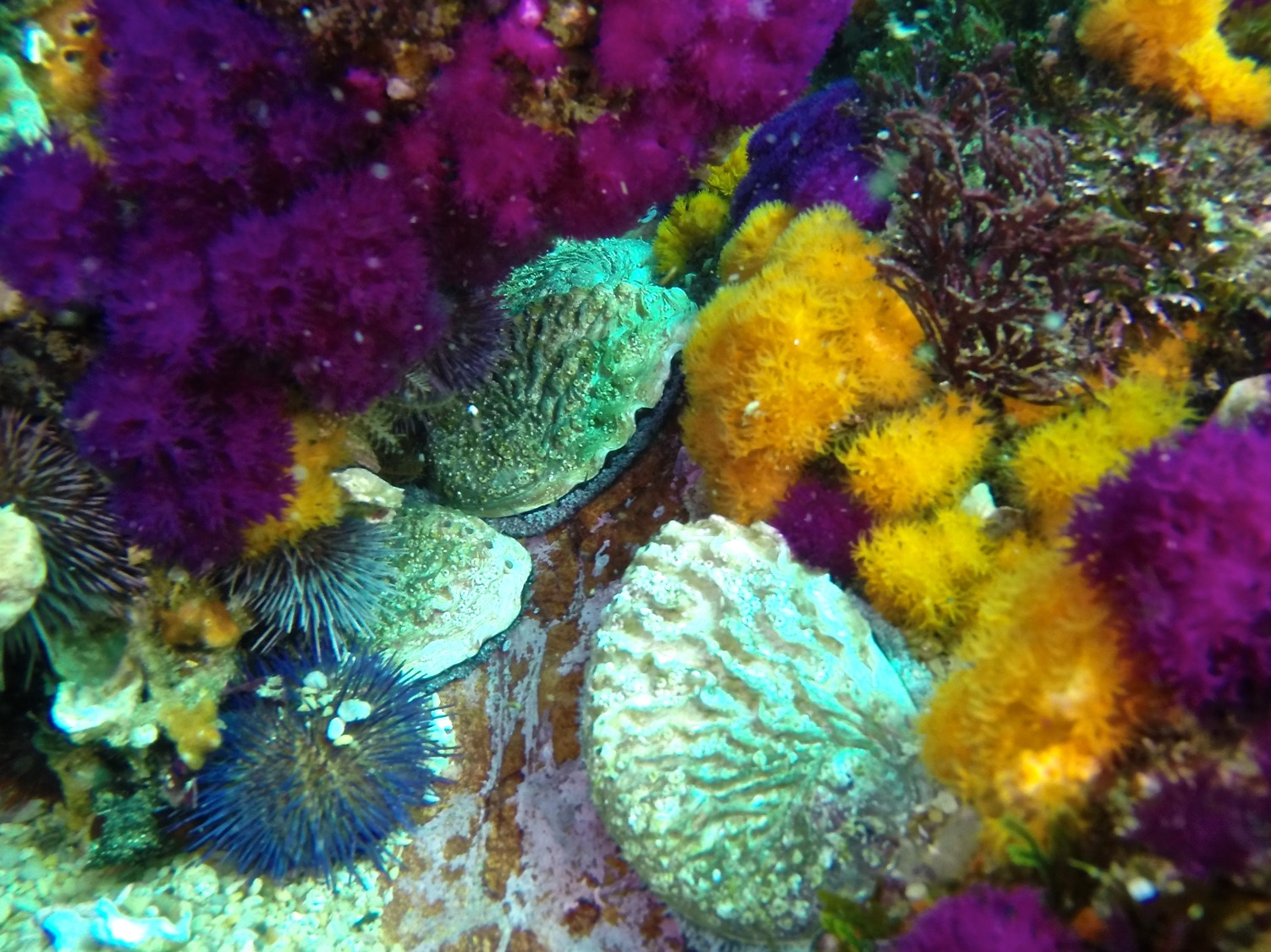
Conclusion
Combination of secure rights to rebuild and protect stock incentivized investment of US$2.5 to date
Poaching effort suppressed in cooperation with agencies of state
Evidence of population recovery
Rights holder applied for first harvest permit
Principles could be used for fishery governance reform in commercial fishery zones.
Community Partnership model

Slide 28
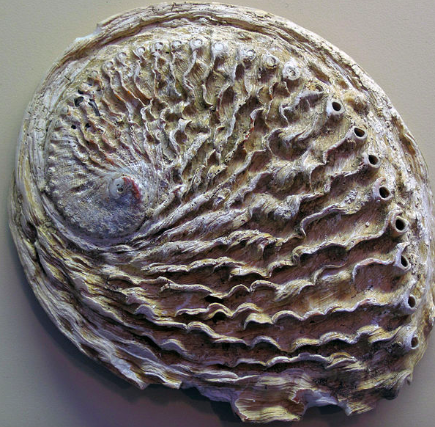
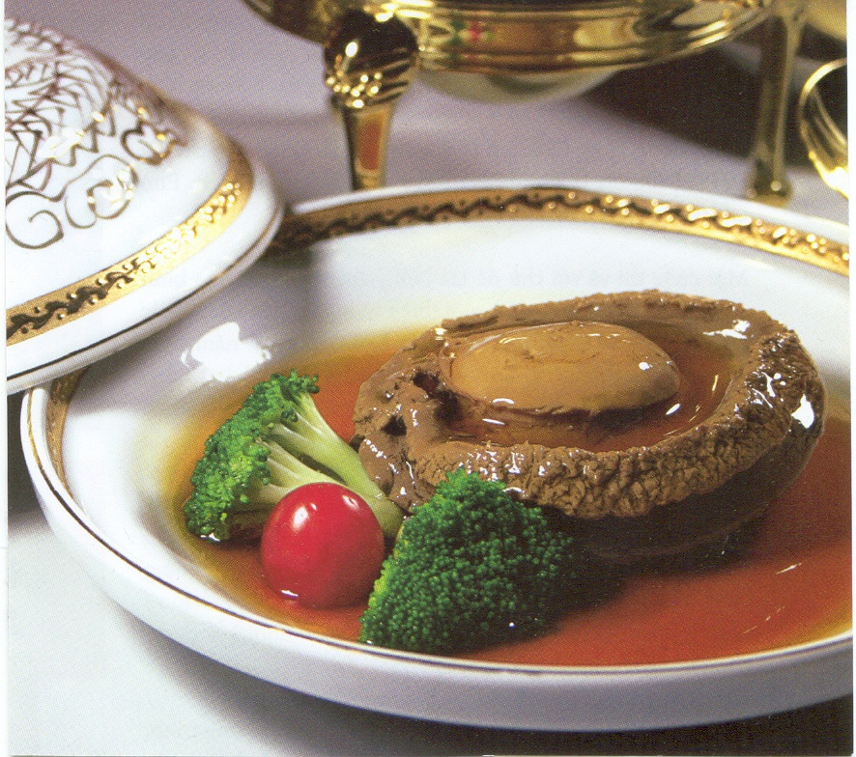
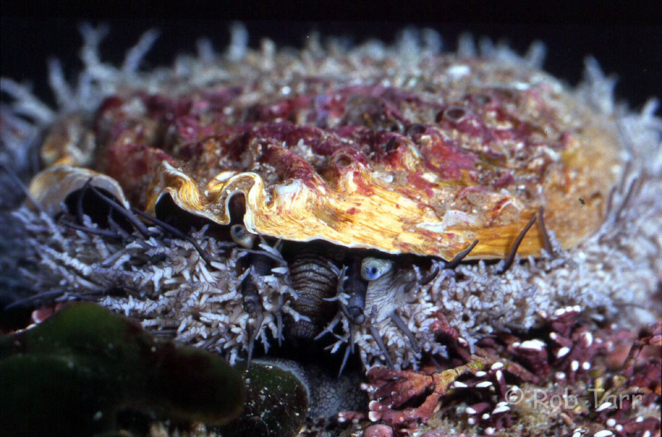
Evidence
Unique anatomical features
  Ribbed shell
  Epipodial tentacles

Slide 29
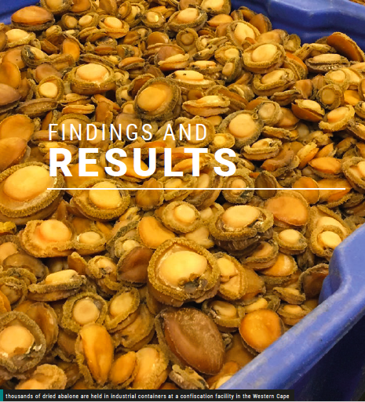
Meat Key features
Size of foot
Shape – muscle attachment, frill
Anatomy of epipodial tentacles

Slide 30
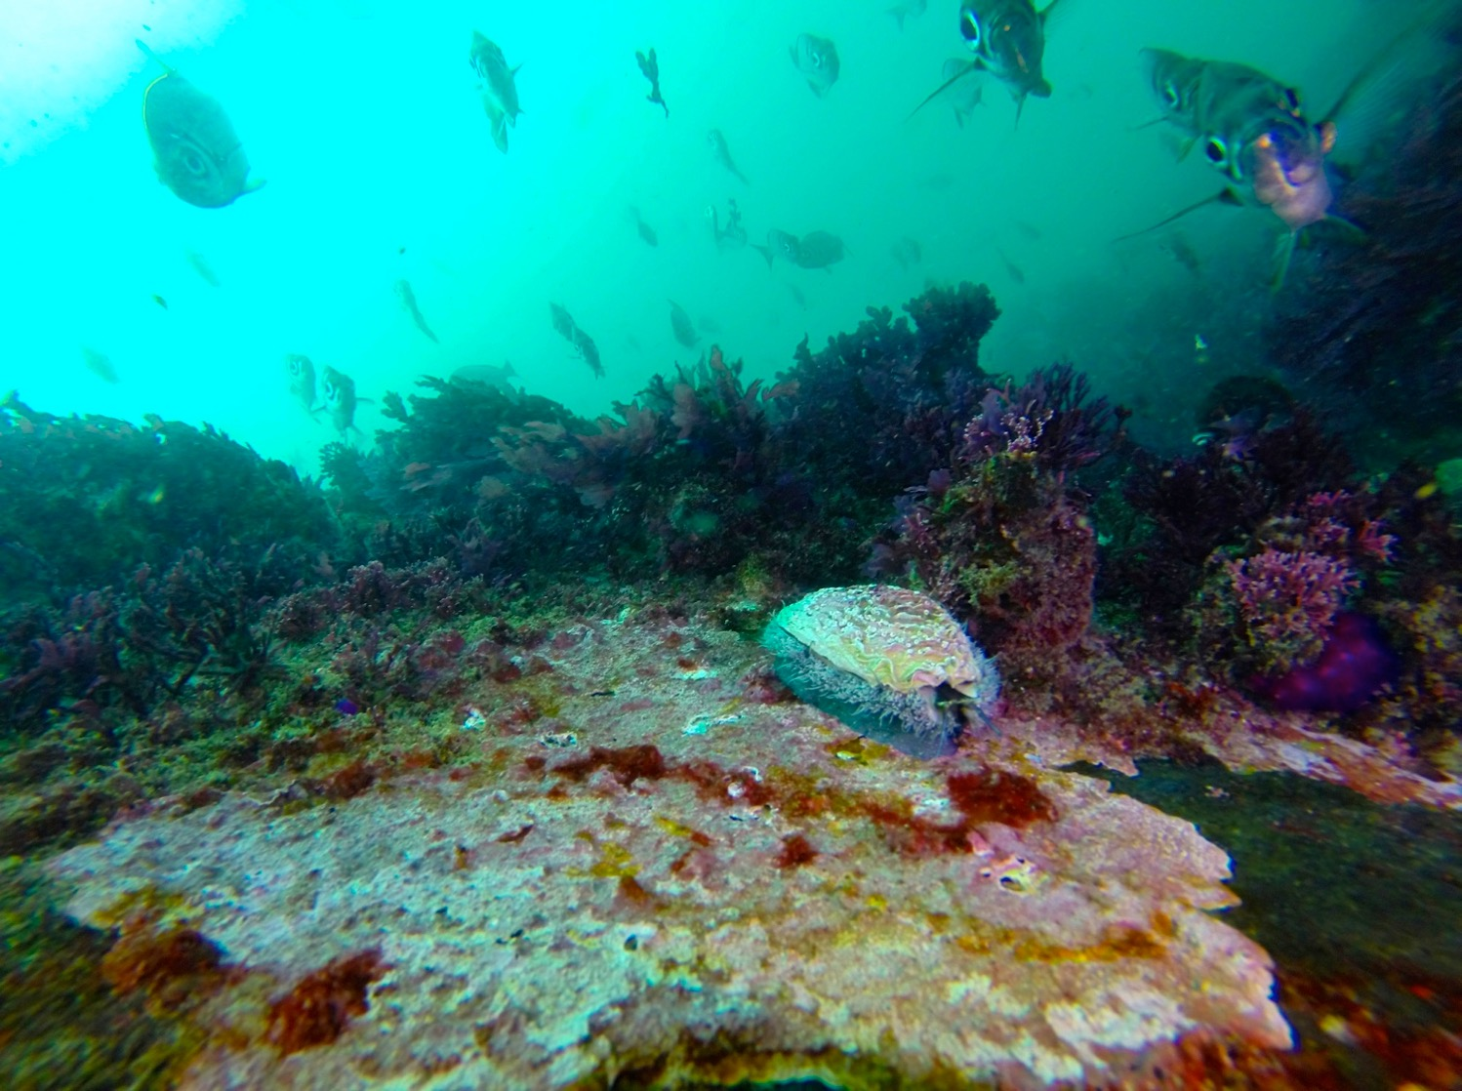
Thank you!

