Slide 1
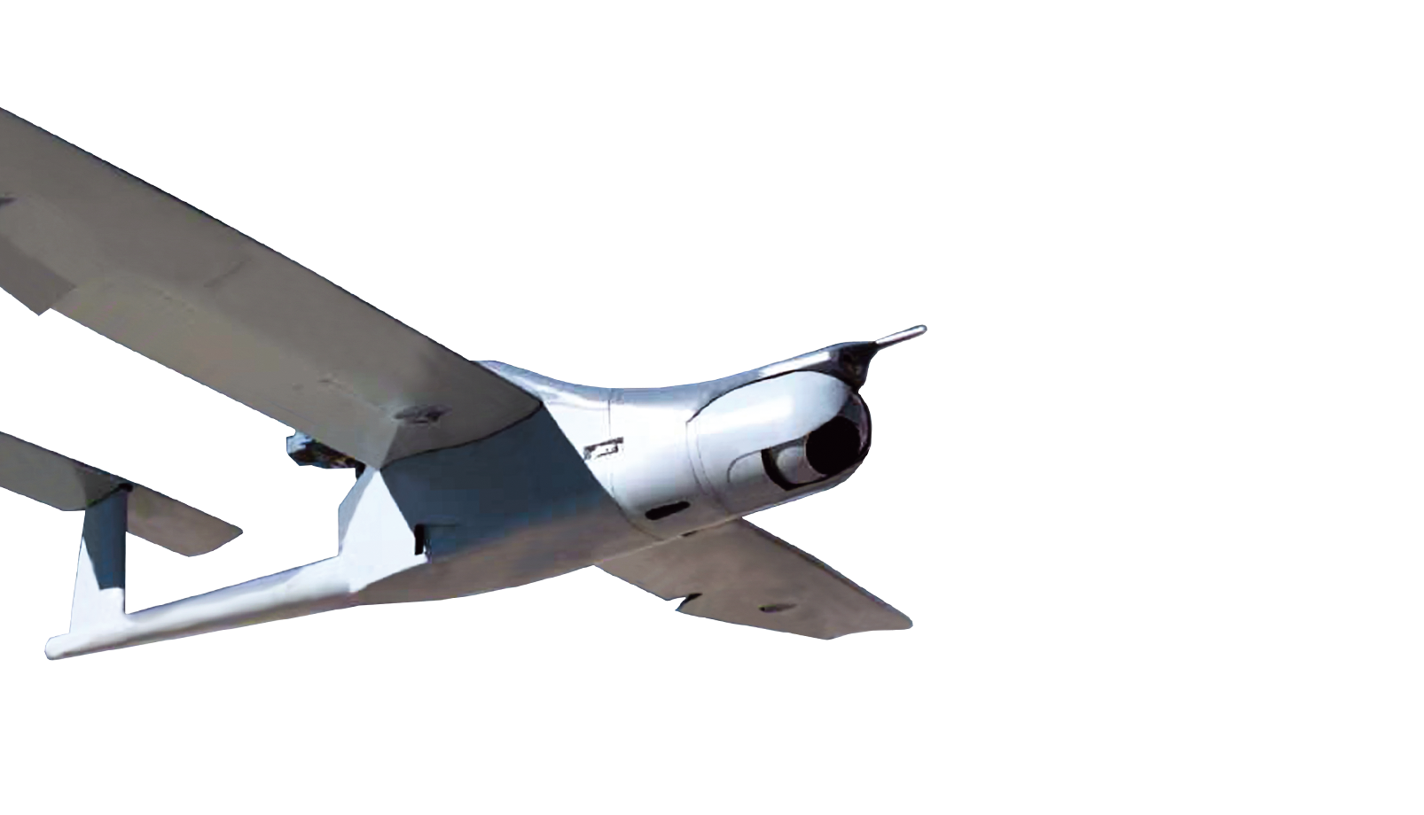
Drone Group
Implemented
01 September 2017

Slide 2
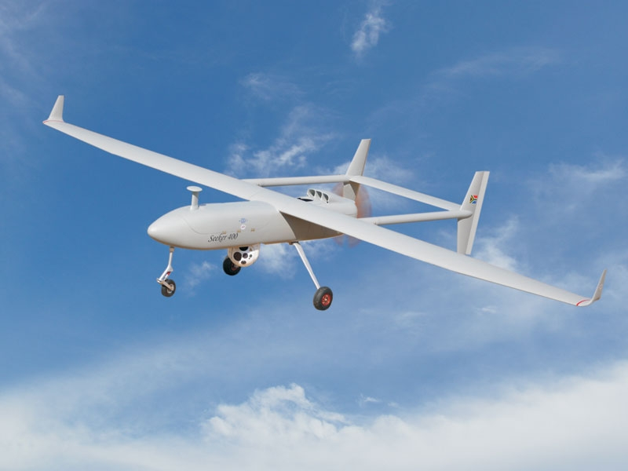
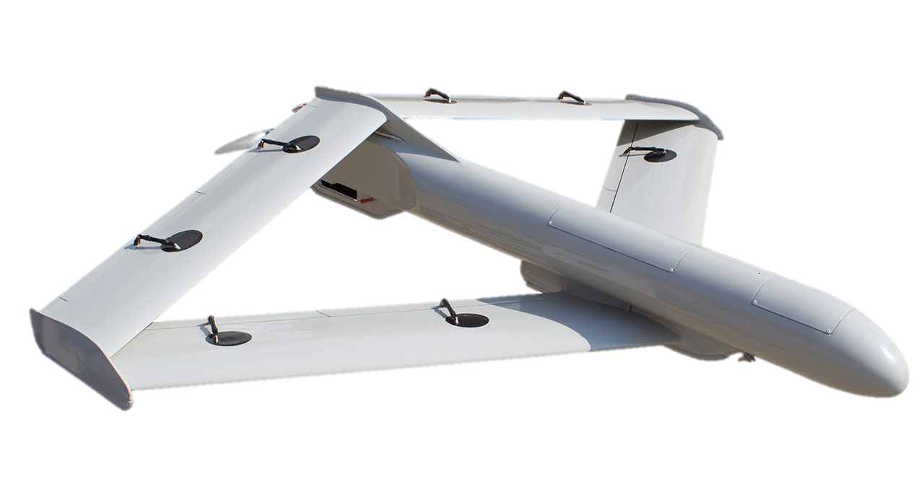
South Africa – A Proud History
ROADRUNNER
15 kg Flying Weight
45 min Endurance
Limited Payload
SEEKER – 200
250 km Range
10 Hour Endurance
18,000 Feet Ceiling
45 kg Payload
1990 – South Africa Global Leaders in Drone Technology. Fallen behind.
2015 – 2023 Estimated $90 Million to be invested in drone development

Slide 3
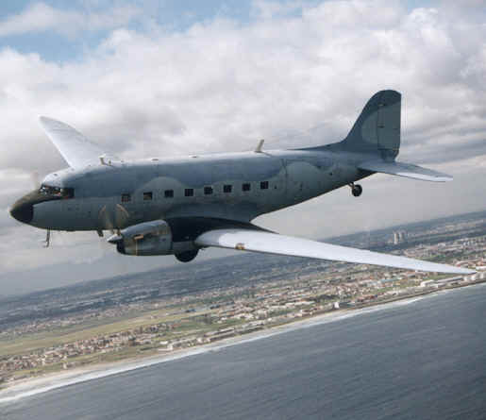
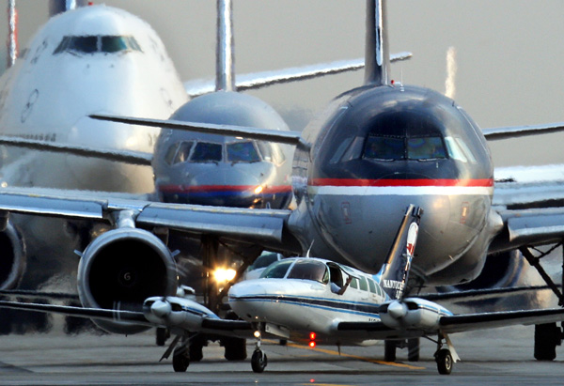
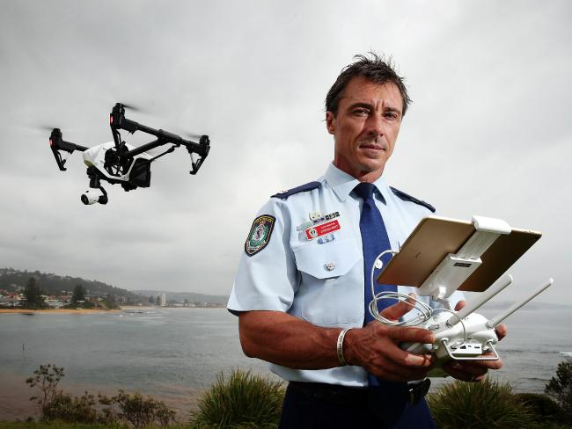
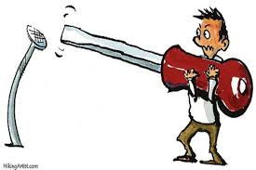
Why Drones?
Scramble Time / Delays
Dangerous / Hazardous Areas
VS
Accessibility
The Right Tool For The Job
Cost

Slide 4
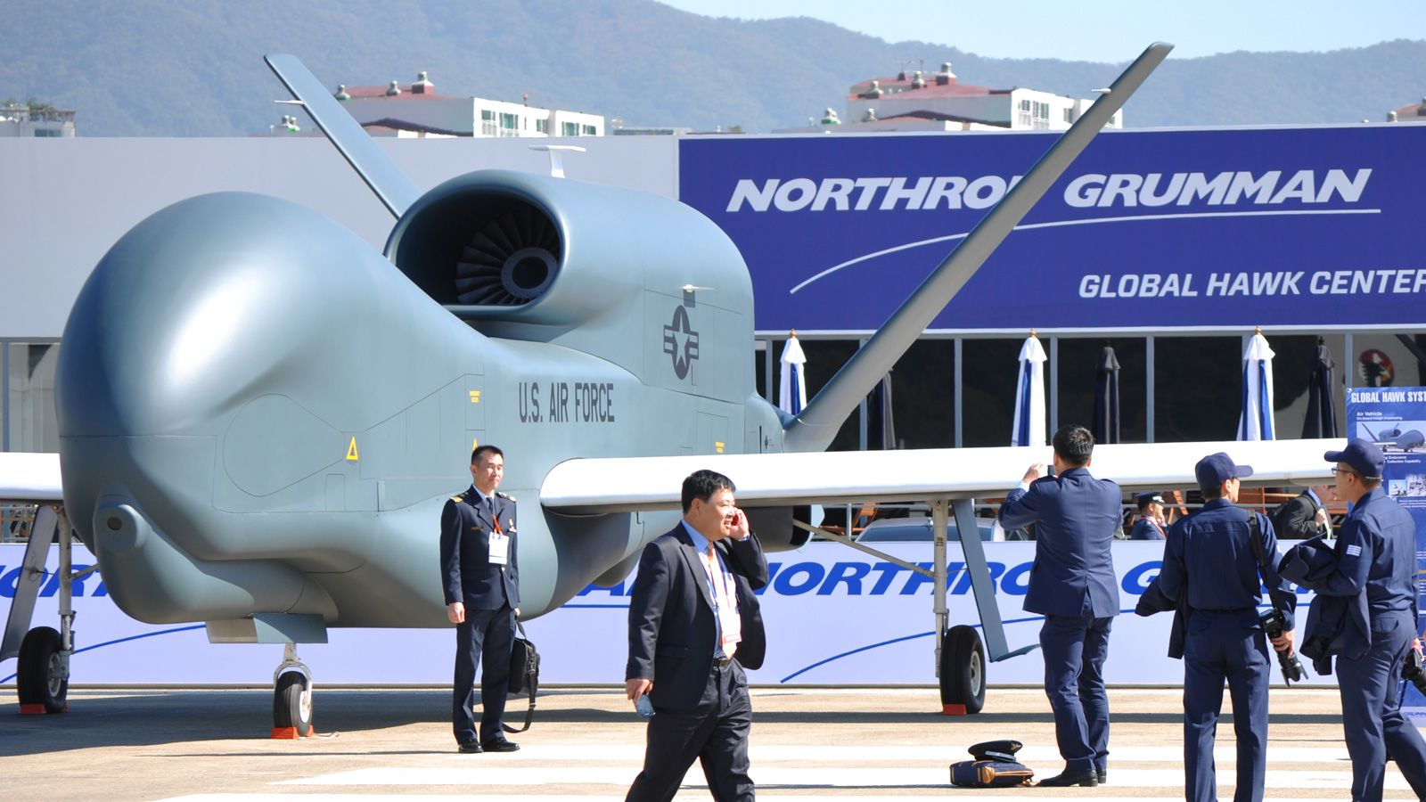
The Goldilocks Problem
So Many Choices
High Altitude Long Endurance (Hale) Drones,
Medium Altitude Long Endurance (Male) Drones,
Tactical Drones,
Small Drones,
Mini-Drones,
Micro-Drones
Nano-Drones.
With Wings or Without.

Slide 5
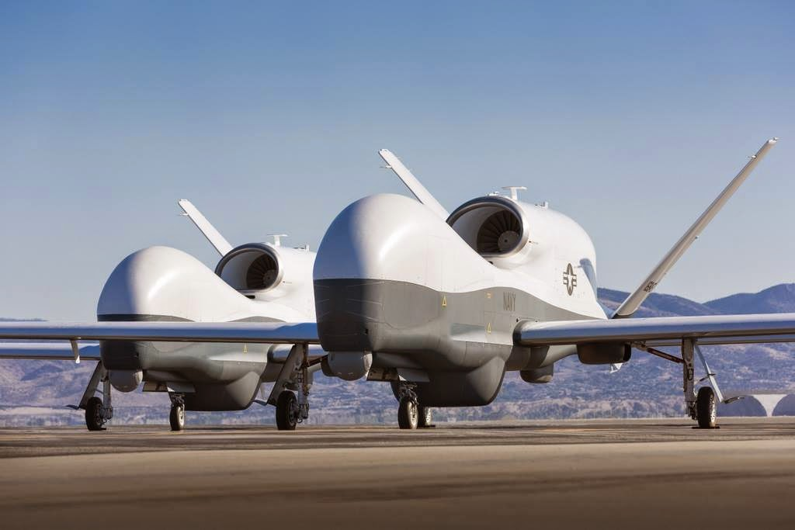
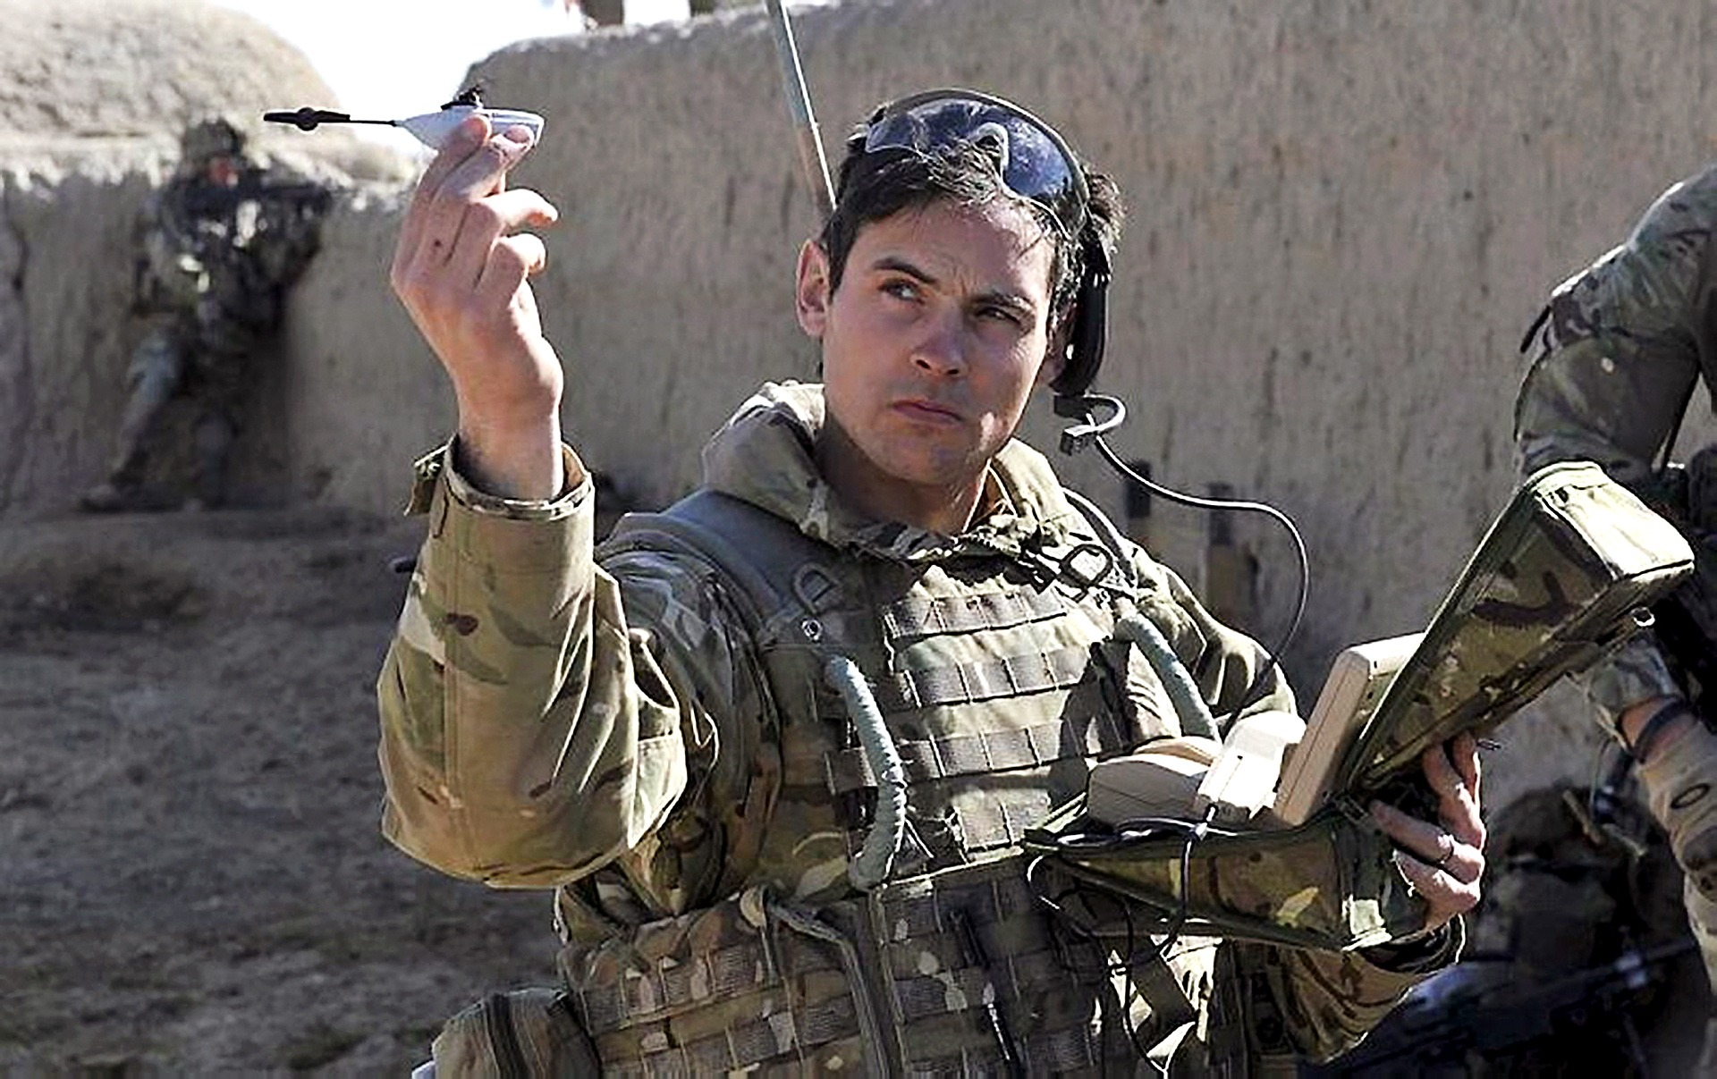
David and Goliath
Black Hornet
Nano-Drone
16 Grams
10 x 2.5 cm
Drone & Base Station Carried In 20cm Pouch
Northrop Grumman
Global Hawk
1.3 Tons Payload
60,000 Feet Ceiling
32 Hours Endurance
Wider Than a Boeing 757

Slide 6
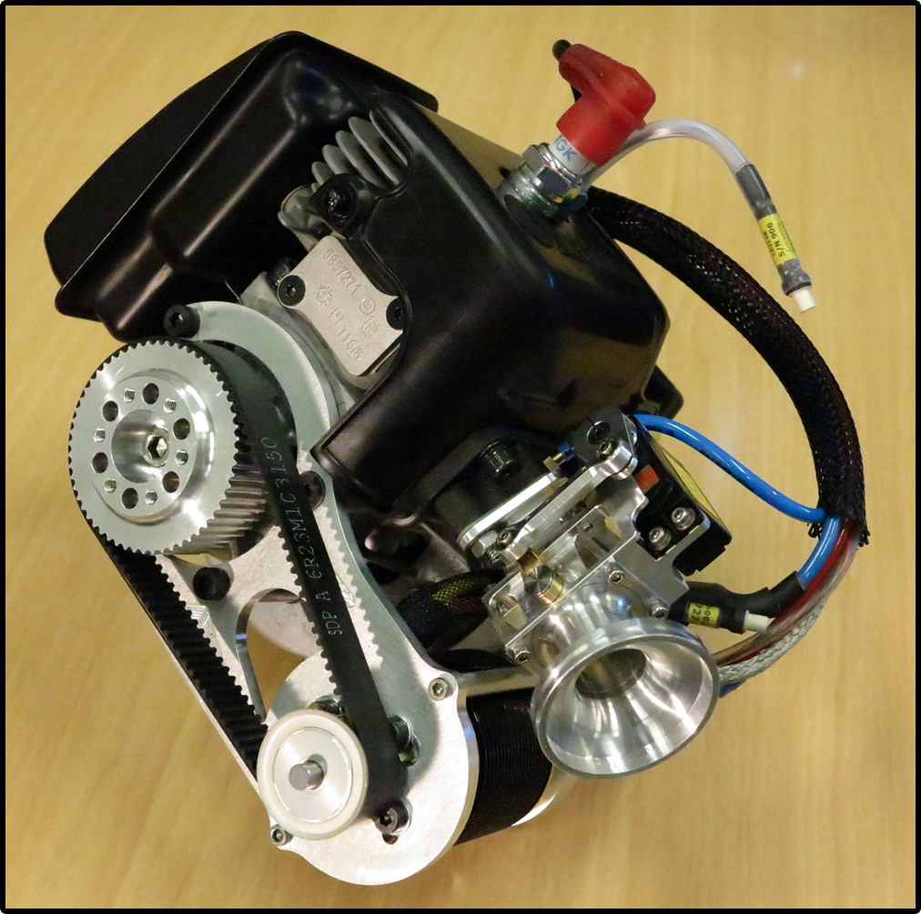
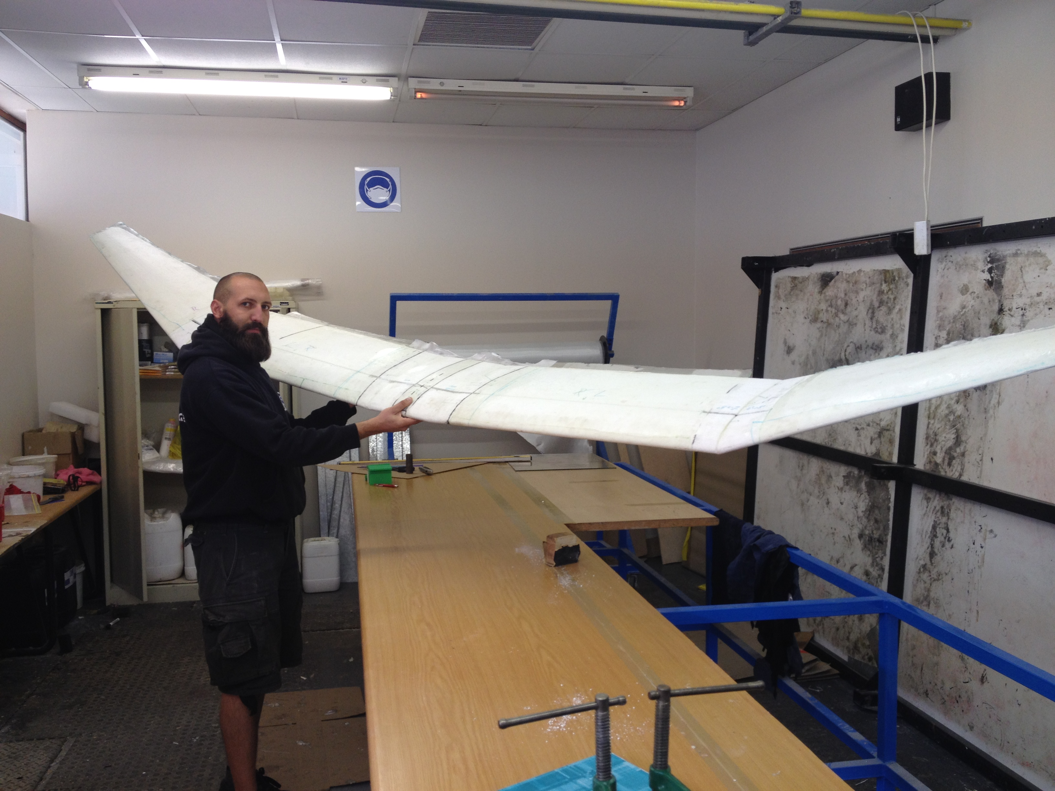
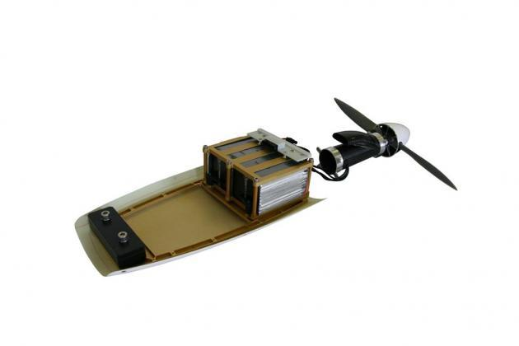
An Empty Shell

Slide 7
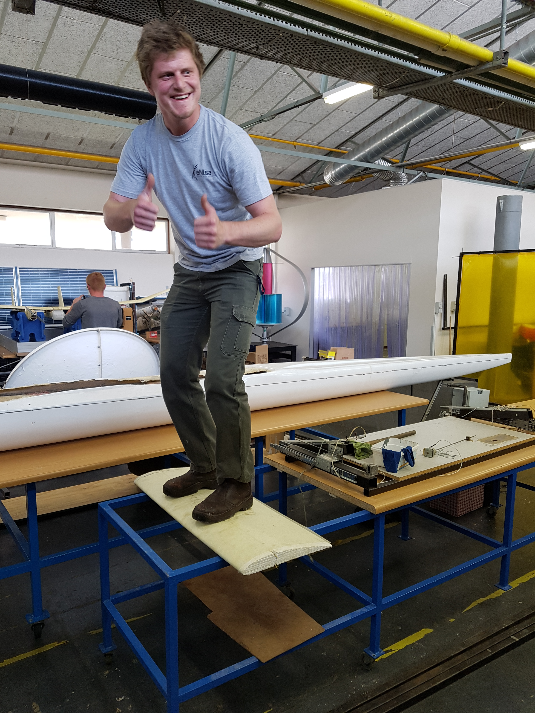
Strength Where It’s Needed
CNC Wire Cut High Density Foam Core
Hand Laid 40 Gram / Meter Glass Cloth
103 kg

Slide 8
Drone Group
Emails arrived:
Could a drone count penguins…..monitor fracking……inspect solar panels……..3D map terrain………map water temperatures…….map crop temperatures……..offer 24 hour security surveillance to the University……..autonomously plant trees…………………….???
Overnight a clear need had been identified for a Remotely Piloted Aircraft Systems capability at the University to assist researchers in data acquisition. A hub where any department could gain access to the services of a drone without having to jump through the legal hoops and endure the R&D time to develop their own drone and train personnel.

Slide 9
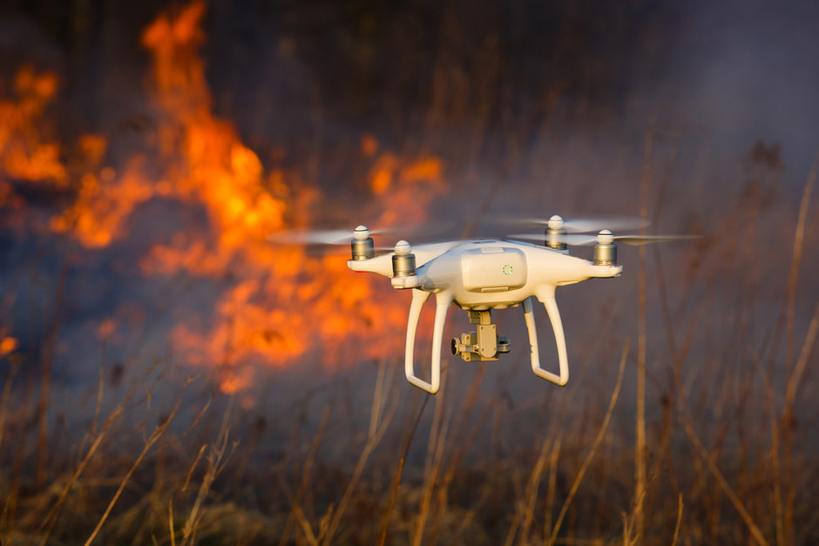
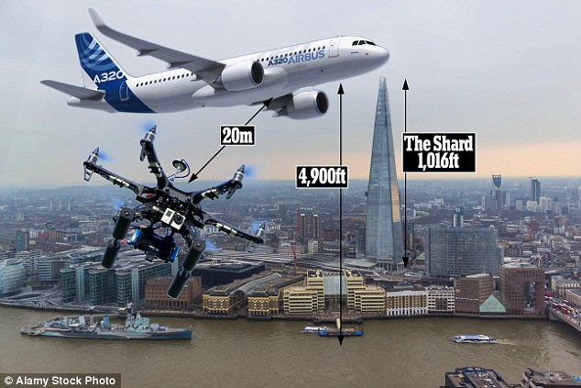
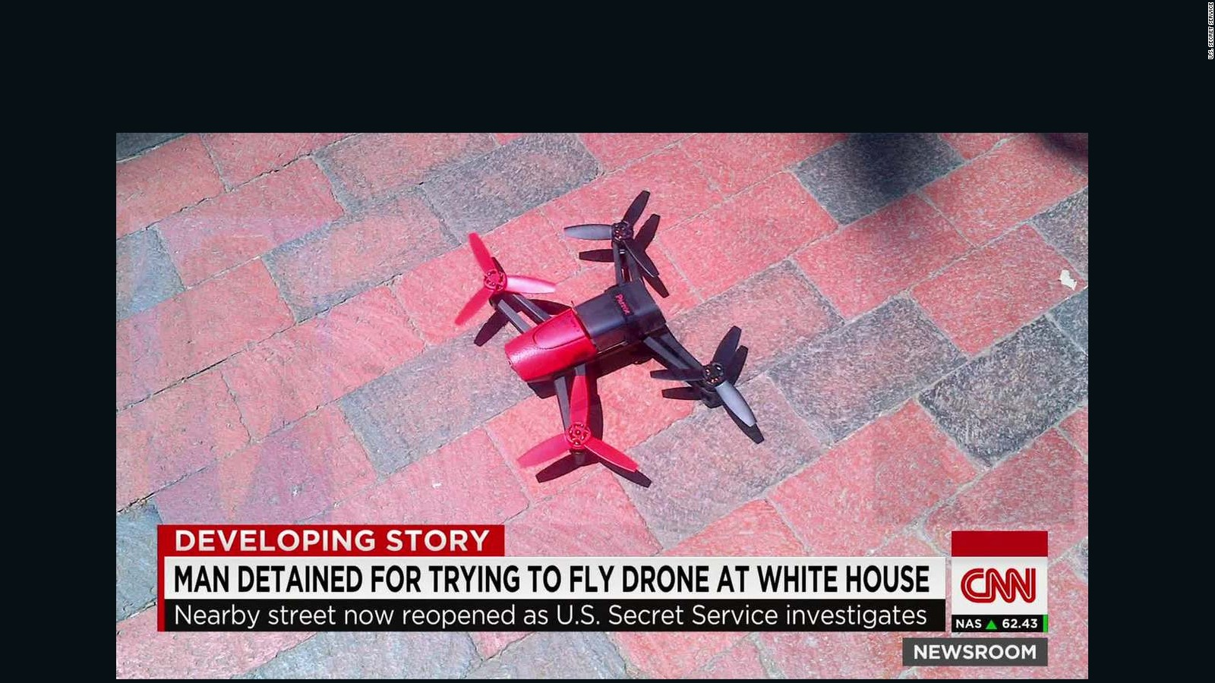
Drones Out Of Control

Slide 10
The Civil Aviation Authority
July 2015 – SACAA publishes Part 101 regulations governing Commercial RPAS Operations.
RPA use is deemed to be commercial when there is commercial outcome, interest or gain.
No commercial use of airborne drones shall take place unless:
The operator has received an RPAS Operators Certificate (This has been known to take up to two years to receive)
The drones to be flown have been registered with the SACAA.
The drones have received Letters of Approval from SACAA.
The pilots flying the drones are in possession of RPAS Pilot Licenses
July 2017 – A supplement is published by SACAA to the Part 101 regulations making way for a Research Flights.
An entity to fly their drones without a RPAS Operators Certificate for the purpose of developing and testing their drones.

Slide 11
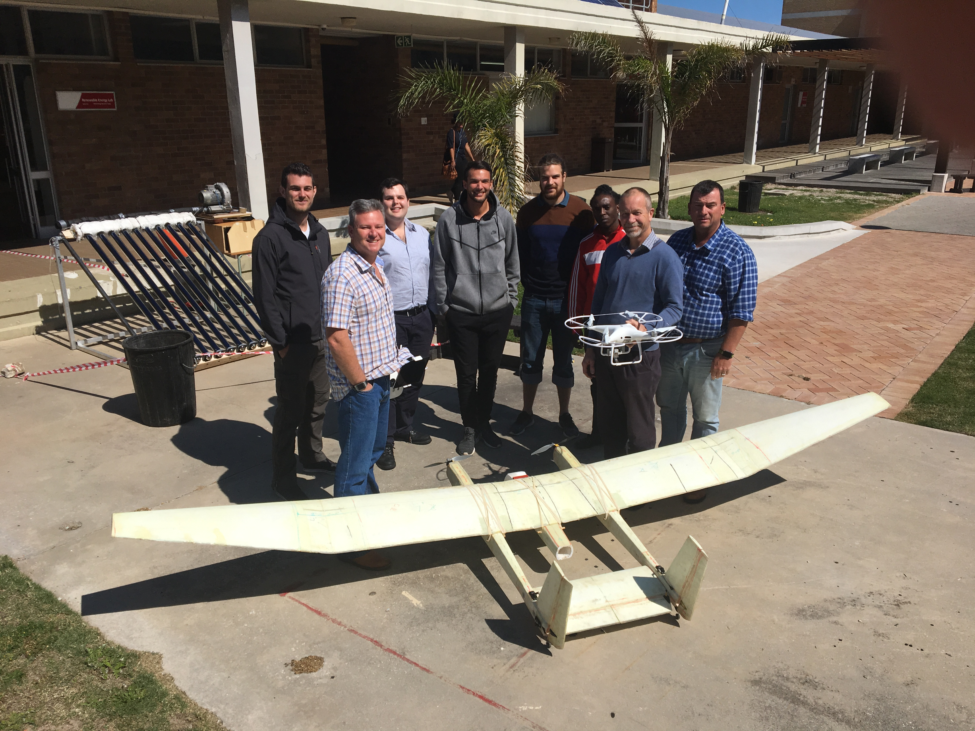
“FrankenDrone”

Slide 12
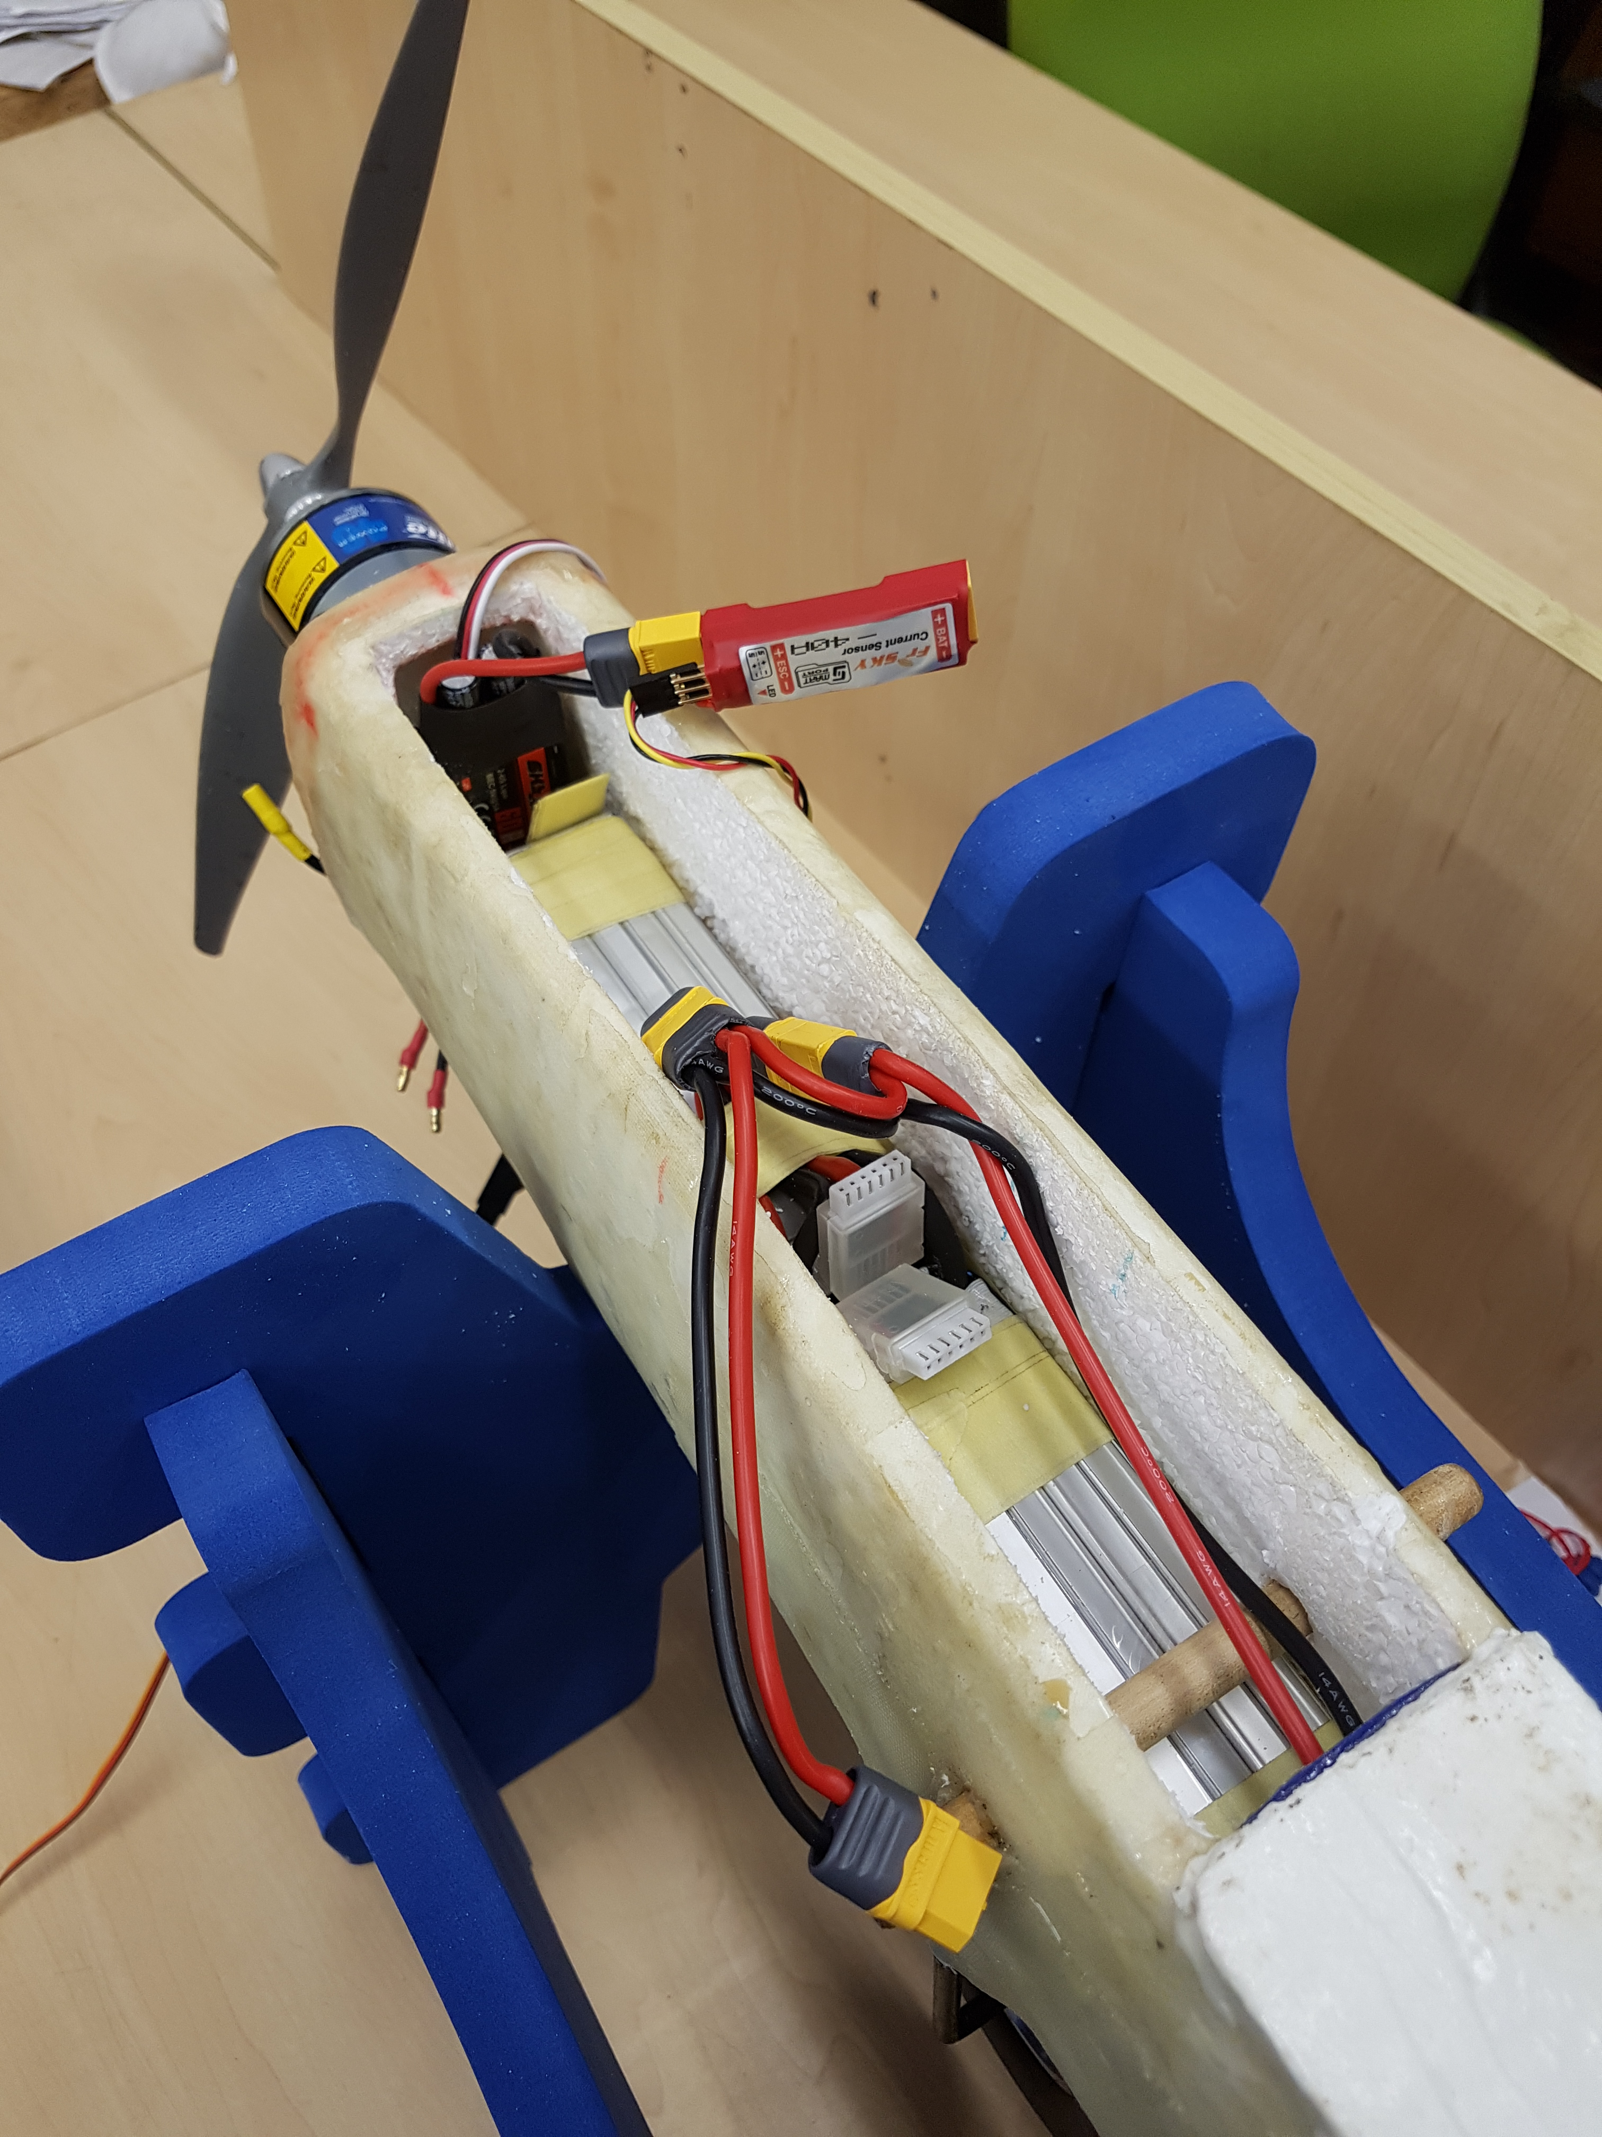
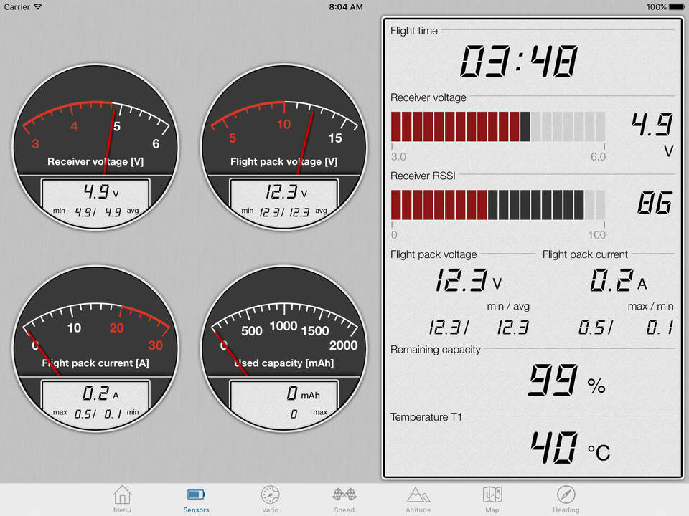
Aircraft Systems

Slide 13
Proof Of Life
Flying Weight 10 kg Wind Speed 62 km/h
Payload 5 kg Max Altitude 3876 ft
Airborne Time 01:00 Hr Max Speed 74 km/h
Distance Covered 43 km
Average Power 400 Watts
Max Power 2000 Watts

Slide 14
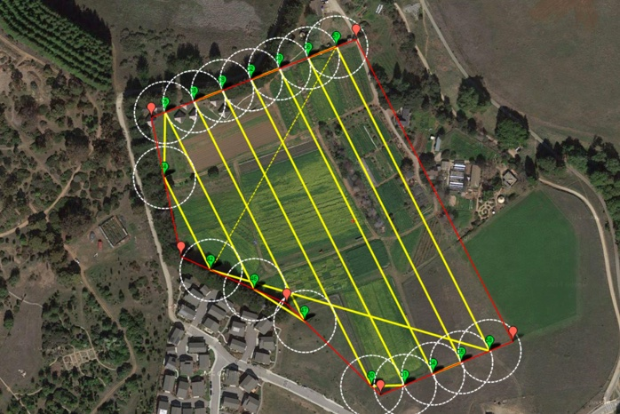
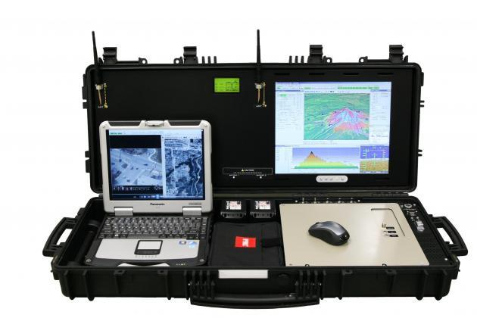
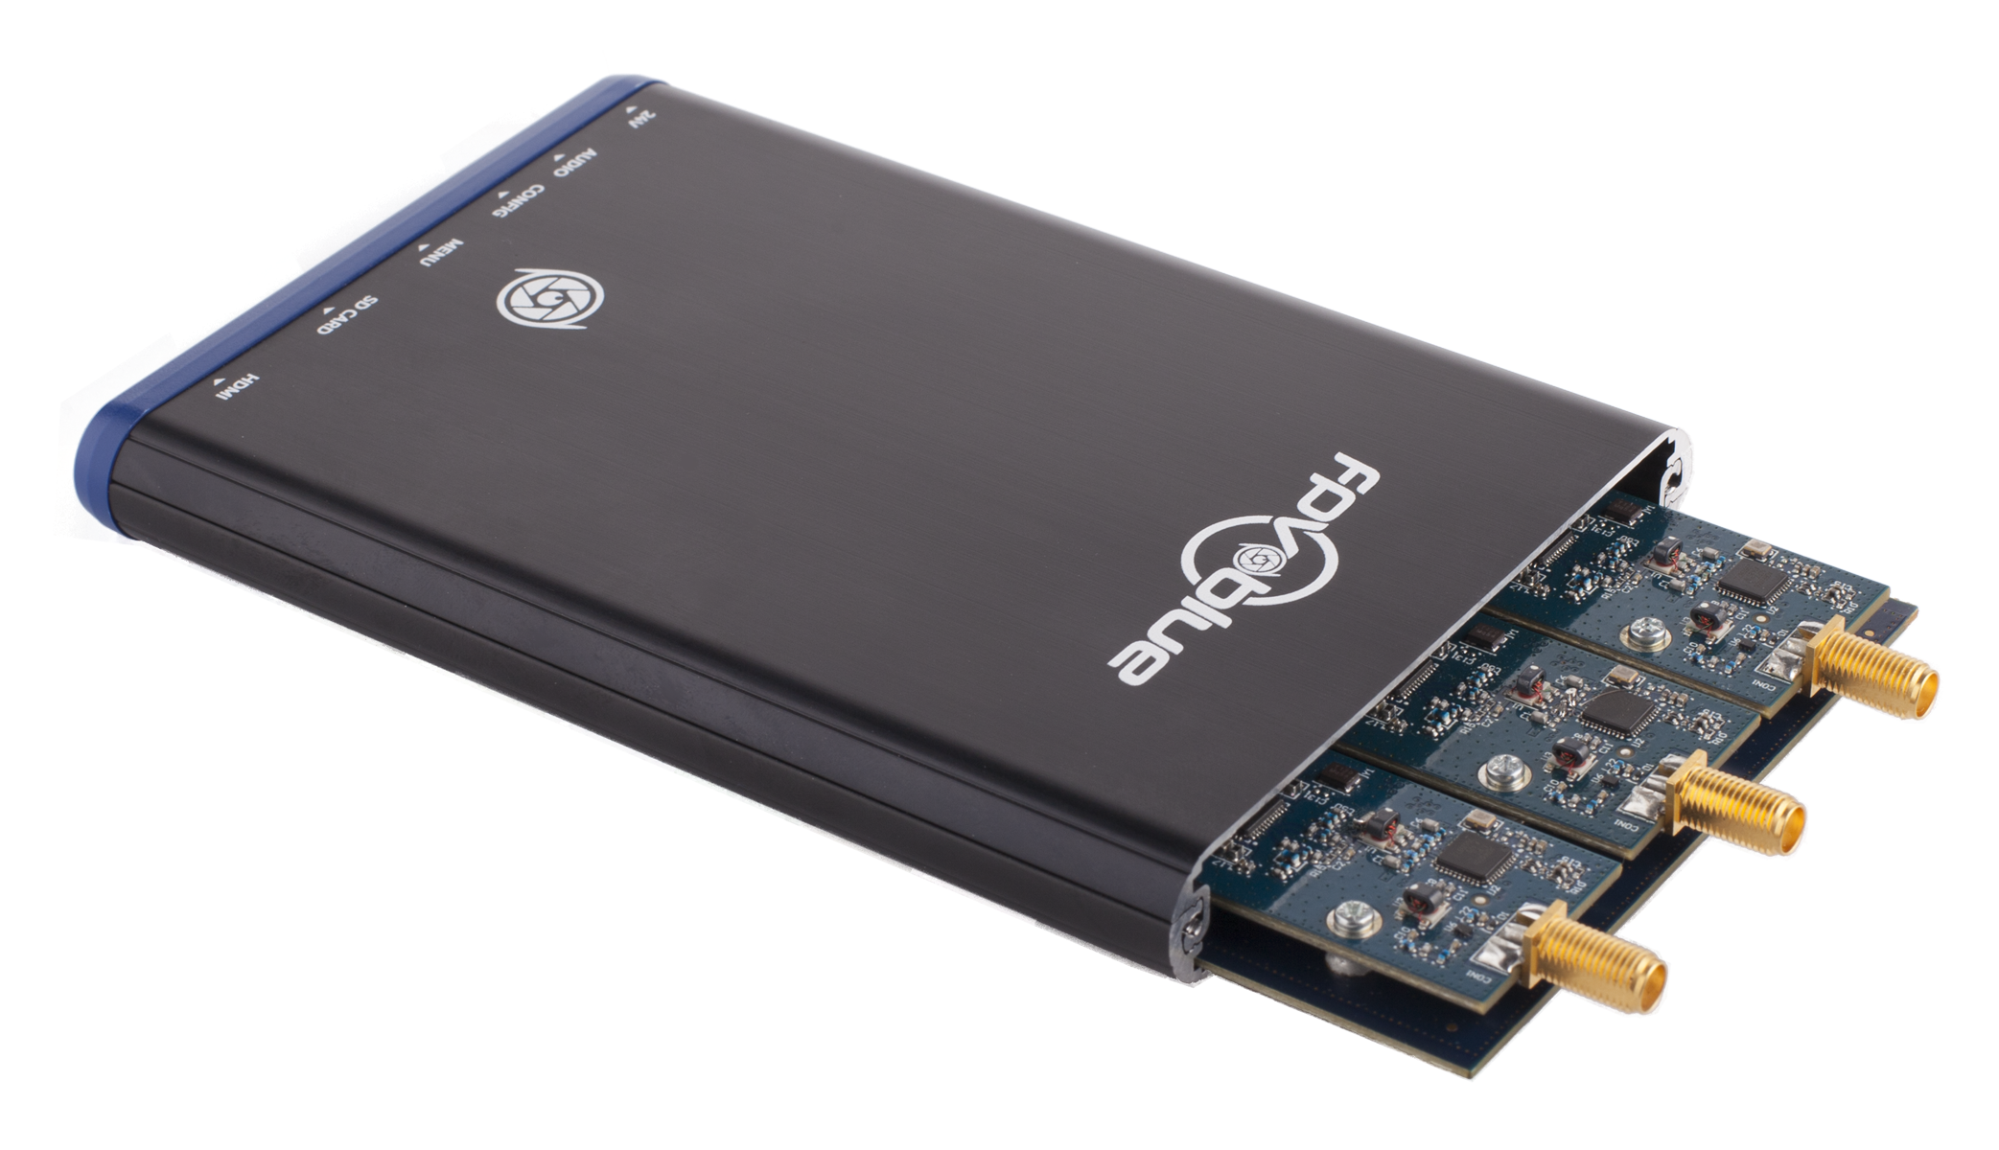
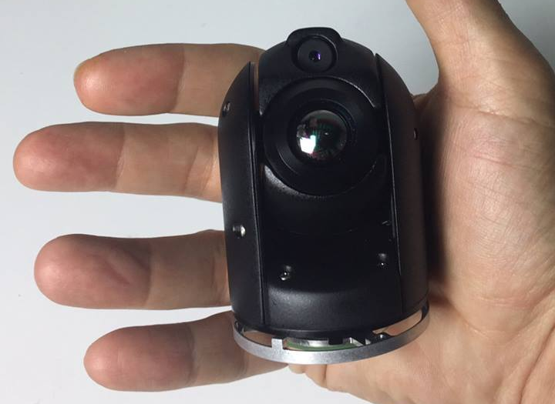
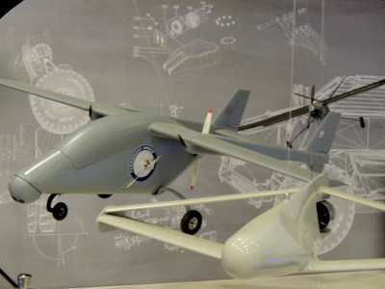
The Future Looks Bright
Fully Autonomous Survey Flight
Base Station Control Handover
HD Digital Video Downlink
Image Recognition And Analysis
Hybrid Thermal Video Camera
Multi Platform Migration

Slide 15
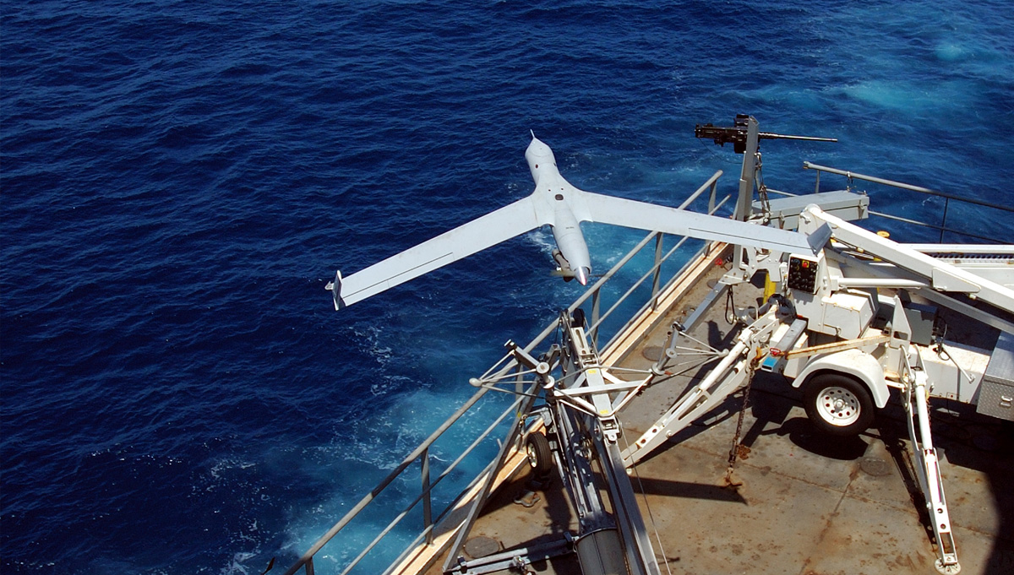
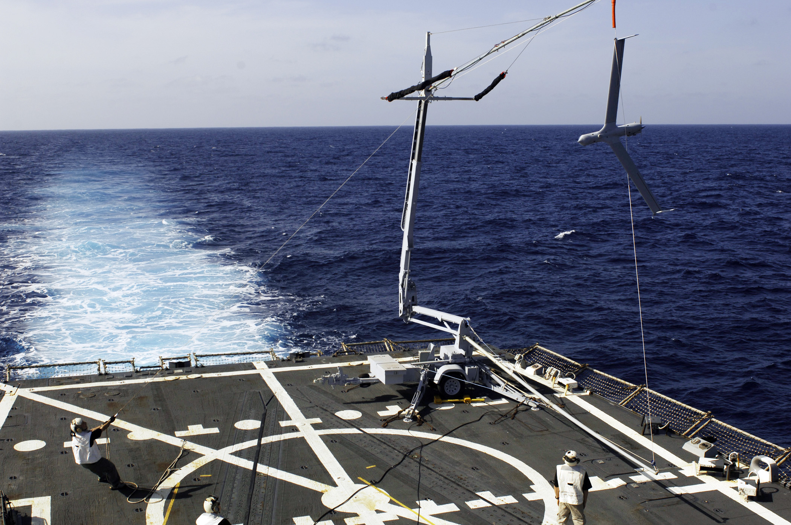
Deployment and Retrieval
Boat Launches And Retrieval
Can We Downsize To A Small Boat And Still Launch and Retrieve A Fixed Wing Aircraft?

