Slide 1
The Role of Asset Forfeiture Legislation (POCA) in Fighting Corruption
By Dr NC Ndzengu
15 April 2025

Slide 2

41 Full-time financial investigators conducting financial investigation and nothing else and 12 Financial Analysts producing Cash Flow analysis!
62 Full-time Advocates specializing
in POCA prepare
and lodge Applications
in Court and
22 Managers

Slide 3
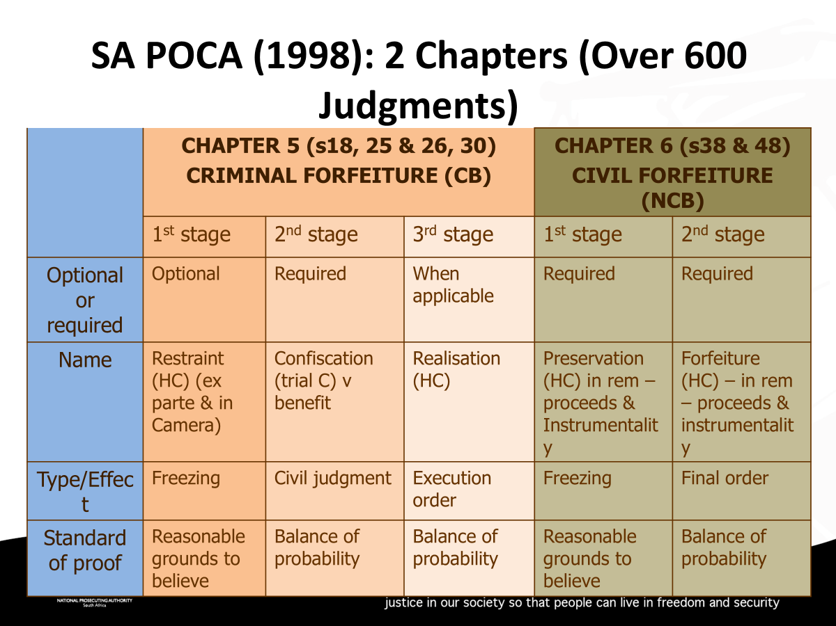
SA POCA 121 of 1998: 2 Chapters & over 600 judgments

Slide 4
Why Do Asset Forfeiture?
Recovery of the proceeds of crime – now, monies recovered can be used by law enforcement to combat crime;
Depriving criminals from enjoying the proceeds of crime;
Removing instruments used for the commission of crime from public access;
Reducing the economic power and influence of organised crime by securing forfeiture of the proceeds of crime;
Discouraging property owners from allowing their properties to be used for criminal purposes; and
Ensuring that property subject to forfeiture is preserved and not dissipated, hidden, or transferred.

Slide 5
AR POST STATE CAPTURE
Using AF (supra) approach
Accelerated use of civil forfeiture approach to hit kingpins
ADRM/Deferred Prosecution/NTR approach
International AR firms’ approach
Institute restraints, preservation, realization & forfeiture applications at Magistrate’s Courts

Slide 6
AF LIMITING FACTORS
Human & work-related resources
No amendments to POCA since 1998
Absence of Unexplained Wealth Orders provisions (Namibia)
AF competing government institutions (AFU, SIU & SARS)
AFU not leading in C-ADR
No funding for international firms’ recovery
Proctracted criminal proceedings and Stalingrad
Limited investigative powers
Operating on a referral basis/model
Notes:
G20
Co-chaired by South Africa and Brazil, the ACWG will hold three technical meetings in 2025 which will precede the Ministerial meeting.
In line with the theme of its Presidency and the G20 ACWG Action Plan 2025-2027, South Africa’s Presidency, the ACWG will focus on the following four key priorities:
Strengthen the public sector by promoting transparency, integrity, and accountability (Deliverables -Compendium of good practices in promoting a transparent, ethical, and accountable public sector and a Ministerial declaration.)
Increase efficiency of asset recovery measures (Deliverables - High-Level Principles on the Management of Seized and Confiscated Assets; Follow-up report on impact of technical assistance support by G20 ACWG countries; and Side event on Efficiency of Asset Recovery Measures)
Enhance and mobilise the inclusive participation of the public sector, private sector, civil society, and academia to prevent and combat corruption (Deliverables: compendium of good practices on the role of multi-stakeholders in preventing and combatting corruption; Side event on the role of the public sector, private sector, civil society, and academia in preventing and combating corruption)
Enhance whistle-blower protection mechanisms (Deliverables: Accountability report with a focus on effective protection of whistle-blowers; and Side event on effective whistle-blowers protection mechanisms)
Given that the focus of the agenda is very asset recovery heavy, it was agreed that Adv Bezuidenhout (AFU would attend and that Florencia would attend the meetings to be informed about what is taking place. The concept note of the ACWG was shared with the SCCU and the ID to indicate whether someone from their respective areas should also be nominated.

Slide 7
Criminal Asset Recovery Account (CARA)
All funds deposited into CARA will be used to fight crime and will be ploughed back into law enforcement agencies. In other words, we take the profit out of crime and fight criminals with their own money!
CARA | FINANCIAL YEAR | AMOUNT R
1 | 2019/2020 | 160 308 006.77
2 | 2020/2021 | 101 896 825.92
3 | 2021/2022 | 76 136 844.49
4 | 2022/2023 (ABB) | 2 667 204 358.56
5 | 2023/2024 (SAP) (Templer, OCM & Tegeta) | 847 180 696.89
6 | 2024/2025 (up to Feb) (McKinsey) | 1 299 457 721.23
 |  | 5 152 184 453.86
Notes:
South African Police Service Amendment Bill
The Bill seeks to align the principal Act with the Constitution of the Republic of South Africa, 1996, the National Development Plan, the White Paper on Policing, 2016, the White Paper on Safety and Security, 2016, the Community Policing Policy, the Use of Force Policy and the Policy on a Single Police Service.
The Bill further proposes amendments to the Regulation of Gatherings Act, in relation to the use of minimum force which is reasonably necessary and proportional in the circumstances during gatherings or demonstrations.
Furthermore, the Bill proposes amendments to the Civilian Secretariat for Police Service Act to provide for the establishment of neighbourhood patrolling, neighbourhood watch and farm watch associations, community policing forums, district, provincial community policing boards and the National Community
NPA legislation committee looked at the Bill (no new provisions impacting on the NPA).
National Satellite Communications Strategy
ICT infrastructure is critical for the digital economy development and serves as a backbone and enabler for all other economies. It is therefore essential that we ensure that the South Africa develops its ICT infrastructure to provide sufficient Telecommunication capacity that will enable continuous state development. To fulfil above requirement and objective, South Africa is planning to launch a SA Owned/Controlled satellite.
Malabo Convention Ratification
Malabo Convention, adopted by the 23rd AU Assembly in 2014 creates a legal framework for addressing cybercrime and data protection in Africa. It harmonises the laws of African States on electronic commerce, personal data protection, Cybersecurity promotion and the fight against Cybercrime. The Convention embodies the existing commitments of AU member states at sub regional, regional and international levels to cooperate in the promotion of Cybersecurity and the fight against cybercrime. South Africa’s ratification of the Convention is necessitated by the evolving threat landscape which makes international cooperation in combating cybercrime and protecting personal data a must.
Ratification by Parliament is a legal requirement still to be met.
International Co-Operation in Criminal Matters Amendment Bill
The primary aim is to facilitate the provision of evidence, the execution of sentences and the confiscation and transfer of proceeds of crime between the Republic and entities (international organisation, international tribunal, international court, or similar body which has jurisdiction in respect of an international crime) to ensure that South Africa complies with its international obligations.
NPA made input into the Bill - since 2023 - these have not been included in the current Bill which was aimed at supporting amendments to the Extradition Act. It was however resolved that the DoJ&CD will commence with the process of the review of the ICCMA Act (concurrently with the review of POCA) while the Department is also processing the ICCM Amendment Bill
Extradition Bill
To amend the Acts: clarity when having to comply with RSA international obligations (e.g. requirement regarding jurisdiction, extra-territorial jurisdiction, provisional arrest); provisions for surrender persons not international entities; provision for consenting to extradition; clarifying the role of magistrates and the Minister; alignment to CC Smit judgment.
NPA considered the Bill in 2023, but supported its processing. However, the extradition legislation still does not make provision for outgoing requests (which we believe should be regulated)

Slide 8
Victim Payments – Restorative Justice
Millions have been paid to victims.
VICTIMS | FINANCIAL YEAR | AMOUNT R
1 | 2019/2020 | 298 186 357.65
2 | 2020/2021 | 111 325 204.93
3 | 2021/2022 | 281 257 473.91
4 | 2022/2023 (ABB) | 2 993 061 202.90
5 | 2023/2024 (SAP) | 953 766 968.92
6 | 2024/2025 (up to Feb) (SAP) | 1 938 682 490.71
 |  | 6 576 279 699.02
Notes:
South African Police Service Amendment Bill
The Bill seeks to align the principal Act with the Constitution of the Republic of South Africa, 1996, the National Development Plan, the White Paper on Policing, 2016, the White Paper on Safety and Security, 2016, the Community Policing Policy, the Use of Force Policy and the Policy on a Single Police Service.
The Bill further proposes amendments to the Regulation of Gatherings Act, in relation to the use of minimum force which is reasonably necessary and proportional in the circumstances during gatherings or demonstrations.
Furthermore, the Bill proposes amendments to the Civilian Secretariat for Police Service Act to provide for the establishment of neighbourhood patrolling, neighbourhood watch and farm watch associations, community policing forums, district, provincial community policing boards and the National Community
NPA legislation committee looked at the Bill (no new provisions impacting on the NPA).
National Satellite Communications Strategy
ICT infrastructure is critical for the digital economy development and serves as a backbone and enabler for all other economies. It is therefore essential that we ensure that the South Africa develops its ICT infrastructure to provide sufficient Telecommunication capacity that will enable continuous state development. To fulfil above requirement and objective, South Africa is planning to launch a SA Owned/Controlled satellite.
Malabo Convention Ratification
Malabo Convention, adopted by the 23rd AU Assembly in 2014 creates a legal framework for addressing cybercrime and data protection in Africa. It harmonises the laws of African States on electronic commerce, personal data protection, Cybersecurity promotion and the fight against Cybercrime. The Convention embodies the existing commitments of AU member states at sub regional, regional and international levels to cooperate in the promotion of Cybersecurity and the fight against cybercrime. South Africa’s ratification of the Convention is necessitated by the evolving threat landscape which makes international cooperation in combating cybercrime and protecting personal data a must.
Ratification by Parliament is a legal requirement still to be met.
International Co-Operation in Criminal Matters Amendment Bill
The primary aim is to facilitate the provision of evidence, the execution of sentences and the confiscation and transfer of proceeds of crime between the Republic and entities (international organisation, international tribunal, international court, or similar body which has jurisdiction in respect of an international crime) to ensure that South Africa complies with its international obligations.
NPA made input into the Bill - since 2023 - these have not been included in the current Bill which was aimed at supporting amendments to the Extradition Act. It was however resolved that the DoJ&CD will commence with the process of the review of the ICCMA Act (concurrently with the review of POCA) while the Department is also processing the ICCM Amendment Bill
Extradition Bill
To amend the Acts: clarity when having to comply with RSA international obligations (e.g. requirement regarding jurisdiction, extra-territorial jurisdiction, provisional arrest); provisions for surrender persons not international entities; provision for consenting to extradition; clarifying the role of magistrates and the Minister; alignment to CC Smit judgment.
NPA considered the Bill in 2023, but supported its processing. However, the extradition legislation still does not make provision for outgoing requests (which we believe should be regulated)

