Slide 1
The identification of priority crimes in South Africa
Brigadier (Dr) Kobus Schwartz
SAPS Research
9 March 2020

Slide 2
TABLE OF CONTENTS
Section 1 Overview of the mandate of SAPS
Section 2 Organisation of SAPS
Section 3 SAPS Division Detective Services Mandate
Section 4 DPCI Mandate
Section 5 Crime statistics
Section 6 Determination of priority crime

Slide 3
SECTION 1
Overview of the mandate of SAPS

Slide 4

South African Police Service
  The SAPS derives its mandate from Section 205 of the Constitution of the Republic of South Africa, 1996.
  The objects of policing are to -
      prevent, combat and investigate crime;
      maintain public order;
      protect and secure the inhabitants of the Republic and their property; and
      uphold and enforce the law.

Slide 5
South African Police Service
Vision
  To create a safe and secure environment for all people in South Africa.
Mission
  To prevent and combat crime that may threaten the safety and security of any community;
  Investigate any crimes threatening the safety and security of any community;
  Ensure that offenders are brought to justice; and
  Participate in efforts to address the causes of crime.

Slide 6
South African Police Service Strategic Outcomes (2020-2025)
The law upheld and enforced, to underpin the stamping (asserting) of the authority of the State
Thorough and responsive investigation of crime
Intelligence-led policing
Collaborative and consultative approach to policing
A professional and capable SAPS

Slide 7
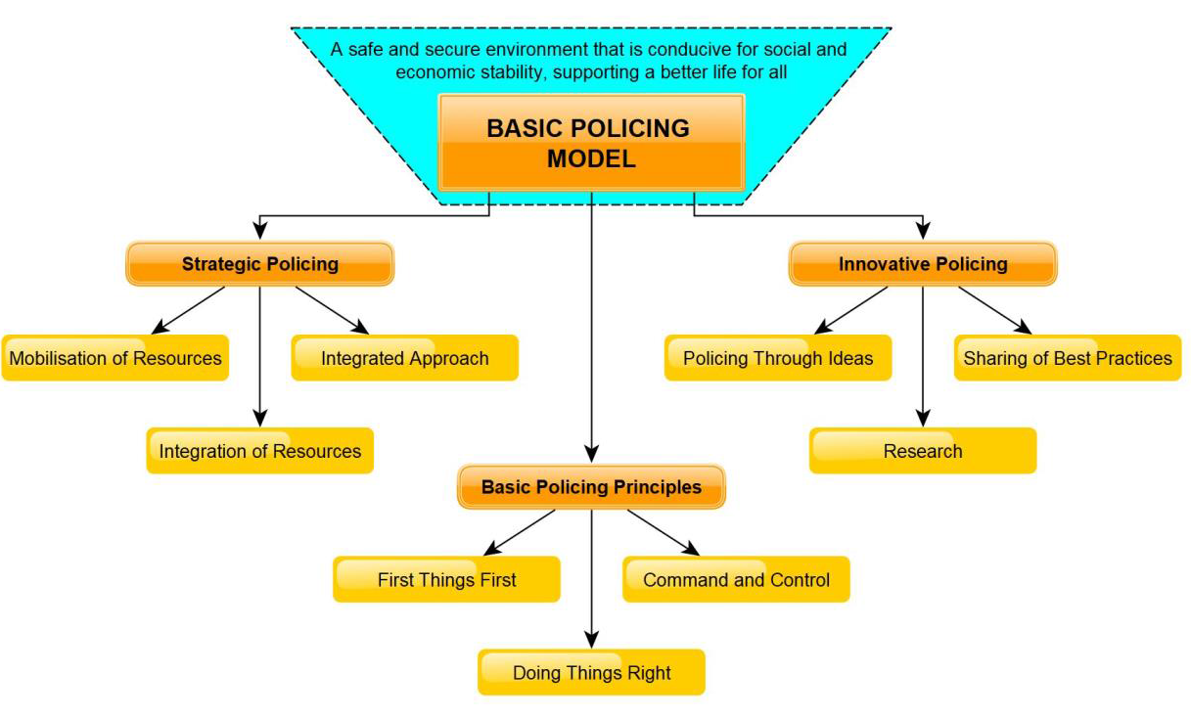
Basic Policing Model

Slide 8
SECTION 2
Organisation of SAPS

Slide 9

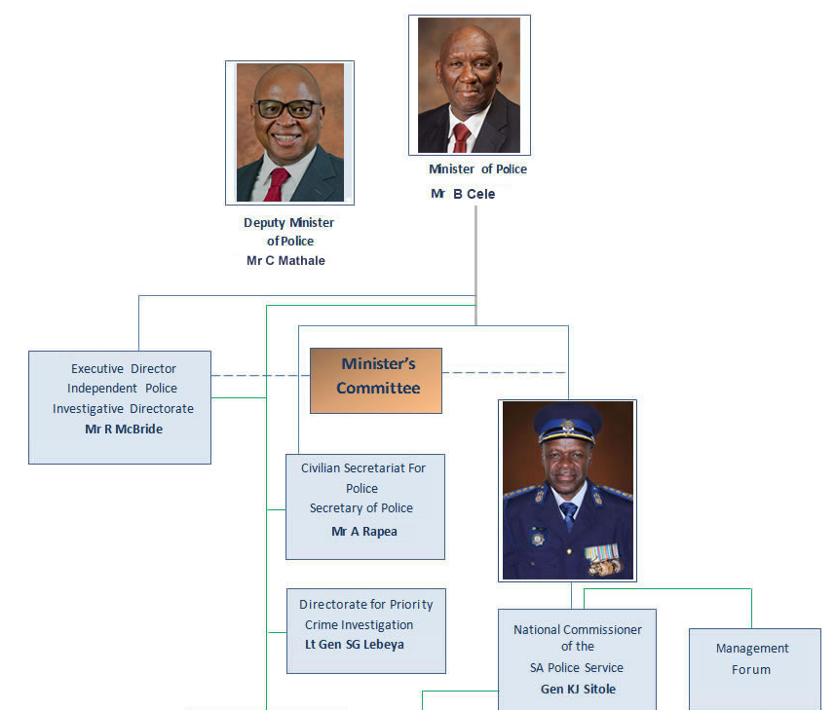

Slide 10
SAPS Organisational Structure

Slide 11
SAPS Divisions: Visible policing and Detective Services
Deputy National Commissioner Policing
Divisional Commissioner
Visible Policing
Divisional Commissioner Operational Response Services
Deputy National Commissioner Crime Detection
Divisional Commissioner Detective Service
Divisional Commissioner Protection and Security Services
Divisional Commissioner Forensic Services
Divisional Commissioner Crime Intelligence

Slide 12
SECTION 3
SAPS Division Detective Services Mandate

Slide 13
SAPS Division: Detective Services
Mandate
FCS Investigation Service
  FCS Investigations
  Forensic Social Work Services
  Serial and Electronic FCS Investigations
Crime Investigation Service
  Crime Investigation Coordination Group A
  Crime Investigation Coordination Group B
  Crime Investigation Coordination Group C
  Harmful Occult Related Practices, Missing Persons and Crime Stop

Slide 14
SAPS Division: Detective Services
Mandate
Specific Crime Investigations
  Stock Theft and Endangered Species
  Vehicle Crime Investigations
  Trans National Crime Investigations
  National Investigation Unit
Organised Crime Investigation
  Operational Desks
  Violent Crime
  Narcotics
  Project Investigations

Slide 15
SAPS Division: Detective Services
Mandate
Commercial Crime Investigation
  Banking and Electronic Crime
  Fraud and Statutes
  Cyber Crime and Deep Web Investigation

Slide 16
SECTION 4
DPCI Mandate

Slide 17
DPCI Mandate
The Directorate for Priority Crime Investigation has been established as an independent directorate within the South African Police Service in terms of Section 17C of the South African Police Service Act, 1995 as amended by the South African Police Service Amendment Act, 2008 (Act 57 of 2008).
Responsible for the combating, investigation and prevention of national priority crimes such as serious organized crime, serious commercial crime and serious corruption in terms of Section 17B and 17D of the South African Police Service Act, 1995 as amended.

Slide 18
DPCI Mandate
Section: Serious Organised Crime Investigation
Serious Organised Crime Investigation is focused on Narcotics, Illicit Mining, Precious Metals and Diamonds, Ferrous and Non-Ferrous metals, environmental crime, Firearms and specific Violent Crimes, Human Trafficking, Crimes Against the State and Transnational Vehicle Crime.
Section: Serious Commercial Crime Investigation
Serious Corruption Investigation is focused on Corruption in the Public Sector, Private Sector, Foreign Bribery and reporting in terms of Sec 34 (3)(a) of the Prevention and Combating of Corrupt Activities Act,2004.

Slide 19
DPCI Mandate
Section: Serious Corruption Investigation
Serious Commercial Crime Investigation is focused on Banking Crime, Serious Economic Offences and Serious Fraud
Section: Priority Crime Specialised Investigation
Priority Crime Specialised Investigation is focused on professional and specialised support capability to the Serious Organised Corruption, Serious Organised Corruption, Serious Commercial Crime and Serious Organised Crime through Specialised Technology and Cyber Crime, Financial and Asset Forfeiture and Forensic investigation services.

Slide 20
DPCI Mandate
Section: Priority Crime Management Centre
The Priority Crime Management Centre collects, monitors and analyses information and intelligence on identified National Priority threats for the production of tactical and strategic analysis products, and research for threat assessments and the forecasting of future developments within the National and Transnational Organised crime environment in collaboration with the relevant Intelligence Services.

Slide 21
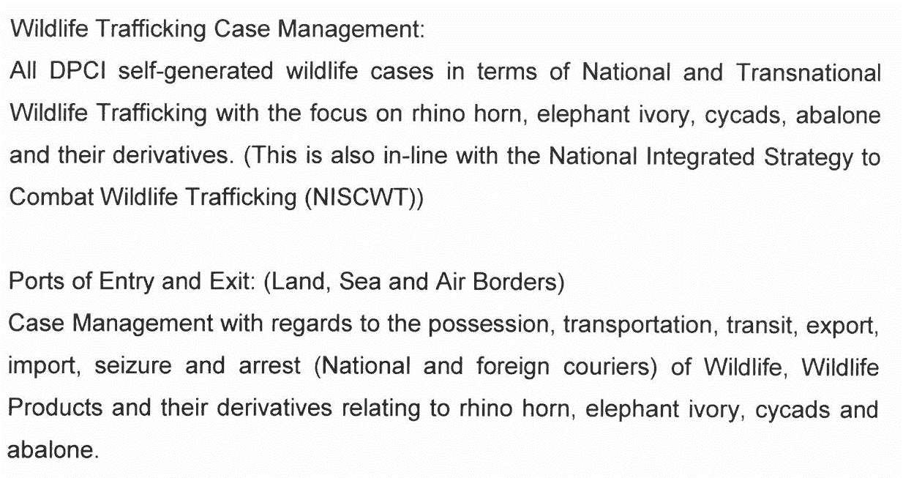
DPCI Mandate: Endangered Species

Slide 22
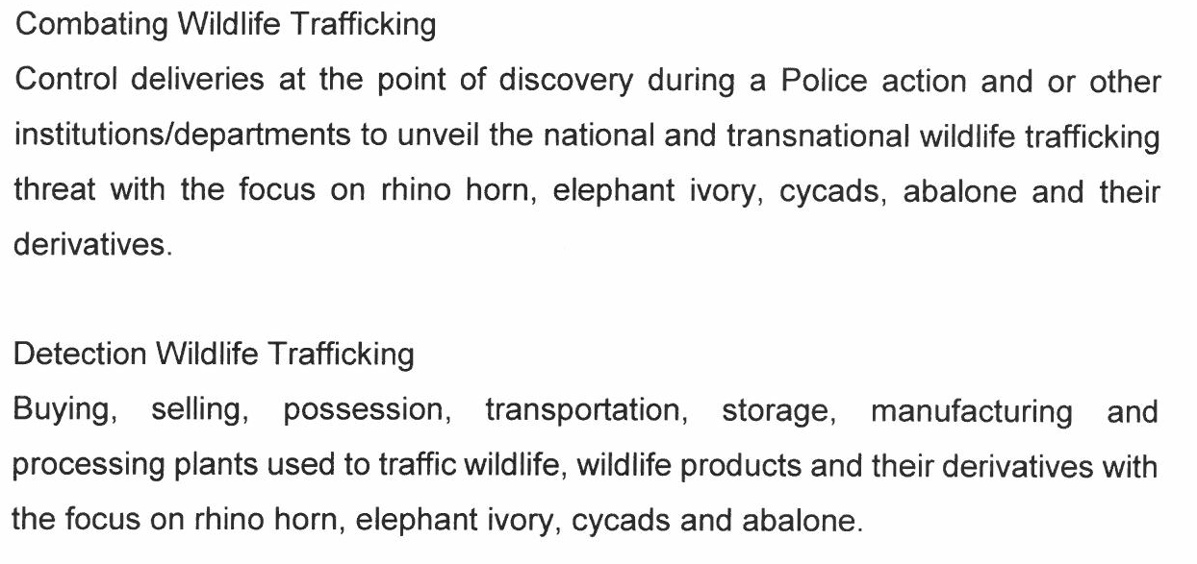
DPCI Mandate: Endangered Species

Slide 23
SECTION 5
Crime statistics

Slide 24
Crime Statistics
Statistics
  Data collected from cases reported
  Data generated by SAPS actions
Statistics are used to determine trends, changes in modus operandi or movement in crime
Crime statistics are used for deployment of police resources in respect of basic policing, crime prevention, intelligence driven operations.
Modus operandi analysis (done by Modus Operandi Strategic Analysis Centre – MOSAC) informs escalation of crime to DPCI – subject to DPCI agreed criteria.

Slide 25
SECTION 6
Determination of priority crime

Slide 26
Priority Crime Defined
“National priority offence” is defined as organised crime, crime that requires national prevention or investigation, or crimes that requires specialised skills in the prevention or investigation thereof, as referred to in section 16(1) of the South African Police Service Act, 1995 (Act No. 68 of 1995).

Slide 27
Regulation of determination of Priority Crimes
s17D. Functions of Directorate of the South African Police Service Act, 1995 (as amended).
(1) The functions of the Directorate are to prevent, combat and investigate—
(a) national priority offences, which in the opinion of the Head of the Directorate need to be addressed by the Directorate, subject to any policy guidelines issued by the Ministerial Committee; and
(b) any other offence or category of offences referred to it from time to time by the National Commissioner, subject to any policy guidelines issued by the Ministerial Committee.

Slide 28
Regulation of determination of Priority Crimes
(2) If, during the course of an investigation by the Directorate, evidence of any other crime is detected and the Head of the Directorate considers it in the interests of justice, or in the public interest, he or she may extend the investigation so as to include any offence which he or she suspects to be connected with the subject of the investigation.
(3) The Head of the Directorate may request the National Director of Public Prosecutions to designate a Director of Public Prosecutions to exercise the powers of section 28 of the National Prosecuting Authority Act, 1998 (Act No. 32 of 1998).

Slide 29
OFFENCES THAT MAY BE ADDRESSED BY
THE DIRECTORATE
Any other national priority offence which a Provincial Commissioner requests the National Head of the Directorate to prevent or investigate, may be addressed by the Directorate, depending on the following factors:
  Monetary value;
  Complexity of the case;
  Extent of the case;
  Public interest;
  Urgency; and
  Organised fashion.

Slide 30
Regulation of determination of Priority Crimes
Coordination by Cabinet.
The Ministerial Committee may determine—
policy guidelines in respect of the functioning of the Directorate;
(b) policy guidelines for the selection of national priority offences by the Head of the Directorate in terms of section 17D(1)(a);
(c) policy guidelines for the referral to the Directorate by the National Commissioner of any offence or category of offences for investigation by the Directorate in terms of section 17D(1)(b);
(d) procedures to coordinate the activities of the Directorate and other relevant Government departments or institutions.

Slide 31
Regulation of determination of Priority Crimes
The policy guidelines of the Minister, as approved by Parliament determine the parameters of the mandate of the Directorate.
In essence, the policy guidelines provide for:
offences selected by the National Head of the Directorate;
offences that must be addressed by the Directorate;
offences that may be addressed by the Directorate;
offences referred to the Directorate by the National Commissioner;
the conclusion of Protocol(s) for the identification of possible offences that may be selected by the National Head of the Directorate as well as Protocol(s) in respect of national priority offences not selected by the National Head of the Directorate; and
transitional arrangements.

Slide 32
Practical Considerations
Crimes mentioned in section 16(1) include criminal conduct or endeavour thereto -
By any enterprise or group of persons who have a common goal in committing crimes in an organised manner;
Crimes committed by persons in a position of trust and making use of specialised or exclusive knowledge;
  in respect of the revenue or expenditure of the national government; or
  in respect of the national economy or the integrity of currencies;

Slide 33
Regulation of determination of Priority Crimes
Crimes of which the proportions require national investigation or prevention in the national interest;
Crimes committed across national and international borders;
Crimes where international requests for assistance are made in the investigation or prevention thereof;

Slide 34
Regulation of determination of Priority Crimes
Crimes which a Provincial Commissioner requests the DPCI to investigate on national level - the Head DPCI decide the level on which the crime shall be investigated (national or provincial); and
Crimes in respect of which investigation thereof by members under the command of a Provincial Commissioner will detrimentally hamper the prevention or investigation of national priority offences.

Slide 35
THANK YOU

