Slide 1
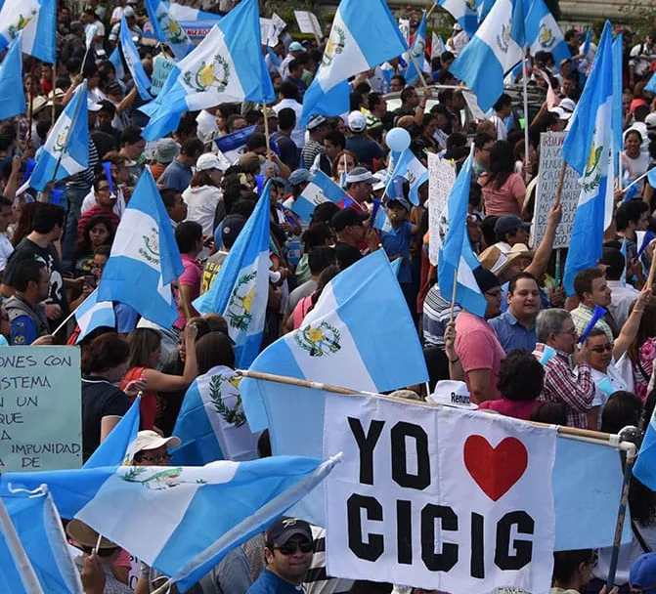

Innovative
Anti-Corruption Models
The Guatemalan experience
Adv. Cameron cordell
International anti-corruption conference
Gqeberha, 15 April 2025

Slide 2
Introduction
Corruption is a crime which affects all countries to varying degrees around the world.
Corruption and impunity tend to be prevalent in post-conflict societies, such as South Africa following the end of apartheid.
There are various means used to combat corruption:
  Single agency approach (Singapore); or
  Multi-agency approach (e.g. South Africa)
In South African Context, how successful has the multi-agency approach been?
  State Capture and highlighting corrupt networks that have operated within the State, along with a prosecuting authority that is struggling to operate.
Other jurisdictions have attempted novel ways to combat corruption – one of these is Guatemala and its Commission Against Impunity in Guatemala (CICIG)

Slide 3
Historical Context
Guatemala has a long history of oppression caused by:
  Colonisation
  Occupation
  US-backed coup d’etat (1954)
  Guatemalan Civil War (1960 – 1996)
    250,000 civilians dead or disappeared and 1.5 million people displaced.
Following the Civil War, and perhaps inspired by South Africa’s path to democracy:
  Two truth and reconcilliation commissions were held
  Many perpetrators of violence granted amnesty
However, by 2000, levels of violence and corruption in the country began to rise, with investgations discovering that former military officers from the War had become the heads of organised crime.
As an example, by 2006, Guatemala faced a 95% impunity rate for homicide.
Public perceptions at the time from civil society were that national justice mechanisms lacked independence in law and practice – a new approach was required.

Slide 4
The first attempt – CICIACS
First conception of this new approach by Guatemalan civil society was an international mechanism with independent prosecutorial powers within the national system.
Result – the Commission against Illegal Networks and Clandestine Security Apparatus (CICIACS).
However, the formation of CICIACS was struck down by the Guatemalan Constitutional Court in 2005, on the basis that the power to prosecute is granted exclusively to the Guatemalan Public Prosecutor’s office.
Back to the drawing board…

Slide 5
Formation of CICIG
The State of Guatemala and the United Nations entered into the Agreement on the Establishment of CICIG in December 2006, with its work due to start throughout the course of 2007.
  Marks one of the first large-scale international interventions into the domestic public sphere
  Also marked by the apparent wide degree of support from the Guatemalan population for CICIG’s formation
Combines features of both the single agency and multi-agency models.
Purpose (CICIG Agreement, article 1(1)):
  “To support, strengthen and assist institutions…responsible for investigating and prosecuting crimes allegedly committed in connection with the activities of illegal security forces and clandestine security organisations… as well as identifying their structures, activities, modes of operation and sources of financing, and promoting the dismantling of these organisations”
  To establish such mechanisms and procedures as may be necessary for the protection of the right to life and personal integrity pursuant to the international commitments of the State of Guatemala…”

Slide 6
Features of the CICIG
Wide mandate in terms of the Article 1 and 2 functions.
CICIG also enjoyed complete functional independence (Article 2(2))
  While it could work autonomously on investigations, must work with the prosecuting authority and the judiciary – strengthened and supported the justice system by removing any potential corrupt interference or procedural hold-ups.
Extensive safeguards
  Guaranteed confidentiality and all members hold diplomatic privileges of inviolability and immunity.
  CICIG ran for consecutive two-year terms, with the option of renewal by the State of Guatemala. Only the UN held the power to remove CICIG during that term.
  This power protected CICIG from interference by the state of Guatemala in 2017, 2018 and 2019, when the president attempted to declare the CICIG Commissioner persona non grata and revoke the Agreement. The Guatemalan Constitutional Court held that this was an unlawful modification of the Agreement and, therefore, void.

Slide 7
Functions of CICIG
CICIG Agreement, Article 2(1):
  INVESTIGATE: Determine the existence of illegal security groups and clandestine security operations, their structure, forms of operation, sources of financing and possible relation to State entities or agents and other sectors that threaten civil and political rights in Guatemala…
  PROSECUTE: Collaborate with the State in dismantling of illegal security groups and clandestine security operations and promote investigation, criminal prosecution and punishment of this crimes committed by their members;
  INSTITUTIONAL REFORM: Recommending to the State the adoption of public policies for eradicating clandestine security organisations and illegal security groups and preventing their re-emergence, including legal and institutional reforms.
  NB – wider ambit than simply “corruption”

Slide 8
Benefits of CICIG
International body staffed by experts from the region – creates a perceived sense of impartiality.
Operational successes bolster the standing of the commission in the eyes of the people of Guatemala, which help it to function efficiently. This had led to CICIG’s inclusion into the national bodies responsible for law reform.
Flexibility – the wide mandate allows CICIG to investigate Civil War era crimes, like genocide, to political and electoral fraud.

Slide 9
Querellante Adheviso
Guatemala is a civil law jurisdiction (like most of Central and South America) and is usually inquisitorial and not adversarial in nature.
In 1992, a new Criminal Procedural Code was passed, which introduced an adversarial system of criminal prosecution. This created a new paradigm.
Like much of Central and South America, state actors were often perpetrators of various crimes against their people – the general populous were suspicious that a prosecuting authority would balance the interests of the State with the need to advocate for victims (or protect the rights of the accused)
Result – the querellante adheviso (“joint complainant”) was written into the Criminal Procedural Code (Article 116).
  Allows a person or association to participate actively in the criminal process – rarely utilised by victims.
  This allowed CICIG to succeed where CICIACS had failed. It utilised a power available to all Guatemalan citizens and associations which, along with its substantial financial and human resources allowed for its effective collaboration with the prosecuting authority.

Slide 10
Investigations
Over the decade of CICIG’s existence, it undertook three main categories of investigation:
  Former security forces and cases into atrocities from the Civil War
    Expanded to include complex criminal organisations, transnational gangs and human trafficking operations
  Politically sensitive cases
    Portillo
    Rosenburg
  Illicit political-economic networks
    La Linea

Slide 11
Prosecutions
From an overview of CICIG’s work between 2007 – 2019, it is clear that the power to assist the prosecutor as co-complainant was used effectively, but with circumspection.
Co-prosecuting powers were usually utilised to support the prosecuting authority in cases where the risk of external pressure to the prosecution is higher than usual. (For example, La Linea)
Also introduced legal tools that can be adopted by the prosecution authority in future cases:
  CICIG utilised witness protection and plea-bargaining to assist with the preparation and successful prosecutions in La Linea, which also led to success in three other cases, Queatzal Port, Cooptación del Estado, and La Cooperacha.
  CICIG has furthermore introduced protected witness testimony into the criminal justice system, as in the Protillo matter – transnational video testimony

Slide 12
Institutional Reform
CICIG pushed for more than 30 institutional reforms in line with its duties as set out in the CICIG Agreement
Most notable was perhaps the proposal for full constitutional reform of the judiciary.
  The selection of the Attorney-General, appellate and supreme court judges had been rife with corruption.
  2010 – the first CICIG Commissioner resigned in protest over the selection of an A-G implicated in CICIG’s investigations.
  Uncovering Parallel Commissions
  2018 – Law Initiative No. 5179 – proposal by the CICIG in conjunction with the National Technical Secratiat to create a permanent institution to oversee the judciairy and propose candidates for elevation to the Bench, as well as greater regulation of and protection for judges.

Slide 13
The end of the CICIG
The tenure of CICIG came to an end in 2019, when the president, Jimmy Morales, who was himself under investigation by the commission, declined to renew the Agreement.
Throughout its tenure, the CICIG had:
  Indicted former president Molina and his vice-president,
  Had assisted in the prosecutions of dozens of government officials including Supreme Court justices, two former presidents, members of the Guatemalan Congress, and various ministers, police officers and drug traffickers.
  Throughout its tenure, CICIG led to over 400 convictions, with an over 85% success rate in prosecutions
  Has inspired other bodies in the region, in particular the Mission to Support the Fight Against Impunity in Honduras, with other similar bodies being investigated in El Salvador and Mexico.

