Slide 1
“Local is Lekker” – Together is better. A local government perspective on marine resource protection City of Cape Town
Arne Purves
08th November 2017

Slide 2
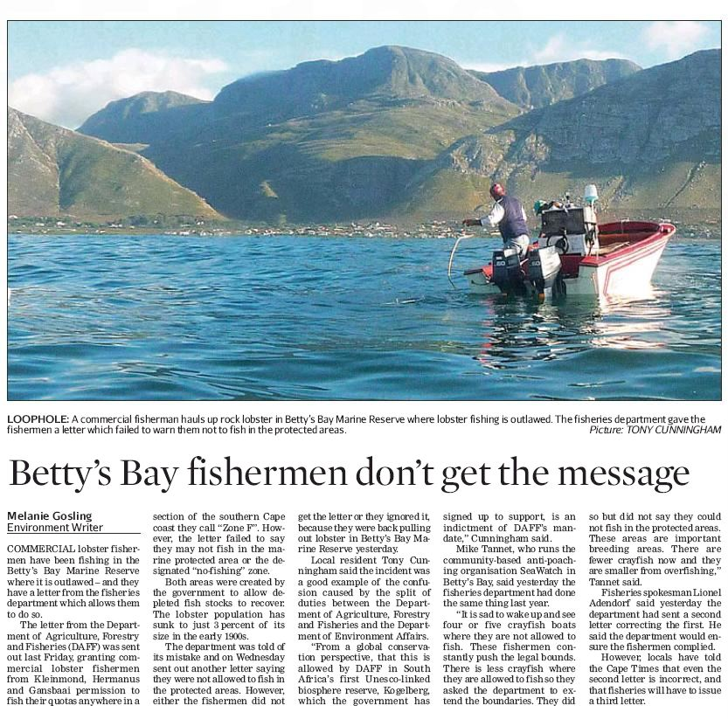
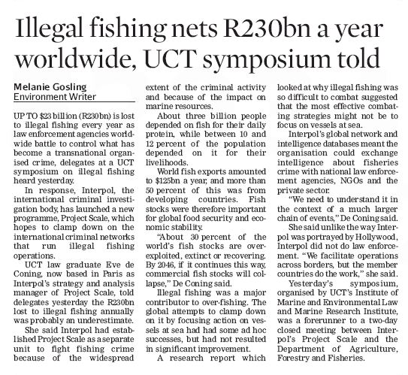
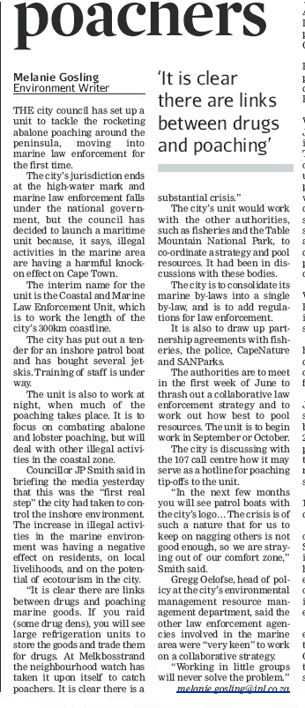
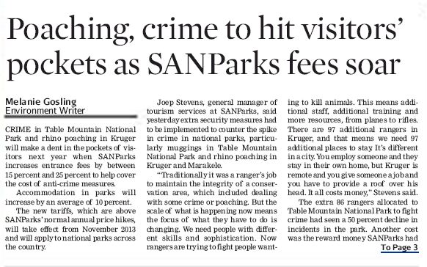
Outline
2

Slide 3
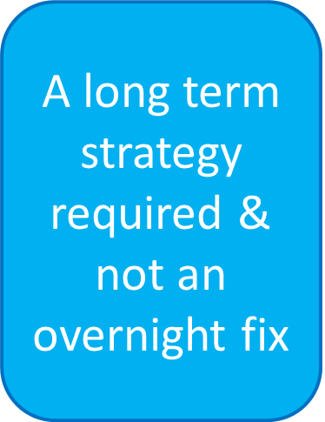
The Challenge
High levels of non-compliance and illegal activity.
Decreasing public confidence in responsible agencies.
Limited capacity/resources in individual organisations.
Large stretch of coastline to cover – 320km’s
The City’s jurisdiction is determined by the high-water mark; however, economic, recreational, environmental and illegal activities operate across jurisdictional boundaries.
Requires cooperation from all three spheres of government

Slide 4
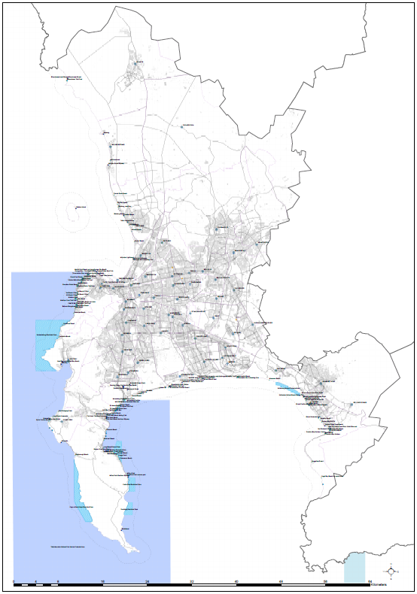
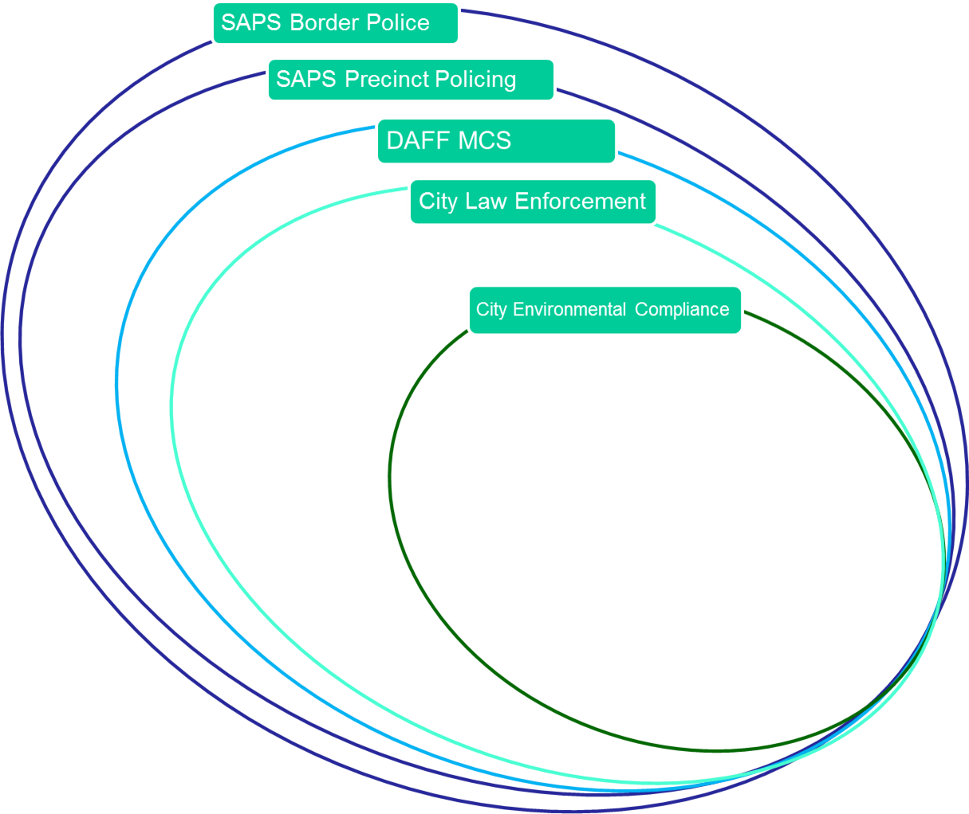
The Challenge
Multiple agencies with differing mandates and areas of jurisdiction.
A plethora of environmental legislation and required appointments.
Knowledge and experience of enforcement officials

Slide 5
A Collaborative Strategy
Collaboration & Cooperation between City Directorates and Departments – Establish Specialised Law Enforcement Marine Unit
Collaboration & Cooperation between Local & Provincial & National Government – June 2012 Stakeholder Workshop

Slide 6
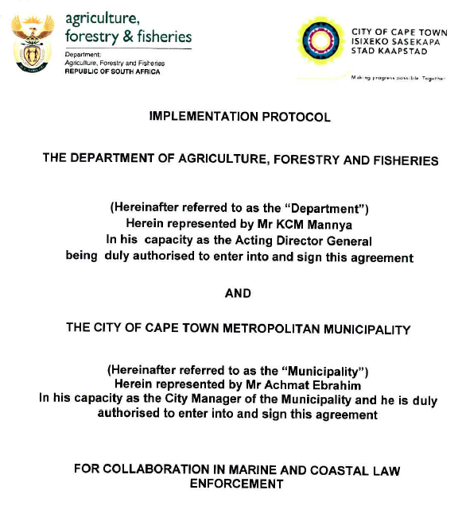
A Collaborative Strategy
An integrated coastal and marine law enforcement and compliance strategy to streamline a coordinated approach to coastal law enforcement in the City.
Marine & Coastal and Law Enforcement Task Team
Signed Implementation Protocol Agreement Between CoCT and DAFF

Slide 7
Implementation
Specialised Marine Unit established
Task Team established and meeting regularly
Training and Appointments
Legislative training – FCO training & Appointments (181 City officials appointed to date)
Enforcement Training – practice and procedures
Marine Species ID training – DAFF Research
Skippers, Marine Radio Licenses, SAMSA Small vessel regulations
EMI Training – EMI Level 2 appointments within Law Enforcement
Law Enforcement for Peace Officers Training - +/- 80 City and 20 Table Mountain National Park staff trained. - NMMU

Slide 8
Implementation cont..
Incident reporting and response – CoCT Emergency Centre
Inshore vessel patrol and response capabilities
Regular joint operations
Ad hoc operations and assistance to other agencies
Inception and implementation of Operation Phakisa Initiative 5 – has focused attention and resources of all spheres of government on the problems facing the marine and coastal enforcement agencies.
Focused attention on problem areas as they arise

Slide 9
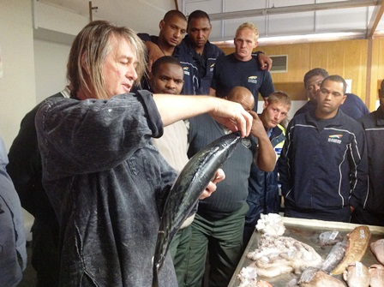
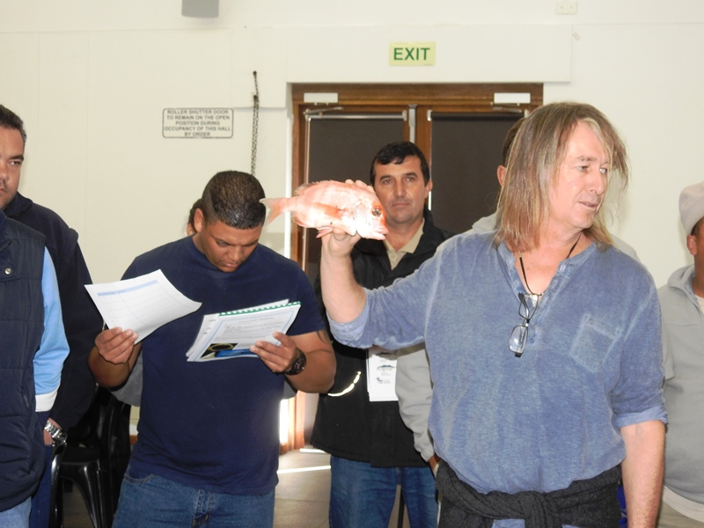
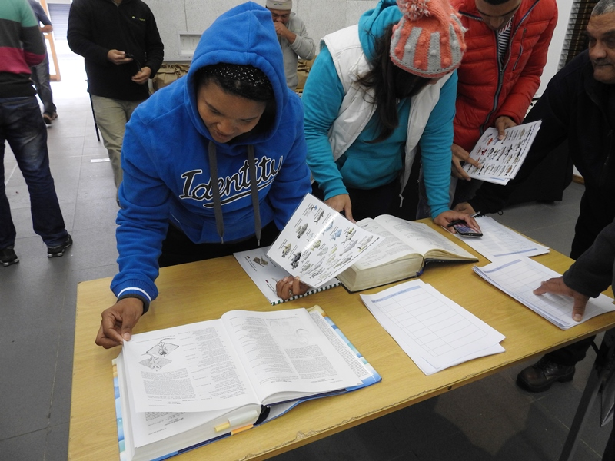
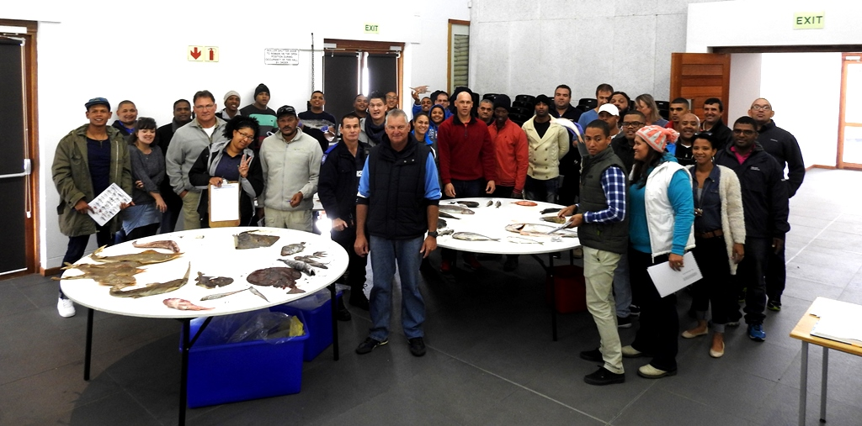
Training interventions

Slide 10
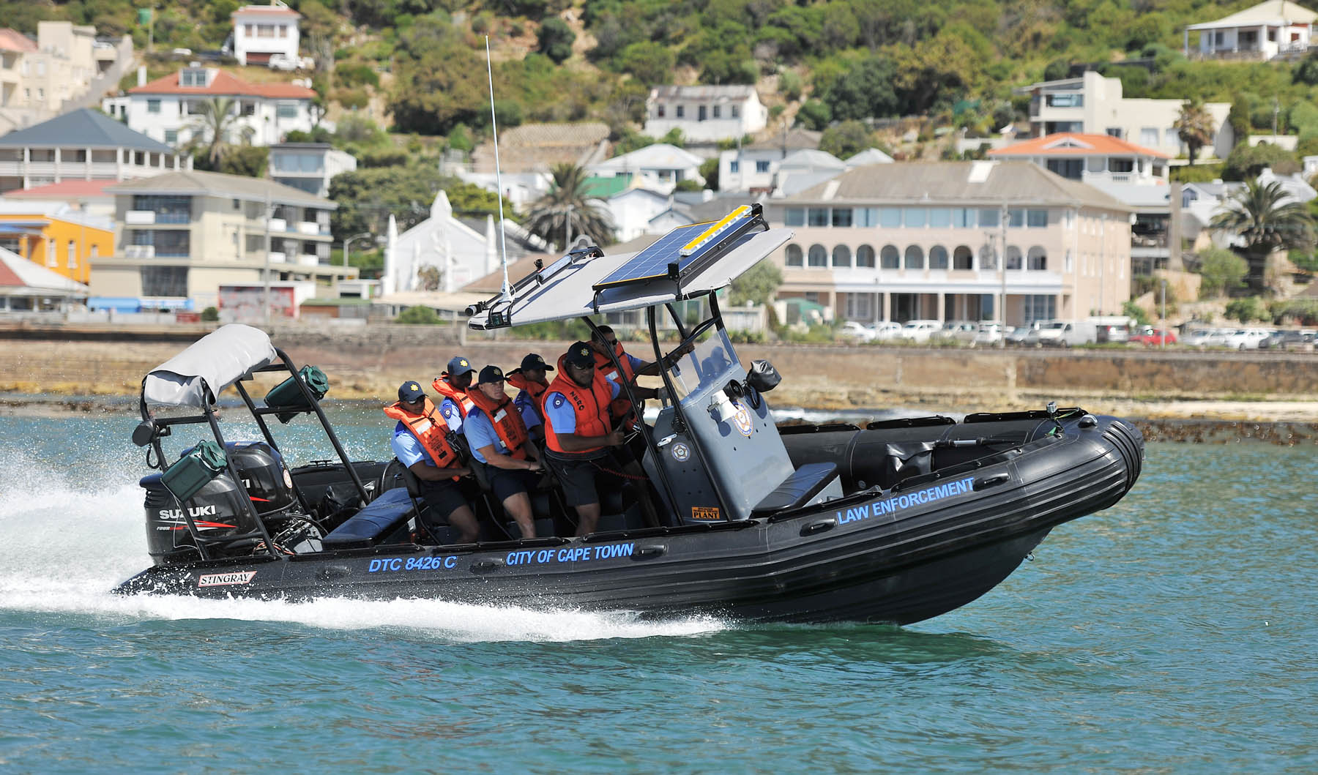
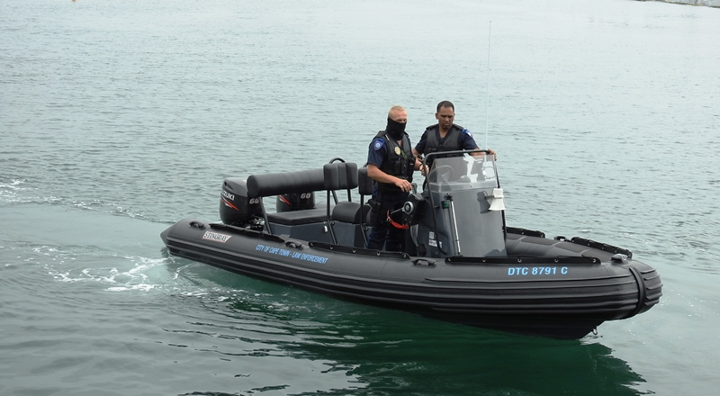
Vessels and Skippers

Slide 11
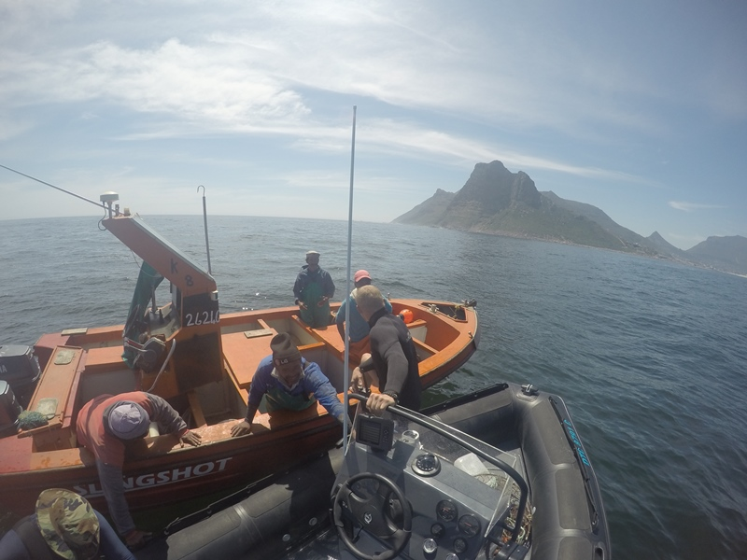
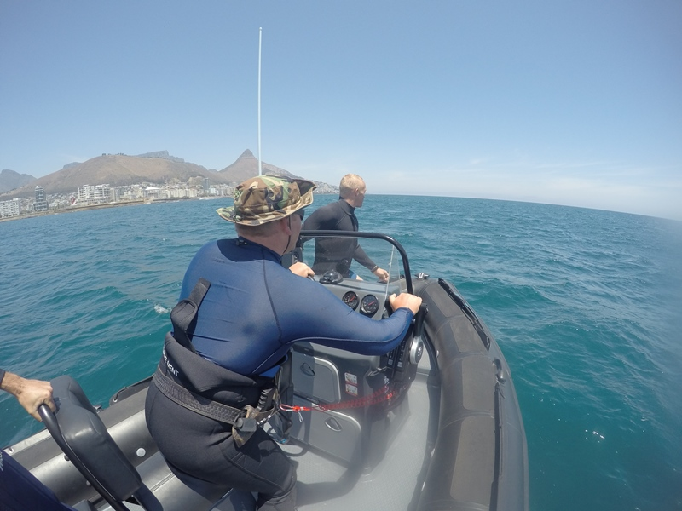
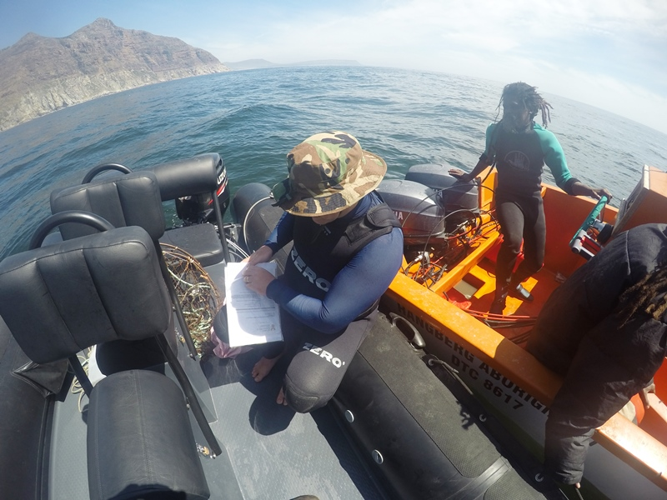

Slide 12
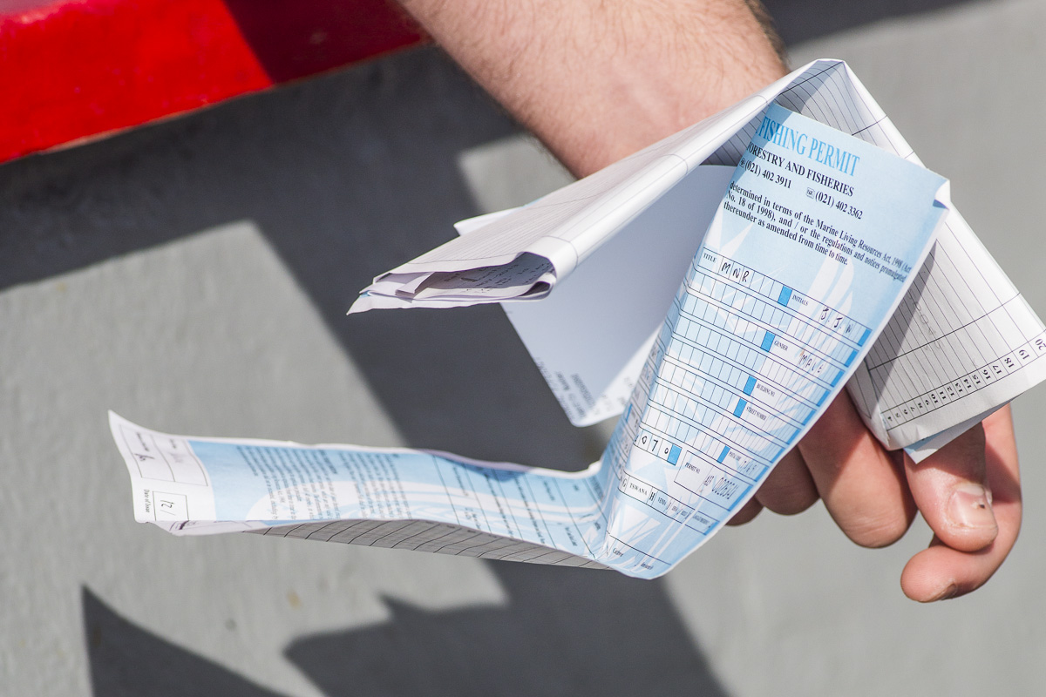
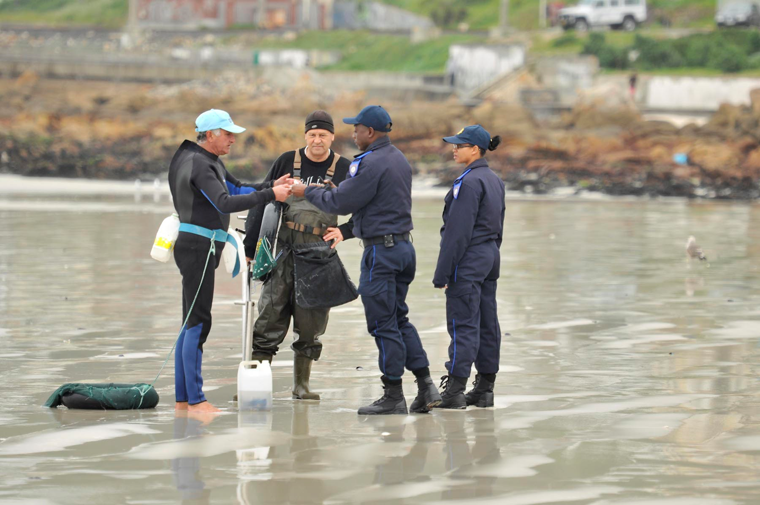
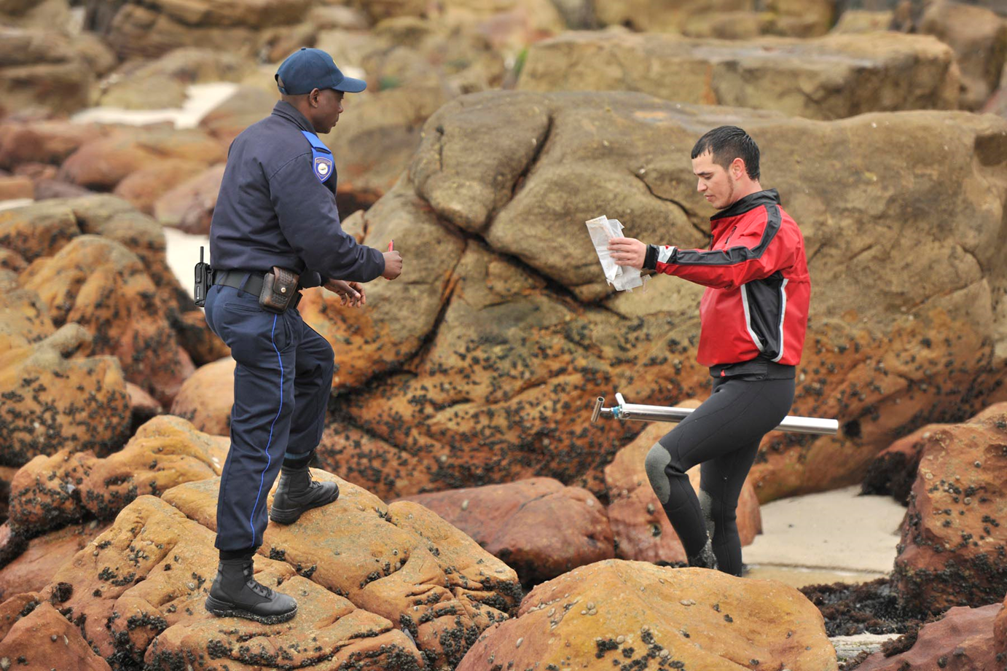
Visible Policing

Slide 13
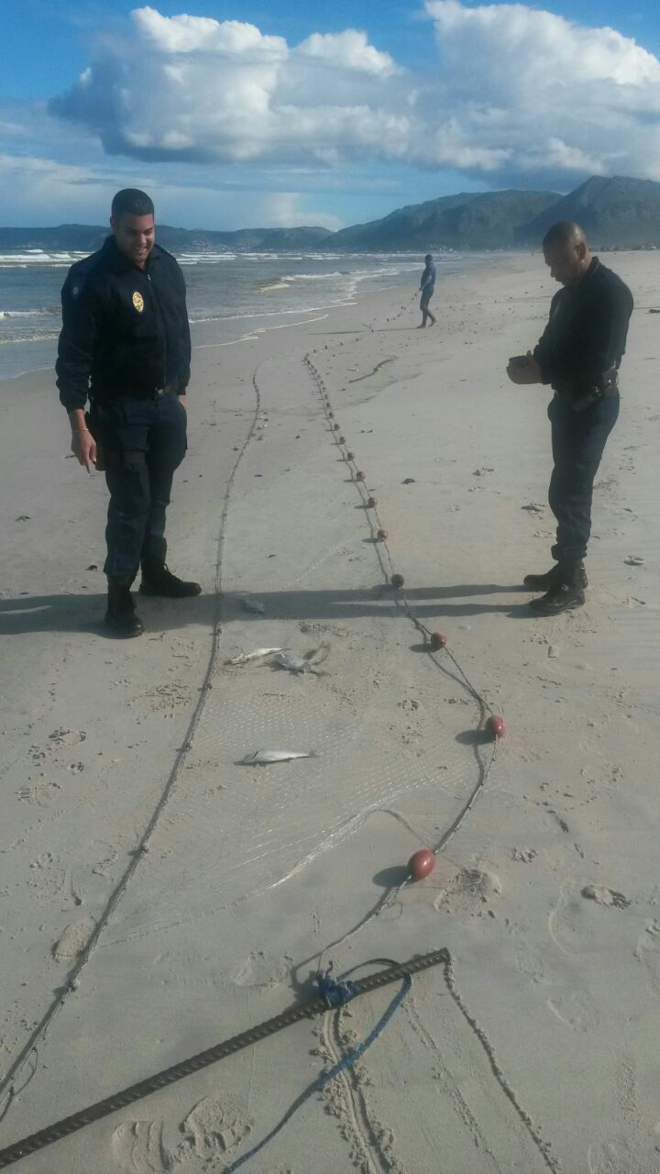

Slide 14
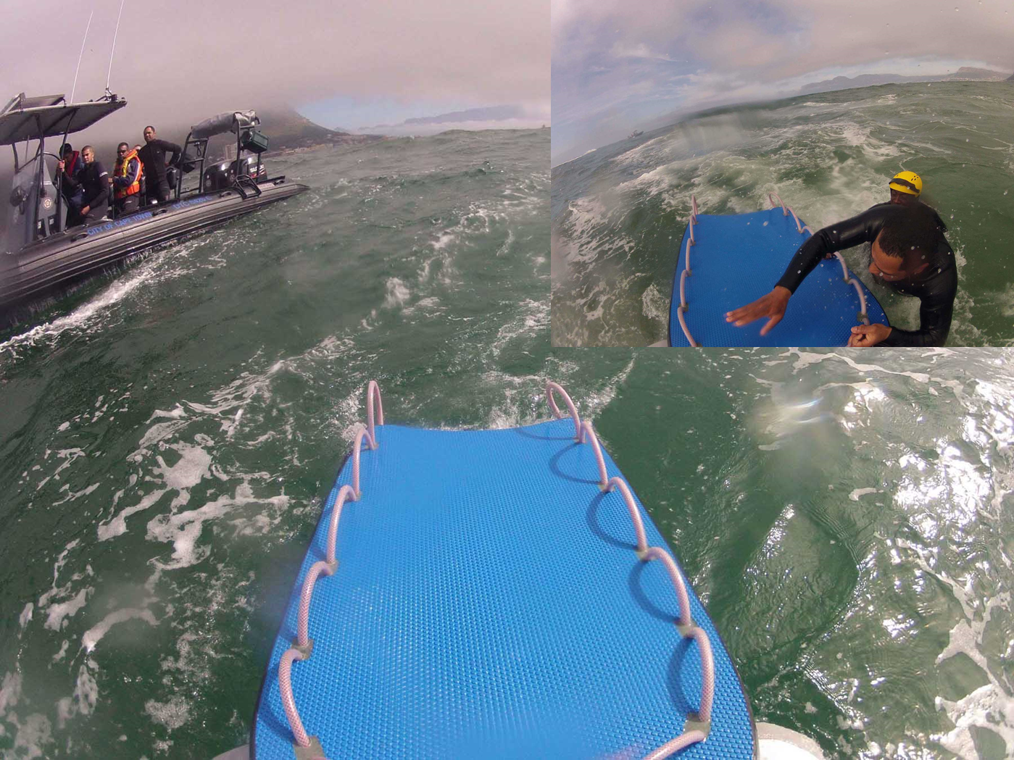
Life saving capacity

Slide 15
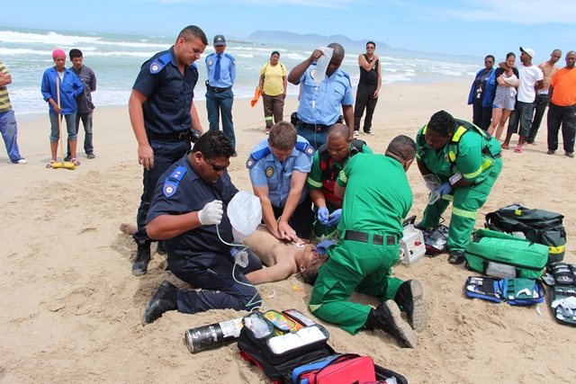

Slide 16
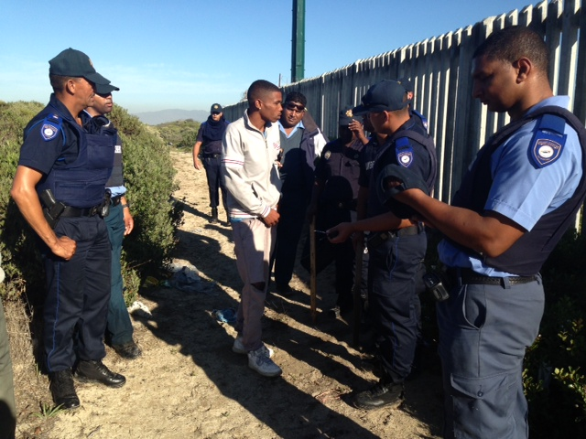
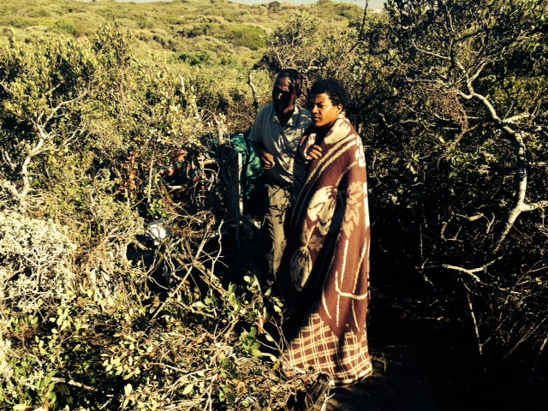
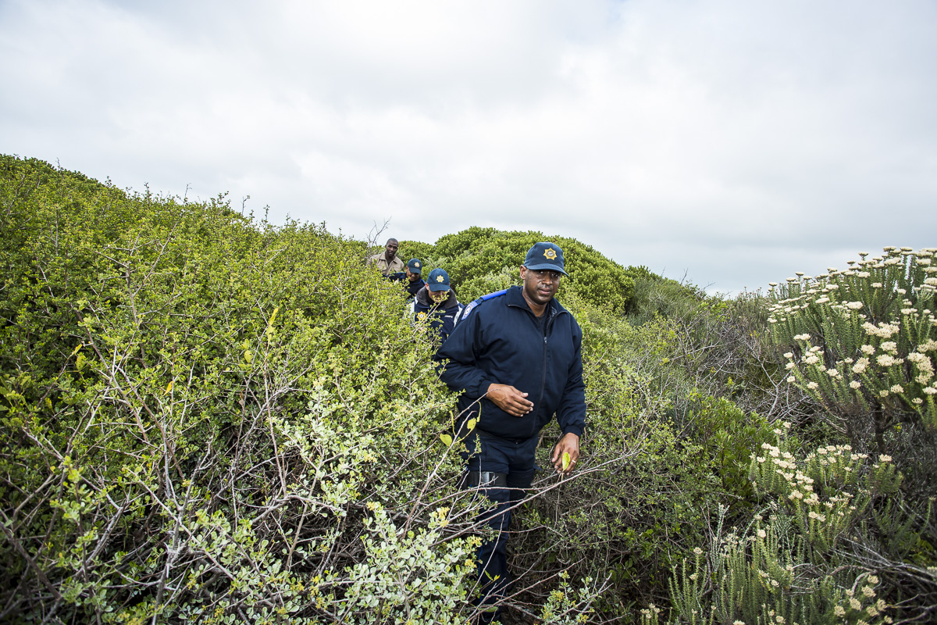
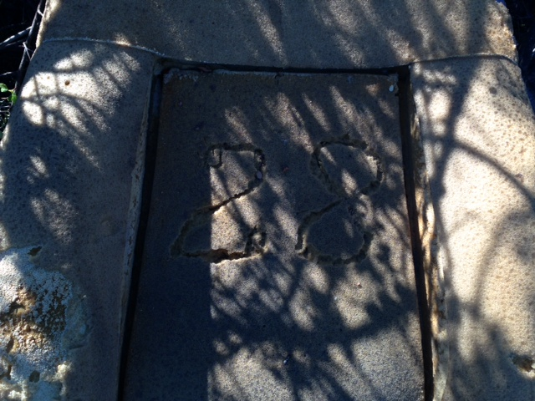
Special Operations in coastal protected areas

Slide 17
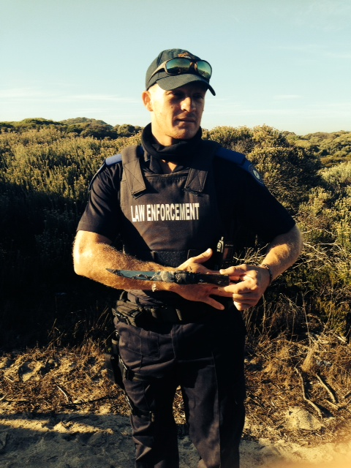
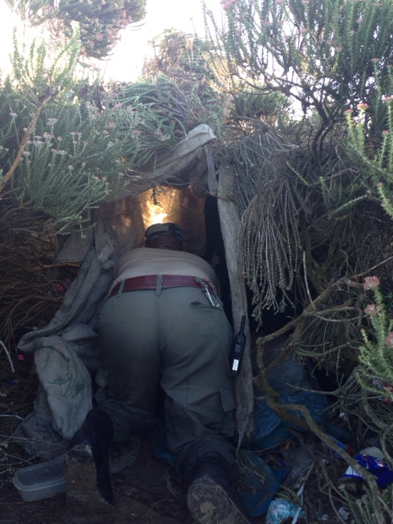

Slide 18
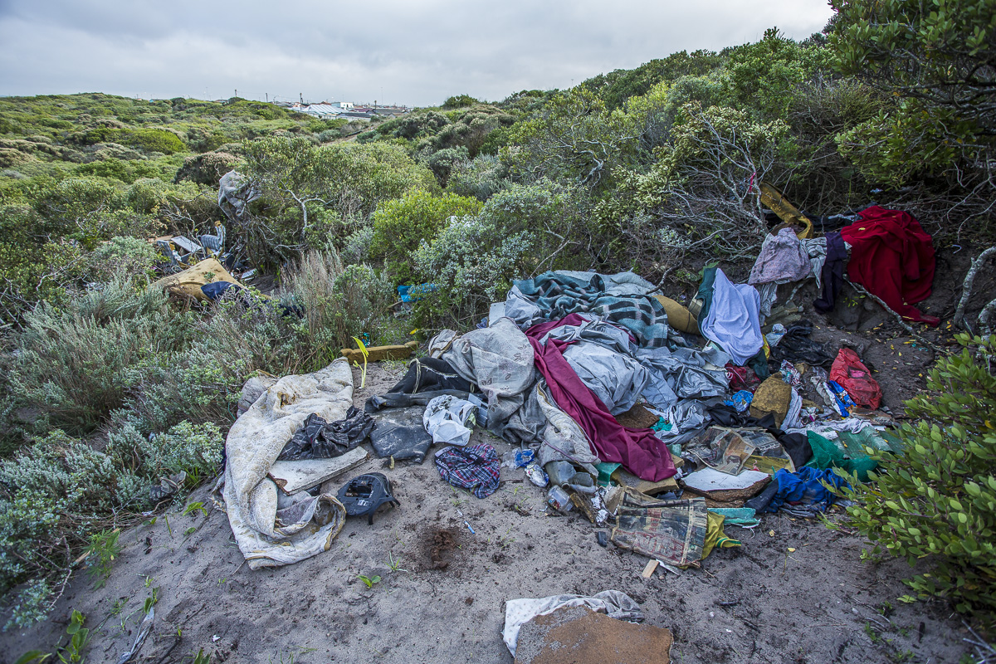
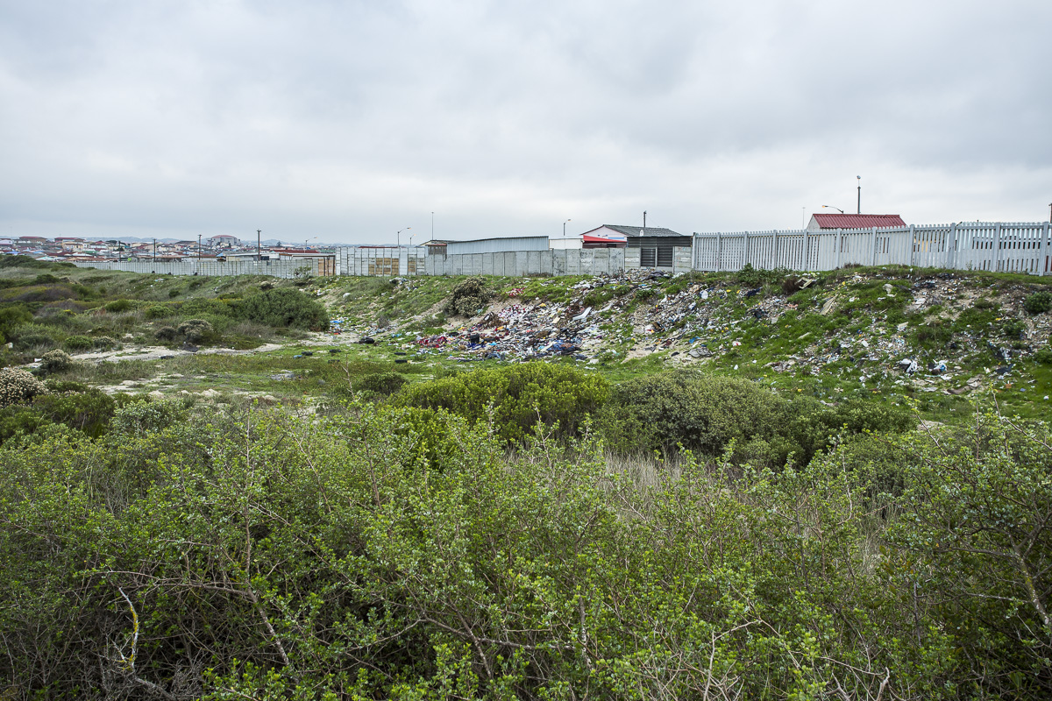
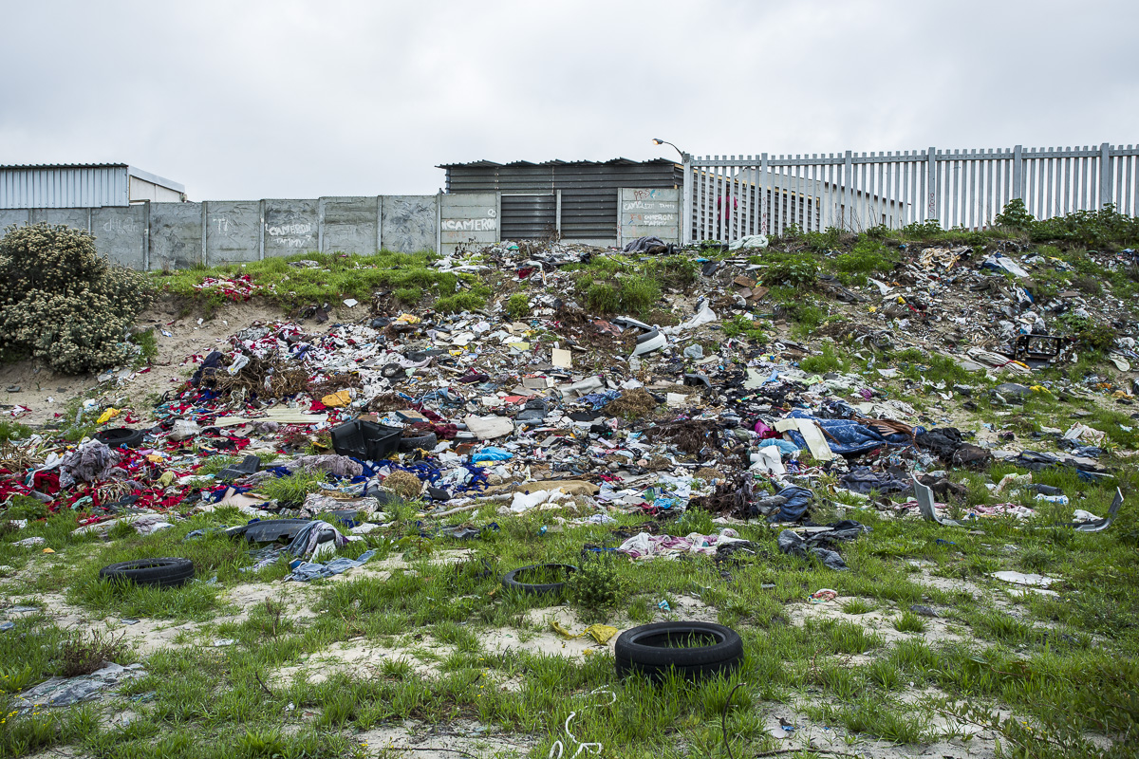

Slide 19
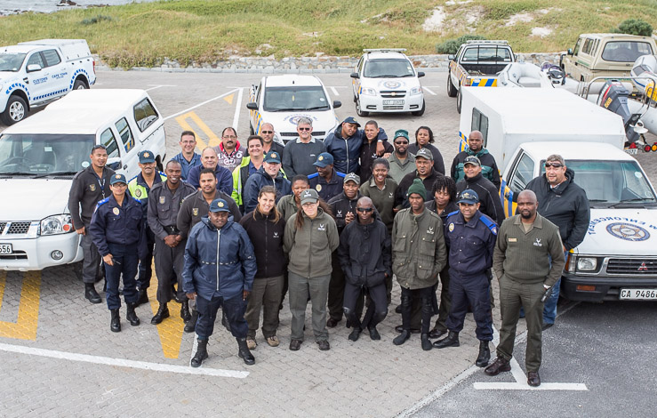
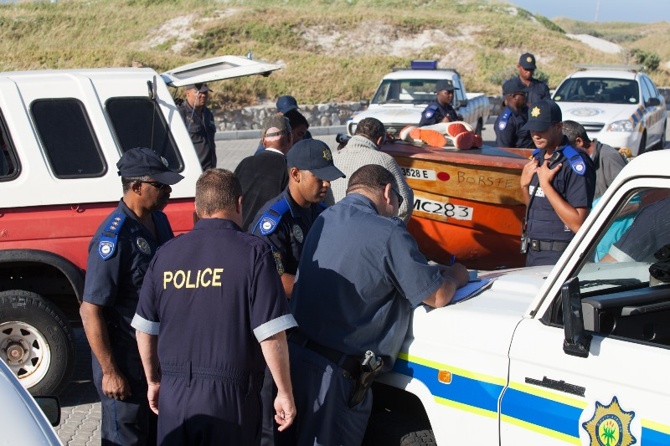
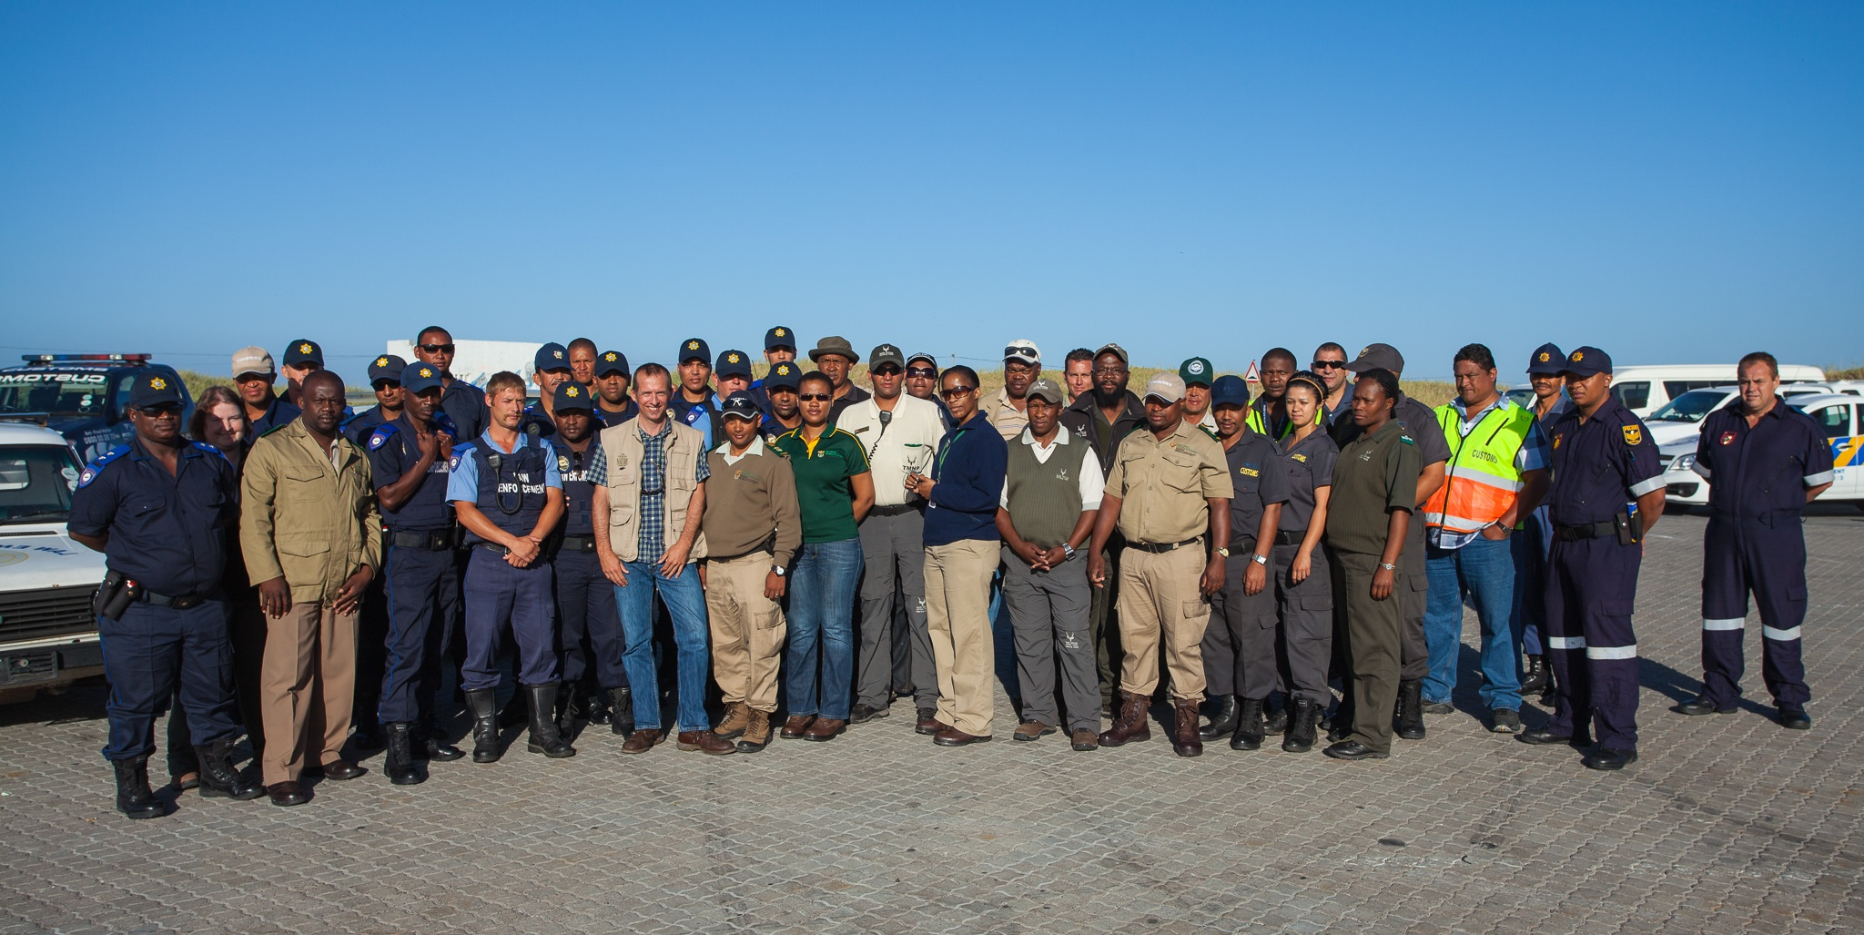
Multi Agency Joint Operations

Slide 20
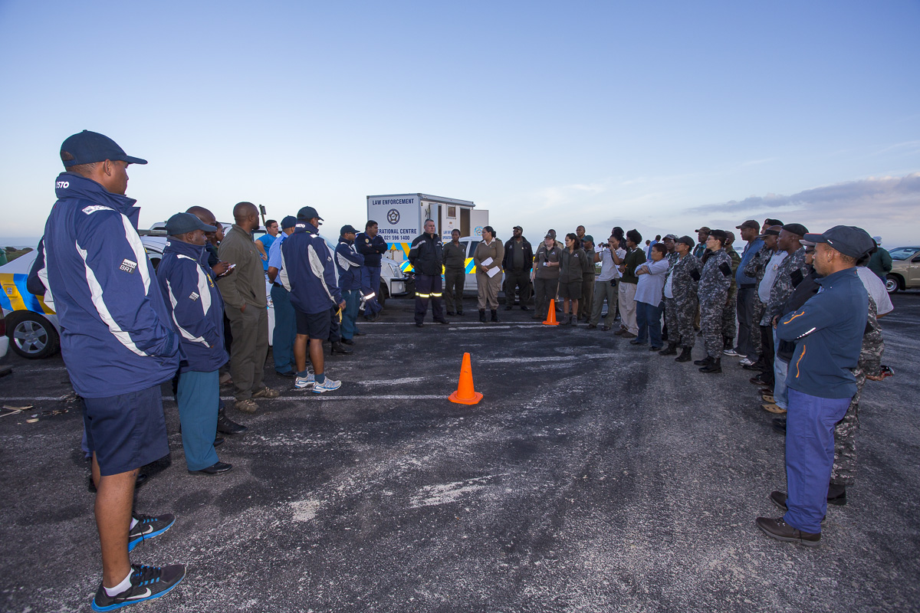

Slide 21
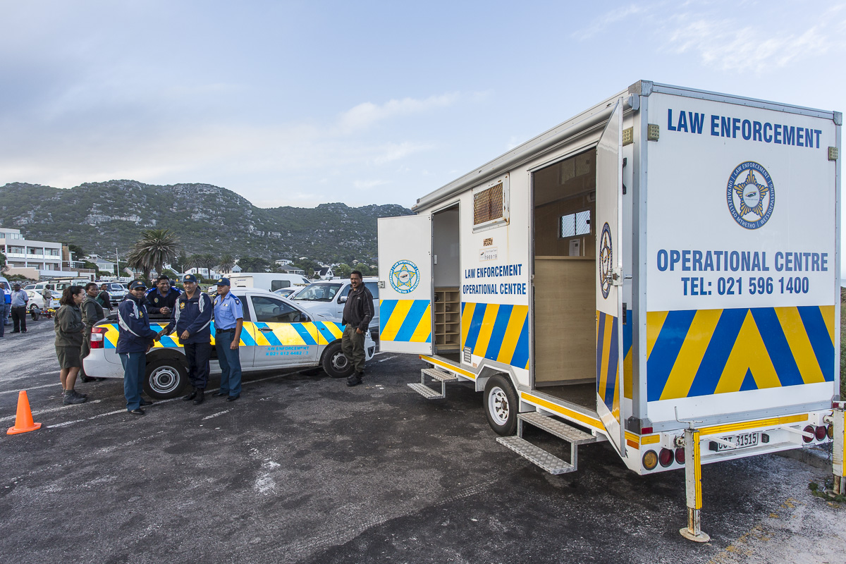

Slide 22
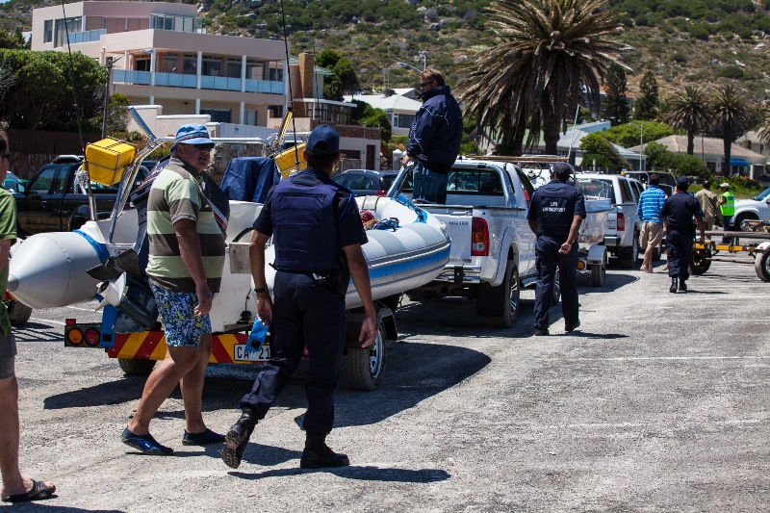

Slide 23
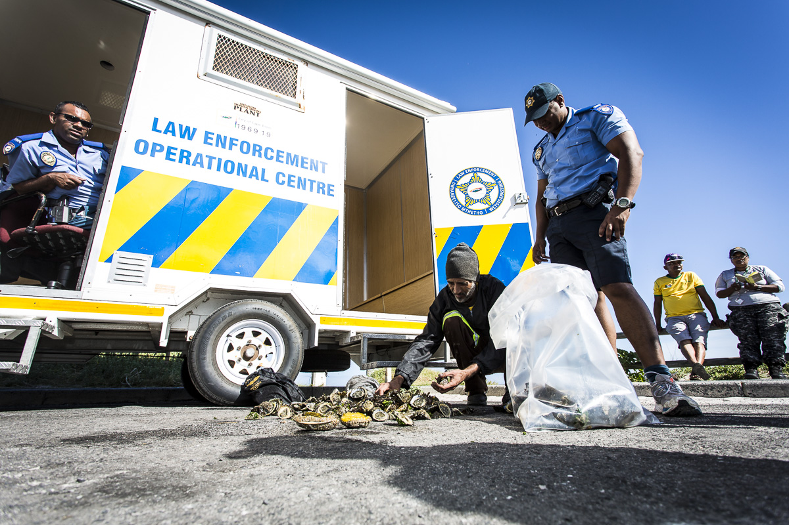

Slide 24
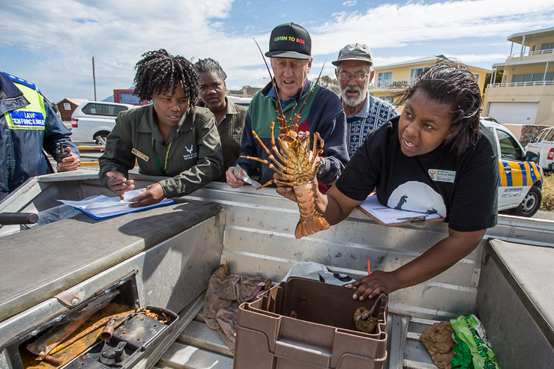
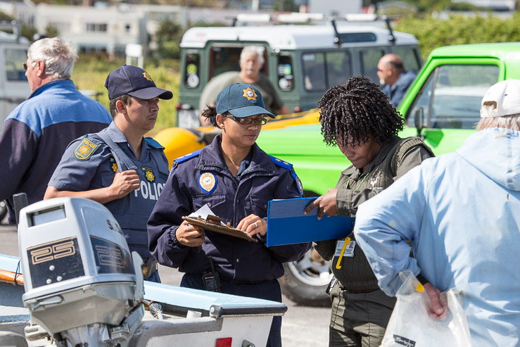
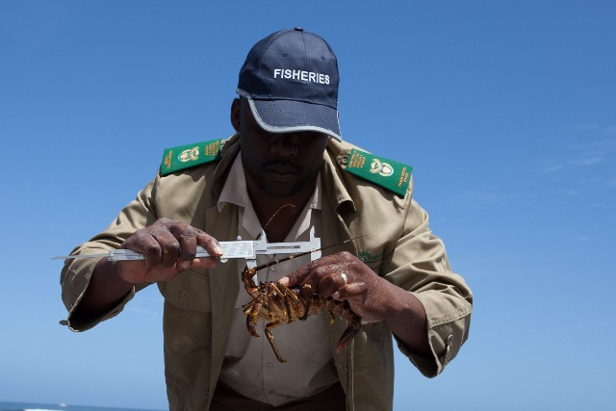

Slide 25
Successes
This is tricky to measure and quantify as it depends on the enforcement objectives.
Resource protection vs Enforcement Actions
Overall, the effectiveness of our Integrated Enforcement Strategy can be measured through the successful implementation of all the actions to date.
We can also measure all our direct enforcement successes
Not easy to measure our successes at keeping resources in the sea

Slide 26
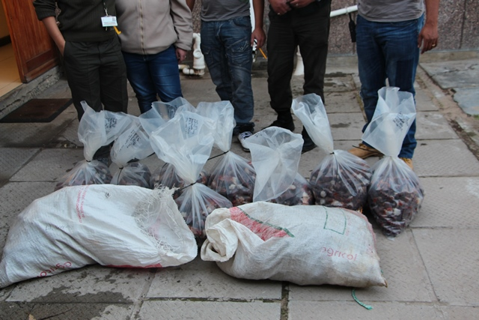
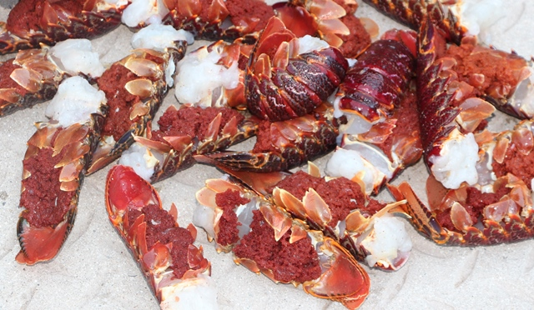
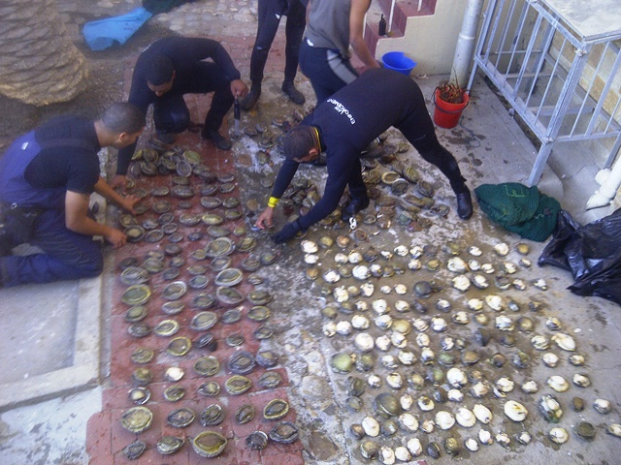
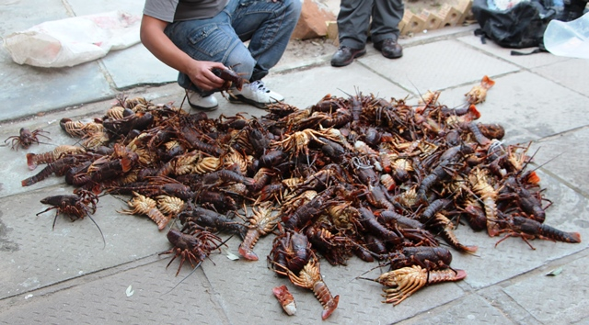
Successful Operations

Slide 27
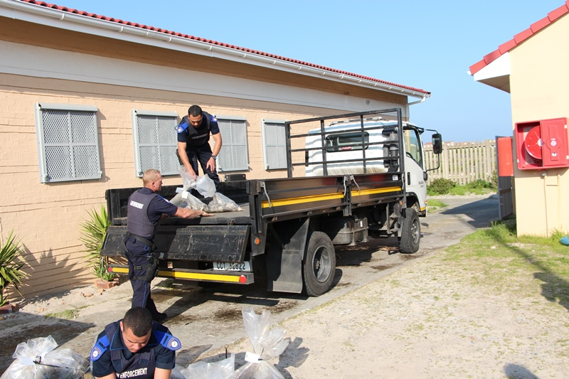
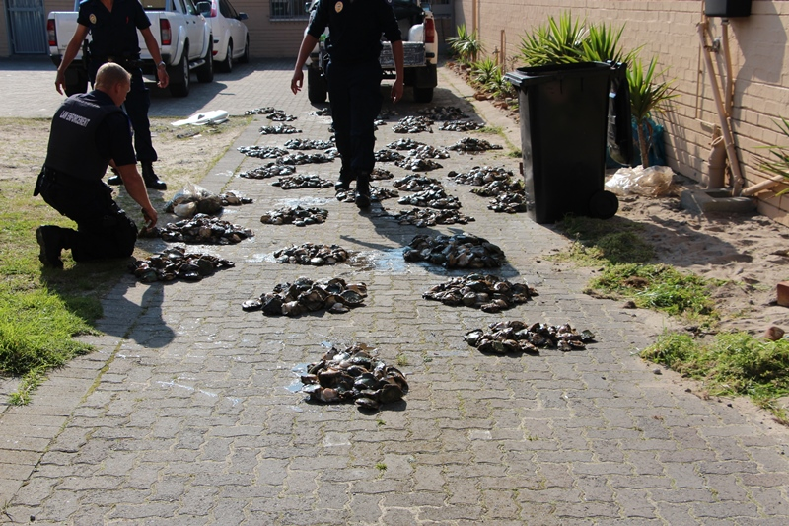
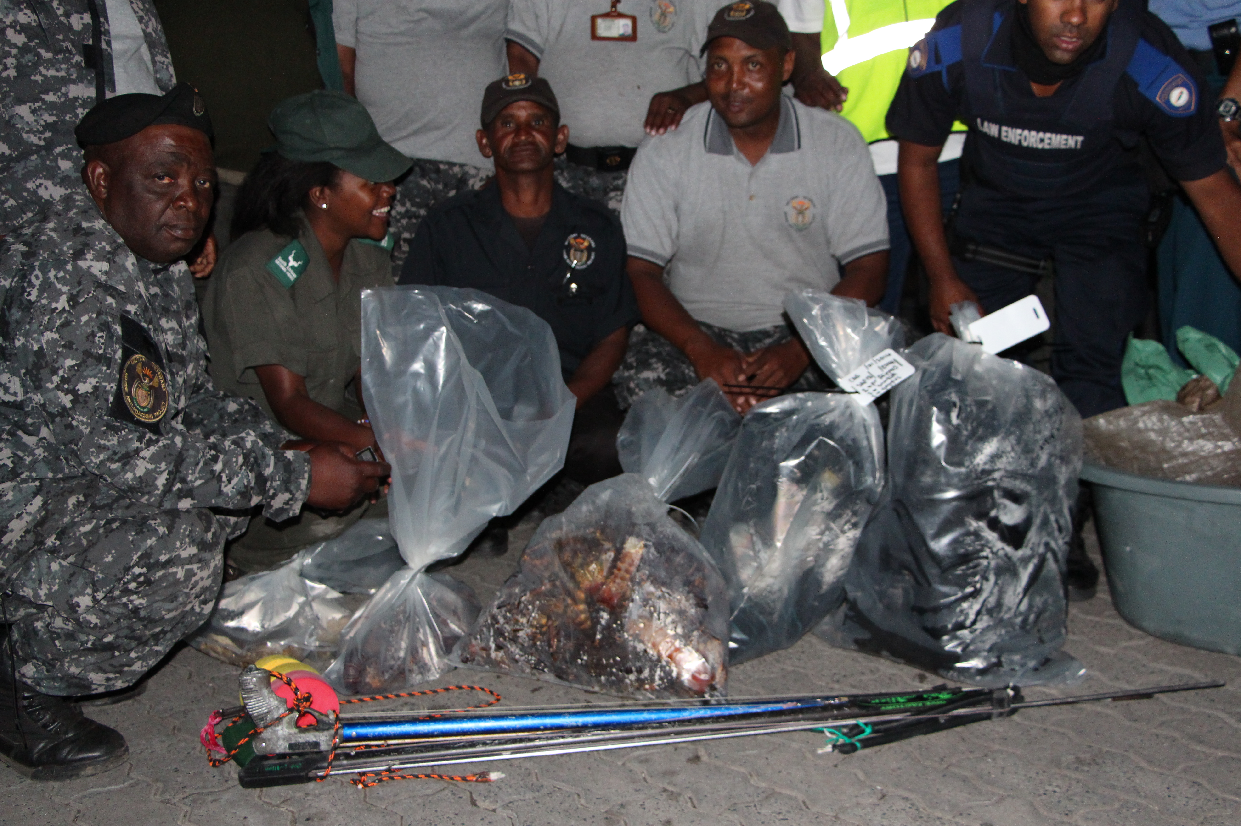
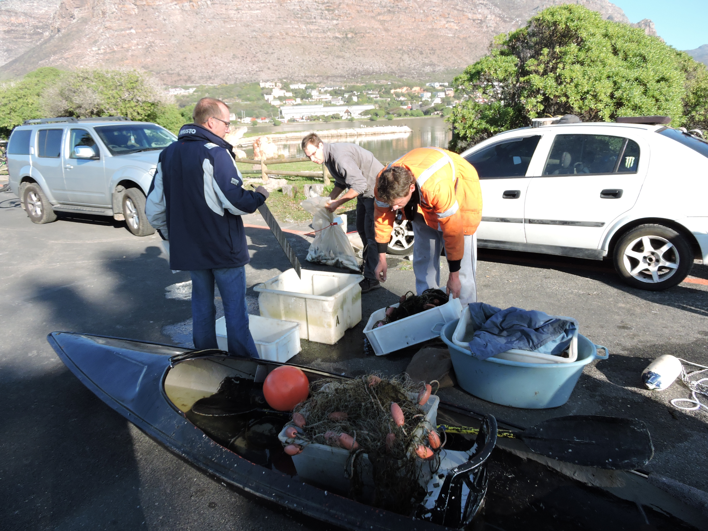

Slide 28
Wednesday 11 October 2017
Members conduct a joint operation with SANPARKS in Fish Hoek area
Cas15/10/2017.
716 shucked and 21 whole state abalone

Slide 29
Thursday 12 October 2017
Law Enforcement assist SAPS with a highspeed chase from Melkbosstrand to Chatsworth where they found a vehicle standing abandoned by the driver with bags of abalone. Malmesbury Cas15/10/2017, 8x sealed bags, SAP13/1225/2017, Monday

Slide 30
Thursday 20 October 2017
Joint Operation with SANPARKS and DAFF in the Simonstown area.
Impoundment of vehicle at Stikland. Suspects arrested.
Cas 44/10/2017, SAP13/287/2017, Stikland 13/2091/2017
1257 Shucked and 196 whole state Abalone. Estimate value +- R 726 000

Slide 31
Thursday 02 November 2017
Law Enforcement received a complaint of a male selling abalone in front of Olympia Restaurant in Kalkbay. Complaint was positive and a coloured male was arrested for the Possession of Abalone without a permit.

Slide 32
Increased publicity and awareness

Slide 33
Challenges
Are we succeeding in protecting the resource in the sea?
Are our borders/points of entry secure?
Our small fishing harbours remain largely unregulated spaces
Our boat launch sites are largely unregulated
ORV’s remain a huge problem, despite intensive enforcement
Poaching is escalating, not decreasing. Despite increased enforcement success by all role players. Increased poaching must also be seen in the context of increased crime generally, alongside a shrinking formal economy.
Are we boosting demand through our enforcement actions?
It is a challenge to maintain the enforcement pressure along 320km’s coastline

Slide 34
Moving forward
Develop by-laws that will assist local enforcement
Coastal By-Law (by-laws are limited in scope however e.g. No powers of arrest)
Address mandates across spheres of government – delegation or assignment to local authorities would allow local LE officers to exercise greater powers e.g. Small Vessel Regulations
Continued engagement with all role players and support to Operation Phakisa Initiatives
Harbour and boat launch site regulation and security
Continued training and development of enforcement officers, including auxiliary enforcement officers and community policing forums etc
Engagement with the prosecutors around marine related offences and prosecutions
Case Management support – legal and administrative

Slide 35
Moving forward
Current enforcement and prosecution of offenders is not having a deterrent effect – response needs to address underlying social and economic drivers, not only regulation
Socio-economic and livelihood solutions need to be implemented in affected communities.

Slide 36
THANK YOU
Thank You
Arne Purves
Senior Professional Officer: Environmental Compliance
Tel: +27 (0)21 444 2796
Cell: +27 (0)82 940 8937
Fax: 086 576 0280
arne.purves@capetown.gov.za

