Slide 1


Demand for high value environmental assets, increases corruption: An example of rhino-counter poaching in Kruger National Park
Nic Funda
14 April 2024
nicholus.funda@sanparks.org

Slide 2

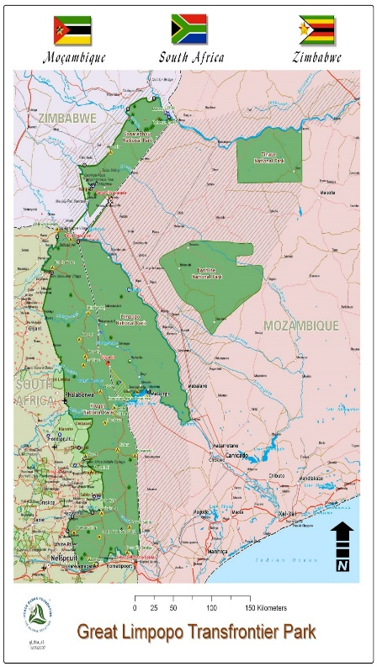

KRUGER NATIONAL PARK AND CONTEXT
Kruger National Park (KNP) is about 2 million Hectares
Perimeter boundary is about 1000 km
395 km international border:
  365 km Moz-SA
  30 km Zim-SA
Cross-border wildlife crimes
Part of the Greate Limpopo Transfrontier Park

Slide 3

DEMAND MANAGEMENT
Protected areas such as KNP caries environmental assets (e.g. Rhino
Poaching) that society value them.
These societal values are diverse e.g.
  Tourists value wildldife different from local communities
  Hunters value wildlife different from poachers
  Communities neighbouring protected areas also attach values to natural assets.
Therefore, protected area management is all about managing diverse demands from society.
The focus of this presentation is on poachers that are stealing from other members of society.
3

Slide 4
PROJECT ICU TO REMOVE CORRUPTION CANCER
Poaching started in 2008 in KNP (24 yrs)
More than 7 000 rhinos poached in KNP.
Rhino populations decreasing in the park
It became difficult for the poachers to find rhinos.
Poachers started recruiting staff members (infiltration).
Corrupt staff members became involved.
Project ICU was developed to counter-staff involvement (cancer).
This included integrated investigations, Polygraph testing, financial management, counselling and imprisonment.
4

Slide 5
MEASURING AN IMPACT (THE SCORE BOARD)
From 2009 to date, 66 staff members were involved direct on indirect.
The cancer is not limited to safety and security personnel.
Polygraph Testing results showed:
  no deception 82%
  Deception 18%
5

Slide 6
DISCUSSION AND CONCLUSION
The high levels of corruption and internal involvement are perhaps the most significant contributing factors to the increased rhino losses.
This situation demoralising to dedicated staff members and negatively affect their well-being.
Polygraph Testing is voluntary, but most of staff members are participated.
Experts are brough into this investigations such the Hawks, Financial Organisations, and NGOs
Counter-poaching is a very expensive operation that involves, technology, human capital, K9, aircrafts, etc.
Without the support from SANParks, government, NGOs, Donors, the narrative will be different.
6

Slide 7
Thank you

