Slide 1
PESCADOLUS and FishFORCE
PescaDOLUS:
A PLATFORM FOR PROMOTING RESEARCH
TOWARDS IMPROVED
FISHERIES CRIME LAW ENFORCEMENT
Nelson Mandela University
8-9 November 2017
Notes:
I am going to talk on the research that PD can contribute towards the FishFORCE Project towards IMPROVED FCLE

Slide 2
‘FishFORCE aims to integrate existing expertise and innovative research to create a permanent education, resource and support centre for fisheries law enforcement officers in developing countries’
‘FishFORCE is envisaged to become a university accredited, research-led programme enjoying international recognition’
Notes:
Research is a central theme in the FishFORCE proejct -

Slide 3
INTERPOL Fisheries Crime Working Group Meeting, CAP Project 2015, NMU: Centre for Law in Action
Notes:
PescaDOLUS was integral part of the development of the FishFORCE Project
Here – have a FCWG meeting on FishFORCE in 2015 with: PescaDOLUS, DAFF, INTERPOL and Kenya University of Nairobi representative
This group formed an Interim Steering Committee for FishFORCE Project to drive it fowards

Slide 4
Outcome 4 FishFORCE Project: ‘stimulate and share research in fisheries crime law enforcement’
Outcome 2: build technical expertise
Outcome 4: improve coordination and cooperation between agencies and in cross-investigations
Notes:
Outcome 4 FishFORCE Project: ‘stimulate and share research in fisheries crime law enforcement’
The idea is that the research will also feed into obtaining TWO OTHER OUTCOMES: 2 AND 3

Slide 5
FishFORCE Project: Research and Evaluation pillar
Facilitate & conduct research in fisheries crime law enforcement
Fisheries law enforcement gap analysis
Law and policy review
Feed research into curriculum development & adjustment
Notes:
Specifically the project cites under its Research Pillar - the following objectives:

Slide 6
Notes:
So WHAT is PD - what does PD do? And HOW will it contribute towards achieving this FF outcome?
In a nutshell, PD grew from a loose international research network established in 2014 (see founding documents) to a non profit co in SA,
PD provides PLATFORM for and PROMOTES research on fisheries crime as understood from within the FISHERIES CRIME LAW ENFORCEMENT MODEL.
In other words, research that understands FC as comprising the full range of offences occurring along the entire supply and value chain of the fisheries sector, on land and at sea - from TOC to economic crime to document fraud to HR violations -
PD recognises that FC is a COMPLEX matter- research is nec to understand FC’s NATURE, its CAUSES (human drivers) to how to BETTER ADDRESS it

Slide 7
Outcome document of FishCRIME 2016:
‘In order to develop effective strategies and legal frameworks nationally and internationally it is important to stimulate cross-disciplinary research on transnational organized fisheries crime and to encourage academia to do so in a multidisciplinary way’
Notes:
PD has been one of co-organisers of the international FISHCRIME symposiums for the last 3 years. The outdome document of the 2016 Symposium emphasised the importance of RESEARCH, stating -

Slide 8
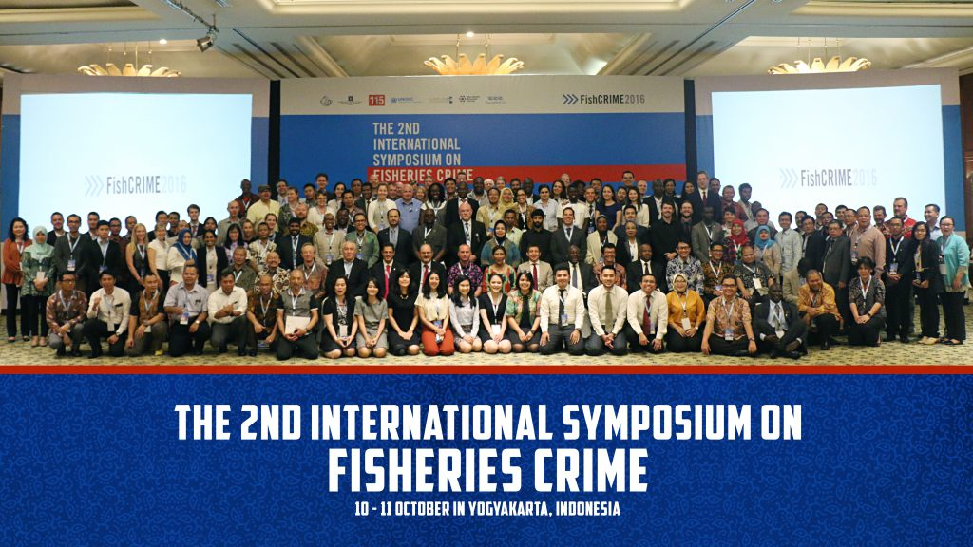
Notes:
This year, following the FISHCRIME 2017 symposium at UNODC offices in Vienna,

Slide 9
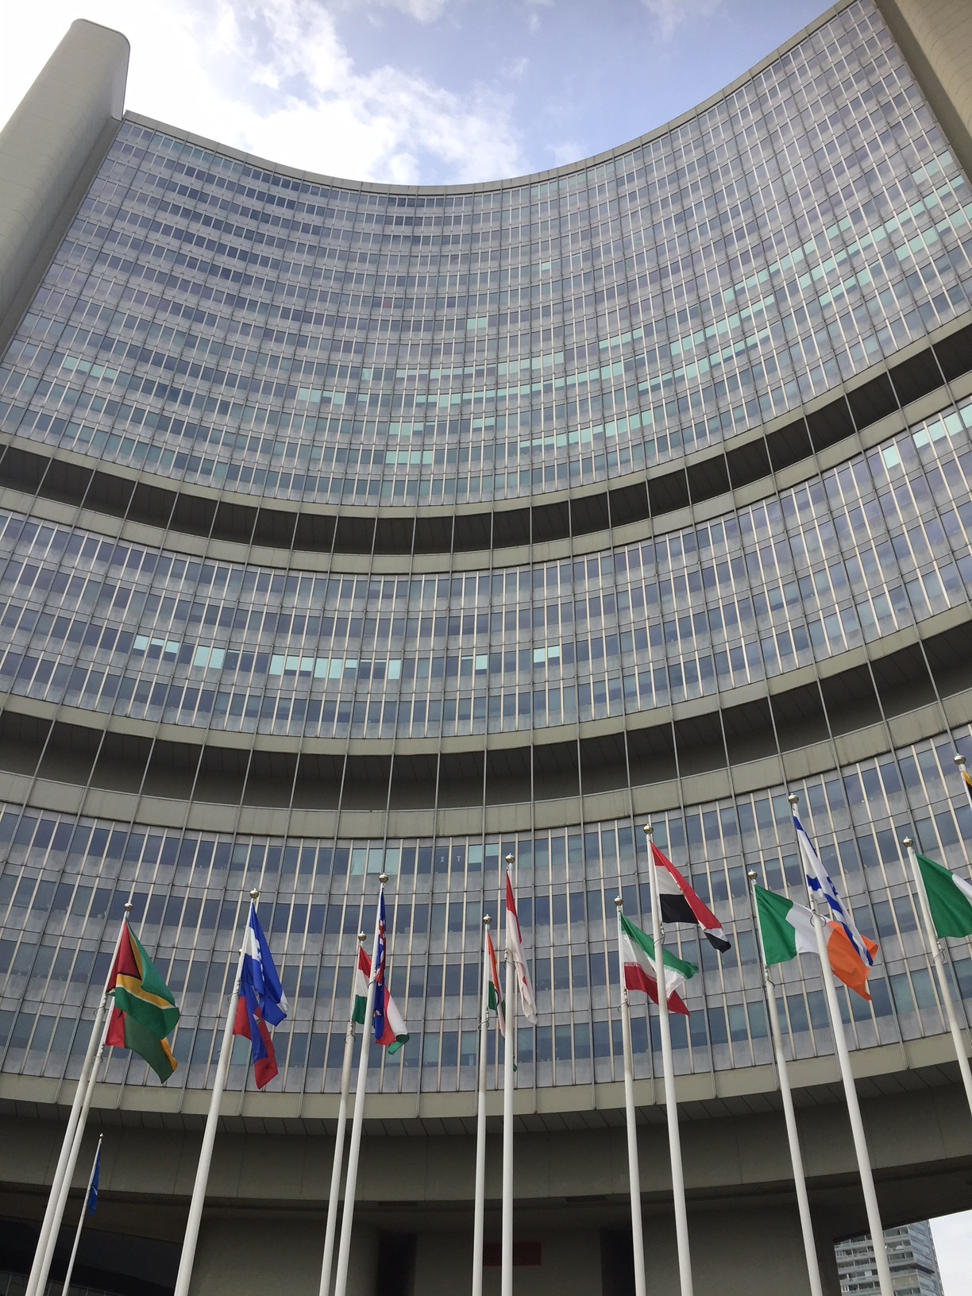
PescaDOLUS Fisheries Crime Research Workshop UNODC, Vienna, September 2017
Notes:
PD hosted its first dedicated FC RESEARCH WORKSHOP right after the symposium. Brought together experts research institutes from 5 Nordic countries, as well as from SA, Kenya, Senega, indonesial and from ILO, OECD, UNODC, African Progress Panel, Nordic Think Tank etc.
So PD has access to a POOL of experts & researchers from a VARIETY OF DISCIPLINES from different countries INTERNATIONALLY from academic institutes, from relevant international organisations (ILO, UNODC, OECD, NAFIG) and including not only academics but also experts from more operational side – can DRAW ON THESE EXPERTS to contribute to training material, curricum development and to content for trainings

Slide 10
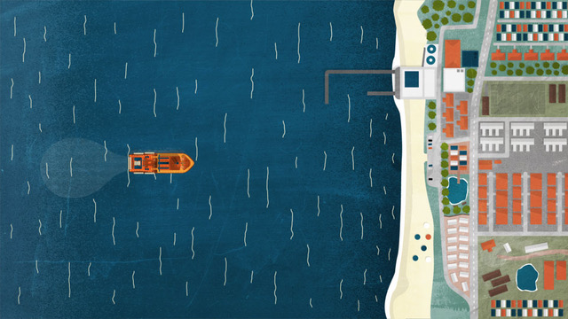
PD products include:
Book on Fisheries Crime
Educational video
Short film on criminal livelihoods
Economic-led project on value chain
www.pescadolus.org
Notes:
What are PD products?
PescaDOLUS is in the process of finalising a BOOK on transnational organised fisheries crime
also recently produced an educational short video on fisheries crime, launched during FishCRIME
and a short documentary on criminal livelihoods which Moenieba has spoken to.
Developing ecnomic-led project on FC along the value chain.

Slide 11
PescaDOLUS research: FishFORCE
Research will support outcomes 2-4 of the FishFORCE project:
Baseline study: report map SA FCLE landscape
Research workshop: stimulate FC LE research
Symposium: interagency collaboration
Notes:
HOW WILL PD RESEARCH SUPPORT FISHFORCE?
PD’s research will support outcomes 2-4 of the FishFORCE project. Specially it will produce:
BASELINE STUDY will be conducted - to provide training of LE officials towards implementing FC law enforcement paradigm, it is crucial to place the training IN CONTEXT by conducting a baseline study of the FCLE landscape, including a gap analysis of FCLE training needs.
RESEARCH WORKSHOP will be held – to stimulate RESEARCH SPECIFICALLY ON FCLE. The importance of such research is recognised by international agencies such as UNODC (see FishNET project).
SYMPOSIUM will be held - The FishCRIME series of symposiums has to date been organised by PD. These symposiums are important for bringing together representatives from aCADEMIA, LAW AND POLICY on the one hand and, on the other, representatives from relevant key agencies on the OPERATIONAL SIDE, eg INTERPOL. Case studies, best practices and research are shared and INTER AGENY COLLABORATION STIMULATED.

Slide 12
Thank you for your attention
Notes:
Outcome 4 FishFORCE Project: ‘stimulate and share research in fisheries crime law enforcement’

