Slide 1
The impact of abalone poaching on small-scale fishing communities
A Western Cape Provincial Parliament Report
Notes:
The Vice chancellor -Prof Muthwa
Acting Deputy Vice chancellor – Professor Govindjee
Prof Hennie van As
All academic fraternity
Ladies and Gentlemen
All protocol observed
[slide 1]
1. Introduction
Disclaimer:
• I was the Chairperson of the Standing Committee on Economic Development, Tourism and Agriculture, a multi-party committee between 2014 and 2018.
• This report was tabled in 2017 and some of the information reported here has subsequently changed.
• For purposes of the report, the Department refers to the Department of Agriculture Forestry and Fisheries known as DAFF and not as the Department of Environmental Affairs and Fisheries (DEFF) as it is now today. DEFF is now overseen by Minister Barbara Creecy whom I have a great deal of respect for, and faith to fix up what was at the time a broken department.
• This is a Western Cape story as told by fishermen and women whose complaints are recorded here in this parliamentary report.
Shaping the context
In Nov 2016, I put a motion forward in the House: That in terms of Rule 105(4) of the Standing Rules of the WCPP, that this House instructs the Standing Committee on Economic Opportunities, Tourism and Agriculture to investigate and report on abalone poaching and the role of the State; to counter the negative impact on coastal communities and the oceans economy of the Western Cape.
This after receiving complaints that entire communities along the Overberg coastline were being destroyed by the impacts of abalone poaching and the rapid increase of young children into drugs and prostitution. The motion set forward of the course of a four-year mission and became a personal passion to uncover as much as possible beneath this crime. This despite the concerns over my safety raised by my parliament and crime intelligence during those years.

Slide 2
OCEANS ECONOMY
R177bn to GDP by 2033
1 million jobs
03
Notes:
[Slide 2]
The potential of the oceans economy according to our investment agency, Wesgro, could contribute an estimated R177 billion to the country’s economy each year, and create as many as 1 million direct jobs.

Slide 3
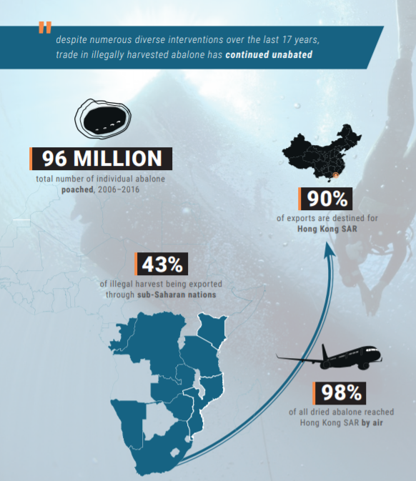
R10 billion
96 million individual abalone stolen
2000 - 2016
SOURCE: TRAFFIC REPORT - 2018
Notes:
[slide 3]
The poaching of abalone costs the economy estimated to be R1 billion annually, and data released estimated from the 2018 TRAFFIC Report, 96 million abalone worth R10bn were poached from South African shores. The loss to the Western Cape economy and the South African economy just cannot be ignored as this transnational crime soars depriving much needed resources from the people of this country.
Research has shown that various factors have been instrumental in the rapid growth of illicit abalone poaching, namely; the weakening of the South African currency against the United States Dollar in the early 1990s, pre-existing presence in South Africa of Chinese organised crime networks who facilitated access to East Asian markets for South African contraband and vice versa; the seemingly insurmountable difficulty of devising and executing border controls and, finally and most importantly, coastal communities unfulfilled expectation of equitable access to marine resources after the transition to a democratic political dispensation.
Furthermore, there is an increased demand for African abalone, due to its superior quality to abalone from other countries, from East Asian economies.
From 1992, abalone became a high value dollar denominated commodity traded by gangs based in the Western Cape for materials used to manufacture drugs, which are possibly smuggled through uncontrolled and commercial land borders, and on unlogged air flights.
Poaching began to thrive in coastal fishing communities and became an important source of livelihood for many, due to the absence of government assurances such as legislation and policy interventions, and ensuring equitable access to marine resources for coastal communities. Government’s failure to address poaching was attributed to a number of factors such as its inability to create a vested interested in anti-poaching initiatives within fishing communities, the coercive influence of gangs trading in abalone, and the frustration caused by the delay in establishing a just and equitable small scale fishing industry.
Over the years, various interventions have been initiated by government in order to curtail poaching; however, minimal success has been achieved and the poaching crisis has only worsened.

Slide 4
1992: Operation Neptune
2005: Operation Trident
2012: Marine & Coastal Law Enforcement & Compliance Task Team
GOING GREEN SERIES PT 3
Notes:
[slide 4]
In 1999, you saw the launch of Operation Neptune, a partnership between Marine Coastal Management (MCM), SAPS and the South African Defence Force (SANDF). The operation supported by specialised environmental courts aimed at prosecuting poachers however this failed over time.
In 2005, Operation Trident came into effect, a joint partnership between MCM and the Overberg District Council, which significantly reduced SAPS’ role in combatting poaching. The daily patrolling of the Western Cape’s coastline was taken over by well trained and equipped conservation officers; however, Operation Trident was closed down shortly, that same year.
In June 2012, DAFF and the City of Cape Town formed a proactive multi-agency collaboration called the Marine and Coastal Law Enforcement and Compliance Task Team and included representatives from DAFF, the City of Cape Town Marine and Environmental Law Enforcement Unit, the SAPS Borderline Police, the Table Mountain National Park Marine Unit, SARS Customs, the National Prosecuting Authority, the Department of Environmental Affairs, Cape Nmarine and coastal law enforcement, management and regulationature Conservation and the South African Maritime Safety Association (SAMSA).
These agencies are all responsible for. However, gang activities related to abalone poaching had worsened, resulting in the decline of traditional small-scale fishers and the rise of drug trafficking, drug abuse and related social crimes. This was evidenced by the number of media reports depicting the illicit trade of illegally caught abalone for materials used in the manufacture of various drugs and also evidenced by the amount of personal testimonies provided by small-scale fishers and individuals from small fishing communities, residing in various coastal towns in the Western Cape.
Within this context, the Standing Committee on Economic Development, Tourism and Agriculture of the WCPP, resolved in August 2016, to host a special committee meeting in September to discuss the impact of abalone poaching on small coastal communities and its effect on the oceans economy. Stakeholders included the Directorate for Priority Crime Investigation (Hawks), DAFF, and Abagold as well as the South African Revenue Service (SARS) and the Western Cape Provincial Commissioner (SAPS).
DAFF’s participation during this time was a critical point for the committee. The Marine Living Resources Act (1998) states quite clearly that DAFF was responsible for the regulation and coordinating functions for the protection and conservation of South Africa’s abalone stock. DAFF’s Monitoring and Surveillance Directorate is responsible for investigating and persuading of the prosecution of high profile offenders and syndicates contravening the Marine Living Resources Act.
A resolution was made by the committee to expand the discussion on abalone poaching to affected communities in the form of three public hearings held in Saldanha Bay on 3 February, Gansbaai on 8 February, and the Western Cape Provincial Legislature Building in Cape Town on 24 February 2017.
Testimonies were heard from fishers in various coastal fisher communities along the West and southern coastline of the Western Cape, as well as municipal officials, and stakeholders and academics with interests in the sector. I must add that it was a difficult time for some communities wanting to speak out. We even had a bus of fishers being shot at leaving the Overberg to attend the hearings. I recall that we had to get a police escort for them. These were brave women and men who wanted a change in their communities.

Slide 5
Concerns raised
Gangsterism
Under- resourcing
Notes:
[slide 5]
CONCERNS/FINDINGS
Following the verbal and written submissions received from various stakeholders (fishers, individuals from fishing communities, academics and municipal officials), the following concerns/findings were recorded
2.1 Abalone poaching and the link to gangsterism and drugs
The key driver of poaching in coastal communities, as indicated by the testimonies received from fishers and members of fishing communities, are socio-economic issues. Many of these fishing communities are poor, living below the poverty line. Many cannot finish school as they have to start providing for their families, and many are fishers because they were raised that way by their forefathers who were fishers. Poaching provides “easy money” for struggling fishers, especially ones who have not received fishing rights and quotas. It allows them to put food on their families’ tables.
However, the youth in these fishing communities have started to see poaching as a way of life and an easy way out of poverty. Drug abuse has become rife amongst the youth with young learners dropping out of school to work for gangs as poachers or lookouts and runners for more experienced poachers.
A major concern is that government is not tackling the socio-economic problems that have arisen alongside poaching. Questions were asked about how much money DAFF or the government in general, is spending on tackling these socio-economic issues that are driving community members towards poaching.
2.2 Under-resourced and under-capacitated department and law enforcement
A recurring issue at all three public hearings was that there is just not enough visible SAPS presence in coastal communities where poaching is rampant. Another concern raised was the lack of intervention from DAFF in general. When law enforcement is called to deal with a poaching matter, they must travel long distances to the scene of the crime. Testimonies showed that SAPS and DAFF are under-resourced, with DAFF officials informing the Committee and public that the department does not have enough staff and dedicated officials on hand to deal with all the poaching problems and fishing rights allocations. Attendees at the public hearings felt that their Constitutional right for safety was and is being ignored.
Due to the lack of visible policing, it has become common practice for community members and small-scale fishers to be intimidated by gangsters and poachers who acted quite bracingly knowing they will not be caught.
A major concern raised, was whether all the relevant government entities are working together to combat the problem of poaching. Since DAFF is not primarily responsible for fighting crime, they the committee felt strongly that they should be working in conjunction with various government entities to combat the illicit harvesting of abalone.

Slide 6
Mandates?
SAPS
SA Navy
Sea Border Unit
Organised Crime Invest Units
Organised Crime Proj Invest (OCPI) unit
SANDF
SAMSA
SSA
SANPARKS
Cape Nature
NPA
Notes:
[Slide 6]
Lets look at the multi agency network mandate to protect our marine resources and this transnational crime
On 7 June 2017, the South African Police Service (SAPS) reported, at a meeting of the Western Cape Provincial Parliament’s Standing Committee on Community Safety, that there are no water wing units operating at national and provincial level due to lack of resources. However SAPS, in collaboration with the SA Navy, has a mandate to protect marine resources and provide the necessary security for the protection of the territorial waters. SAPS is responsible for the securing of international borders of the sea to prevent and investigate all illegal or clandestine cross-border movement of persons and goods. The Sea Border Unit is responsible for marine policing. Serious Organised Crime Investigation Units are responsible for the investigation of projects relating to national and transnational organised crime-related activities. These activities are addressed through the Organised Crime Project Investigations (OCPI) unit, whose objective is to dismantle the functioning of criminal syndicates by prosecuting its members and seizing the assets they obtained through their illegal activities. Abalone poaching is one of the crimes investigated through this unit.
The SANDF provides a pivotal role in maritime security and border safeguarding in support of protecting the country’s marine resources.
The South African Maritime Safety Authority (SAMSA) is a government agency generally responsible for maritime safety, combatting pollution of the maritime environment by ships and promoting the country’s maritime interests. The agency is required to investigate maritime accidents/incidents and marine related services both on behalf of government and to government.
The State Security Agency (SSA) is mandated to provide government with intelligence on domestic and foreign or potential threats (such as organised crime) to national stability, the constitutional order, and the safety and well-being of all South Africans.
SANParks is responsible for the conservation of biodiversity through the development and management of national parks. National parks may also include Marine Protected Areas (MPAs). SANParks has a responsibility to secure and protect resources and estates under its management, which includes programmes to fight against poaching of natural resources such as rhino and abalone.
Cape Nature is responsible for the enhancement and promotion of conservation of Western Cape’s biodiversity and ecosystems. They currently manage six Marine Protected Areas on behalf of the DEA. Cape Nature’s Biodiversity Crime Unit aims to prevent the illegal trading of animals and plants in the Western Cape. The unit provides the public with advice and information on various issues relating to biodiversity crime. It also works with SAPS to respond to illegal activities reported.
The National Prosecuting Authority (NPA) – Section 179(2) of the Constitution empowers the NPA to institute criminal proceedings on behalf of the state. The NPA derives its mandate to prosecute environmental crimes from environmental related legislation. Illegal hunting, dealing and possession of rhino, rhino horns, abalone etc. are amongst the NPA’s prioritised focus areas that impact on the environment. Illegal hunting, dealing and possession of rhino, rhino horns, abalone etc. are amongst the NPA’s prioritised focus areas that impact on the environment.
And yet Ladies and gentlemen we have the world’s highest theft of ocean wildlife, abalone being one of them.

Slide 7
Further concerns raised
Negative impact on tourism
Small-scale fishing rights & quotas
Confiscated abalone
Small boat harbours
Notes:
[Slide 7]
2.3 Negative impact on tourism: Ban on recreational fishing and gangsterism
At the public hearings in Gansbaai and Saldanha Bay, there was a great concern that the ban of recreational fishing to conserve the stock of certain marine resources did not address the problem of illegal poaching. Rather, it had a negative impact on small fishing communities where tourists usually came to do recreational diving. Poaching of abalone has continued regardless of the ban.
Furthermore, international and domestic tourists have complained that they are being intimidated by poachers and gangsters that have taken over the area. The result is that fewer tourists are visiting areas that are reliant on them economically.
In Gansbaai, one of the testimonies was that abalone poaching was costing the tourism industry in coastal communities millions of Rands as tourists are too afraid to visit the areas. With the additional ban on recreational fishing, which affects stock much less than commercial fishing, the situation has since worsened.
2.4 Limited access to small-scale fishing rights and quotas
Many applicants testified that there were many subsistence fishers that turned to poaching because even though they have been fishers all their lives; they have not been successful in terms of the small-scale fishing applications. Communities are have been challenging the decisions taken by DAFF in this regard, as they are not protecting the traditional fishers.
Fishing rights/permits are considered too complicated for some small-scale fishers to understand. Communities felt that DAFF should respect the language of the WC people and interact with communities in their own language. There have been complaints that application forms for the fishing permits and quotas are in English, when the majority of applicants for small-scale fishing permits speak Afrikaans or isiXhosa. Application forms are translated into Afrikaans, isiXhosa and Zulu, but it seems that they are not easily available to most communities.
Many small-scale fishing applicants do not have access to medical aid, and this harms their chances of being granted a license.
From the preliminary list of applicants that were granted permits, it seems that there were many permits that were given to applicants with no interest in fishing. This meant that there were a number of legitimate small-scale fishers that were without permits and would have to apply for the appeals process. Even with the Small-Scale Fisheries Policy and the process followed by DAFF to register small-scale fishers and ensure they meet the small-scale fishing criteria, many of the testimonies from traditional fishers at the public hearings showed that the provisional lists that they had seen did not have any resemblance to the criteria described by DAFF i.e. the length of time applicants had been in the industry, whether they reside in the community etc. Applications for fishing rights and quotas also seemed to disappear they said. Some applicants did not hear back from DAFF at all. This created the perception that government agencies do not care about small fishing communities.
During DAFF’s feedback to the Committee at the public hearing in Cape Town, the Committee was informed that DAFF does not have enough staff/capacity to deal with all poaching problems and fishing rights allocations. The Committee expressed major concern that there are only eight dedicated officials in the Department that are running the programme dealing with registering small-scale fishers, interviewing fishers, releasing the provisional and final small-scale fisher lists, including the appeals process.
2.5 Government reducing the market value of abalone, and DAFF’s income from the sale of confiscated abalone
The Committee expressed concern that DAFF confiscates illegally poached abalone and sells it at way below market value. The sale of confiscated, sub-standard abalone is at prices far below what the commercial fishers can sell abalone, resulting in the market becoming less competitive. Furthermore, according to comments made there is no quality standard or certification that must be met for this sale into international markets.
Moreover, the money from the sale of confiscated abalone becomes part of DAFF’s budget. According to the DAFF’s response at the public hearing in Cape Town, money from the sale of confiscated abalone is ring-fenced towards combatting poaching. However, the Committee concern was that even though millions are set aside for tackling poaching, DAFF continues to be under-resourced and under-capacitated. The question was raised as to why DAFF was so under-resourced if the money was set aside for tackling poaching and protecting marine resources. Even though the Department made millions of Rands from poached abalone, they did not have more officials on the ground in fishing communities where poaching is rife and community members’ lives are threatened daily by poachers and gangsters. Yet DAFF’s Marine and Coastal Management’s budget fund was completely depleted.
What really concerned the committee is that national government’s involvement in benefitting from confiscated abalone, contributes to the criminalisation of fishing communities along the Western Cape’s coastlines. The committee felt that this could lead to a perverse incentive i.e. DAFF having a direct interest in maintaining illegal abalone poaching.
From testimonies received from the public at all three hearings, small-scale fishers and community members from fishing communities expressed concern that the money DAFF receives from the sale of confiscated abalone should be directed back into fishing communities in the form of uplifting/up-skilling programmes, or towards the restoration of marine resources so that jobs remained possible.
2.6 Twelve small boat harbours in the Western Cape
Since 2005, a Harbour steering committee (HSC) of representatives from national Departments of Agriculture, Forestry and Fisheries, Public Works and National Treasury has been responsible for managing harbours. The National Department of Public Works (DPW) is the current custodian of the twelve small boat harbours in the province, managing the sale and maintenance of all buildings and other fixed assets, while DAFF is responsible for seaweed activities in the small harbours, as well as fee collection for access to and use of the harbour facilities. The twelve small boat harbours in the Western Cape have been managed poorly and have fallen into disrepair. Currently, small harbours are being wasted as public assets. Economic opportunities are being lost, deepening the reliance for communities without work to take desperate measures such as turning to poaching for a small income. The Constitution under Schedule 4, and the Integrated Coastal Management Act (Act 24 of 2008) empowers local government to be the legislative and executive authority of harbours and to have the power to assume management programmes, planning schemes and by-laws provided that they are consistent with provincial and national legislation and policies. The Western Cape Provincial Government has initiated an intergovernmental dispute with National Government over the management of the twelve small boat harbours. No further progress has been made and the issue remains unresolved for close to a decade.

Slide 8
Recommendations
Alternative opportunities
Aquaculture and fish farming
Intergovernmental relationships
Monitoring and reporting
Notes:
[slide 8]
Recommendations:
The committee felt:
That alternative opportunities for income generation for fishermen and women be identified and explored, in particular to aquaculture and fish farming (pisciculture);
That aquaculture and fish farming (pisciculture) be reclassified under agricultural farming and brought under the ambit of Provinces;
A necessity to establish a stronger intergovernmental relationship between national, provincial and local government to manage and administer the process of small-scale fishing and aquaculture.
We also called on:
The Western Cape’s Department of Community Safety, to train community watch organisations, and, together with SAPS, re-establish a coordinated joint operation on a full time basis.
The establishment of a dedicated Green Scorpions for abalone poaching
A provincial prosecution body through the Biodiversity Crime Unit must be set up.
Establishing a skill development programme and aquaculture learnership for fisher men and women.
Local municipalities to develop a by-law to assist in the management of the small boat harbours in Cederberg, Saldanha Bay, Bergrivier, Overstrand, Cape Agulhas, and Hessequa municipalities as tourism hubs.
The implementation of an effort control system
There is a need for an effort control system across abalone fishery which would help to reduce the excess effort imposed on these fisheries. A business plan should be developed to finance stock rehabilitation. We support the proposal by the WWF_SA to develop a joint Fisheries Conservation Project (FCP) in setting catch and effort limitations.
8. Improved monitoring and reporting of legal catches
This must be implemented through the use of an electronic catch monitoring system. This should be followed by a mechanism to improve the traceability of WCRL and abalone products from source to the final destination market. The Western Cape is an increasing digitised Province and endeavours to align itself with international trends pertinent to the Fourth Industrial Revolution.

Slide 9
Recommendations
Management plans
Compliance and surveillance
Catch limit
Confiscated abalone
Agro-processing
Notes:
9. The development of localised inshore fisheries management plans
This must be done in partnership with communities and other relevant stakeholders such as the World wide fund for Nature (WWF – SA). The plans must recognise that marine resources are limited, and they must prioritise the identification and initiation of meaningful alternative livelihood options for fishing communities. Government and our coastal communities should share the responsibility of implementing these plans.
10. Improved monitoring, compliance and surveillance capacity needed within DAFF
This is critical; however, dedicated regional environmental courts, which focus solely on the prosecution of environmental and marine crimes has also proven to successfully deter illegal fishing.
11. Scientific research submissions to government
The requirement that a catch limit recommended by the Scientific & Statistical Committee (SSC) cannot be exceeded by the Council, should be included in legislation. The requirement that a catch limit recommended by the SSC cannot be exceeded by the Council is advisory only. Thus there is no requirement for it to be adhered to.
12. The flow of money from illegally fished abalone
Money made from the sale of illegally fished abalone that is confiscated by DAFF, should be allocated to social upliftment projects in the affected areas via visible interventions, policing initiatives, as well as for the rehabilitation of marine resources. Furthermore, sold abalone must be audited by an independent audit body overseen by SARS, including investigate the revenue generated from the sale of confiscated abalone and monitor the compliance sold. SARS must also ensure that dried abalone be subjected to the same standards of health certification as wet abalone,
South African abalone is not protected in Hong Kong law, as Markus Burgener of TRAFFIC has indicated, meaning that there is no course of legal or enforcement action available to block the sale of poached abalone once the product reaches the market. This could be easily resolved with a Cites listing. We should be pushing for this.
13. Abalone farming and the processing of raw materials (agro-processing)
This is a costly industry, but a very profitable industry as well. According to comments made farmed abalone businesses, for every ton of farmed abalone produced, one job is created. However, there remains a need to rehabilitate abalone resources so that it can be harvested in a legal and responsible manner. I support the proposal made by a large abalone farm, which is to follow Japan’s model and seed wild abalone populations (ranched) with abalone spat raised on farms. By doing this, Japanese producers sustainably harvest more than 5,000 tons of abalone a year. This creates an opportunity for self-regulation and protection of wild abalone.

Slide 10
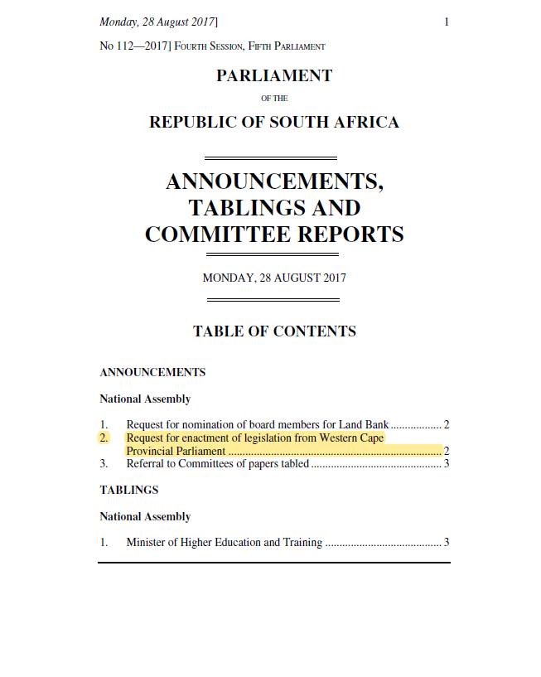
Recommendations
Sentencing
Tabling of the report at the NA
Notes:
14. The reclassification of poaching sentences
We note that that abalone poaching has been reclassified as a serious priority crime to be investigated by the SAPS Organised Crime Unit since its announcement in 2019. At the time it was still a category 1 offence so we welcome the change. .
Furthermore, a call for specialised environmental courts should be established in the Overstrand, Swartland, Saldanha Bay and Cape Agulhas municipalities to convict offenders of specialised and organised environmental crimes.
Tabling of the report at the NA
Recommendations to the National Assembly
Section 104(5) of the Constitution provides for a provincial legislature to recommend to the National Assembly legislation concerning any matter outside the authority of that legislature.
The Western Cape Provincial Parliament recommends to the National Assembly the following:
a) Re-evaluate the allocation of small-scale fishing right to ensure there is more inclusivity. Priority should be given to existing fishermen and women who live in and along coastal towns;
b) That alternative opportunities for income generation for fishermen and women be identified and explored, in particular to aquaculture and fish farming (pisciculture);
c) That aquaculture and fish farming (pisciculture) be reclassified under agricultural farming and brought under the ambit of Provinces;
g) The National Assembly must establish a national set of guidelines, to be incorporated into the Marine Living Resources Act, in order to ensure that a catch limit recommended by the Scientific and Statistical Committee (SSC) cannot be exceeded; and
h) Establish a stronger intergovernmental relationship between national, provincial and local government to manage and administer the process of small-scale fishing and aquaculture.

Slide 11
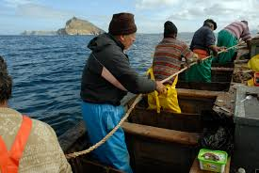
In a sea(nut)shell…
Notes:
Finally,
The story of the Western Cape small fishing communities is a sad one indeed. The most marginalised community of people, and yet potentially can be the most criminalised if government does not take heed of the social-economic challenges these people face.
Ladies and gentlemen the current plight of the many fisher men and women across our shores is one that government must be accountable for. Depleted, stolen and mismanaged resources is a failure of this generations leaders on the future generation of fishers in South Africa.
-The End-

Slide 12
Beverley Schäfer
Western Cape Provincial Parliament
(e) beverley.schafer@wcpp.gov.za
(Twitter): Bevschafer
LinkedIn: BeverleySchafer

